Slide 1
Surveillance report
Annual Epidemiological Report on communicable diseases in Europe
ECDC Surveillance Unit
European Centre for Disease Prevention and Control
Stockholm, October 2009

Slide 2
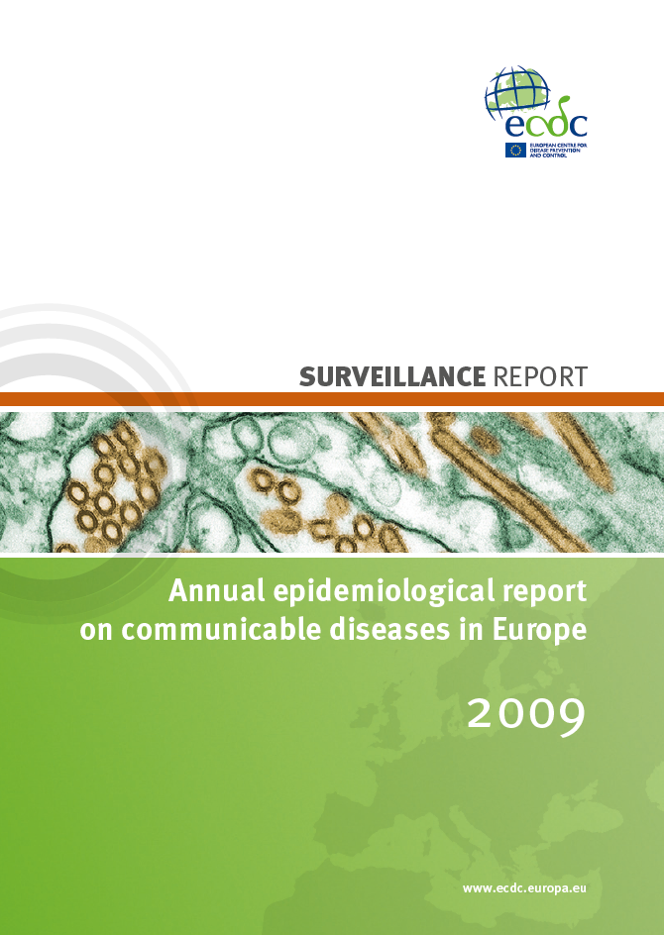
Annual Epidemiological Report (AER) 2009
The Annual Epidemiological Report (AER) is the result of a collective effort between ECDC and all EU and EEA/EFTA Member States.
The Annual Epidemiological Report 2009:
contains a special chapter on vaccine-preventable diseases and immunisation programmes (Chapter 2);
provides incidence data (2007) for 47 communicable diseases and two health issues for which surveillance is mandatory in the EU and EEA/EFTA countries (Chapter 3); and
assesses health threats during 2008 (Chapter 4).
Notes:
Add new slides with CTRL-M.
Helpful hints:
1. Write "Total outpatient antibiotic use in Europe", not "Total Outpatient Antibiotic Use in Europe".
2a. Write "Member States", not "MS", i.e. avoid avoidable abbreviations.
2b. Write "and", not "&".
2c. Write "three", not "3".
3. Write: "HIV infections", not "HIV INFECTIONS".
4. No pink, purple, and red, especially not in headlines.
5. Use soft returns (CTRL-RETURN) instead of hard returns (RETURN) whenever possible.
6. Don't centre text! All text should be aligned left.
7. Don't enlarge pictures beyond their actual size/resolution.
8. Don't use italics, except for e.g. 'Clostridium difficile'.
9. Crop pictures.
10. Make sure you understand how bulleted lists work.

Slide 3


Threats from communicable diseases in the EU in 2008
Major threats from communicable diseases in the EU in 2008 have not changed from the two previous reports:
antimicrobial resistance;
healthcare-associated infections;
vaccine-preventable diseases, with particular emphasis on pneumococcal infections;
respiratory tract infections, with particular focus on influenza (pandemic potential as well as annual seasonal epidemics), and tuberculosis; and
HIV infection.

Slide 4
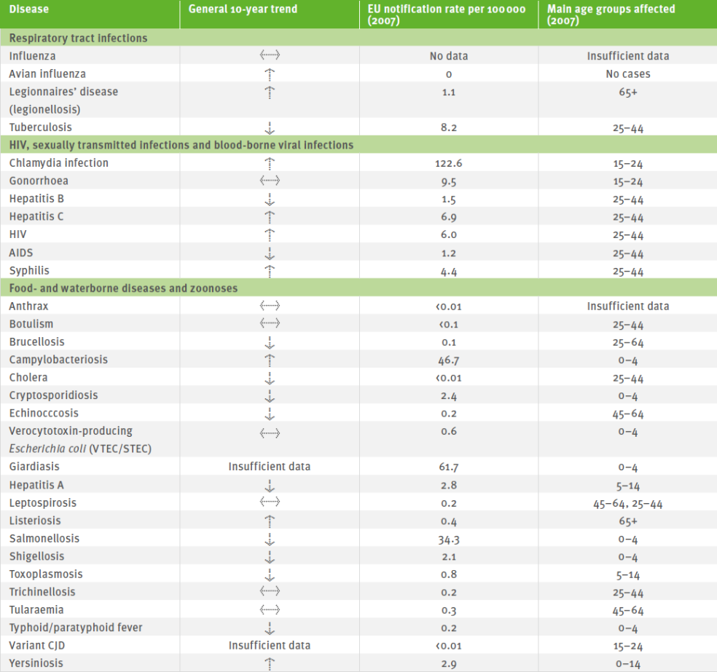
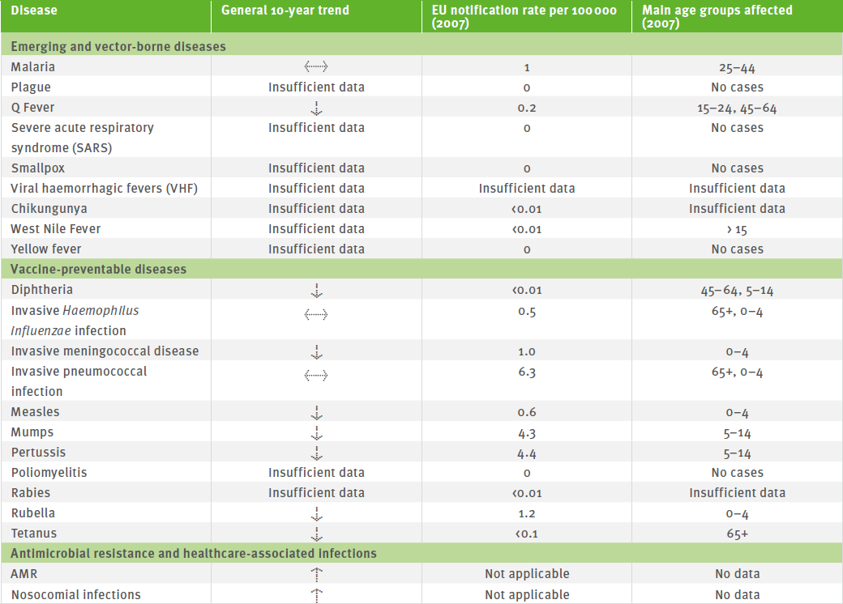
General disease trends
'Based on the summary of key figures and trends we can conclude that the priorities for communicable disease prevention and control in the EU and EEA/EFTA have not changed substantially since the previous edition of the Annual Epidemiological Report.' — AER 2009, p. 5
Overview of the general trend, EU notification rate and main age groups affected for communicable diseases reported in the EU and EEA/EFTA in 2007. Number of reporting countries (n=30)

Slide 5
Antimicrobial resistance and healthcare-associated infections (AMR/HCAI)
AER, Chapter 3.6
Antimicrobial resistance constitutes an increasingly important public health hazard in Europe.
Methicillin-resistant Staphylococcus aureus (MRSA) remains a significant problem all over Europe. In some of the high-endemic countries, MRSA proportions seem to be stabilising, and decreasing trends are observed in a few countries.
Penicillin non-susceptibility in Streptococcus pneumoniae (PNSP) shows a heterogeneous picture in Europe with most northern European countries reporting low levels; relatively high levels are reported by southern European and Mediterranean countries.
Resistance to fluoroquinolones, aminopenicillin, aminoglycoside and third generation cephalosporins in Escherichia coli has increased significantly in nearly all reporting countries.

Slide 6
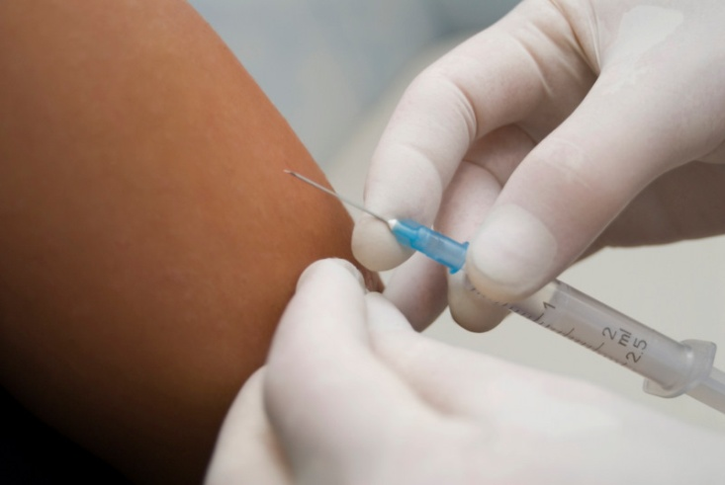
Vaccine-preventable diseases (VPDs)
Success stories
Vaccination is one of the most cost-effective measures for the prevention and control of infectious diseases. (See table.)
The global eradication of smallpox and the elimination of polio in most parts of the world (including Europe) are examples of successful vaccination programmes.
After the introduction of vaccination in several countries, hepatitis B infections and disease incidence rates fell significantly.
(See graph.)

Slide 7
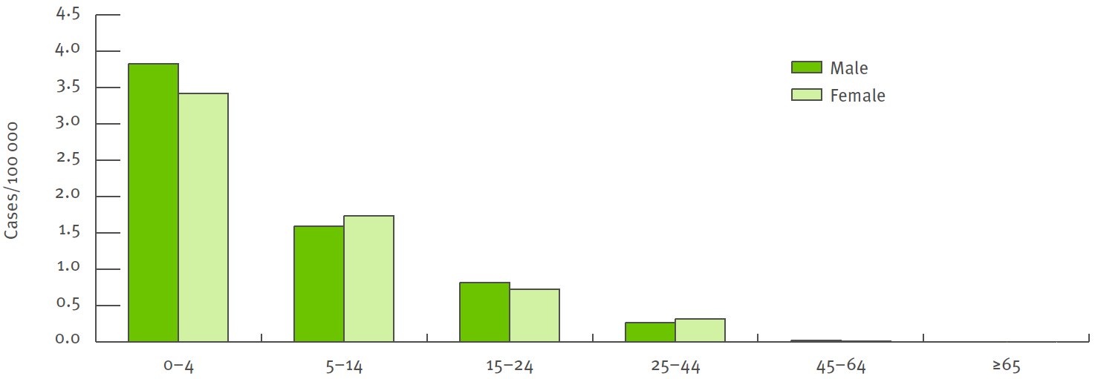
Vaccine-preventable diseases (cont'd)
Challenges
Ensuring high coverage for VPDs and maintaining immunity.
Improving the sensitivity and specificity of rubella surveillance (particularly in view of the WHO 2010 elimination goal).
Eliminating measles (see below) and rubella disease.
Notification rates of measles cases by age and gender, in EU and EEA/EFTA countries, 2007 (n = 2 684)
Source: AER 2009, country reports: Austria, Denmark, Estonia, France, Germany, Ireland, Italy, Netherlands, Poland, Romania, Spain, Sweden, UK and Norway. Cyprus, Finland, Hungary, Latvia, Lithuania, Luxembourg, Portugal, Slovakia, Slovenia and Iceland all reported zero cases.

Slide 8

Measles — progress and challenges
Measles remain a leading cause of death among children worldwide; in 2006, 242 000 measles deaths were estimated globally.
In Europe, a total of 2 817 confirmed cases was reported in 2007, fewer than last year (overall notification rate of 0.56 per 100 000 population).
Only four countries (representing less than 3 % of the EU population) have been measles-free during the last three years.
Around 90 % of all people with measles cases in 2007 had not been vaccinated.
The vast majority of measles cases (2007) are indigenous and more than 60 % of all imported cases originated in another EU country.
In 2007, one case was fatal and two developed encephalitis
(2006: six deaths and eight cases of encephalitis).
Measles continue to spread in populations with low vaccination coverage; this could be prevented with catch-up programmes for susceptible population groups.

Slide 9
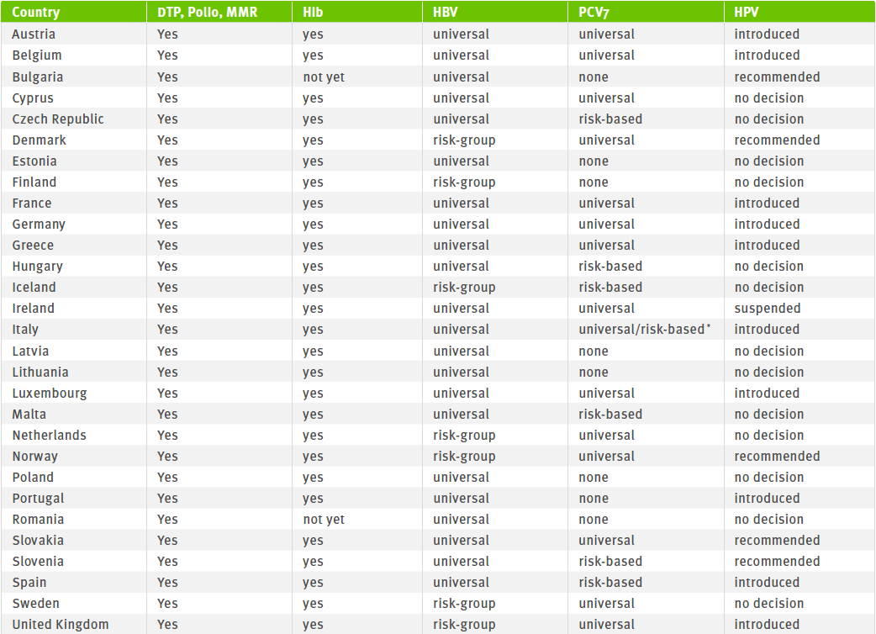
Vaccine offer in EU and EEA/
EFTA countries
Source: VENICE.
*PCV7 offer is different among the regions.

Slide 10
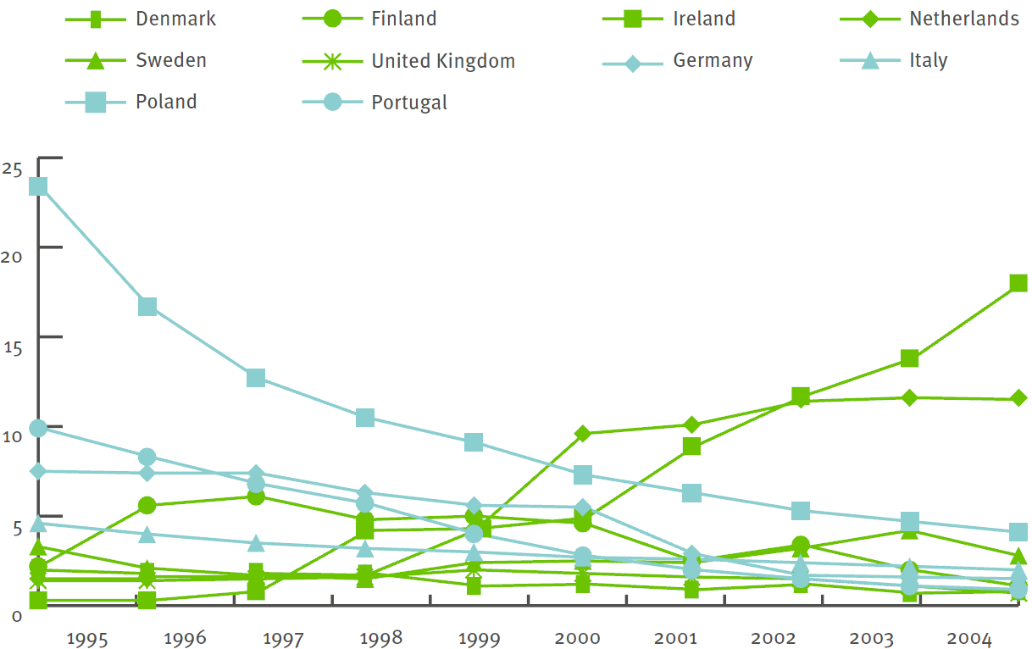
Hepatitis B notification rates
Acute hepatitis B notification rates per 100 000 population, 1995–2004 in selected EU countries
Countries with universal HBV vaccination shown in turquoise, countries with HBV immunisation strategies for risk groups only shown in green.
Source: AER 2009.

Slide 11
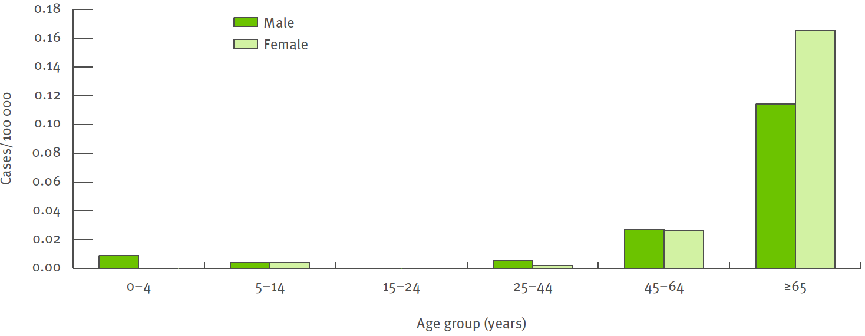
Tetanus notification rates
Notification rates of tetanus cases by age and gender, in EU and EEA/EFTA countries, 2007 (n = 124)
Source: AER 2009, country reports from Denmark, France, Greece, Ireland, Italy, Poland, Portugal, Romania, Slovenia and Spain.
Bulgaria, Cyprus, Czech Republic, Estonia, Luxembourg, Malta, Sweden and Iceland reported zero cases.

Slide 12
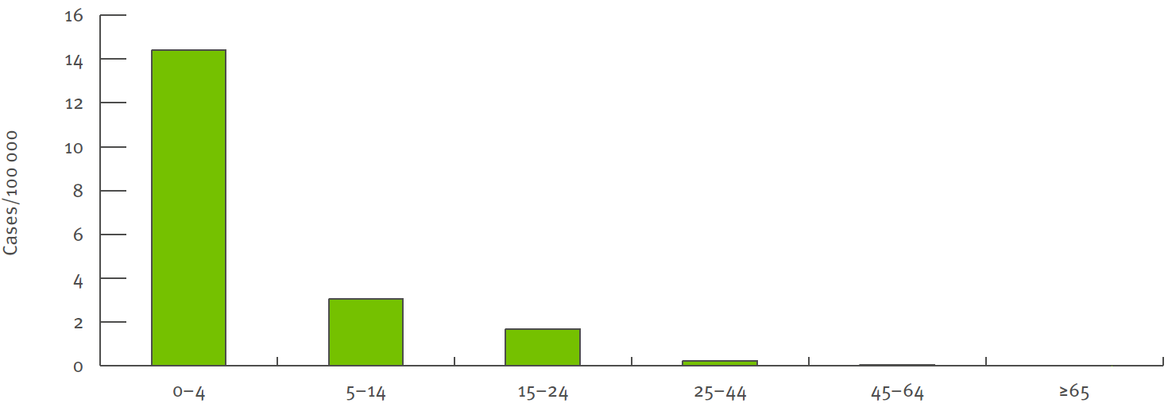
Rubella — approaching the elimination goal
Reported rates of confirmed rubella cases in 2007 were low.
Rubella incidence decreased dramatically over the last few years, from 21 per 100 000 in 2005 to below 2 per 100 000 in both 2006 and 2007.
12 Member States have notification rates below 1 per 100 000;
nine countries reported no cases.
As Europe approaches the rubella elimination goal, laboratory confirmation is strongly encouraged.
Notification rates of rubella cases by age group, in EU and EEA/EFTA countries, 2007 (n = 3 802)
Source: AER 2009, country reports from Austria, Estonia, Ireland, Italy, Latvia, Lithuania, Portugal, Romania, Spain, Sweden and UK.
Cyprus, Denmark, Finland, Greece, Hungary, Luxembourg, Malta, Iceland, and Norway all reported zero cases.

Slide 13

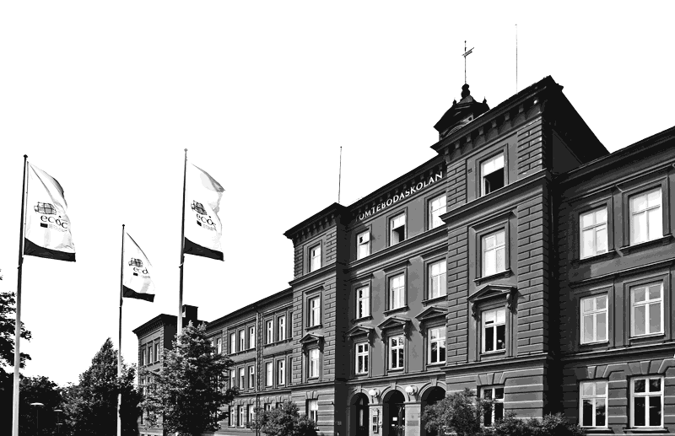
Annual Epidemiological Report (AER) 2009
Detailed information can be found in the 'Annual Epidemiological Report on Communicable Diseases in Europe 2009' which will soon be available both online and in print.
The printed version can be ordered by sending a request to
publications@ecdc.europa.eu
or through bookshop.europa.eu.

