Slide 1
Reusable maps and graphs from ECDC Communicable Disease Threats Report
Week 10, 2024
You are encouraged to reuse our maps and graphs for your own purposes and are free to translate them, provided the content is not altered and the source is acknowledged.

Slide 2
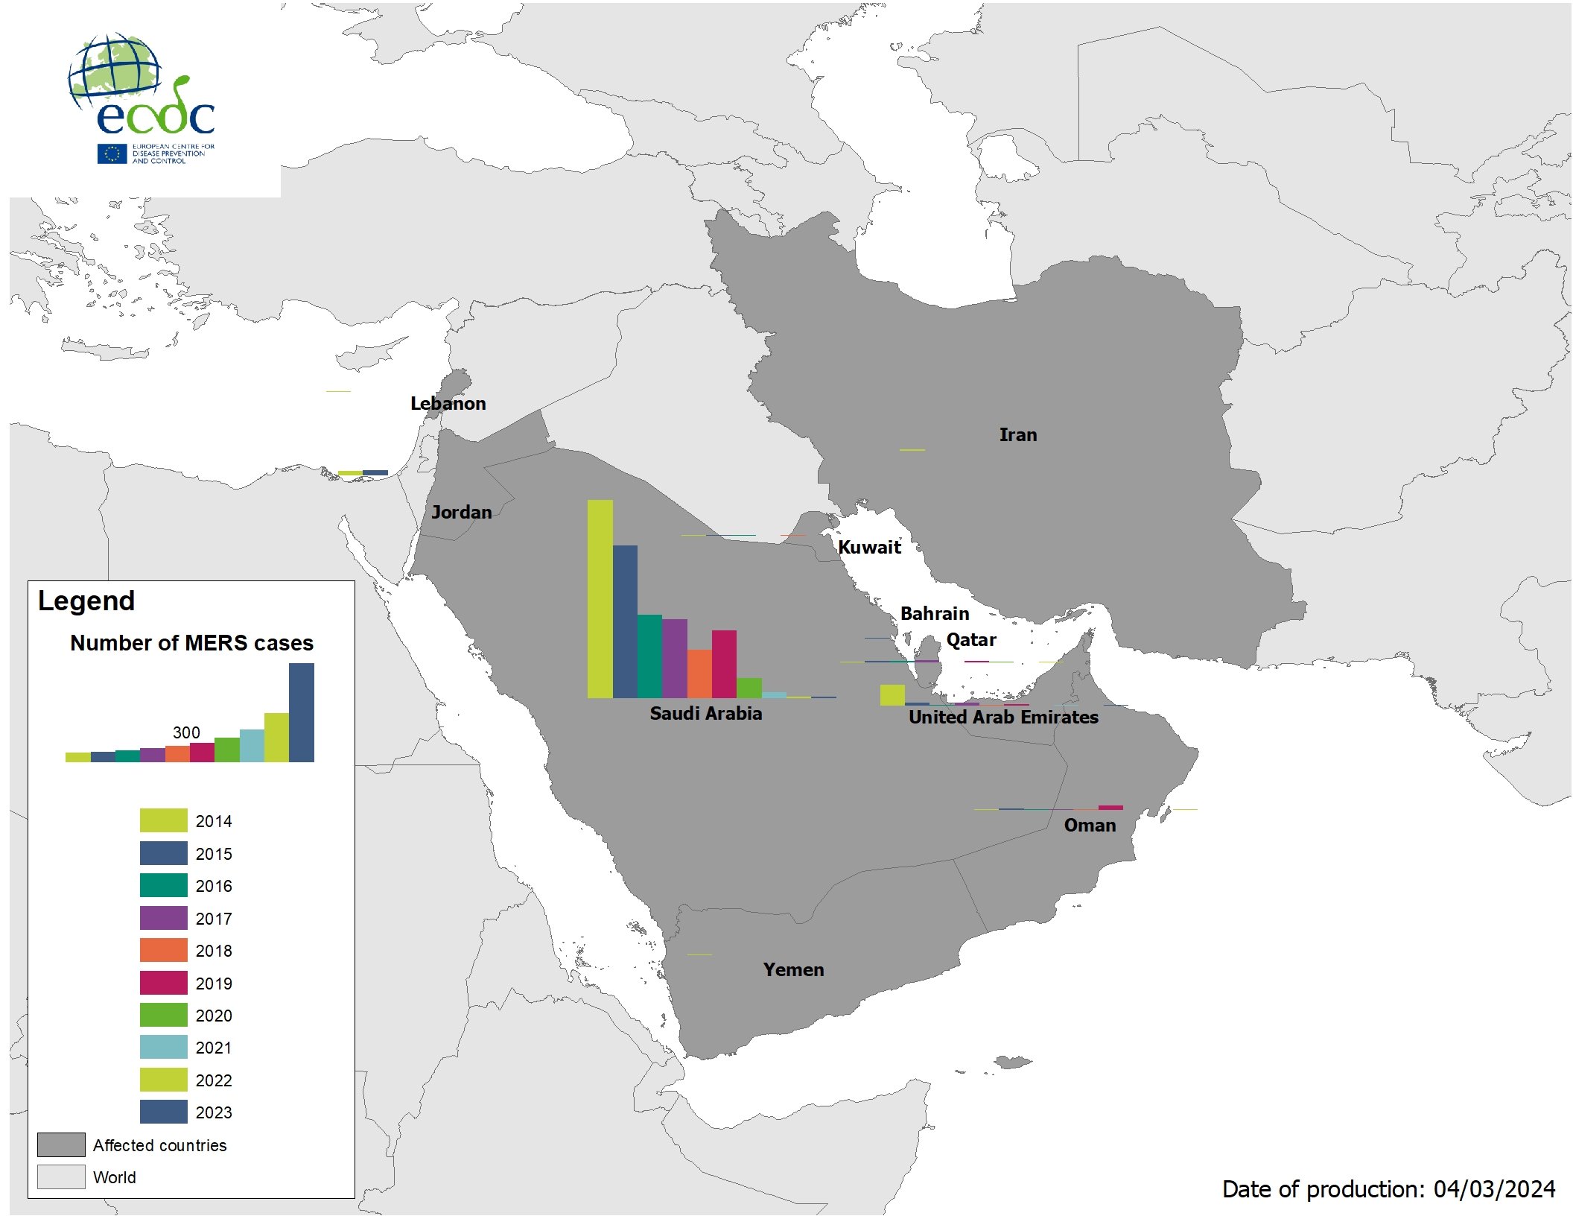
Geographical distribution of confirmed MERS-CoV cases by country of infection and year, from April 2012 to February 2024

Slide 3
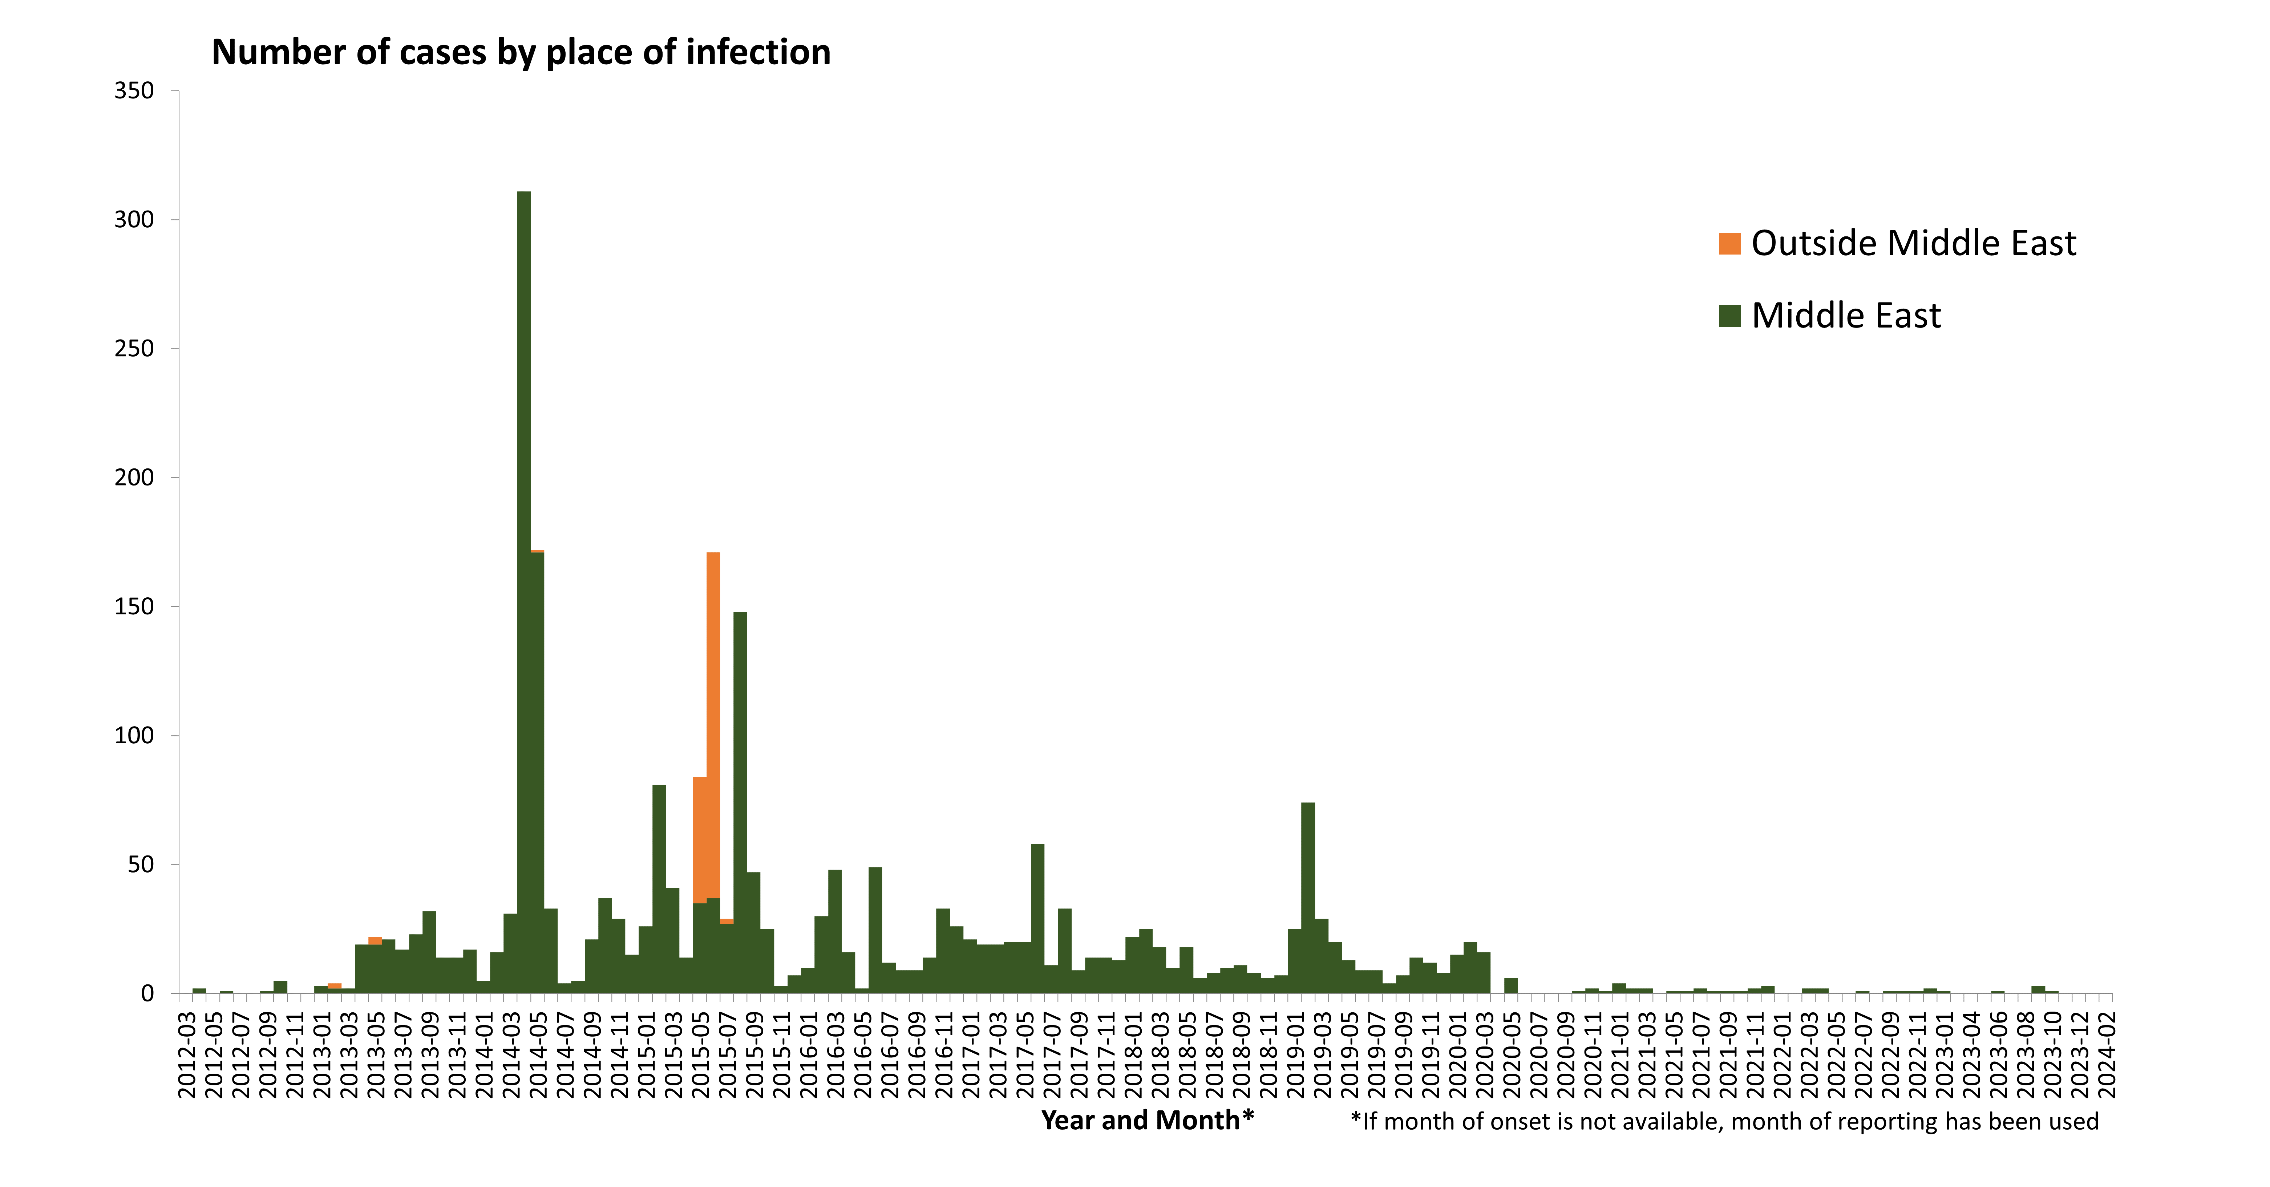
Distribution of confirmed cases of MERS-CoV by place of infection and month of onset, March 2012 – February 2024

