Slide 1


Surveillance of hepatitis B and C in the EU/EEA – 2016 data
Programme for HIV, STI and Viral Hepatitis B and C infections
Programme for HIV, sexually transmitted infections and viral hepatitis
Surveillance of hepatitis B and C
in the EU/EEA – 2016 data
June 2018
European Centre for Disease Prevention and Control
April 2018
European Centre for Disease Prevention and Control

Slide 2
Surveillance of hepatitis B and C
– principles
  Surveillance programme coordinated by ECDC
  Data from EU/EEA countries are uploaded annually into the European Surveillance System (TESSy) – a purpose-built web-based system for data collection
  Case-based and aggregate reporting possible
  Countries requested to follow the EU 2012 case definitions, including acute and newly diagnosed chronic infections
  Data collected on 35 variables
  Data validated by Member States

Slide 3
Hepatitis B data and trends

Slide 4
Hepatitis B data: reporting countries and case definitions used
30 countries provided hepatitis B data in 2016
    Five countries could only provide data on acute cases
Case definitions varied:
  22 countries used the EU 2012 case definition
  Four countries used the EU 2008 case definition
  Four countries used national case definitions
Aggregate data from two countries (Bulgaria,
Croatia)

Slide 5
Hepatitis B data: distribution by disease status, EU/EEA, 2016
In 2016 29 307 cases reported* (5.5 per 100 000)
Acute: 2 529 (8.6%)
Chronic: 17 662 (60%)
Unknown: 8 780 (30%)
* 336 (1%) could not be classified by disease status due to incompatible format of the data provided

Slide 6
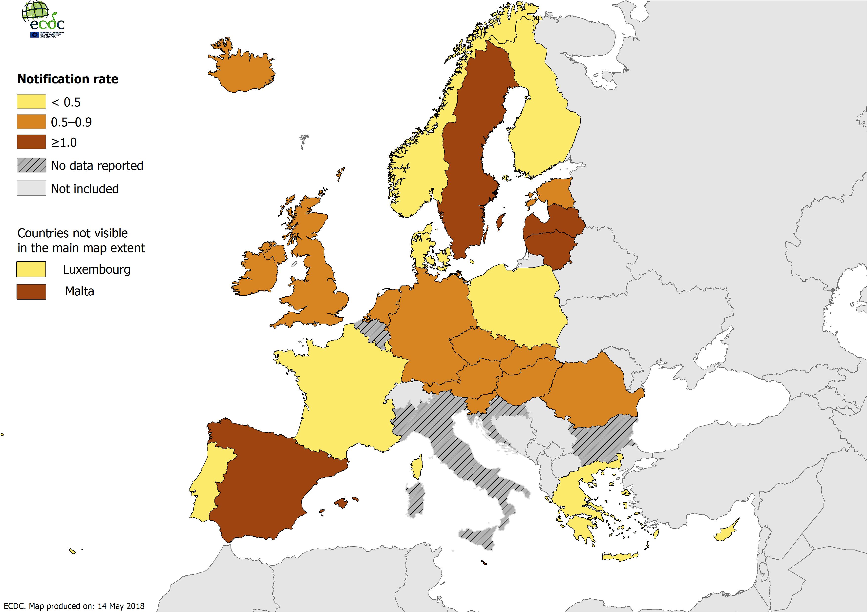
Rate of reported acute hepatitis B cases per 100 000 population by country, 2016*
* UK data exclude Scotland

Slide 7
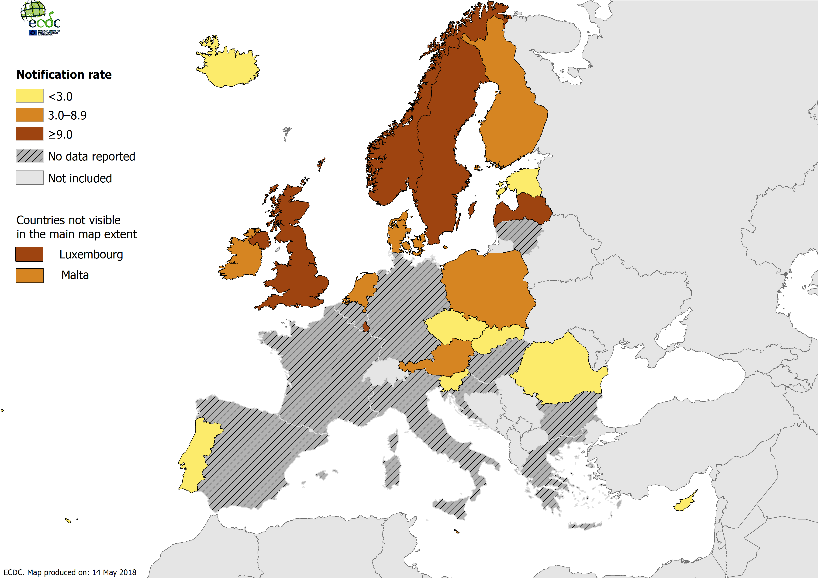
Rate of reported chronic hepatitis B cases per 100 000 population by country, 2016*
* UK data exclude Scotland
Notes:
Geo trends for chronic cases are also not so clear as data for many countries missing. However, rates are highest in north European countries which is the opposite of what may be expected based on the results from sero studies. It is possible these studies may underestimate true prevalence as they may not include migrant groups among whom prevalence is high.
Discrepancy highlights difficulty in interpreting routine surveillance data for chronic infections which are mostly asymptomatic until late stages so data more reflective of testing practices with higher rates in UK and Scandinavian countries which are known to have comprehensive testing programmes.

Slide 8
Rates of acute and chronic hepatitis B cases in EU/EEA countries, 2007–2016
Acute cases: Country reports from: Denmark, Estonia, Finland, France*, Germany, Greece, Hungary, Ireland, Latvia, the Netherlands, Norway, Romania, Slovakia, Slovenia, Sweden, and the United Kingdom**.
Chronic cases: Country reports from: Denmark, Estonia, Finland, Ireland, Latvia, the Netherlands, Norway, Slovakia, Slovenia, Sweden, and the United Kingdom**.
* Underreporting of acute hepatitis B in France was estimated at 76.5% in 2013.
** UK data exclude Scotland.

Slide 9
Hepatitis B data: distribution by age, transmission and importation status, 2016
29.5% of cases were aged between 25 and 34; 11.9% of acute cases and 12.3% of chronic cases aged under 25
Male-to-female rate ratio: 1.7 to 1
Transmission mode (18% complete):
    Most common acute: Heterosexual transmission (30%); nosocomial (17%); transmission among men who have sex with men (12%); injecting drug use (10%)
    Most common chronic: nosocomial transmission (33%); mother-to-child transmission (32%)
Migration variables poorly reported but 47% of cases with complete information were classified as ‘imported’; 87% of ‘imported’ infections were chronic

Slide 10
Rate of reported hepatitis B cases per
100 000 by age and disease status, 2016
Source: Country reports from: Austria, Czech Republic, Denmark, Estonia, Finland, France*, Germany, Greece, Hungary, Iceland, Ireland, Latvia, Lithuania, Luxembourg, Malta, the Netherlands, Norway, Poland, Portugal, Romania, Slovakia, Slovenia, Spain, Sweden, and the United Kingdom**.
* Underreporting of acute hepatitis B in France was estimated at 76.5% in 2013.
** Note that UK data exclude Scotland.

Slide 11
Reported transmission category for acute and chronic hepatitis B cases, 2016
Source: Country reports from: Country reports from: Austria, Denmark, Estonia, Finland, France, Germany, Hungary, Ireland, Italy, Latvia, Lithuania, Malta, the Netherlands, Norway, Poland, Portugal, Romania, Slovakia, Spain and Sweden.

Slide 12
Hepatitis C data and trends

Slide 13
Hepatitis C data: reporting countries and case definitions used
29 countries provided hepatitis C data in 2016
    Three countries could only provide data on acute cases
Case definitions varied:
  20 countries used the revised EU case definition
  Five countries used the EU 2008 case definition
  Four countries used national case definitions
Aggregate data from two countries (Bulgaria, Croatia)

Slide 14
Hepatitis C data: distribution by disease status, EU/EEA, 2016
In 2016, 33 860 hepatitis C cases* were notified representing a rate of 7.4 cases per 100 000:
    813 (2.4%) acute
    7 386 (22%) chronic
    25 396 (75%) unknown**
* 265 cases (1%) could not be classified by disease status due to incompatible format of the data provided
** As acute hepatitis C is difficult to diagnose clinically or serologically, most ‘unknown’ cases are likely to be chronic infections.

Slide 15
Rate of all reported hepatitis C cases across EU/EEA countries, 2007-2016
Source: Country reports from: Austria, Czech Republic, Denmark, Estonia, Finland, Germany, Greece, Hungary, Ireland, Latvia, Malta, Norway, Romania, Slovakia, Slovenia, Sweden, and the United Kingdom.

Slide 16
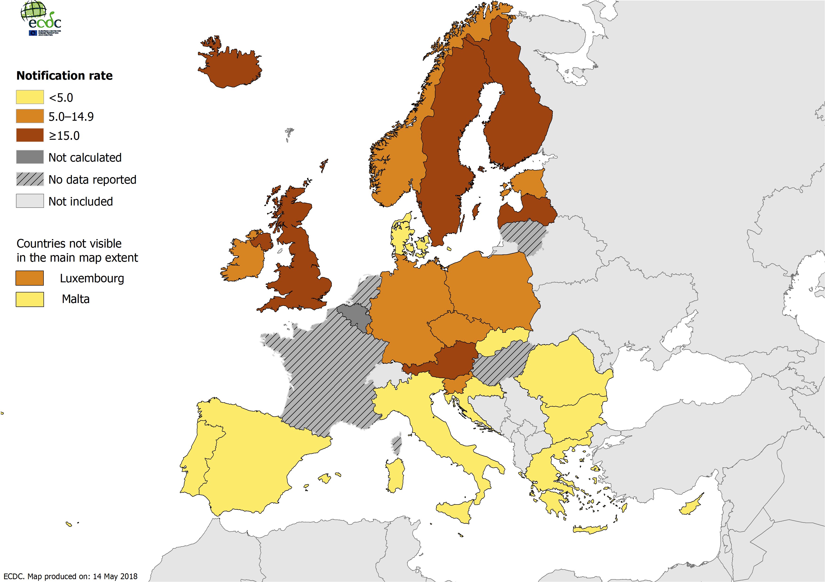
Rate of reported hepatitis C cases per 100 000 population by country, 2016*
* Countries not reporting any data or reporting data only on acute cases are excluded.

Slide 17
Hepatitis C: distribution by age, transmission and importation status, 2016
52% of cases were aged between 25 and 44 - 7% were aged under 25
The overall male-to-female rate ratio was 1.9 to 1
Transmission mode (26% complete):
    Most common acute: injecting drug use (37%); nosocomial (18%); men who have sex with men (13%)
    Most common chronic: injecting drug use (50%); nosocomial (19%); blood and blood products (12%)
18% of cases with complete information were classified as ‘imported’

Slide 18
Rate of reported hepatitis C cases per
100 000 by age and gender, 2016
Source: Country reports from: Austria, Cyprus, Czech Republic, Denmark, Estonia, Finland, Germany, Greece, Hungary, Iceland, Ireland, Italy, Latvia, Lithuania, Luxembourg, Malta, the Netherlands, Norway, Portugal, Romania, Slovakia, Slovenia, Spain, Sweden, and the United Kingdom.

Slide 19
Reported transmission category for acute and chronic hepatitis C cases, 2016
Source: Country reports from: Austria, Denmark, Estonia, Hungary, Iceland, Ireland, Italy, Latvia, Lithuania, Malta, the Netherlands, Poland, Portugal, Romania, Slovakia, Slovenia, Spain, Sweden, and the United Kingdom.

Slide 20
Conclusions

Slide 21
Summary of key findings
High numbers of newly diagnosed hepatitis B and C cases notified across Europe
    Hepatitis C more commonly reported than hepatitis B
    Chronic cases dominate across both diseases
    Marked variation between countries
Hepatitis B:
    a decrease in acute cases
Hepatitis C: strong north-south geographical trend
Transmission routes for hepatitis B differ from hepatitis C, and for hepatitis B these routes vary by disease status
Imported cases are significant, especially for hepatitis B

Slide 22
Key limitations of the data
Due to the largely asymptomatic nature of hepatitis infections, data are strongly related to local testing practices
Challenges relating to the case definitions:
    Different definitions used by countries
    Some countries only report acute hepatitis cases, especially for hepatitis B.
    High proportion of cases coded as unknown
Data completeness low for certain variables:
    Transmission, genotype, complications, country of nationality, HCV status (for HBV cases), HBV status (for HCV cases), HIV status, sex worker, healthcare worker
Underreporting major issue reported by some countries

Slide 23
Other information

Slide 24
Surveillance of hepatitis B and C
– epidemiological objectives
1. To monitor the incidence and routes of transmission of newly diagnosed cases of hepatitis B and C in the general and vulnerable populations
2. To monitor the prevalence of chronic hepatitis B and C virus infection to determine burden of infection (and estimate the proportion undiagnosed) in the general and vulnerable populations
3. To monitor the proportion of chronic cases that are engaged in care (continuum of care)
4. To monitor the proportion of newly diagnosed chronic cases presenting late
5. To determine genotype and sequence distributions of newly acquired infections to better follow transmission patterns, the emergence of resistance and vaccine escape mutants and potentially more virulent virus strains (priority on hepatitis C infections)
6. To determine and describe the proportion of co-infections (HIV/HBV/HCV/HDV)
7. To determine the proportion of HCV re-infections (especially among key risk groups with high incidence e.g. PWIDs)

Slide 25
Hepatitis B case definition
Hepatitis B | EU 2008 Case definition | EU 2012 case definition
Clinical criteria | Any person with a discrete onset of symptoms (e.g. fatigue, abdominal pain, loss of appetite, intermittent nausea and vomiting) AND At least on of the following three: Fever Jaundice Elevated serum aminotransferase levels | Not relevant for surveillance purposes
Laboratory criteria | Hepatitis B virus core IgM antigen specific antibody response Laboratory results need to be interpreted according to vaccination status | Positive results of at least one or more of the following tests or combination of tests: IgM hepatitis B core antibody (anti-HBc IgM) Hepatitis B surface antigen (HBsAg) Hepatitis B e antigen (HBeAg) Hepatitis B nucleic acid (HBV-DNA)
Epidemiological criteria | An epidemiological link by human to human transmission (e.g. sexual contact, vertical transmission or blood transmission) | N/A
Case definition – possible | N/A | N/A
Case definition – probable | Any person meeting the clinical criteria and with an epidemiological link | N/A
Case definition – confirmed | Any person meeting the clinical and laboratory criteria | Any person meeting the laboratory criteria
The following combination of laboratory tests shall not be included or reported:
Resolved hepatitis – hepatitis B total core antibody (anti‐HBc) positive and hepatitis B surface antibody (anti‐HBs) positive
Immunity following vaccination – hepatitis B total core antibody (anti‐HBc) negative and hepatitis B surface antibody (anti‐HBs) positive
Anti‐HBc IgG positivity only

Slide 26
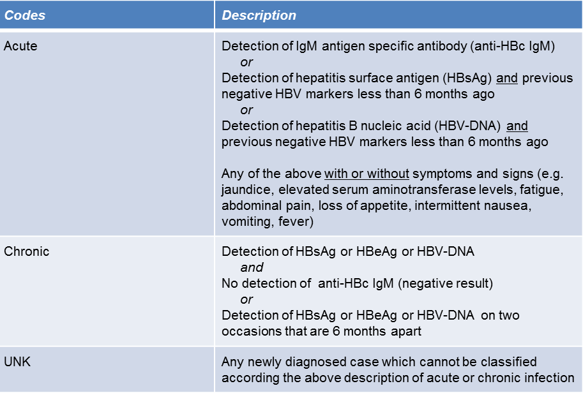
Differentiation of hepatitis B by stage of infection

Slide 27
Hepatitis C case definition
Hepatitis C | EU 2008 Case definition | EU 2012 case definition
Clinical criteria | Not relevant for surveillance purposes | Not relevant for surveillance purposes
Laboratory criteria | At least one of the following two: Detection of hepatitis C virus nucleic acid in serum Hepatitis C specific antibody response confirmed by a different antibody test | At least one of the following three: Detection of hepatitis C virus nucleic acid (HCV RNA) Detection of hepatitis C virus specific antigen (HCV-core) Hepatitis C virus specific antibody (anti-HCV) response confirmed by a confirmatory (e.g. immunoblot) antibody test in persons older than 18 months without evidence of resolved infection
Epidemiological criteria | N/A | N/A
Case definition - Possible | N/A | N/A
Case definition - Probable | N/A | N/A
Case definition - Confirmed | Any person meeting the clinical and laboratory criteria | Any person meeting the laboratory criteria
The following combination of lab tests shall not be included or reported:
Resolved infection: Detection of hepatitis C virus antibody and no detection of hepatitis C virus nucleic acid (HCV RNA negative result) or hepatitis C virus core antigen (HCV‐core negative result) in serum/plasma.

Slide 28
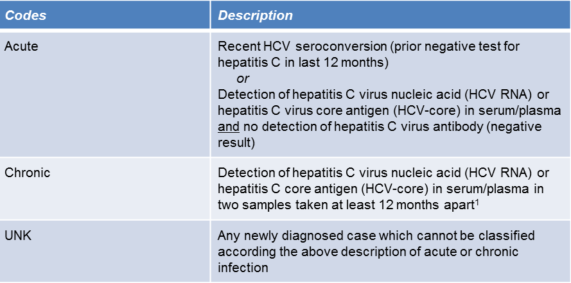
Differentiation of hepatitis C by stage of infection
¹ In the event that the case was not notified the first time

Slide 29
Surveillance of hepatitis B and C: data completeness in 2016

Slide 30
Acknowledgements
Thank you to:
The European Hepatitis B and C Network and Coordination Committee.
EU/EEA country hepatitis and surveillance contact points.
Surveillance colleagues at ECDC: Lina Nerlander, Erika Duffell, Catalin Albu, Julien Beauté, Denis Coulombier, Catia Cunha, Gaetan Guyodo, Františka Hruba, Valentina Lazdina, Phillip Zucs.
Colleagues in the programme on HIV/AIDS, STI and Viral Hepatitis B and C: Lina Nerlander (main author), Andrew Amato-Gauci, Caroline Daamen.
Contact: stihivhep@ecdc.europa.eu

