Slide 1
Reusable maps and graphs from ECDC Communicable Disease Threats Report Week 45, 2018
You are encouraged to reuse our maps and graphs for your own purposes and free to translate, provided the content is not altered and the source is acknowledged.

Slide 2
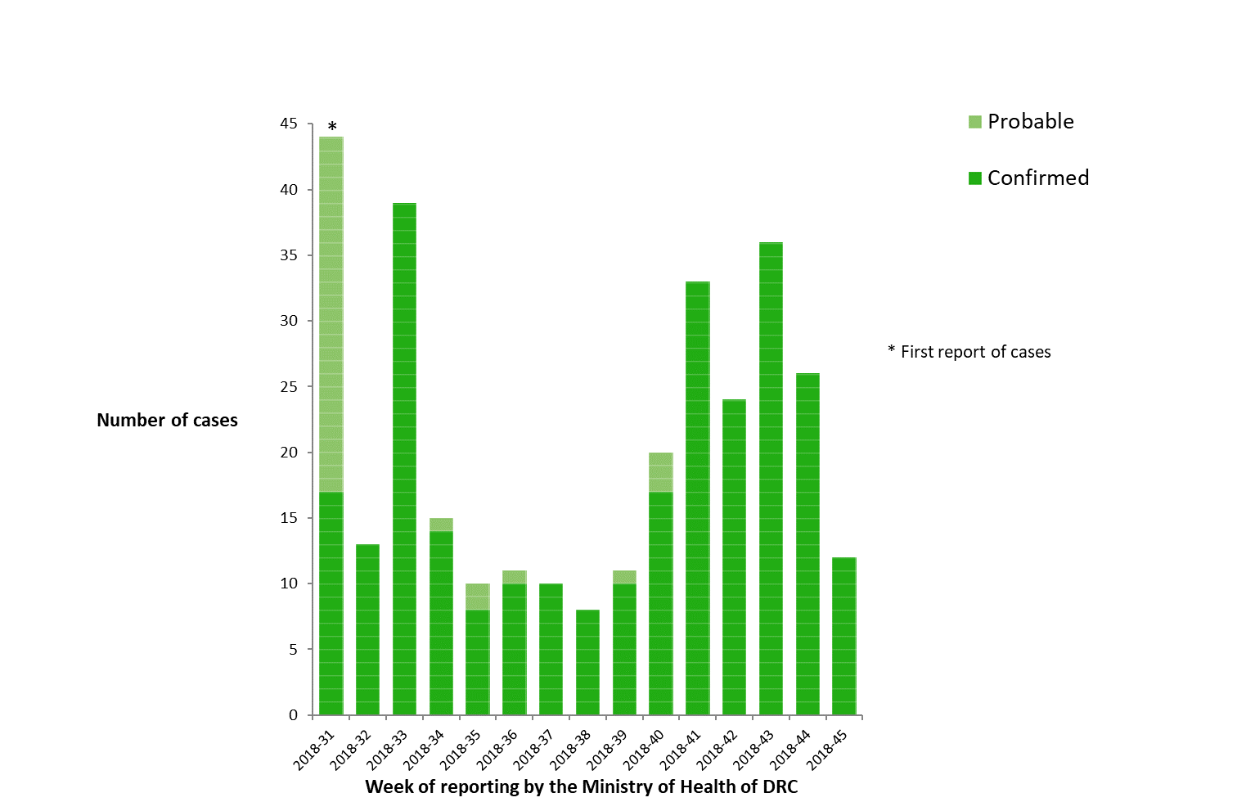
Geographical distribution of confirmed and probable cases of Ebola virus disease, North Kivu and Ituri Provinces, Democratic Republic of the Congo, as of 7 November 2018

Slide 3
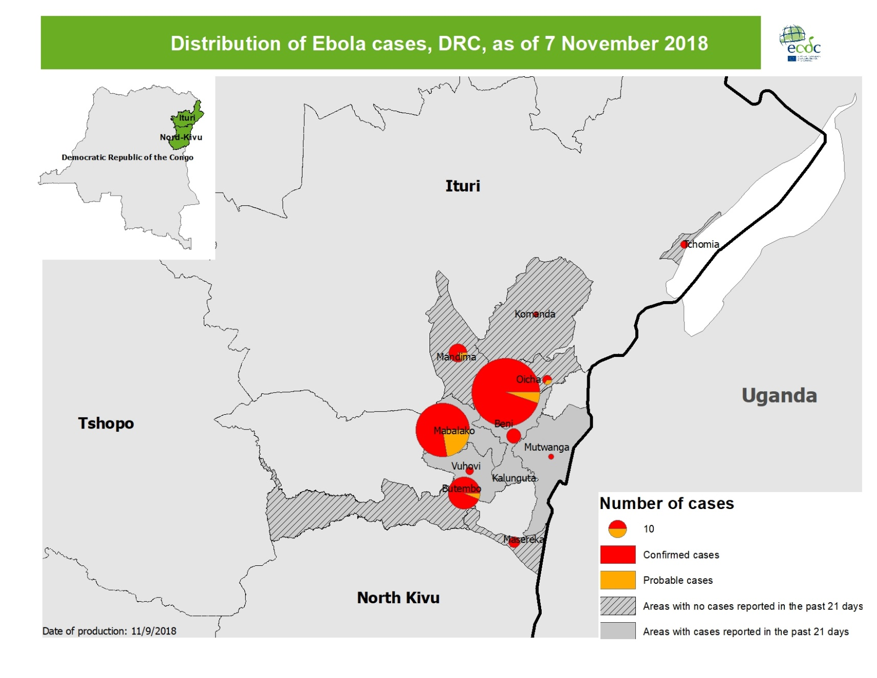
Distribution of confirmed and probable cases of Ebola virus disease, North Kivu and Ituri Provinces, Democratic Republic of the Congo, as of week 45, 2018

Slide 4
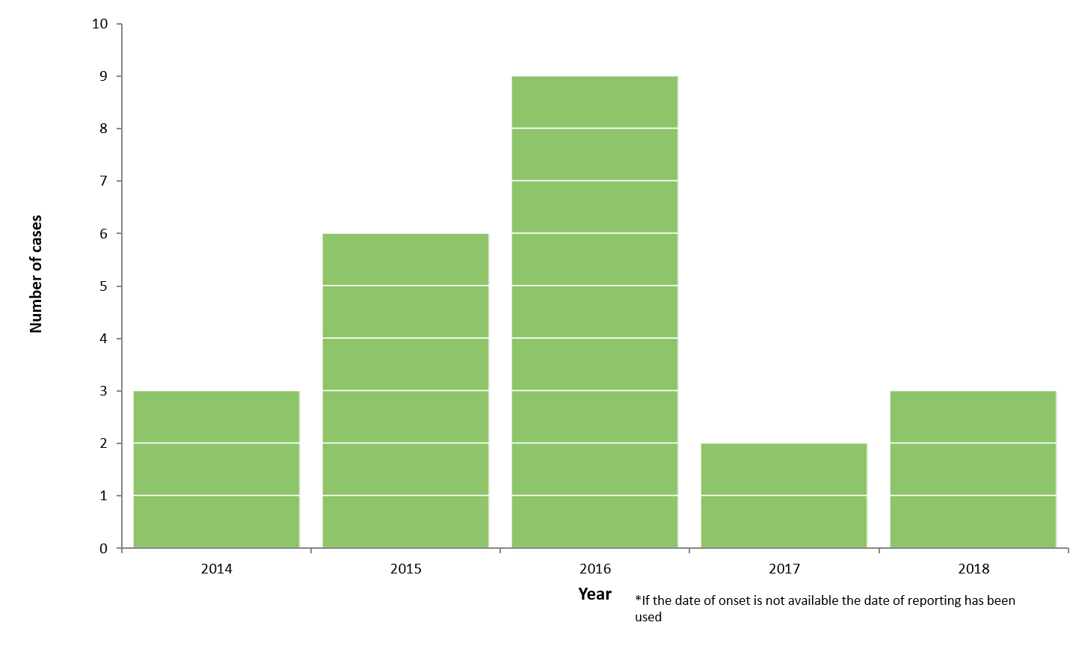
Distribution of confirmed cases of A(H5N6) by year of onset, 2014–2018 (n=23)

Slide 5
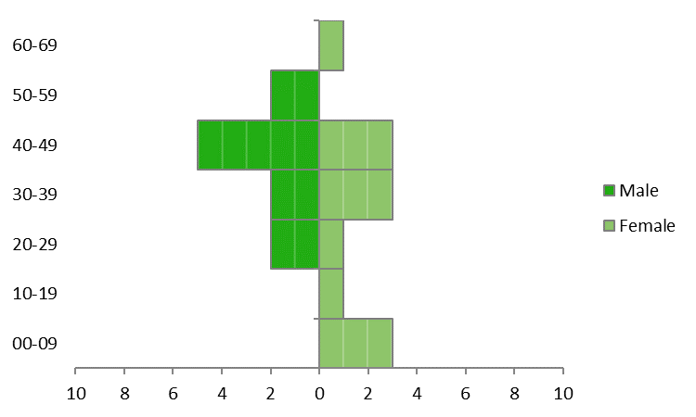
Distribution of confirmed cases of A(H5N6) by age and gender, 2014–2018 (n=23)

Slide 6
Geographical distribution of confirmed cases of A(H5N6), China, 2014–2018 (n=23)

Slide 7
Distribution of confirmed cases of MERS-CoV by place of infection and month of onset, March 2012 to 31 October 2018

Slide 8
Geographical distribution of confirmed MERS-CoV cases by probable region of infection and exposure type, October 2018

Slide 9
Geographical distribution of confirmed MERS-CoV cases by country of infection and year of onset, April 2012 to 31 October 2018

