Slide 1
Reusable maps and graphs from ECDC Communicable Disease Threats Report Week 9, 2019
You are encouraged to reuse our maps and graphs for your own purposes and free to translate, provided the content is not altered and the source is acknowledged.

Slide 2
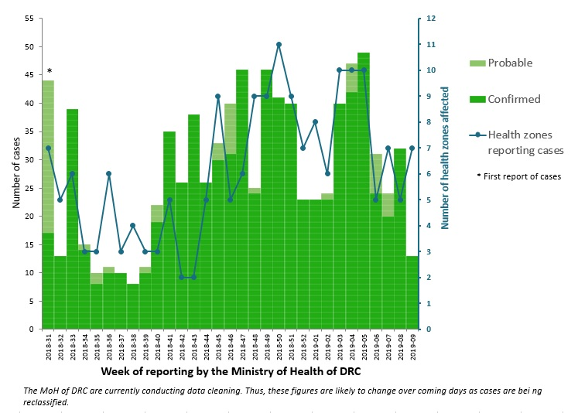
Distribution of confirmed and probable cases of Ebola virus disease and health zones reporting cases, North Kivu and Ituri Provinces, Democratic Republic of the Congo, as of 27 February 2019

Slide 3
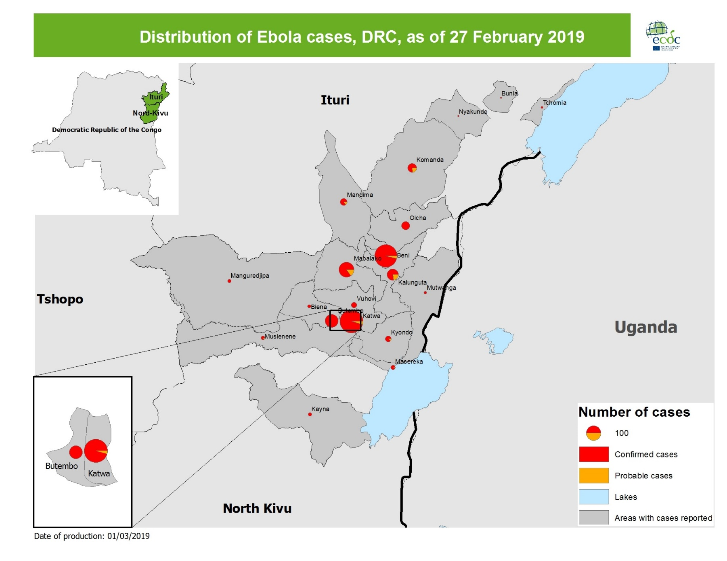
Geographical distribution of confirmed and probable cases of Ebola virus disease, North Kivu and Ituri Provinces, Democratic Republic of the Congo, as of 27 February 2019

Slide 4
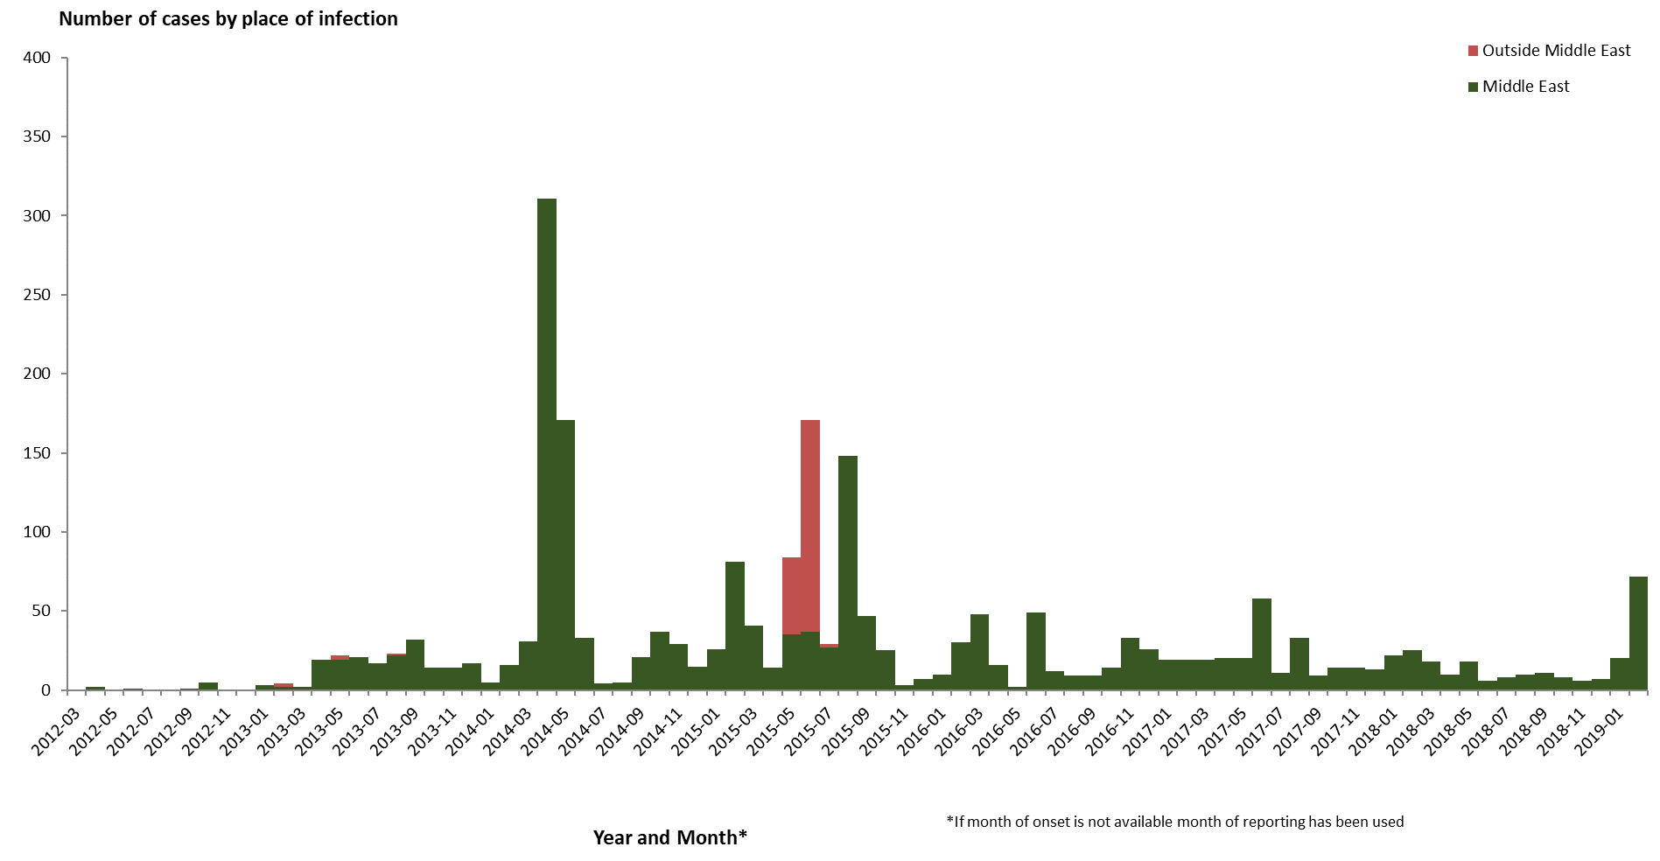
Distribution of confirmed cases of MERS-CoV by place of infection and month of onset, March 2012–27 February 2019

Slide 5
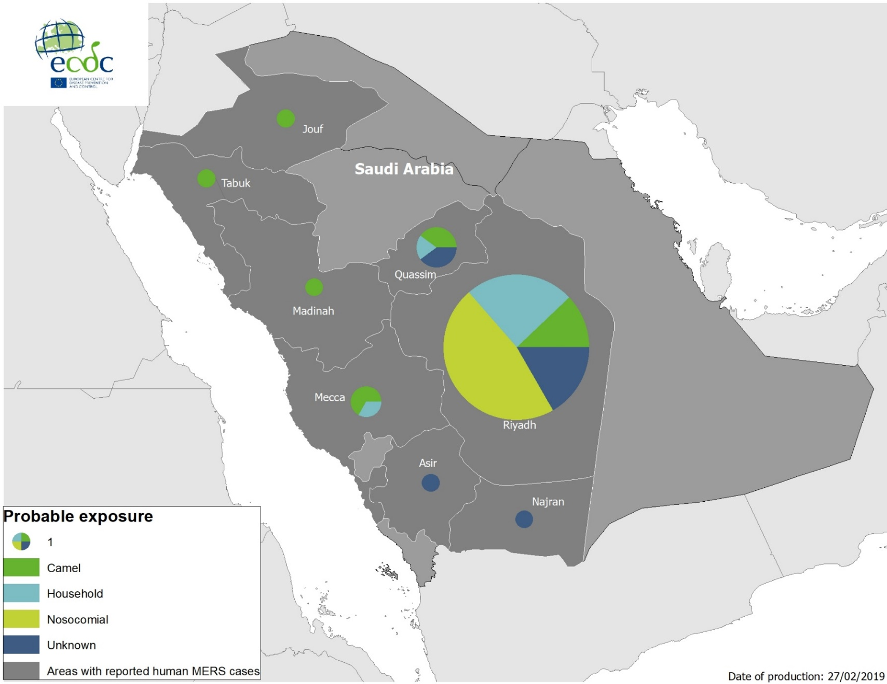
Geographical distribution of confirmed MERS-CoV cases by probable region of infection and exposure in 2019, as of 27 February 2019

Slide 6
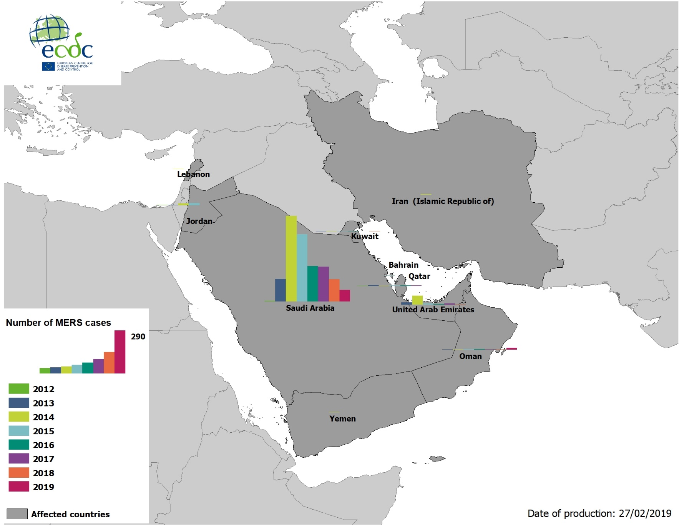
Geographical distribution of confirmed MERS-CoV cases by country of infection and year, April 2012–27 February 2019

Slide 7
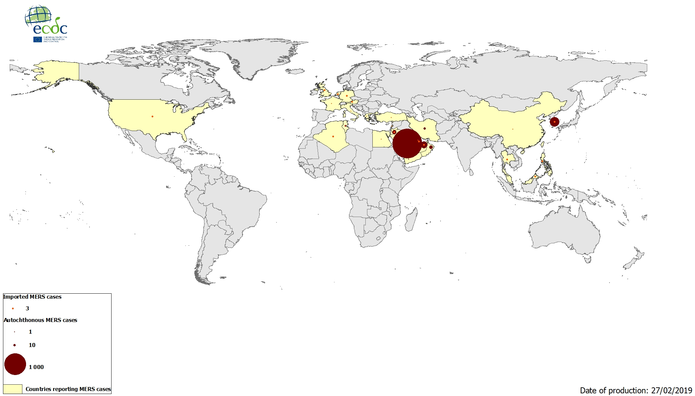
Geographical distribution of confirmed MERS-CoV cases by reporting country, April 2012–27 February 2019

Slide 8
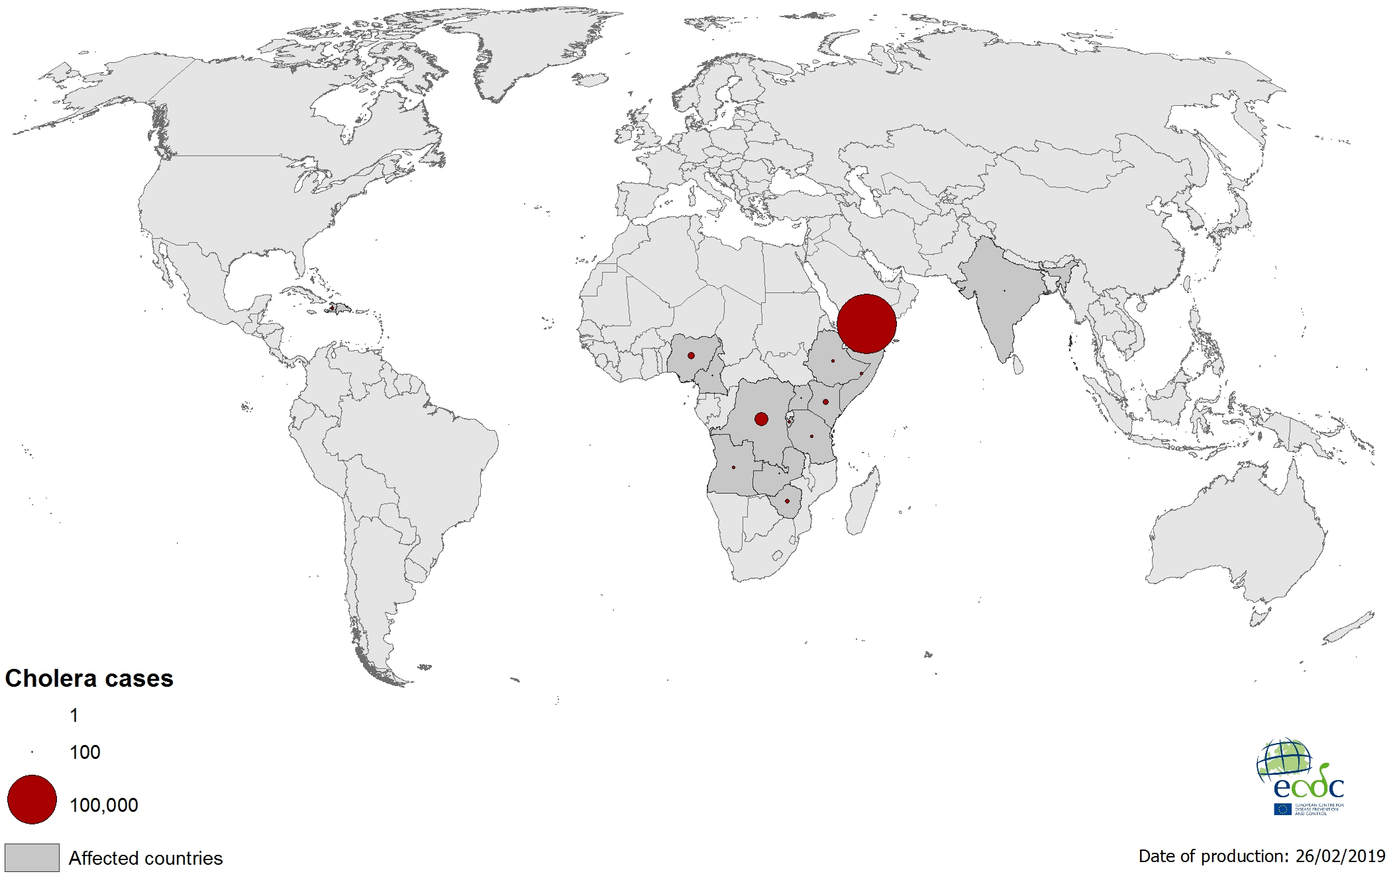
Geographical distribution of new cholera cases reported worldwide between December 2018–February 2019

Slide 9
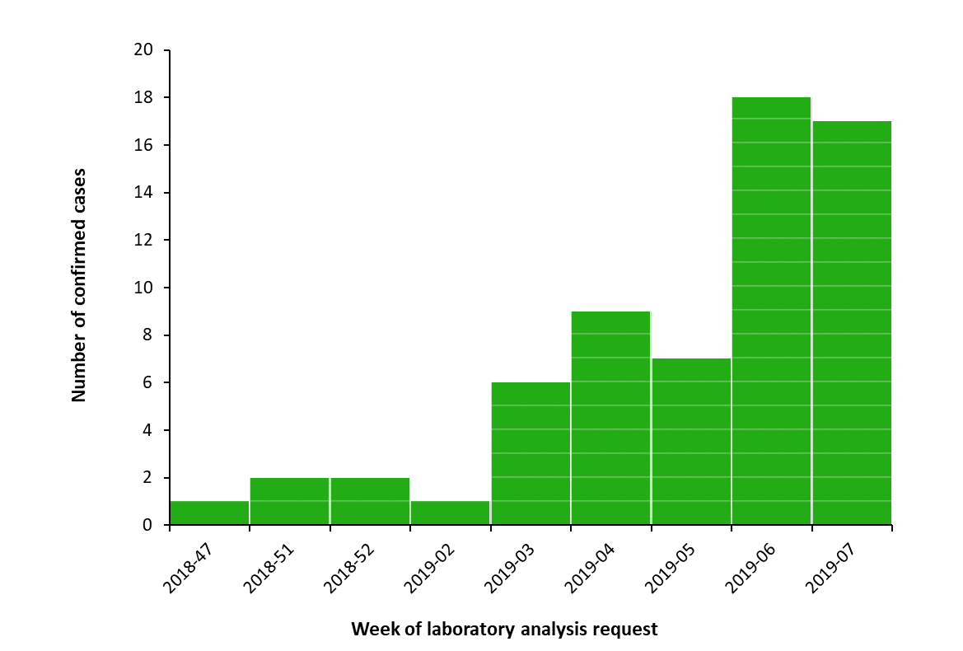
Distribution of confirmed human cases of Rift Valley fever in Mayotte (n=63) by week of laboratory analysis request, 22 November 2018–21 February 2019

Slide 10
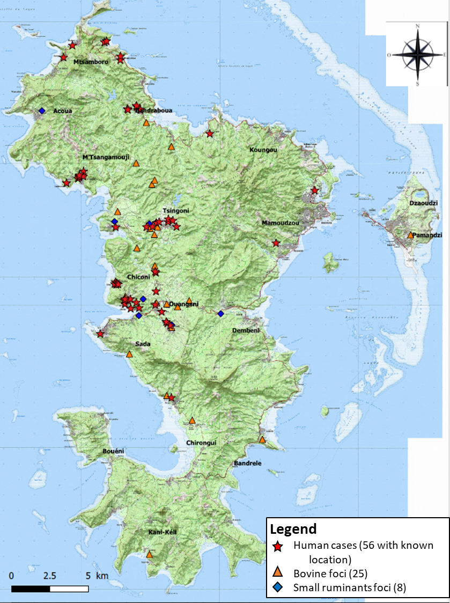
Geographic distribution of human cases (stars) and animal outbreaks in cattle (triangles) and small ruminants (diamonds) of Rift Valley fever in Mayotte, 22 November 2018–21 February 2019

