Slide 1
Reusable maps and graphs from ECDC Communicable Disease Threats Report Week 27, 2023
You are encouraged to reuse our maps and graphs for your own purposes and are free to translate them, provided the content is not altered and the source is acknowledged.

Slide 2
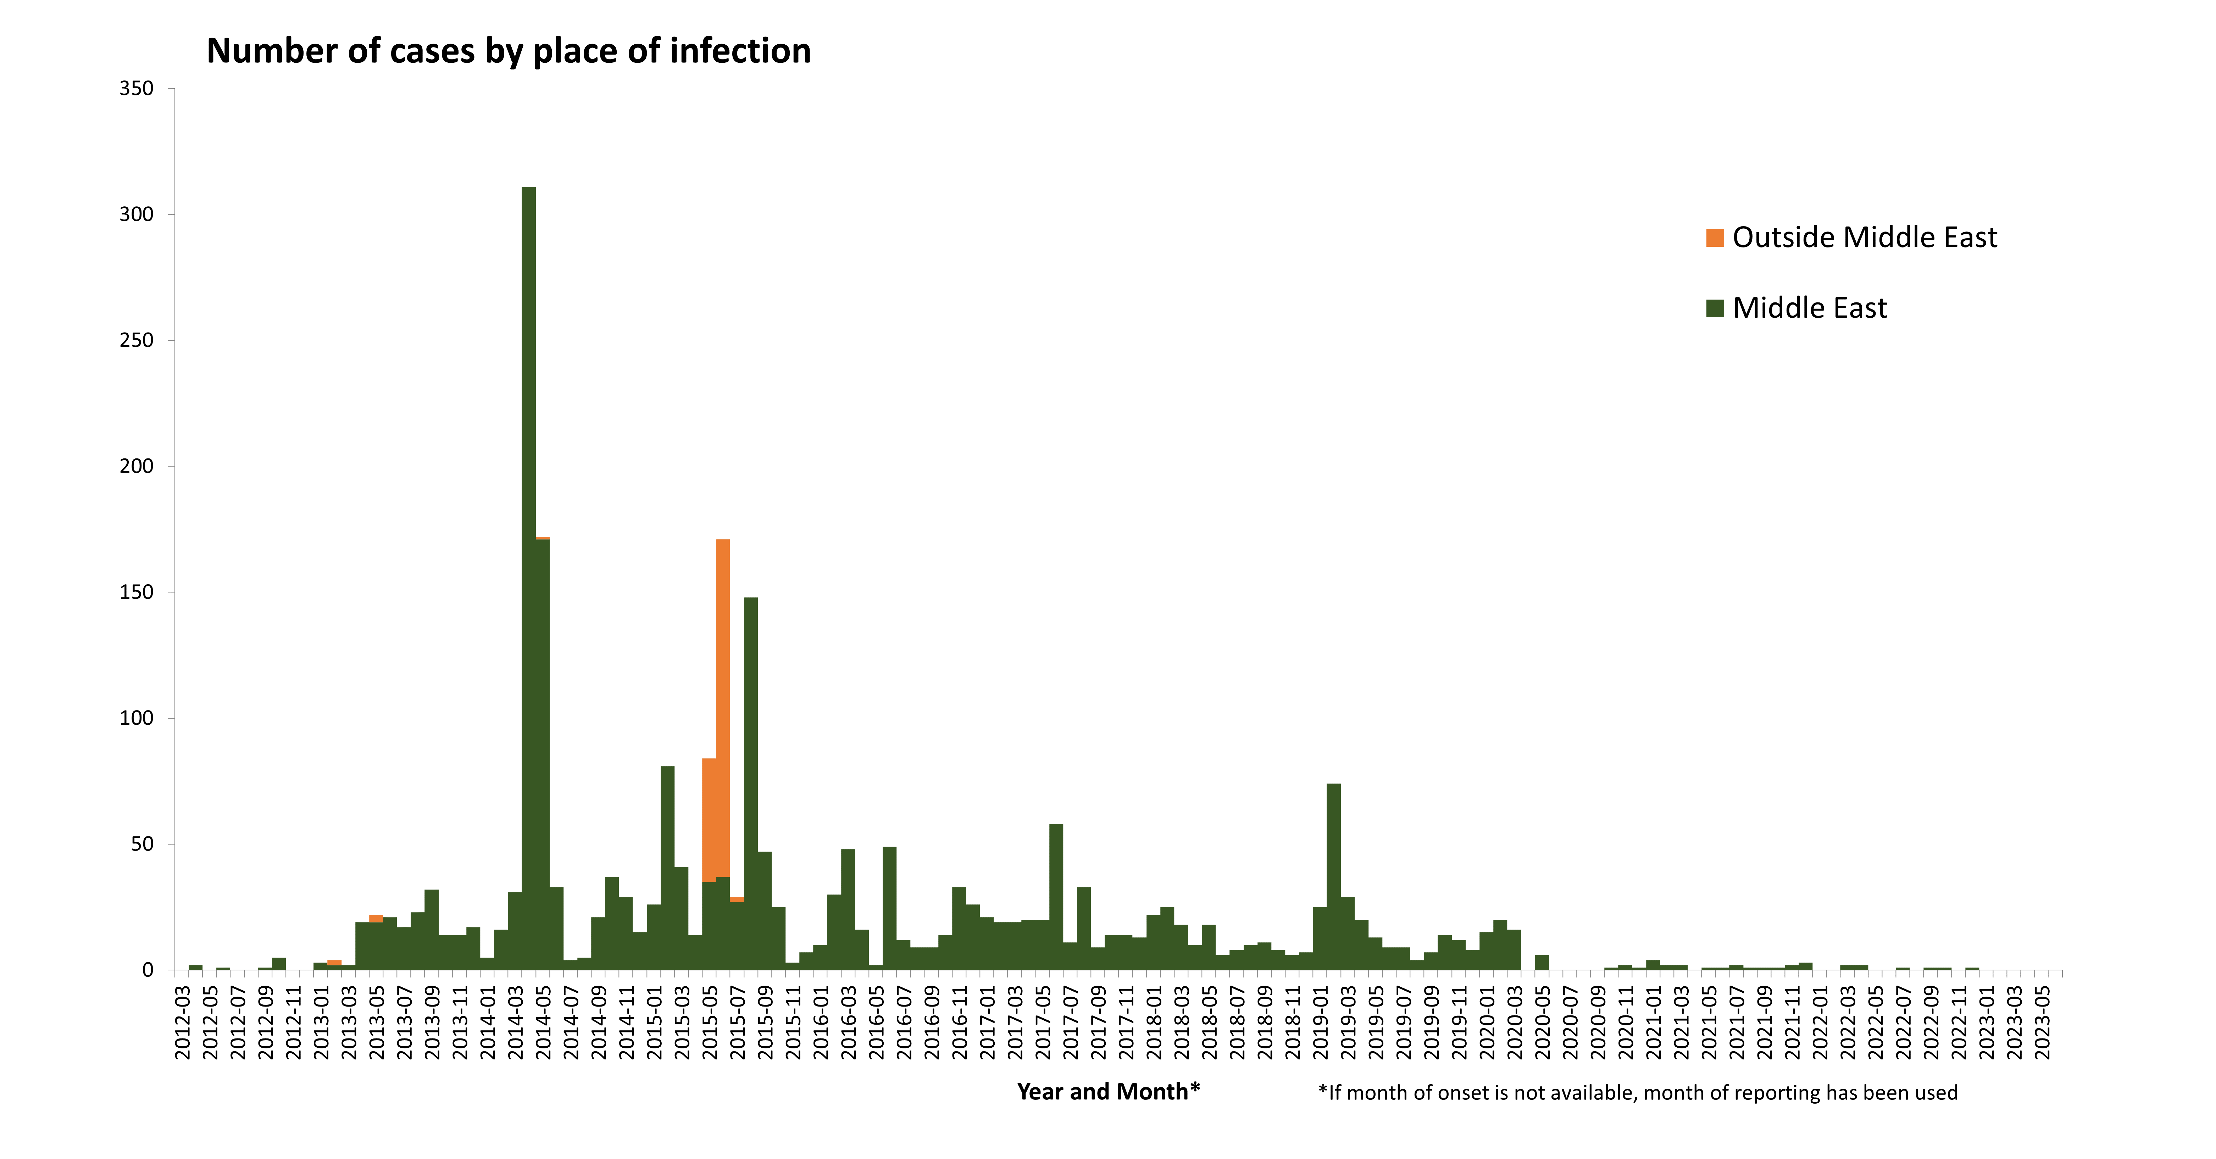
Distribution of confirmed cases of MERS-CoV, by place of infection and month of onset, March 2012 – June 2023

Slide 3
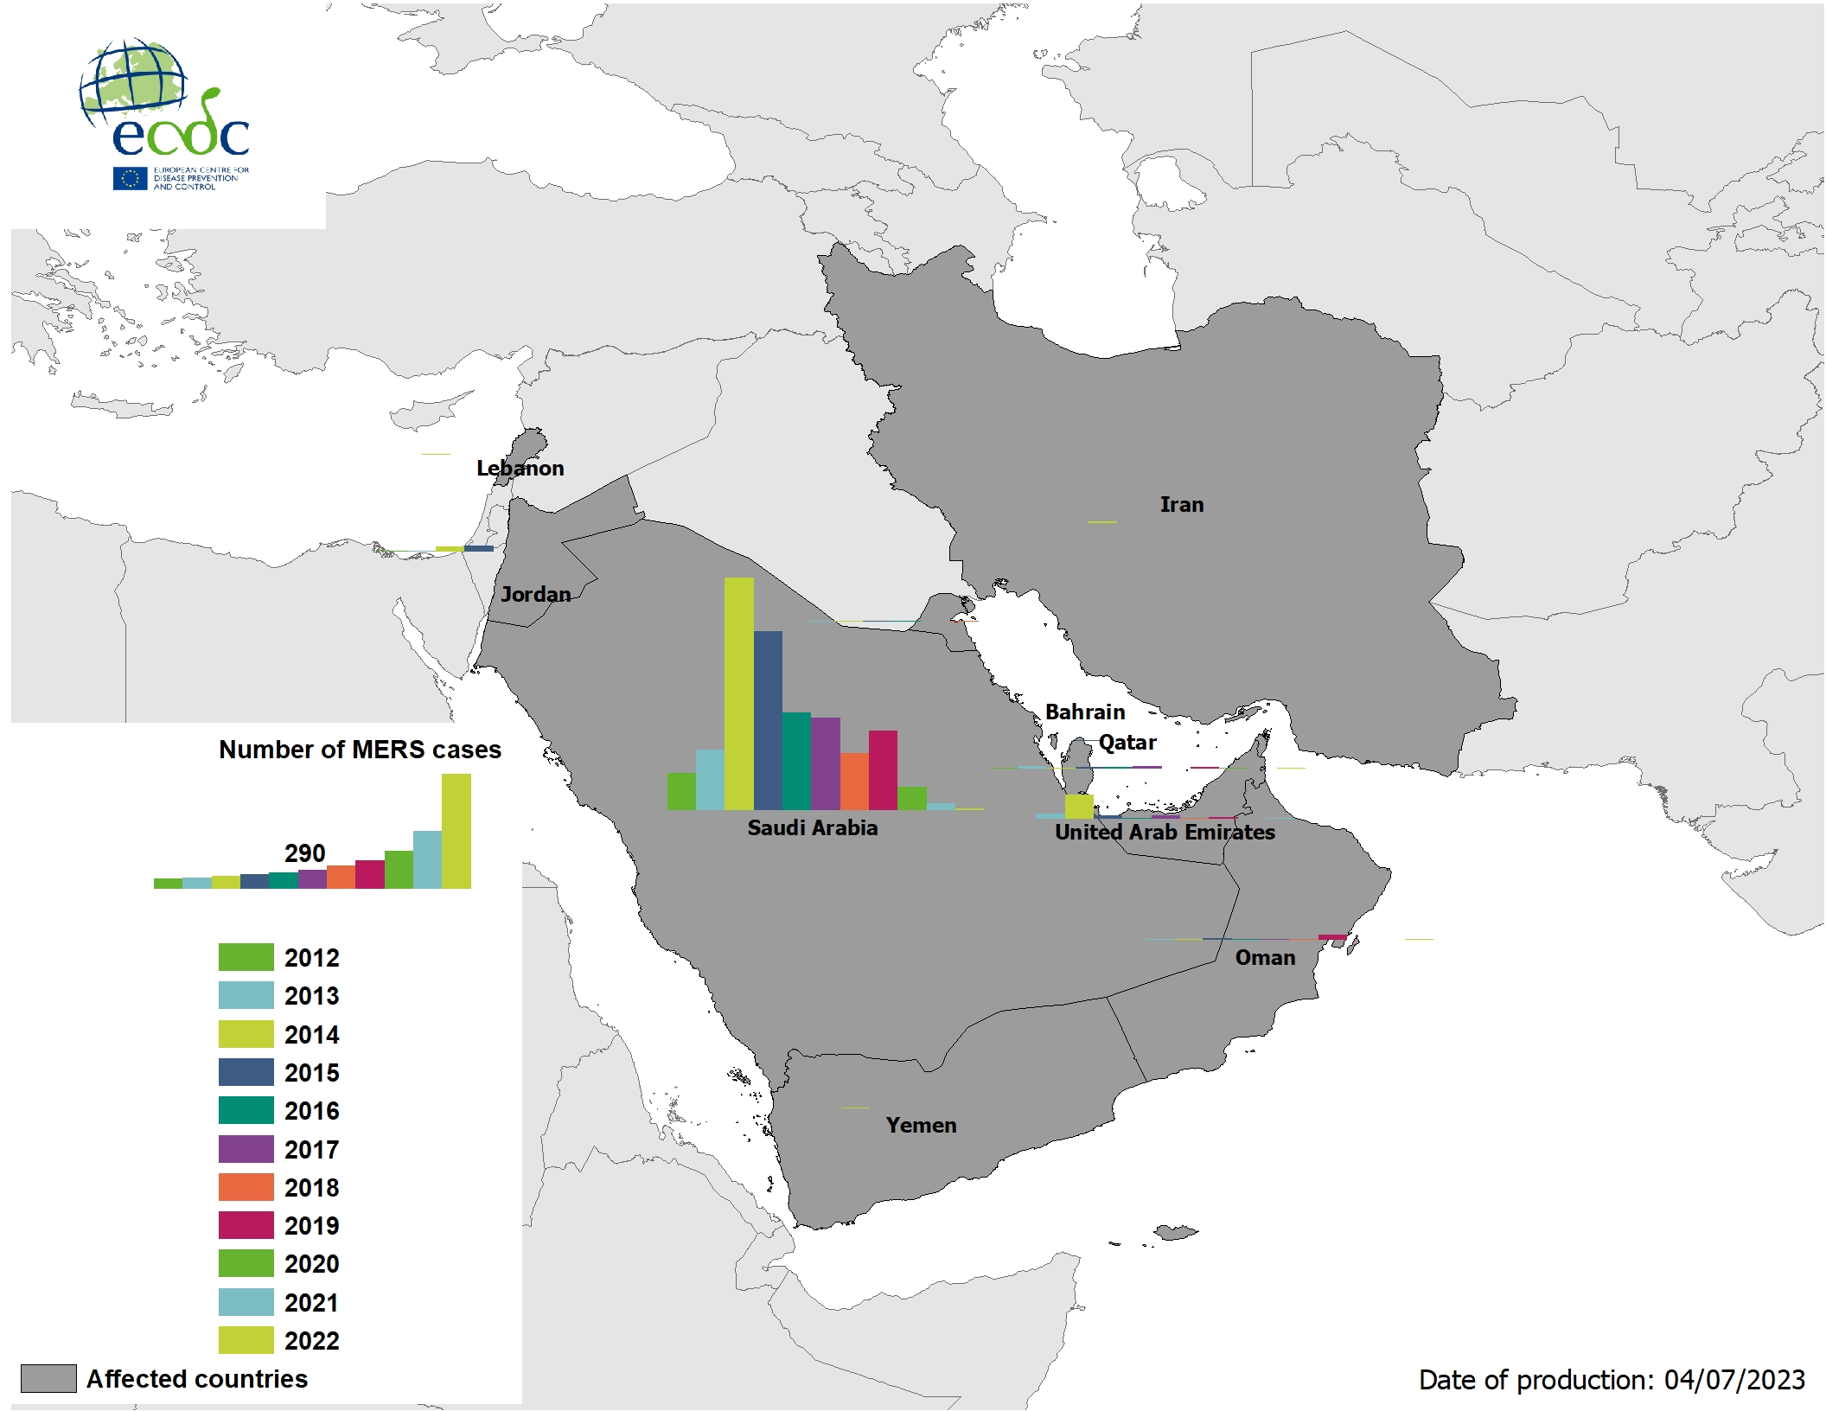
Geographical distribution of confirmed cases of MERS-CoV, by country of infection and year, from April 2012 to June 2023

Slide 4
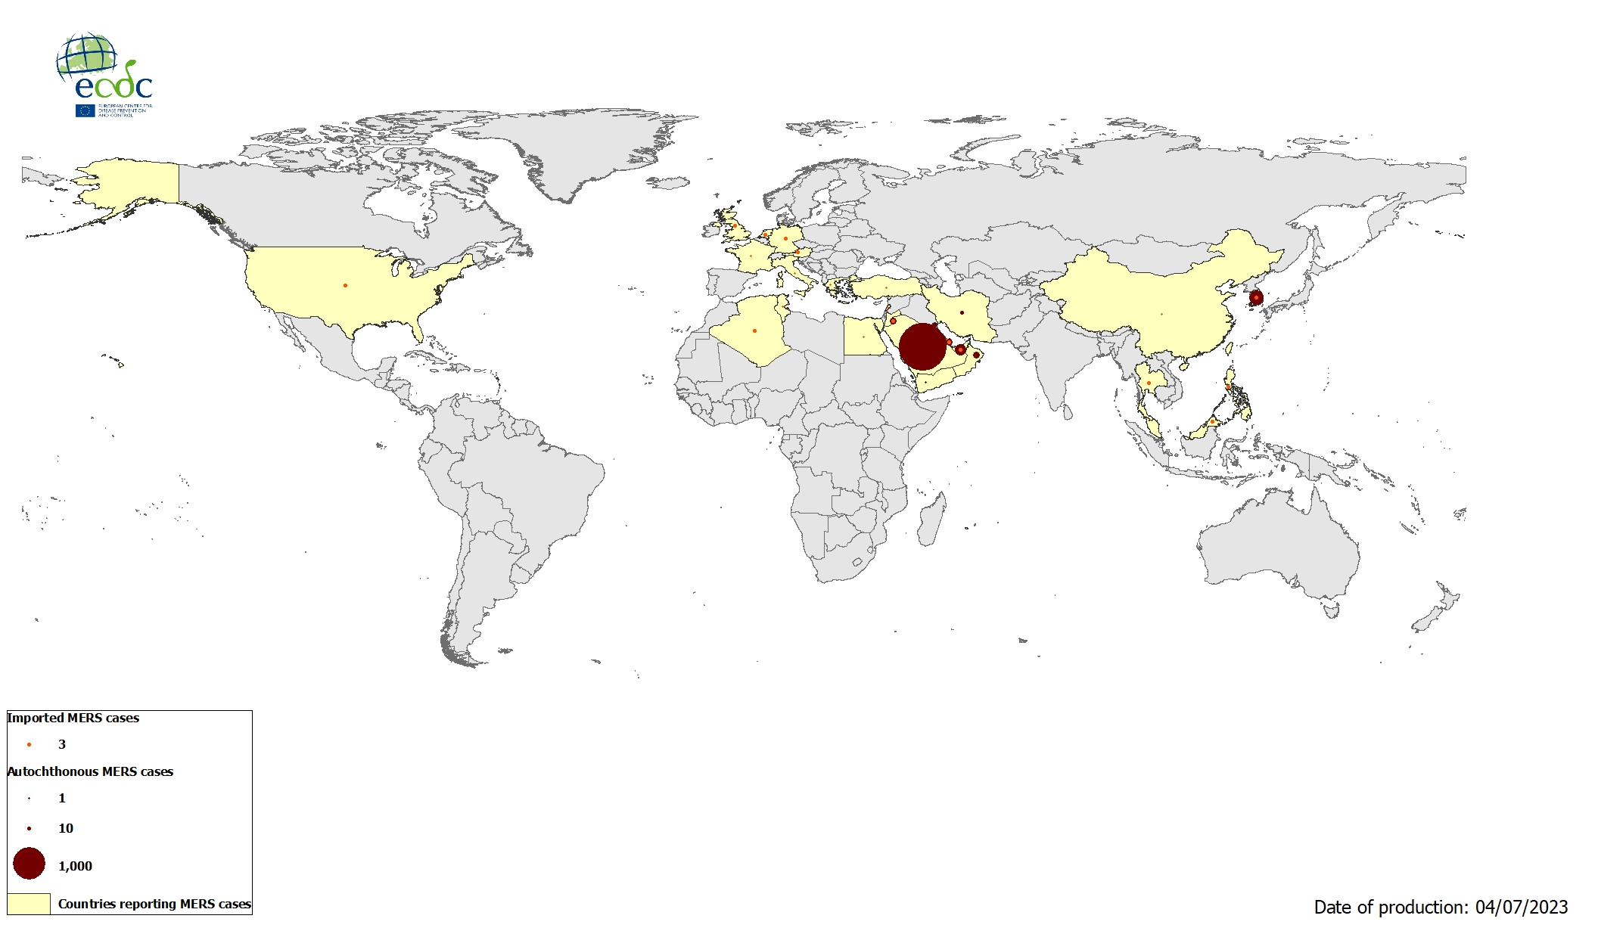
Geographical distribution of confirmed cases of MERS-CoV, by reporting country, April 2012 – June 2023

