Slide 1
Reusable maps and graphs from ECDC Communicable Disease Threats Report Week 49, 2022
You are encouraged to reuse our maps and graphs for your own purposes and are free to translate them, provided the content is not altered and the source is acknowledged.

Slide 2
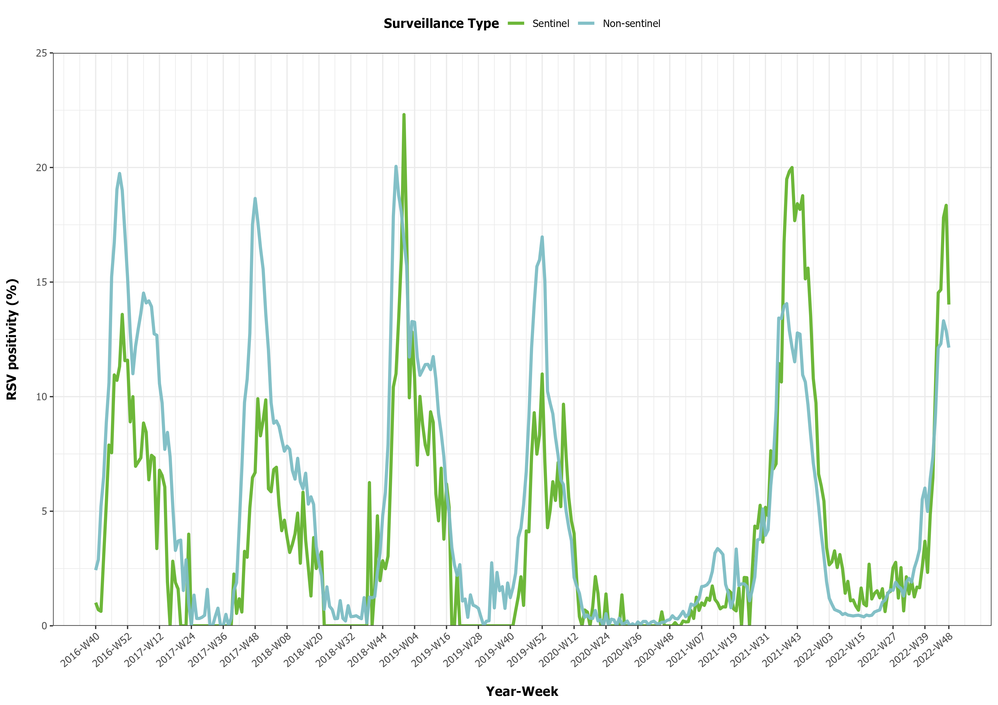
Proportions of RSV positive samples by epidemiological week in the EU/EEA, sentinel and non-sentinel surveillance, week 40, 2016 – week 48, 2022

Slide 3
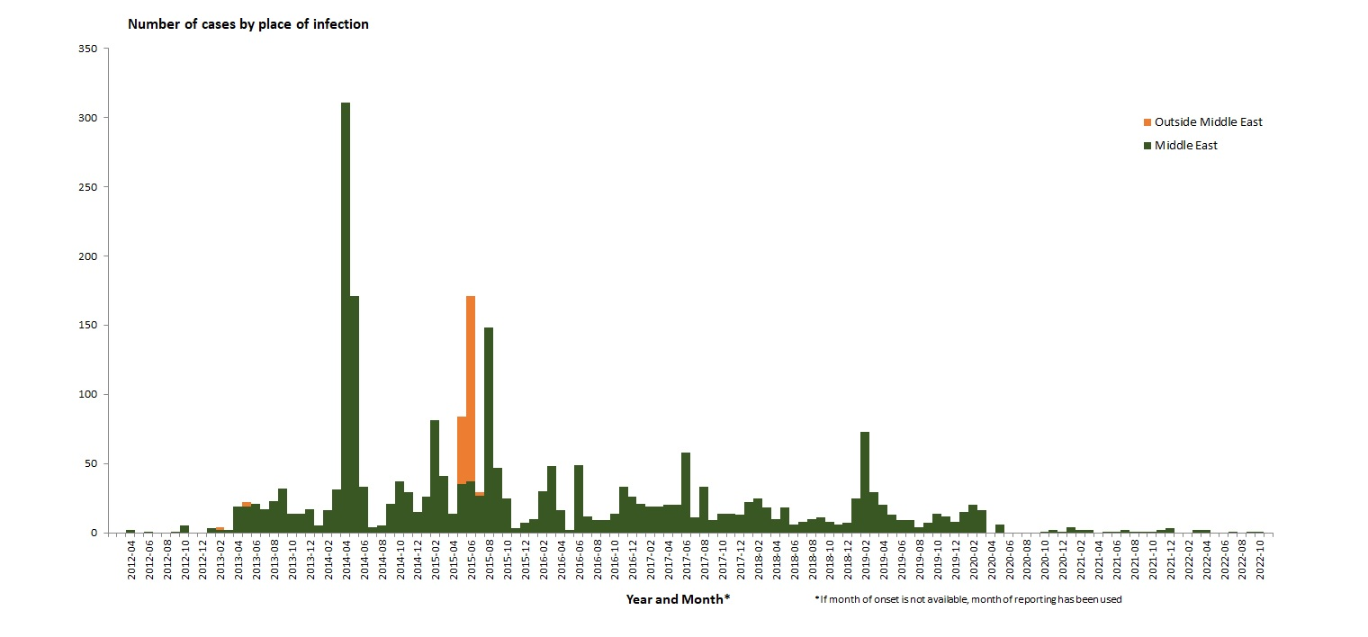
Distribution of confirmed cases of MERS-CoV by place of infection and month of onset, March 2012– December 2022

Slide 4
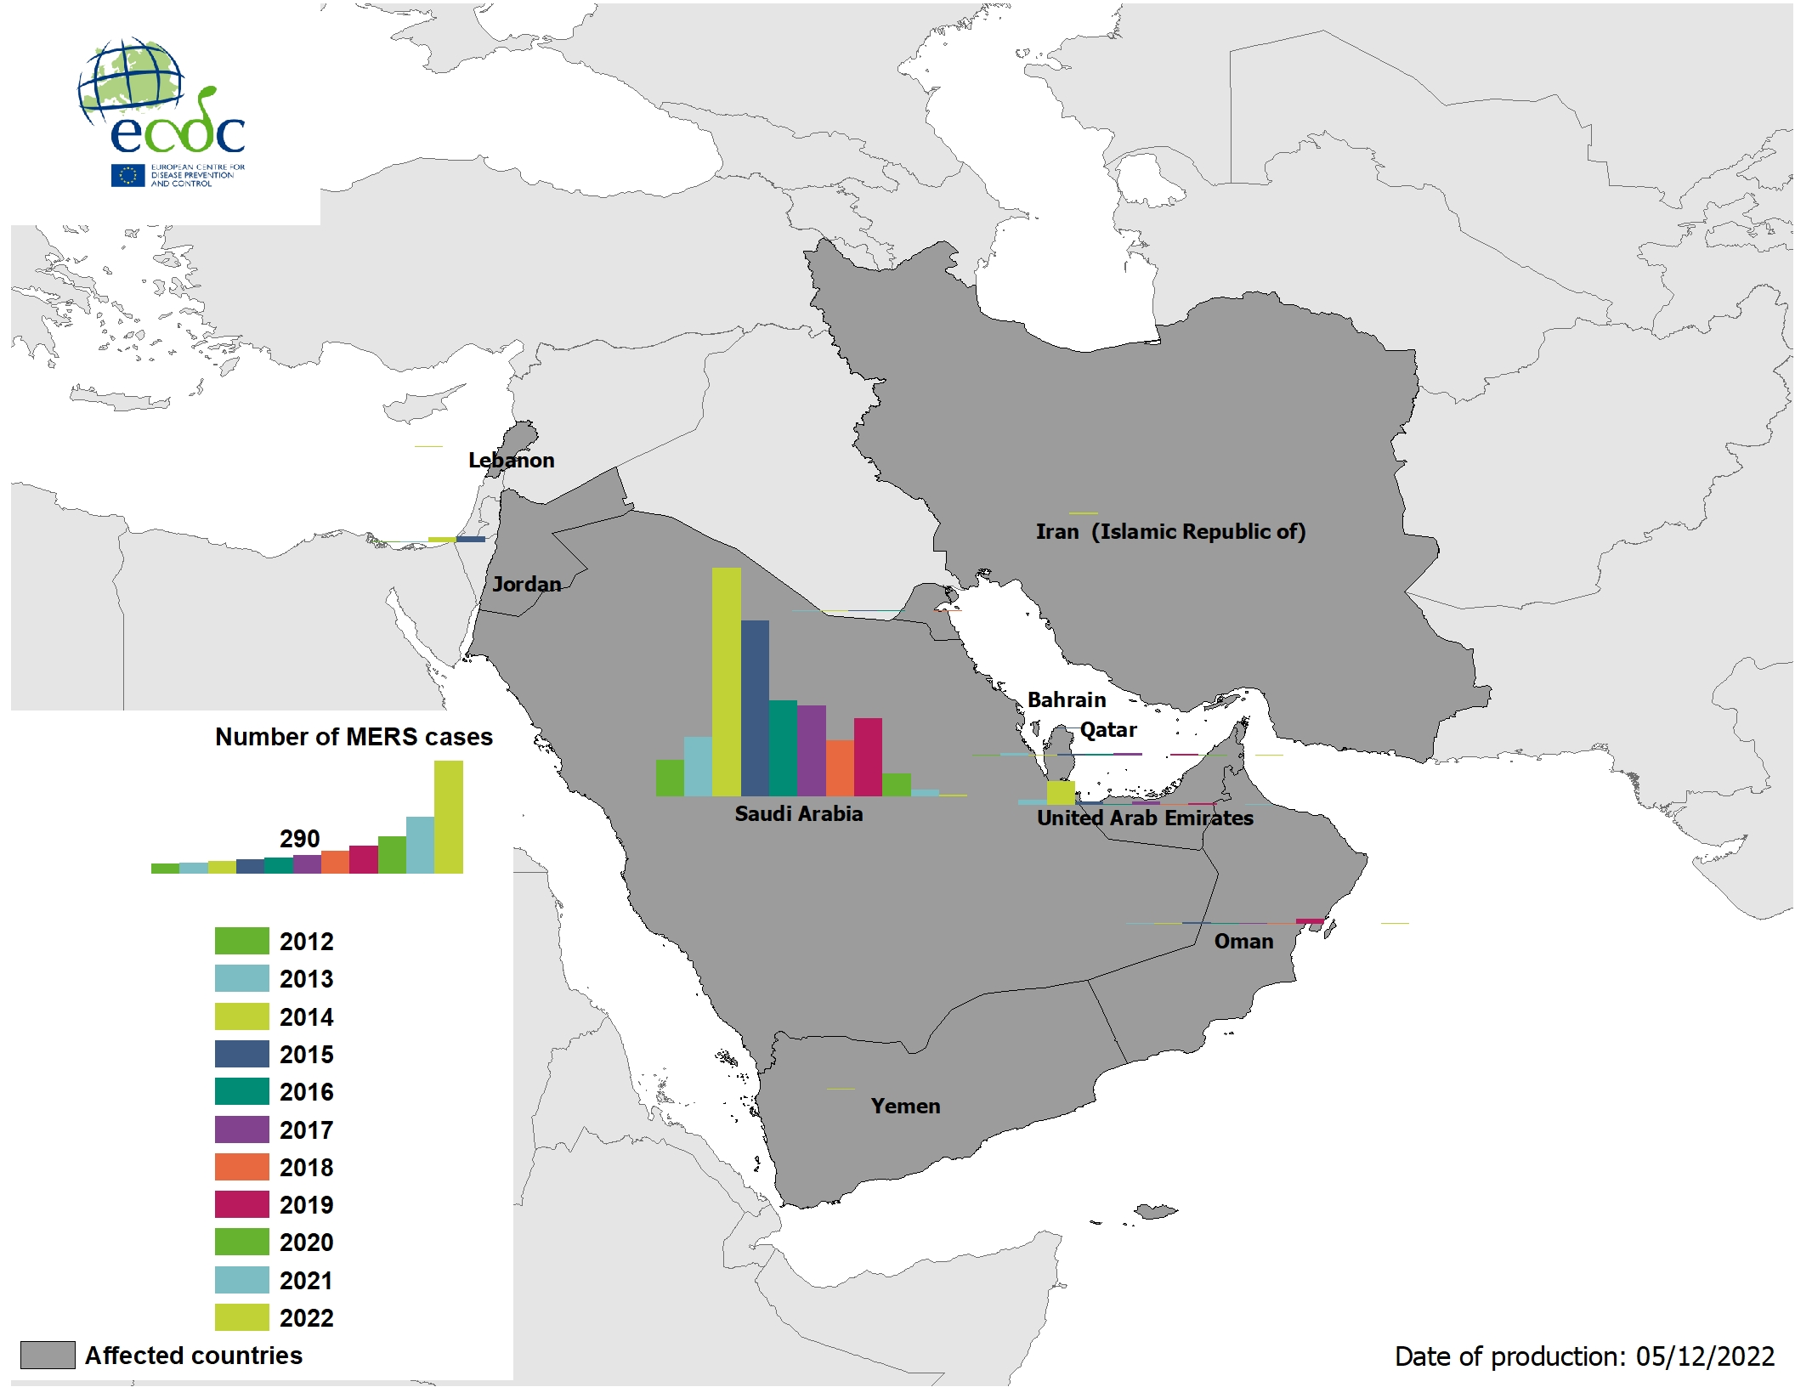
Geographical distribution of confirmed cases of MERS-CoV by probable region of infection and exposure, 1 January 2022 – 5 December 2022

Slide 5
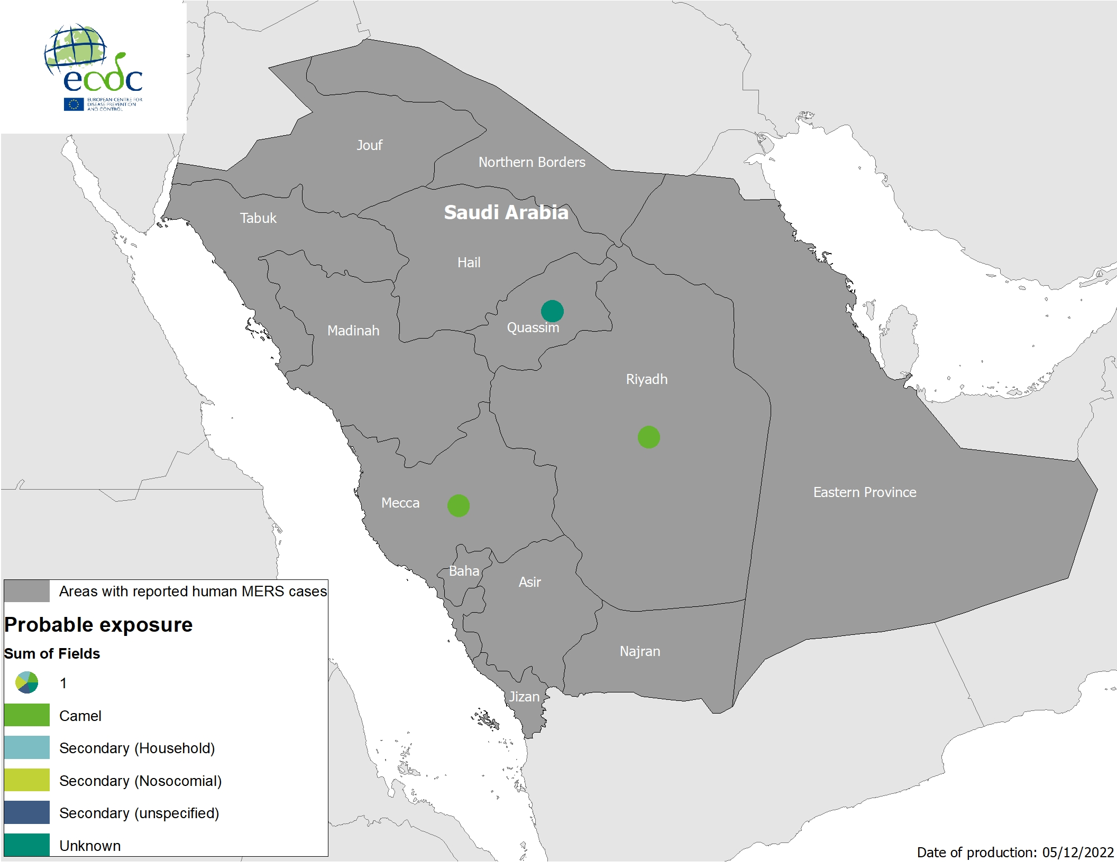
Geographical distribution of confirmed cases of MERS-CoV by country of infection and year, April 2012– 5 December 2022

Slide 6
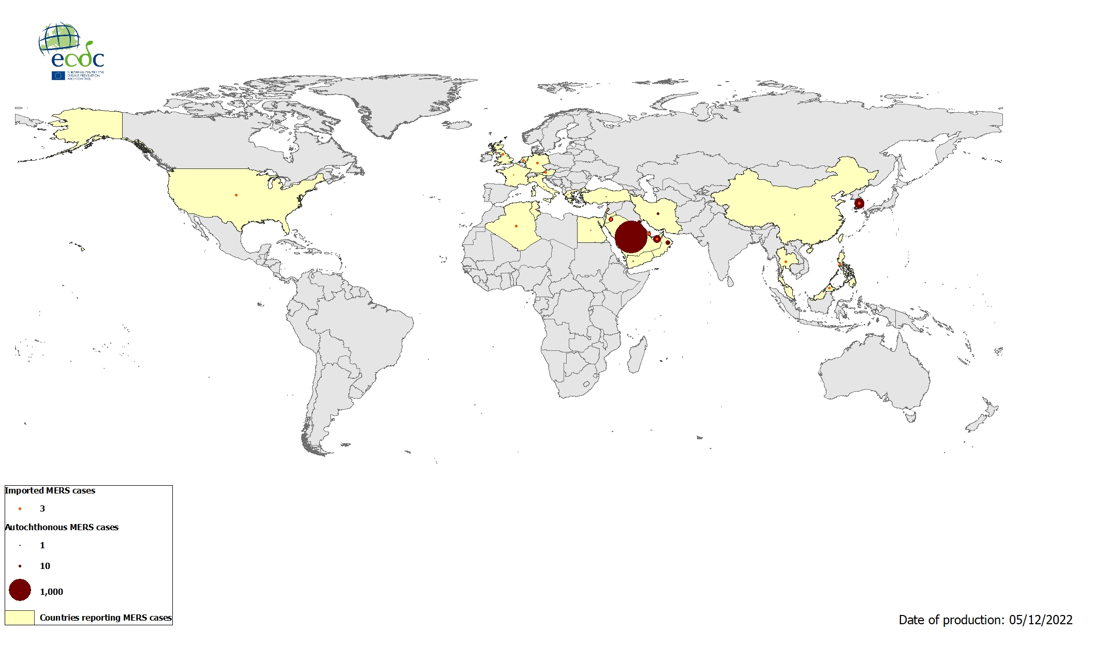
Geographical distribution of confirmed cases of MERS-CoV by reporting country, April 2012 - December 2022

Slide 7
Ebola disease cases reported in Uganda in 2022, by week of reporting.

Slide 8
Geographical distribution of EVD cases in Uganda, 2022.

