Slide 1
Reusable maps and graphs from ECDC Communicable Disease Threats Report Week 15, 2019
You are encouraged to reuse our maps and graphs for your own purposes and free to translate, provided the content is not altered and the source is acknowledged.

Slide 2
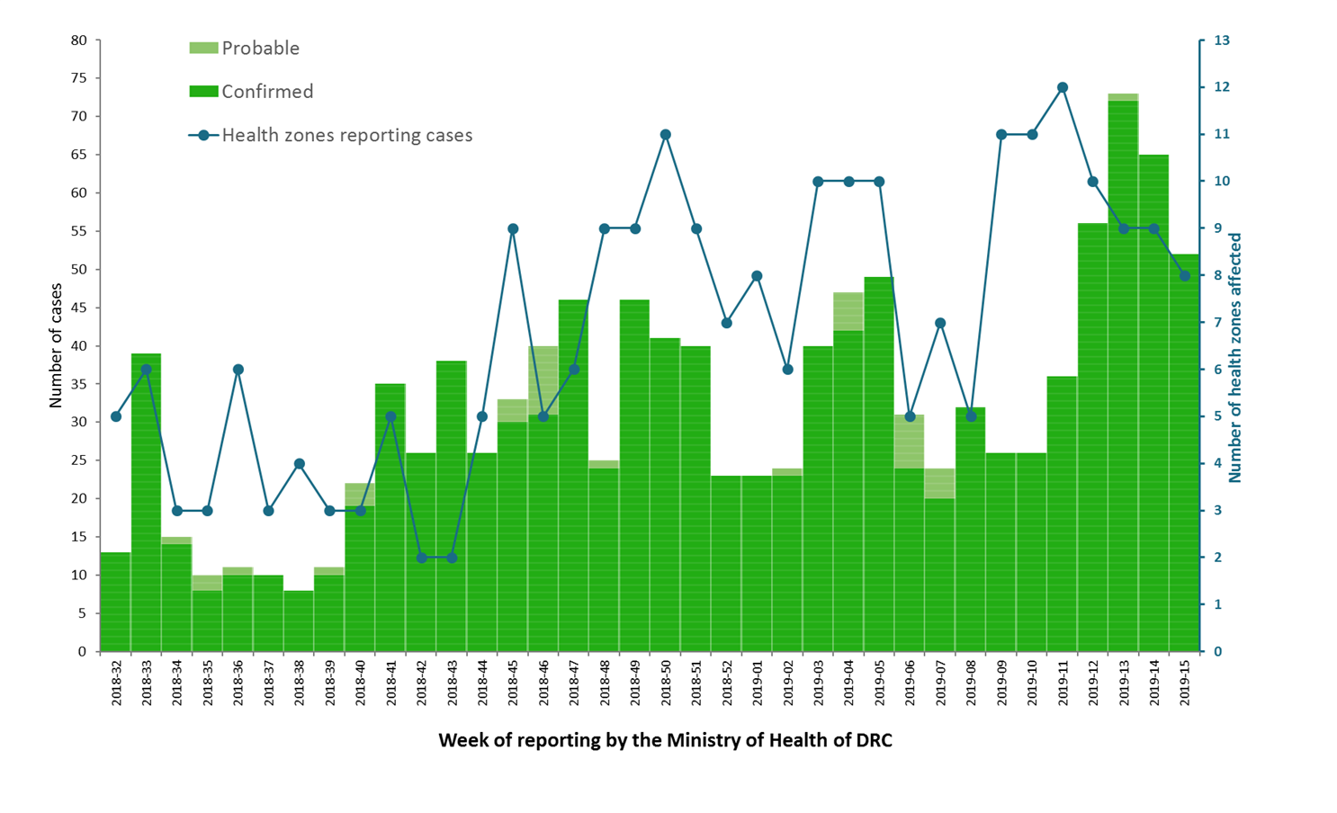
Distribution of confirmed and probable cases of Ebola virus disease and health zones reporting cases, North Kivu and Ituri Provinces, Democratic Republic of the Congo, as of 10 April 2019

Slide 3
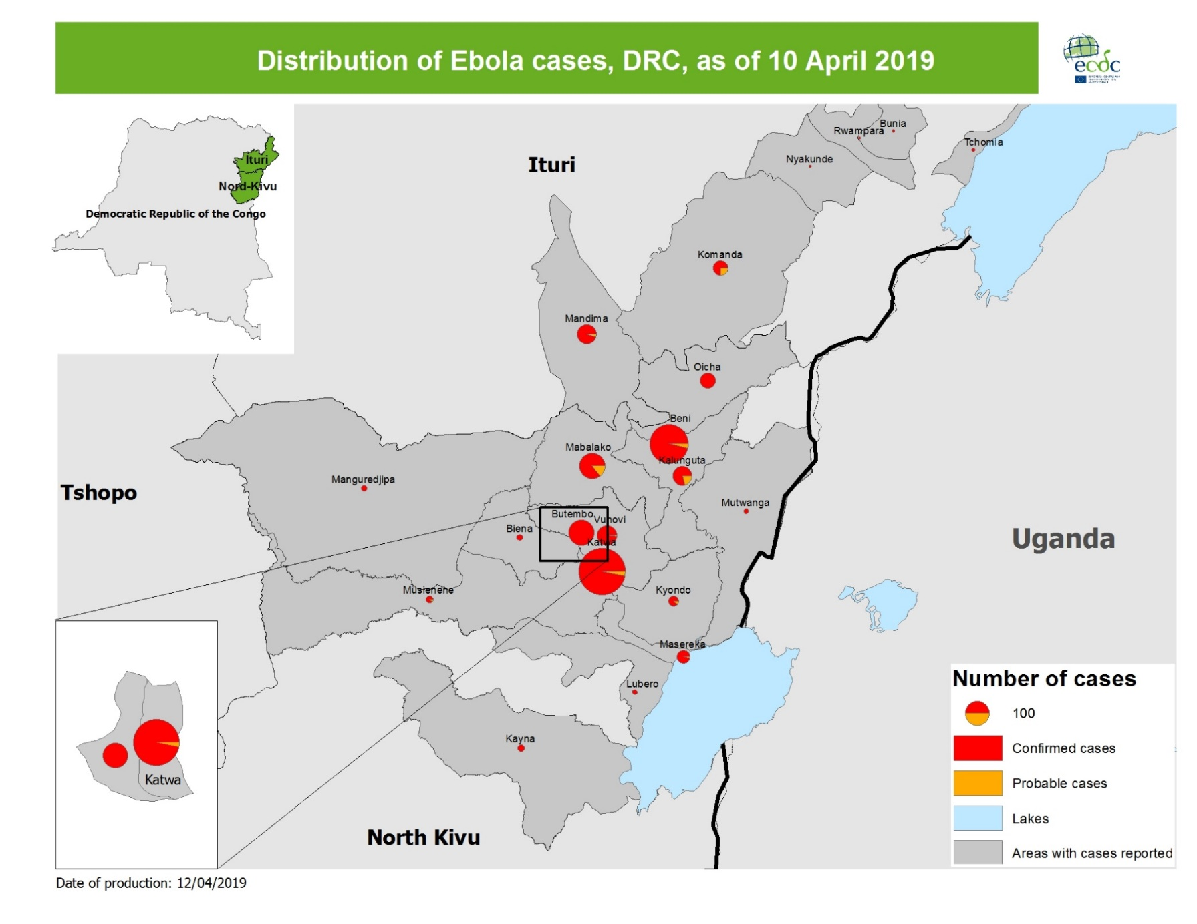
Geographical distribution of confirmed and probable cases of Ebola virus disease, North Kivu and Ituri Provinces, Democratic Republic of the Congo, as of 10 April 2019

Slide 4
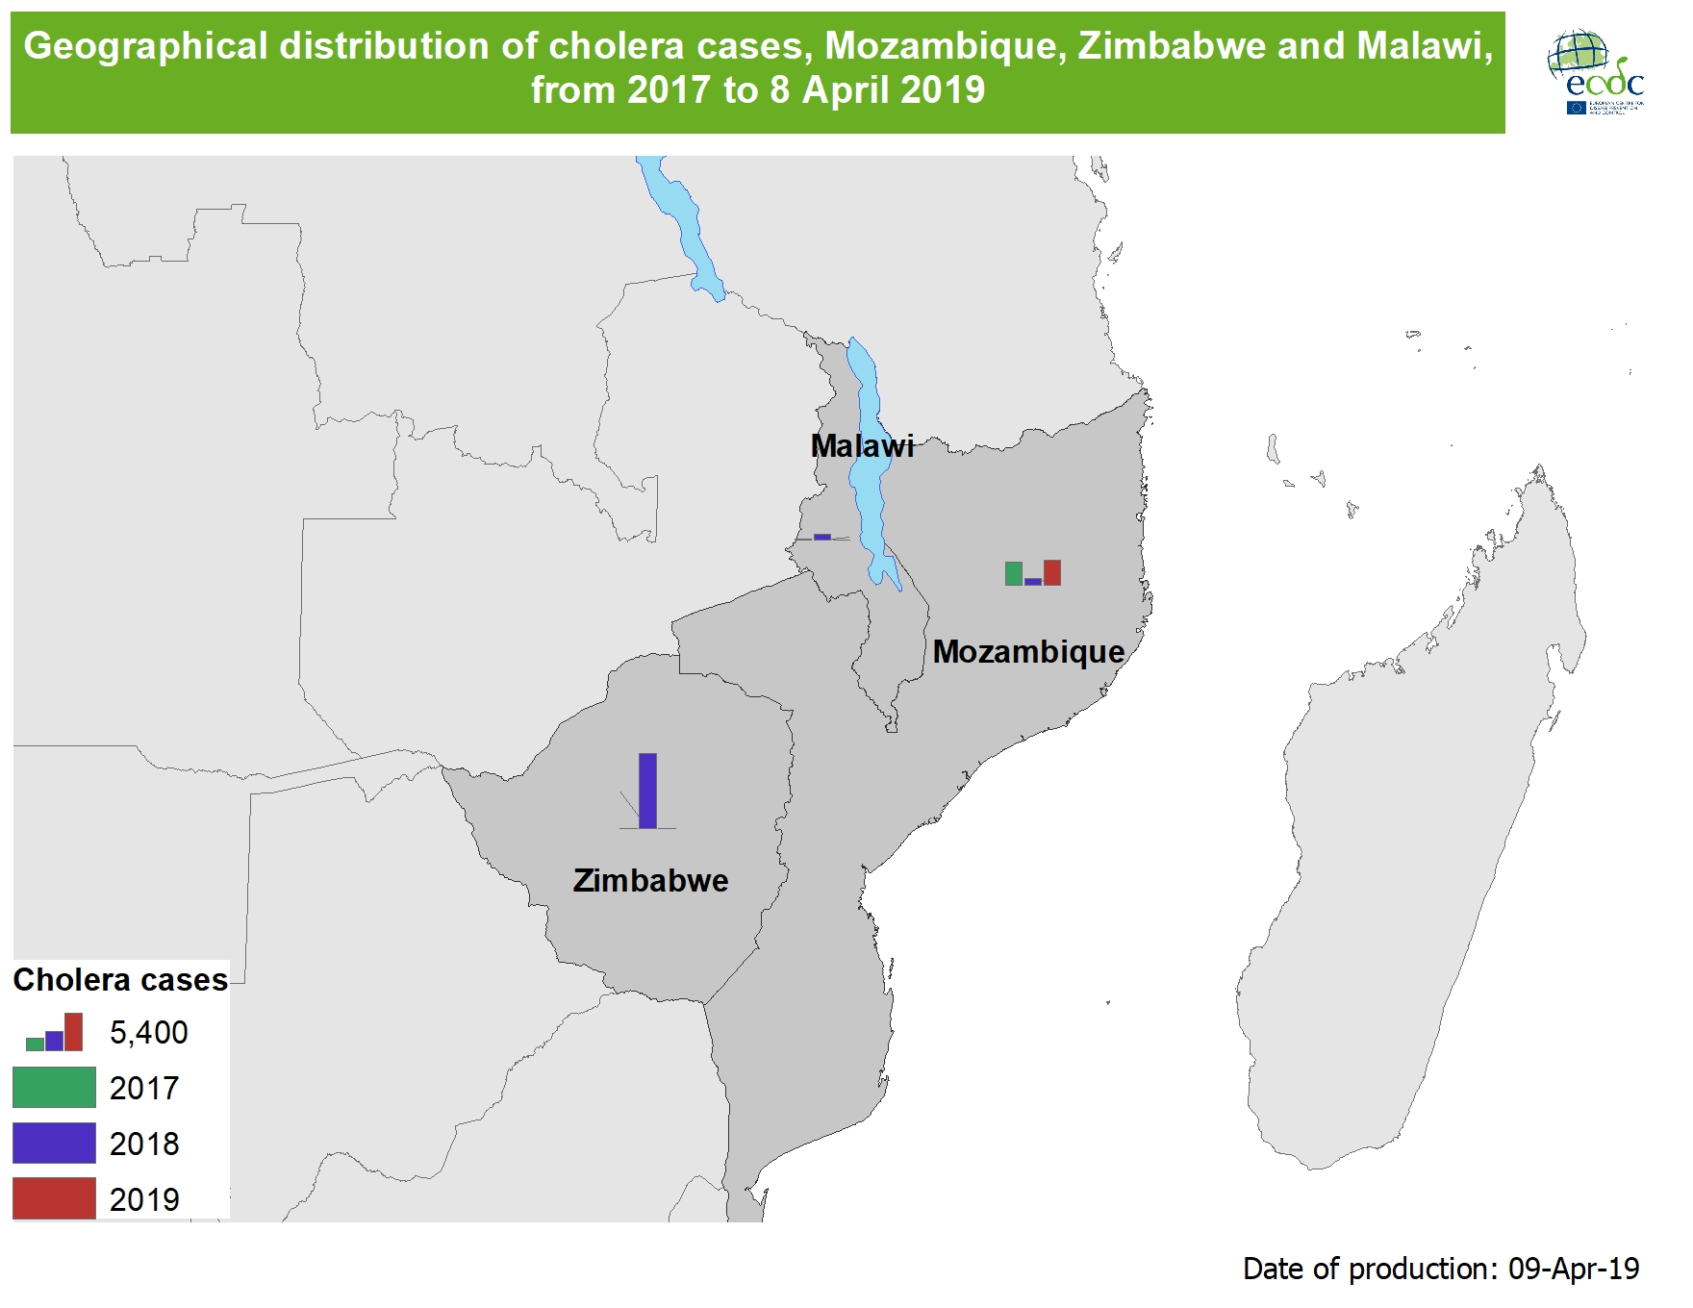

Slide 5
Measles monthly update

Slide 6
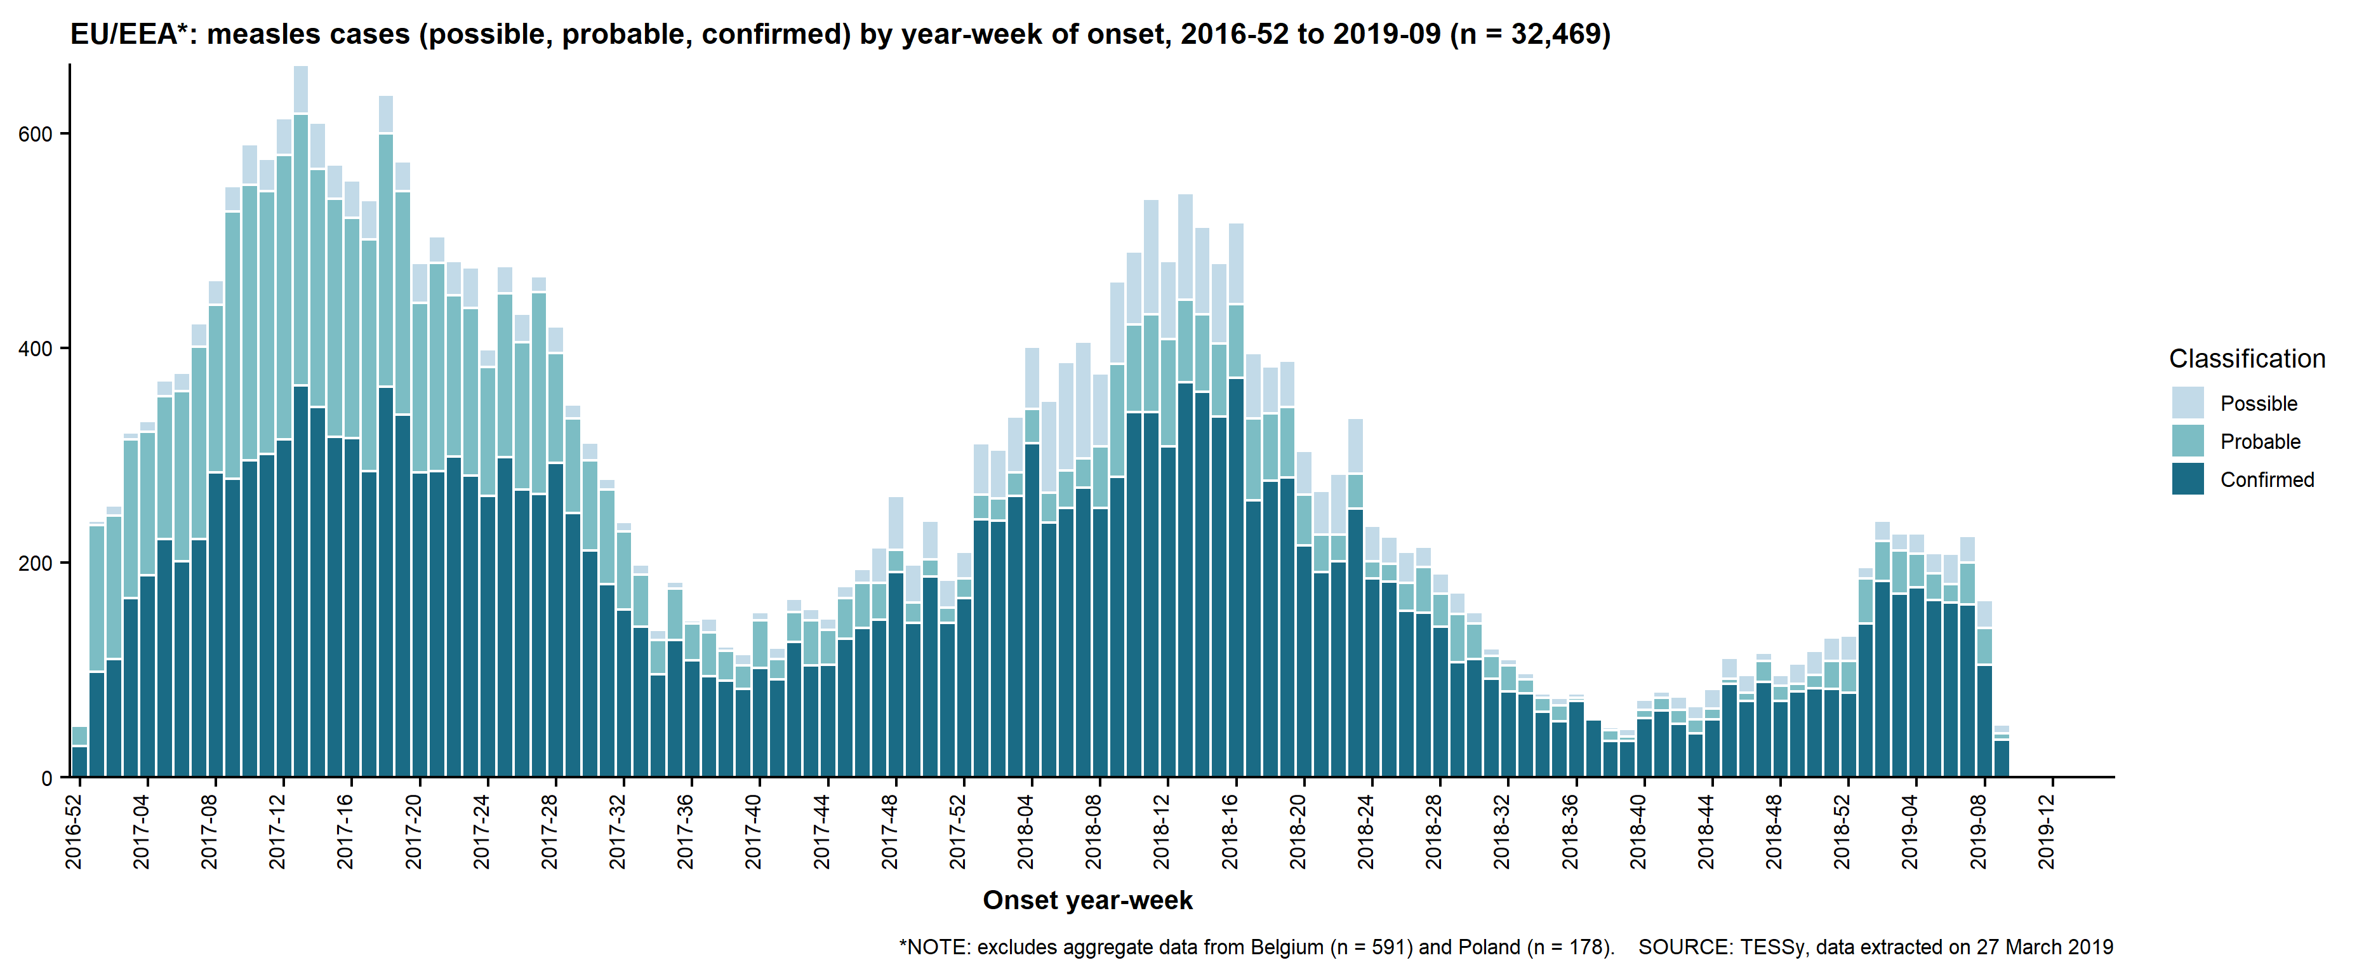
Distribution of measles cases in EU/EEA, January 2017–February 2019
Source: European Centre for Disease Prevention and Control. Communicable Disease Threats Report, 2019

Slide 7
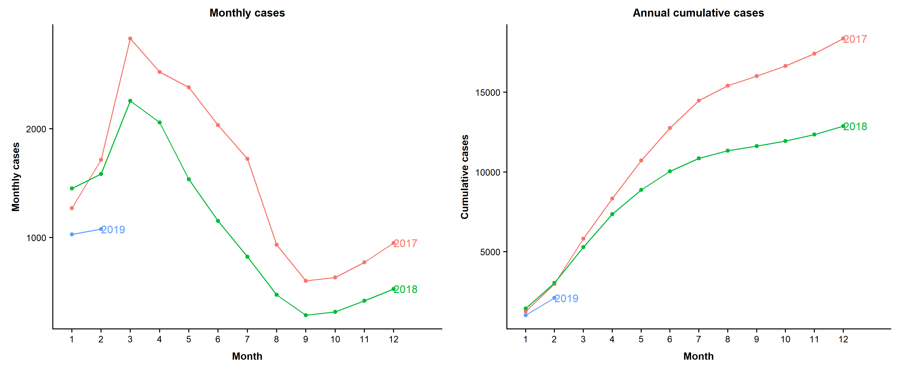
Distribution of measles cases in EU/EEA, January 2017–February 2019
Source: European Centre for Disease Prevention and Control. Communicable Disease Threats Report, 2019

Slide 8
Geographical distribution of measles cases in EU/EEA, February 2019
Source: European Centre for Disease Prevention and Control. Communicable Disease Threats Report, 2019

Slide 9
Annual deaths by country, January 2017–February 2019
Country | 2017 | 2018 | 2019 | Total
Romania | 24 | 22 | 1 | 47
Italy | 5 | 9 |  | 14
France | 1 | 3 |  | 4
Greece | 2 | 2 |  | 4
Bulgaria | 1 |  |  | 1
Germany | 1 |  |  | 1
Portugal | 1 |  |  | 1
EU/EEA | 35 | 36 | 1 | 72
2019: 3 recent deaths (2 in Romania, 1 in France) detected by epidemic intelligence that are not in TESSy
Source: European Centre for Disease Prevention and Control. Communicable Disease Threats Report, 2019

