Slide 1
Reusable maps and graphs from ECDC Communicable Disease Threats Report Week 17, 2019
You are encouraged to reuse our maps and graphs for your own purposes and free to translate, provided the content is not altered and the source is acknowledged.

Slide 2
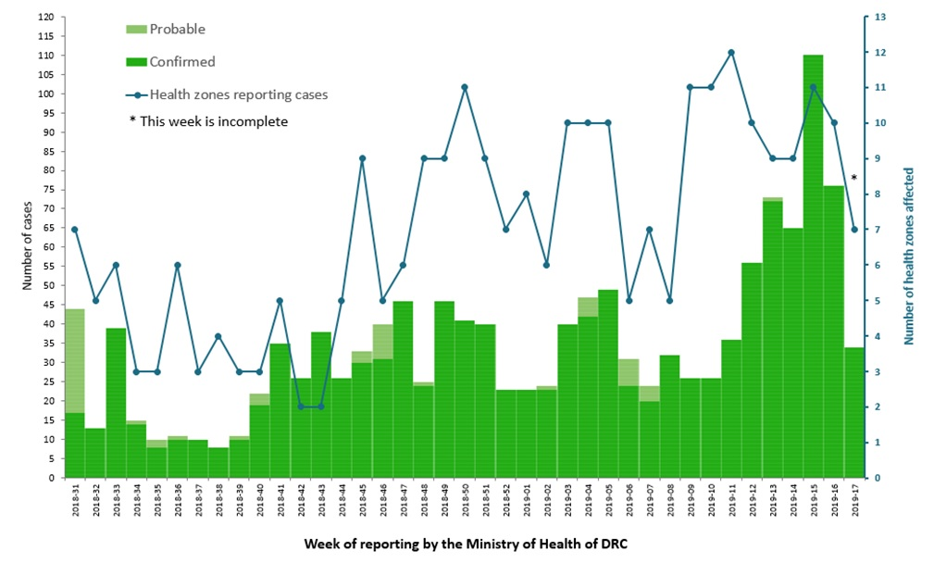
Distribution of confirmed and probable cases of Ebola virus disease and health zones reporting cases, North Kivu and Ituri Provinces, Democratic Republic of the Congo, as of 24 April 2019

Slide 3
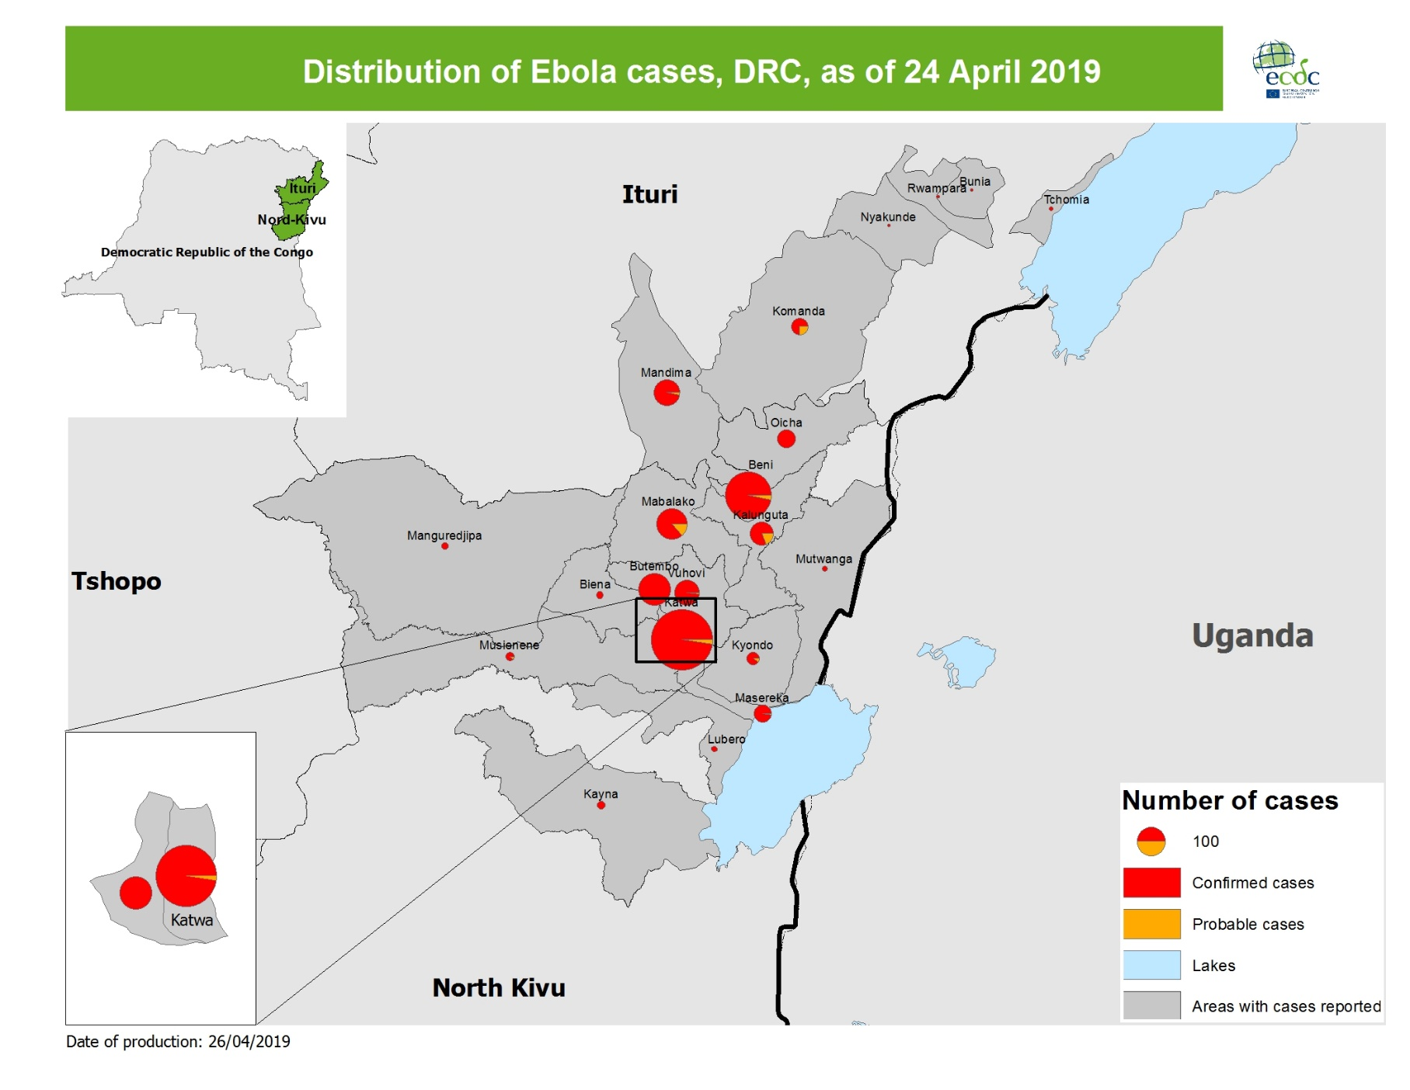
Geographical distribution of confirmed and probable cases of Ebola virus disease, North Kivu and Ituri Provinces, Democratic Republic of the Congo, as of 24 April 2019

Slide 4
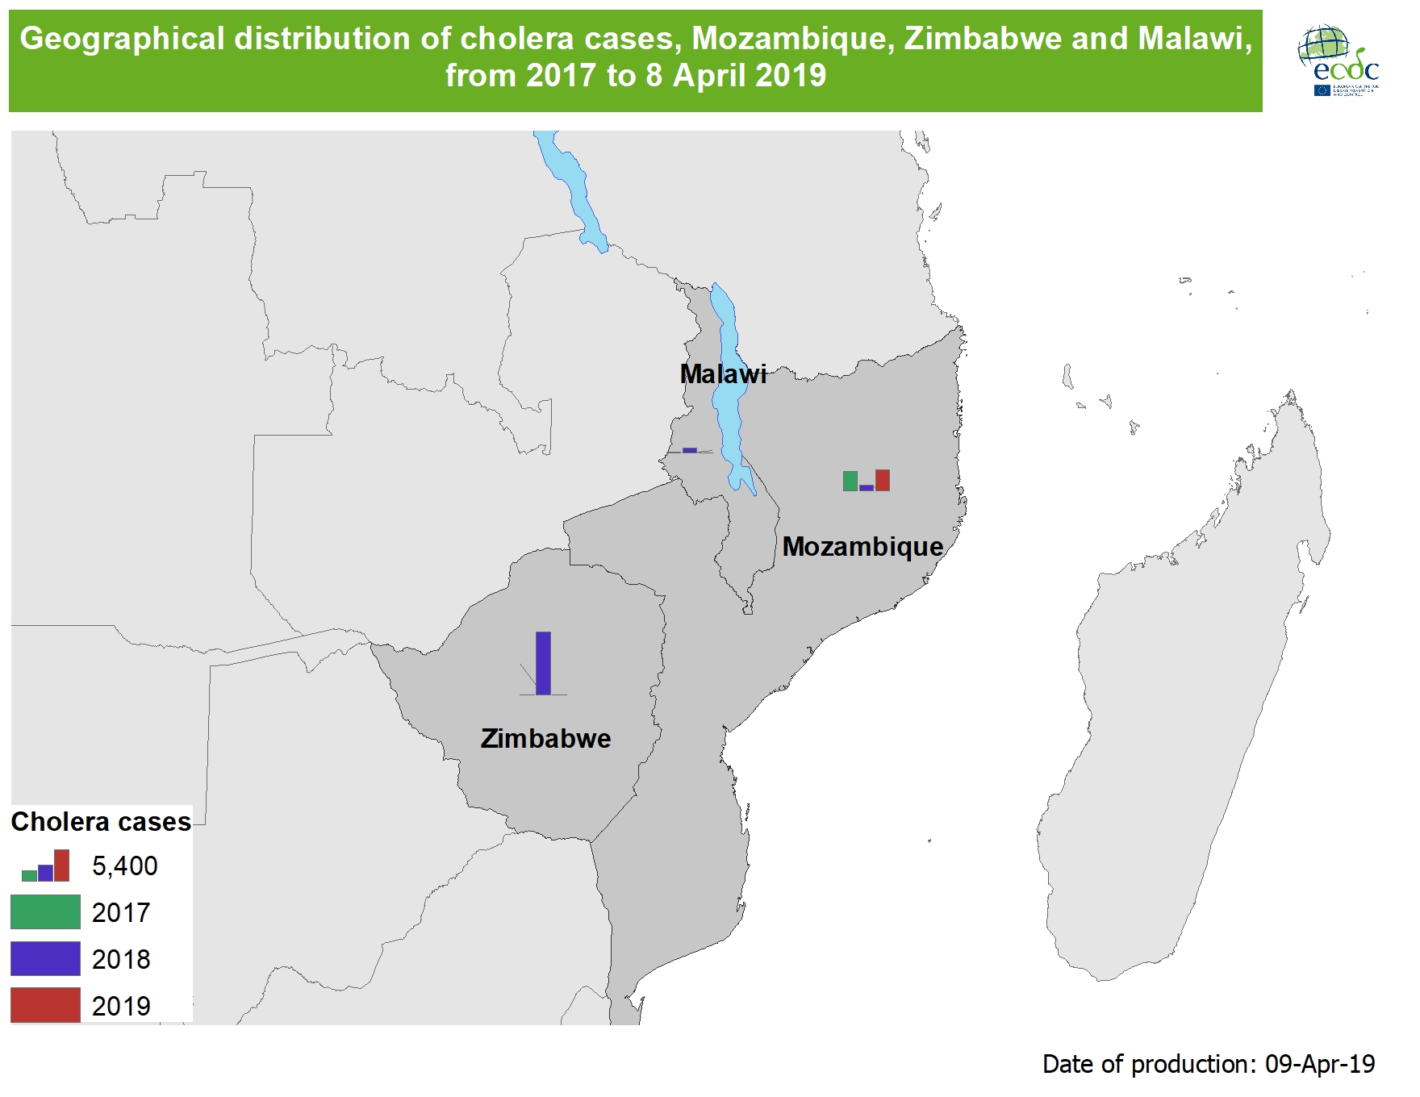

Slide 5
Geographical distribution of chikungunya virus disease cases reported worldwide, February–April 2019

Slide 6
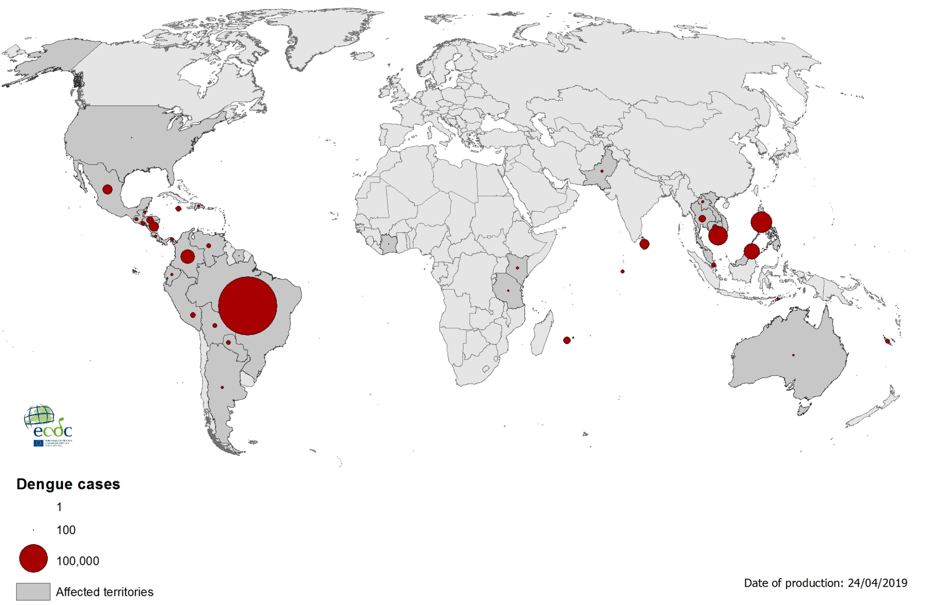
Geographical distribution of dengue cases reported worldwide, February–April 2019

Slide 7
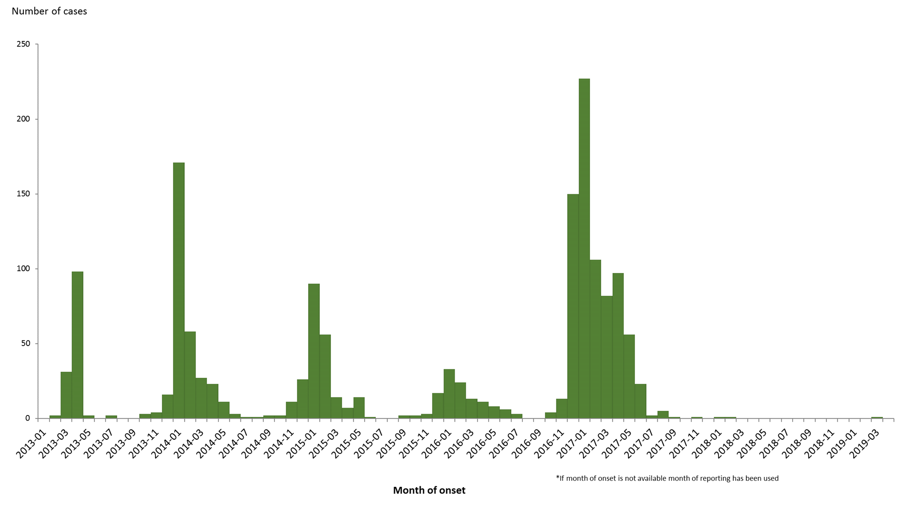
Distribution of confirmed cases of influenza A(H7N9) by first available month, February 2013–20 April 2019 (n= 1 568)

Slide 8
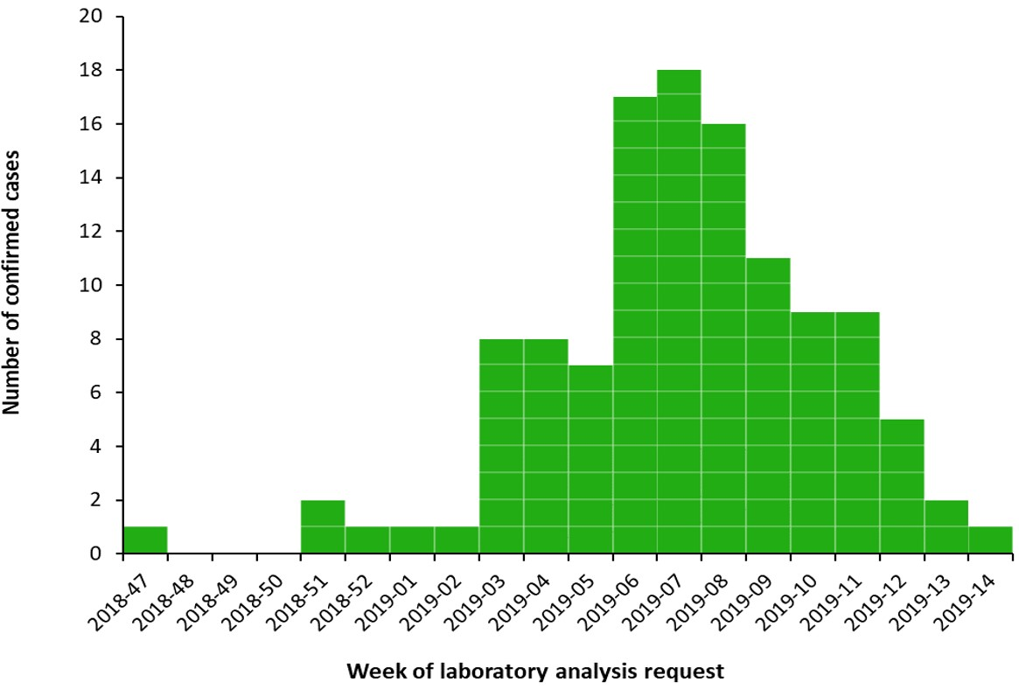
Distribution of confirmed human cases of Rift Valley fever in Mayotte by week of laboratory analysis request, 22 November 2018–22 April 2019

Slide 9
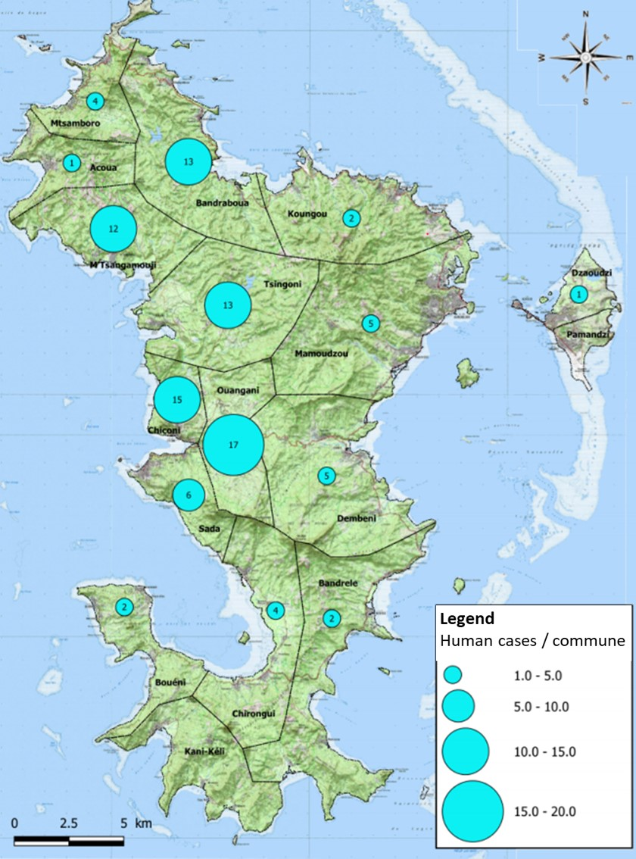
Geographic distribution of Rift Valley fever human cases (n=102 with known location) in Mayotte, 22 November 2018–18 April 2019

