Slide 1
Reusable maps and graphs from ECDC Communicable Disease Threats Report Week 19, 2019
You are encouraged to reuse our maps and graphs for your own purposes and free to translate, provided the content is not altered and the source is acknowledged.

Slide 2
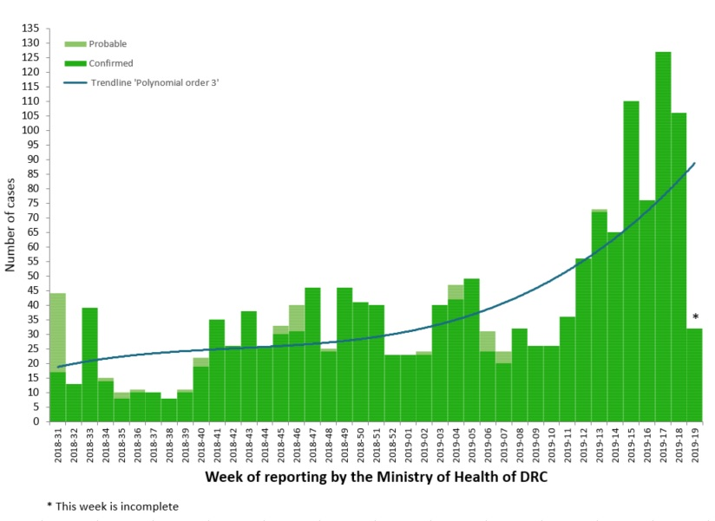
Distribution of confirmed and probable cases of Ebola virus disease and health zones reporting cases, North Kivu and Ituri Provinces, Democratic Republic of the Congo, as of 8 May 2019

Slide 3
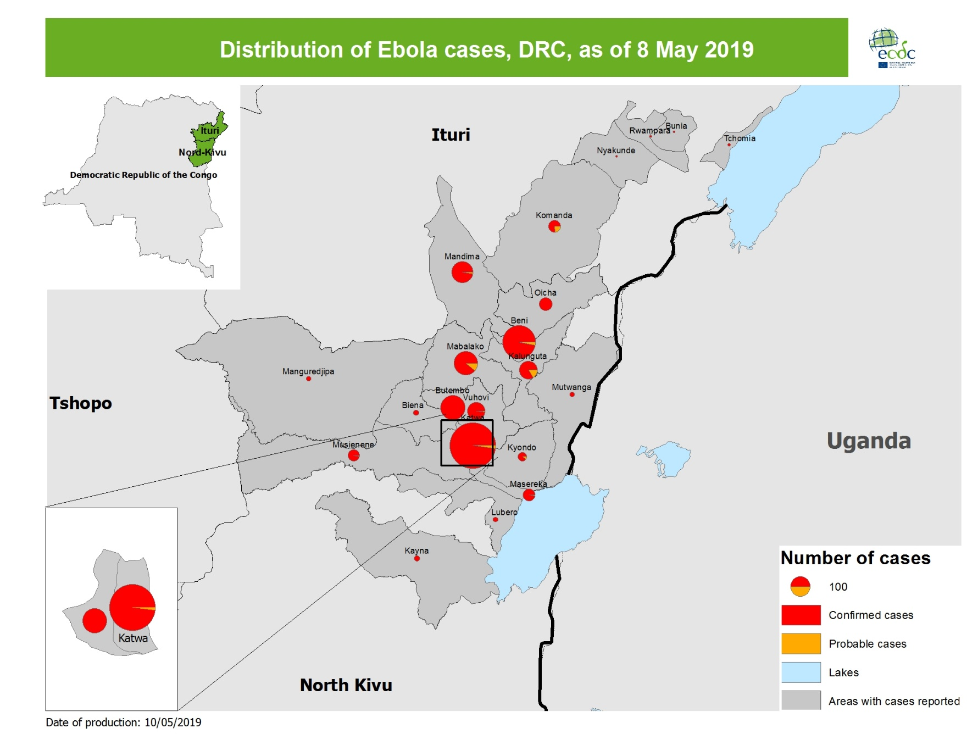
Geographical distribution of confirmed and probable cases of Ebola virus disease, North Kivu and Ituri Provinces, Democratic Republic of the Congo, as of 8 May 2019

Slide 4
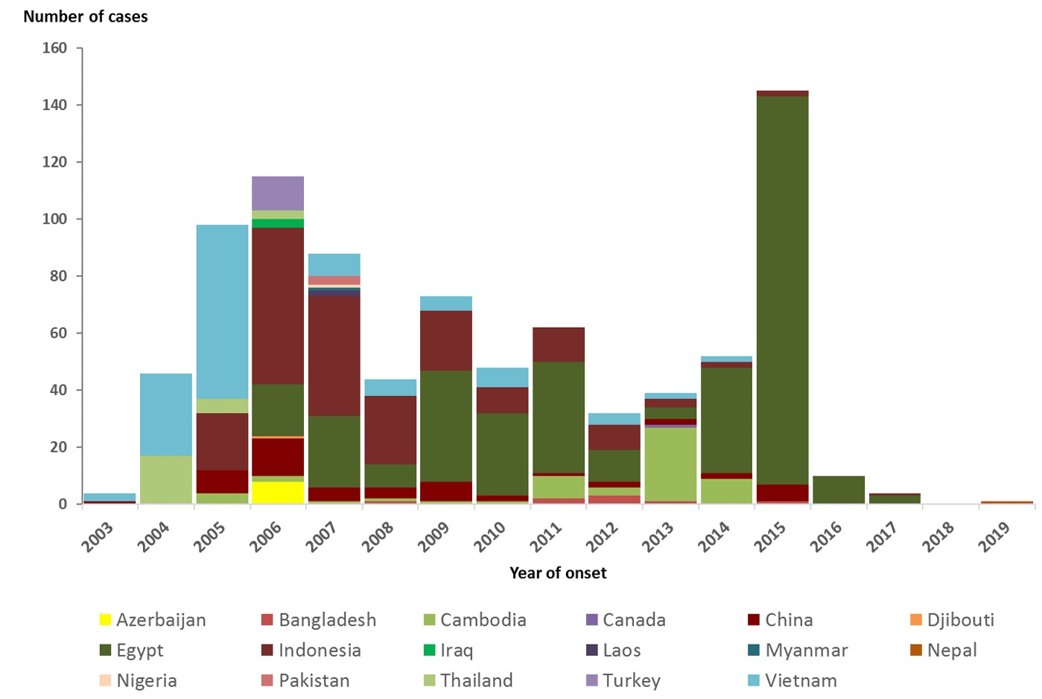
Distribution of confirmed human cases of A(H5N1) by year and country of reporting, 2003–2019, as of 2 May 2019
Source: adapted from WHO

Slide 5
Measles roundtable monthly update
8 May 2019 VPD and EI Teams

Slide 6
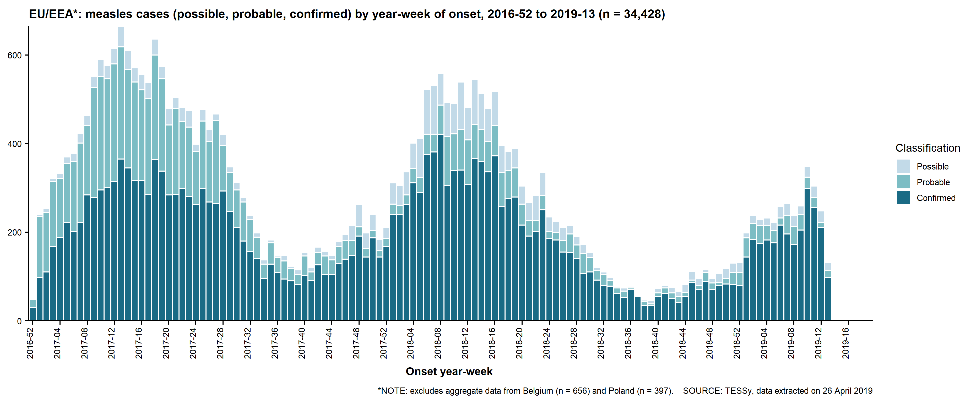
EU/EEA, weekly cases (case-based data), January 2017–March 2019

Slide 7
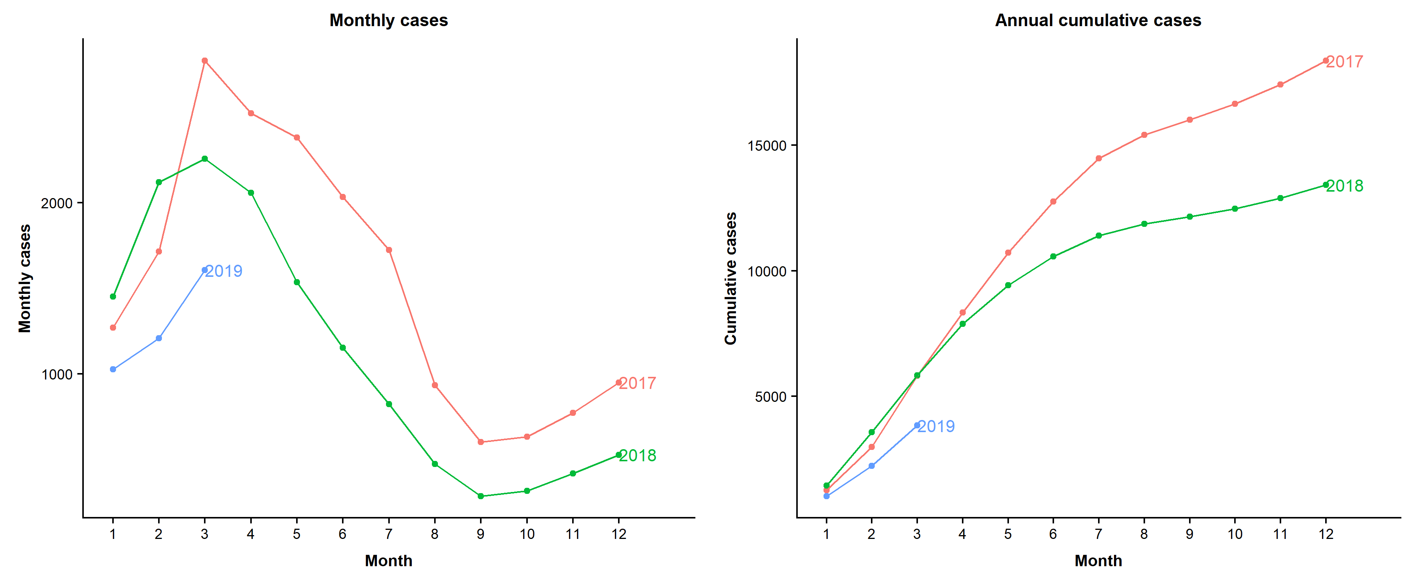
Seasonality and annual cumulative cases in TESSy, January 2017–March 2019

Slide 8
Annual deaths by country, January 2017–March 2019
Country | 2017 | 2018 | 2019 | Total
Romania | 24 | 22 | 1 | 47
Italy | 5 | 9 |  | 14
France | 1 | 3 |  | 4
Greece | 2 | 2 |  | 4
Bulgaria | 1 |  |  | 1
Germany | 1 |  |  | 1
Portugal | 1 |  |  | 1
EU/EEA | 35 | 36 | 1 | 72
According to epidemic intelligence, 5 deaths were reported in the EU in Romania (4) and France (1) in 2019.

Slide 9
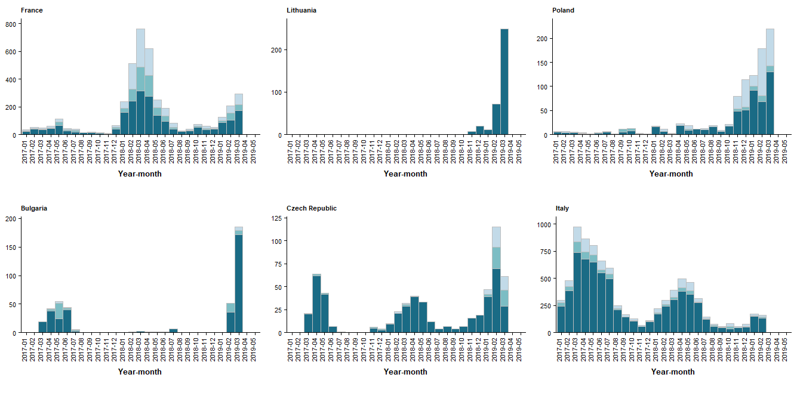
Ongoing outbreaks, 1 January 2017–31 March 2019
628 in 2019 (TESSy)
+ 224 extra (EI)
332 in 2019 (TESSy)
+ 237 extra (EI )
678 in 2019 (TESSy)
+ 158 extra (EI )
332 in 2019 (TESSy)
+ 225 extra (EI, to 31 Mar only)
236 in 2019 (TESSy)
+ 261 extra (EI )
223 in 2019 (TESSy)
+ 223 extra (EI )

Slide 10
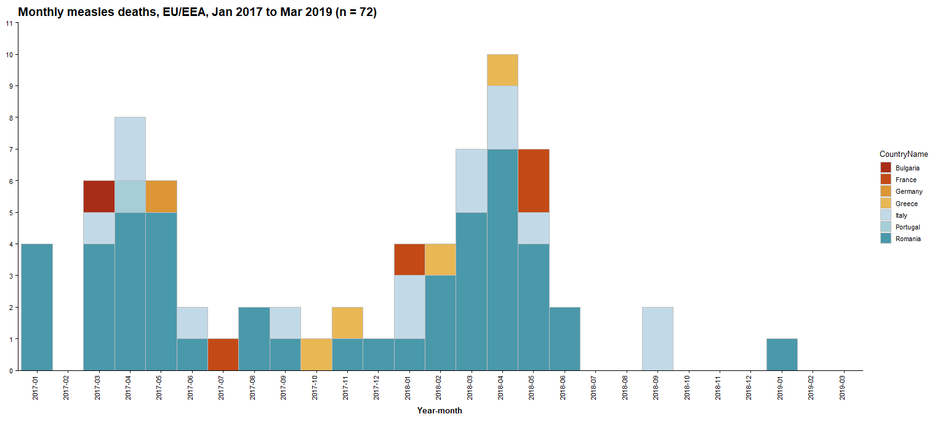
Monthly deaths by country, January 2017–March 2019

