Slide 1
Reusable maps and graphs from ECDC Communicable Disease Threats Report Week 2, 2024
You are encouraged to reuse our maps and graphs for your own purposes and are free to translate them, provided the content is not altered and the source is acknowledged.

Slide 2
Proportion of sequences belonging to BA.2.86 lineages per sample collection week, reported by EU/EEA countries to GISAID EpiCoV as of 8 January 2024

Slide 3
Diphtheria cases reported to TESSy by pathogen and month of reporting, January 2022 – December 2023

Slide 4
Geographical distribution of confirmed MERS-CoV cases by country of infection and year, from April 2012 to December 2023

Slide 5
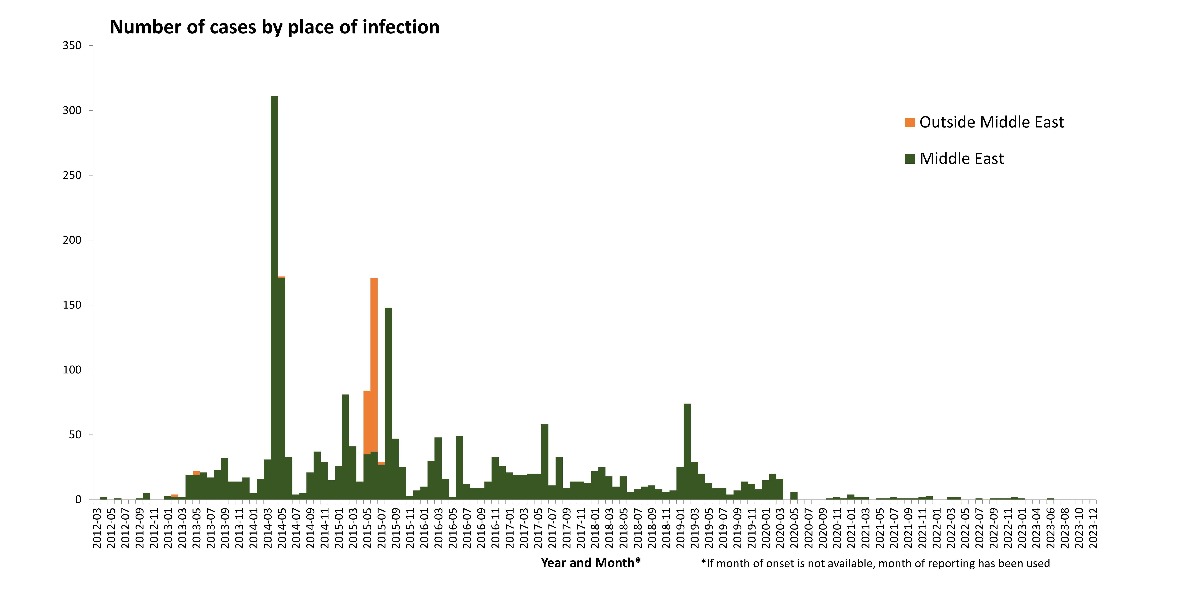
Distribution of confirmed cases of MERS-CoV by place of infection and month of onset, March 2012– 10 January 2024

