Slide 1
Reusable maps and graphs from ECDC Communicable Disease Threats Report Week 23, 2020
You are encouraged to reuse our maps and graphs for your own purposes and free to translate, provided the content is not altered and the source is acknowledged.

Slide 2
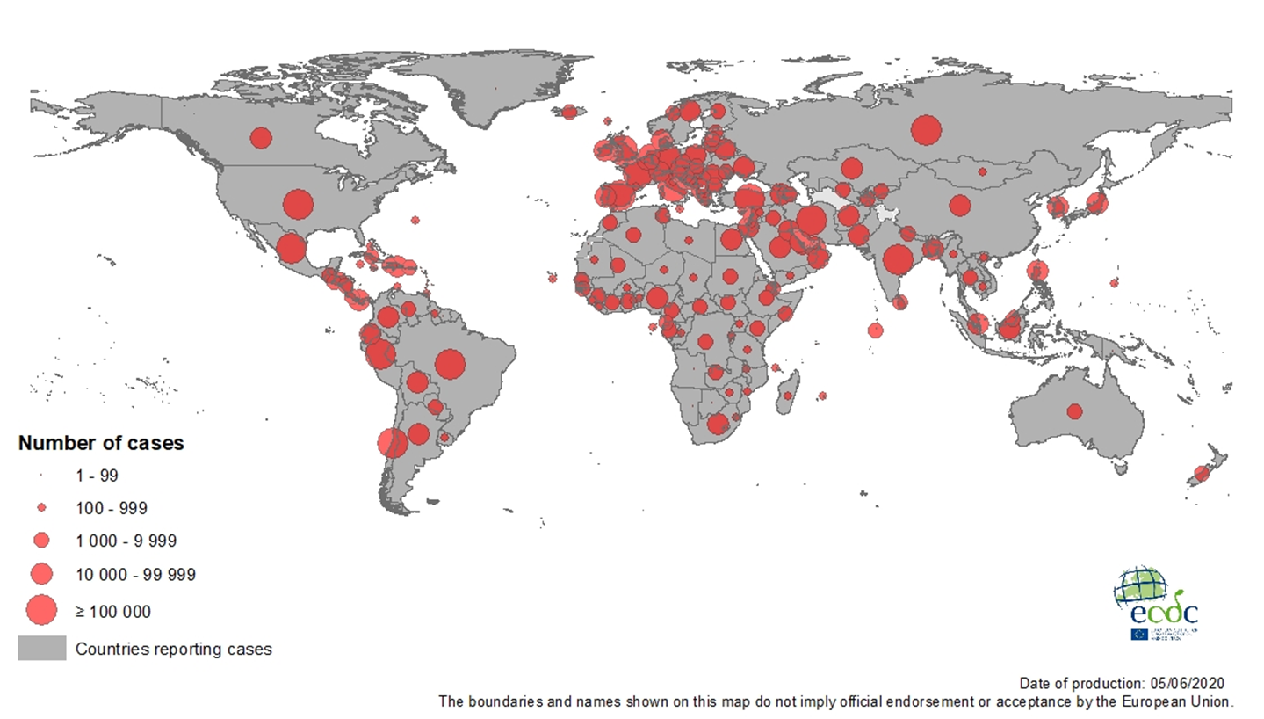
Geographical distribution of COVID-19 cases (in accordance with the applied case definition in the country), as of 5 June 2020

Slide 3
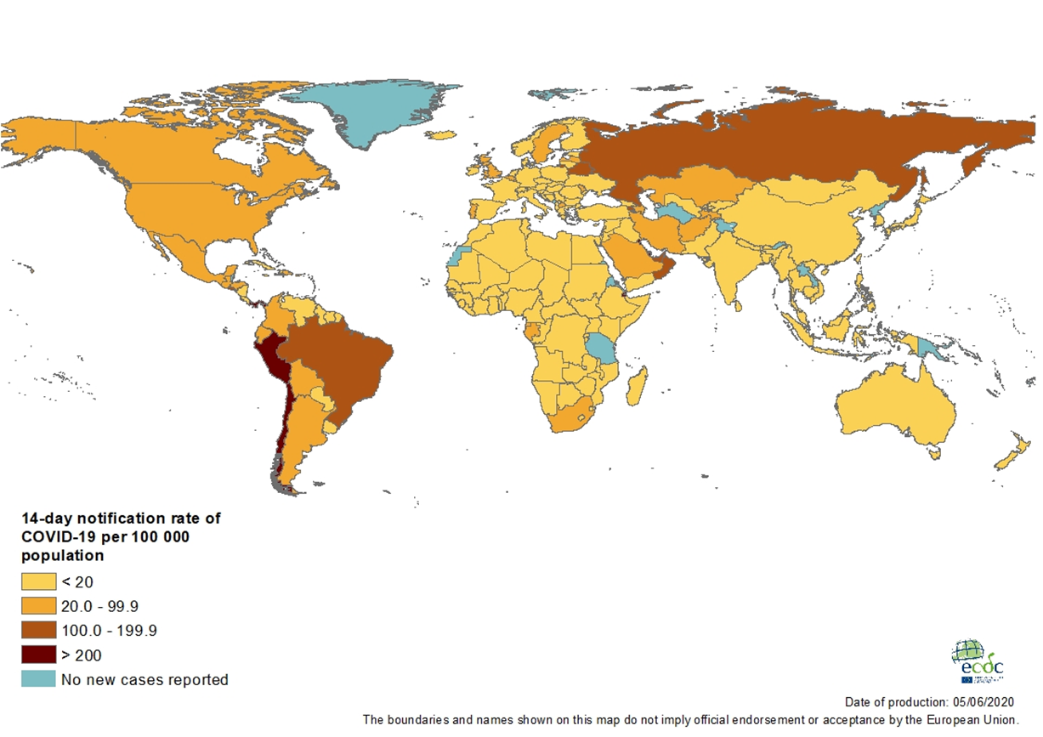
Geographic distribution of 14-day cumulative number of reported COVID-19 cases per 100 000 population, worldwide, as of 5 June 2020

Slide 4
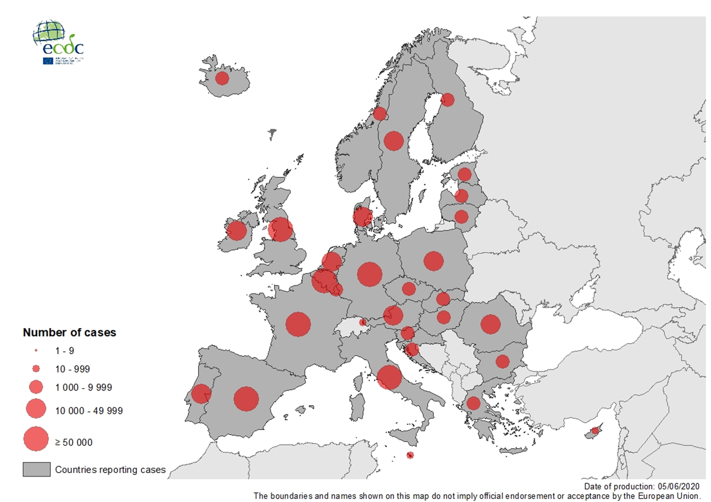
Geographic distribution of laboratory confirmed COVID-19 cases in the EU/EEA and the UK, as of 5 June 2020

Slide 5
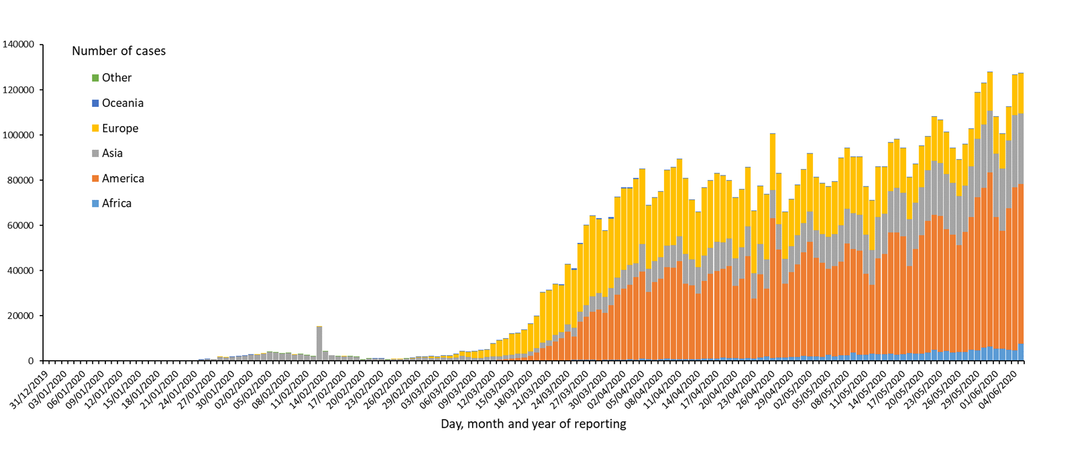
Distribution of COVID-19 cases* (in accordance with the applied case definition in the country) by country and region, as of 5 June 2020
*Spain: Since 11 May, the frequency of reporting from regional level to national level has changed. This may lead to possible discrepancies in cases and death numbers due to data validation. This discrepancy could persist for several days.

Slide 6
Distribution of COVID-19 deaths (in accordance with the applied case definition in the country) by country and region, as of 05 June 2020
*
* Increase of deaths in America is attributable to the US, which since 14 April 2020 includes confirmed and probable cases and deaths:
https://www.cdc.gov/coronavirus/2019-ncov/cases-updates/cases-in-us.html#2019coronavirus-summary
** Spain: Since 11 May, the frequency of reporting from regional level to national level has changed. This may lead to possible discrepancies in cases and death numbers due to data validation. This discrepancy could persist for several days.
In the displayed graph no new deaths are reported for Spain from the 25 of May as the change in reported deaths would result in a negative number of deaths for Europe overall.

Slide 7
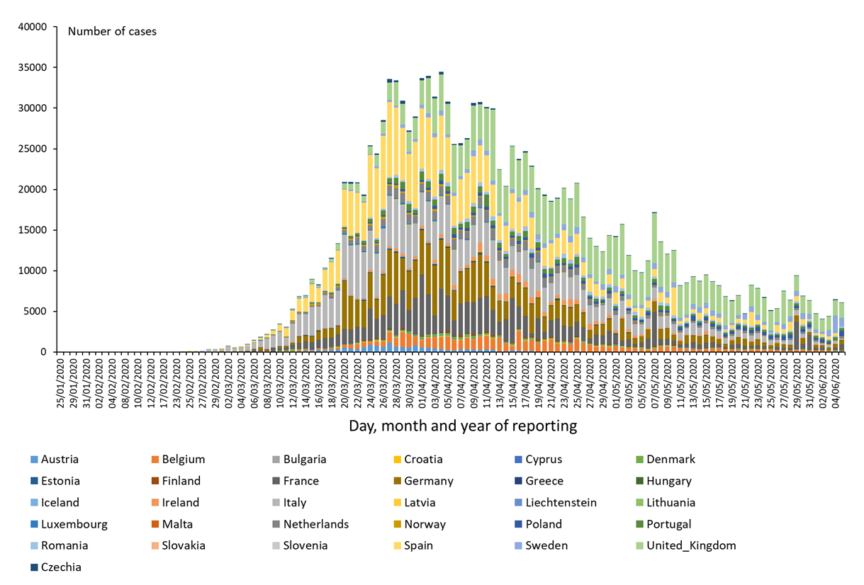
Distribution of COVID-19 cases* (according to the applied case definition in the country) in EU/EEA and the UK, as of 5 June 2020
*Spain: Since 11 May, the frequency of reporting from regional level to national level has changed. This may lead to possible discrepancies in cases and death numbers due to data validation. This discrepancy could persist for several days.

Slide 8
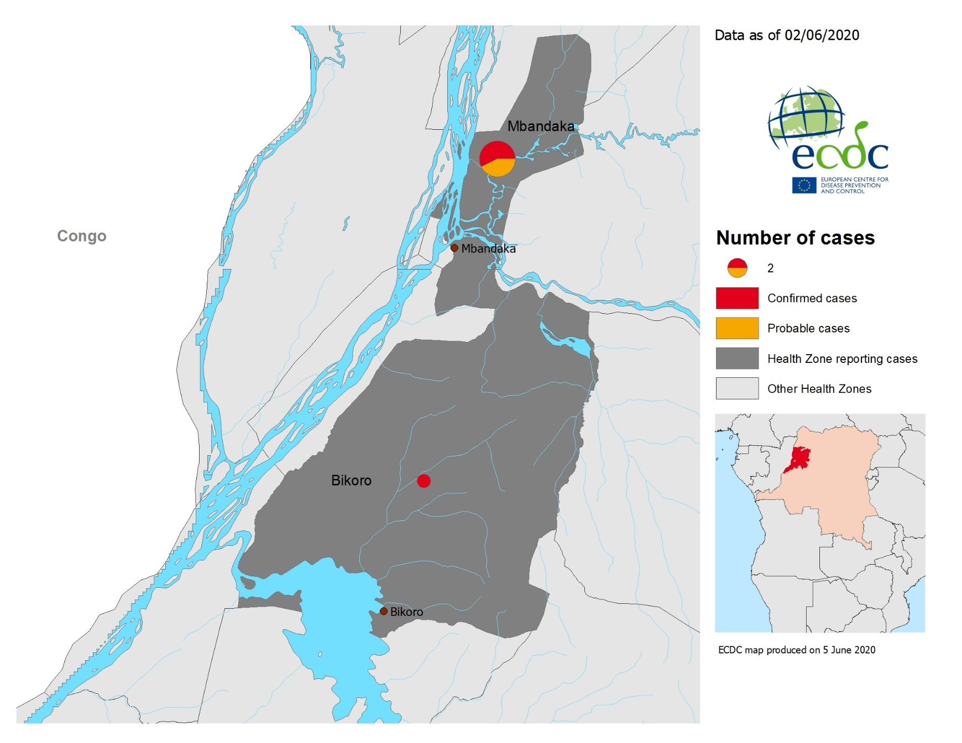
Geographical distribution of confirmed and probable cases of Ebola virus disease, Equateur Province, Democratic Republic of the Congo, as of 2 June 2020

Slide 9
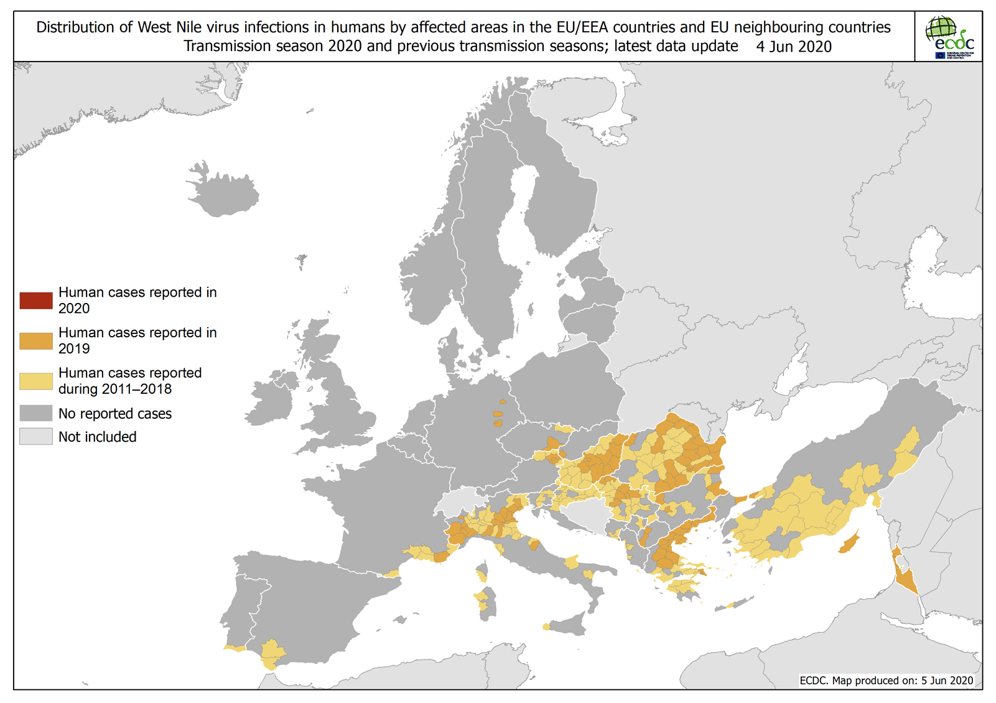
Distribution of West Nile virus infections in humans by affected areas in the EU/EEA countries and EU neighbouring countries, as of 4 June 2020

Slide 10
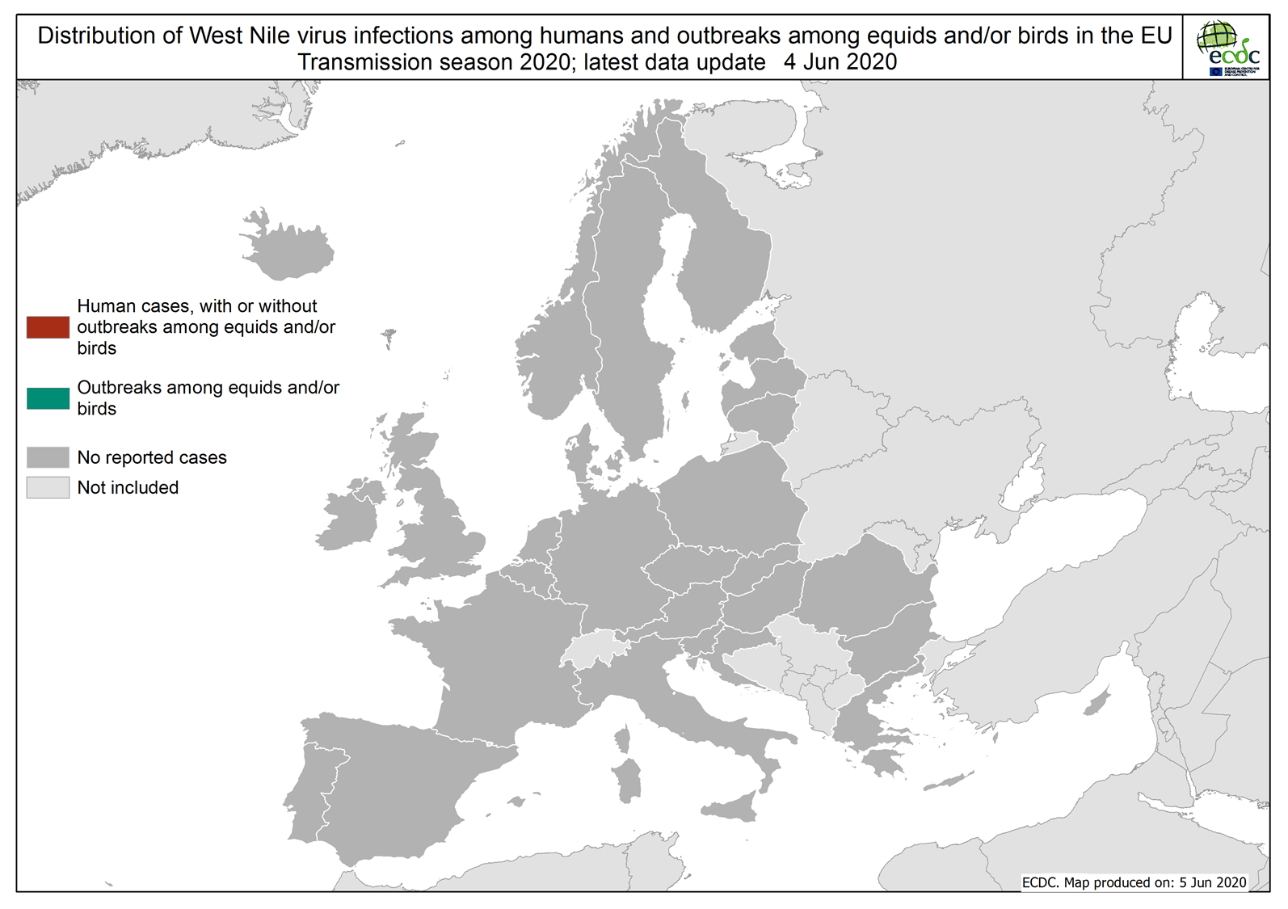
Distribution of West Nile virus infections among humans and outbreaks among equids and/or birds in the EU, as of 4 June 2020

