Slide 1
You are encouraged to reuse our maps and graphs for your own purposes and free to translate, provided the content is not altered and the source is acknowledged. Either copy the images from the following slides or download directly from: ecdc.europa.eu/en/publications/surveillance_reports/Communicable-Disease-Threats-Report/Pages/cdtr.aspx
European Centre for Disease Prevention and Control
Reusable maps and graphs from ECDC Communicable Disease Threats Report, week 26, 2017

Slide 2
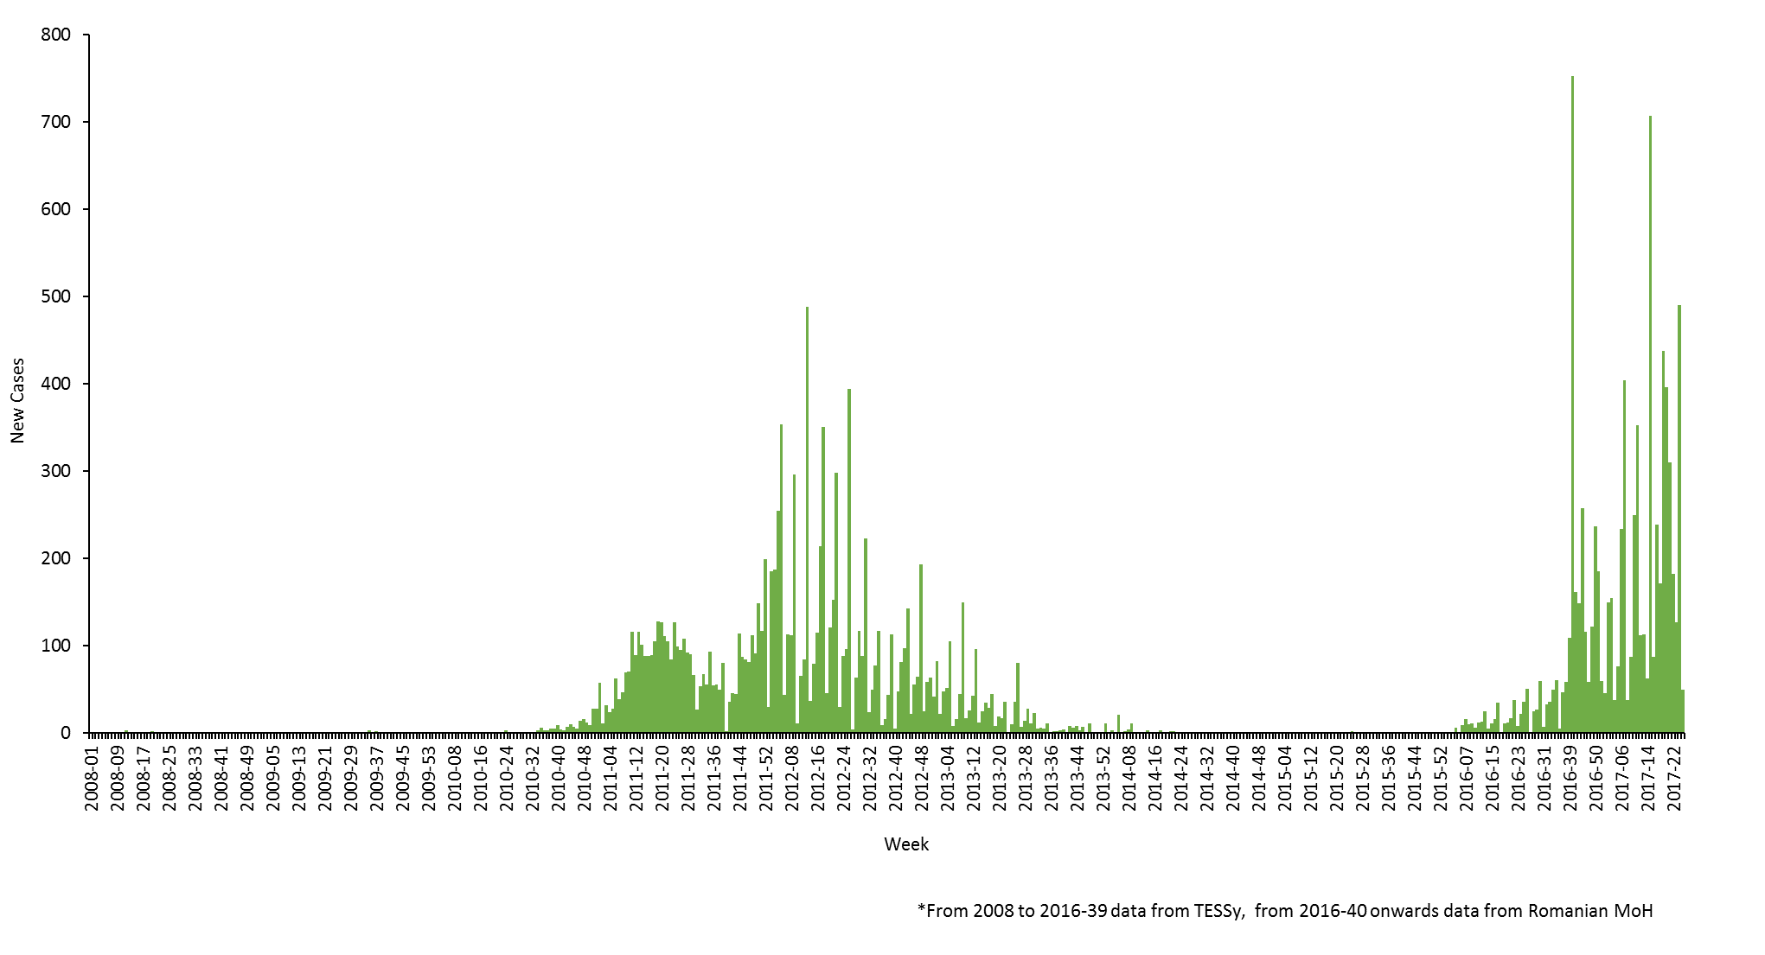
New measles cases per week of reporting, week 2008-1 to 2017-25, Romania

Slide 3
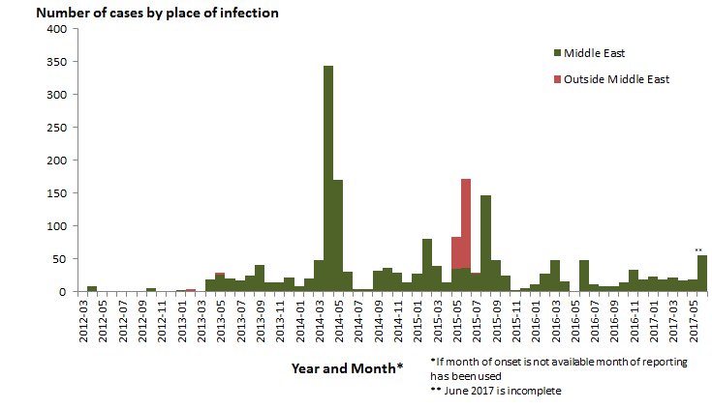
Distribution of confirmed cases of MERS-CoV by first available month and place of infection, March 2012 - 30 June 2017

Slide 4
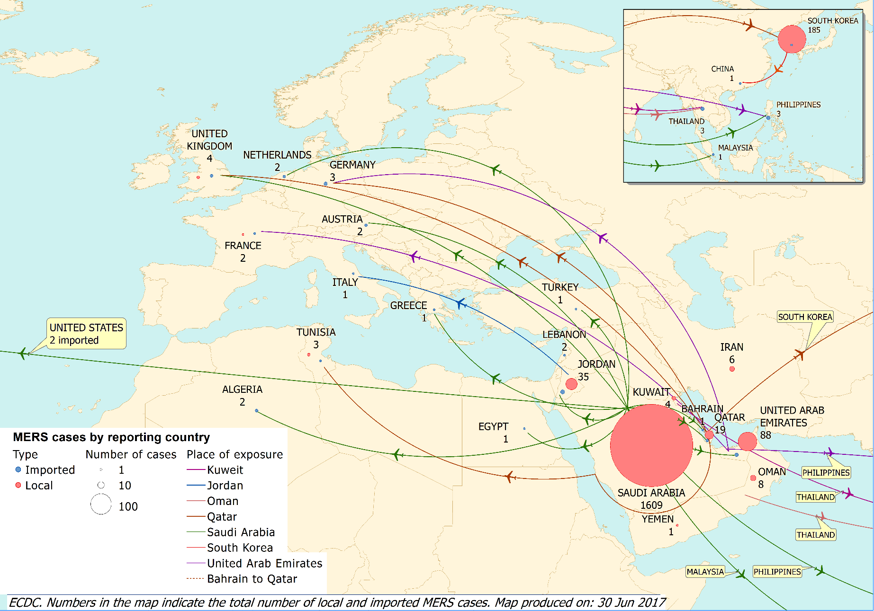
Distribution of confirmed cases of MERS-CoV by reporting country and place of probable infection, March 2012 - 30 June 2017

Slide 5
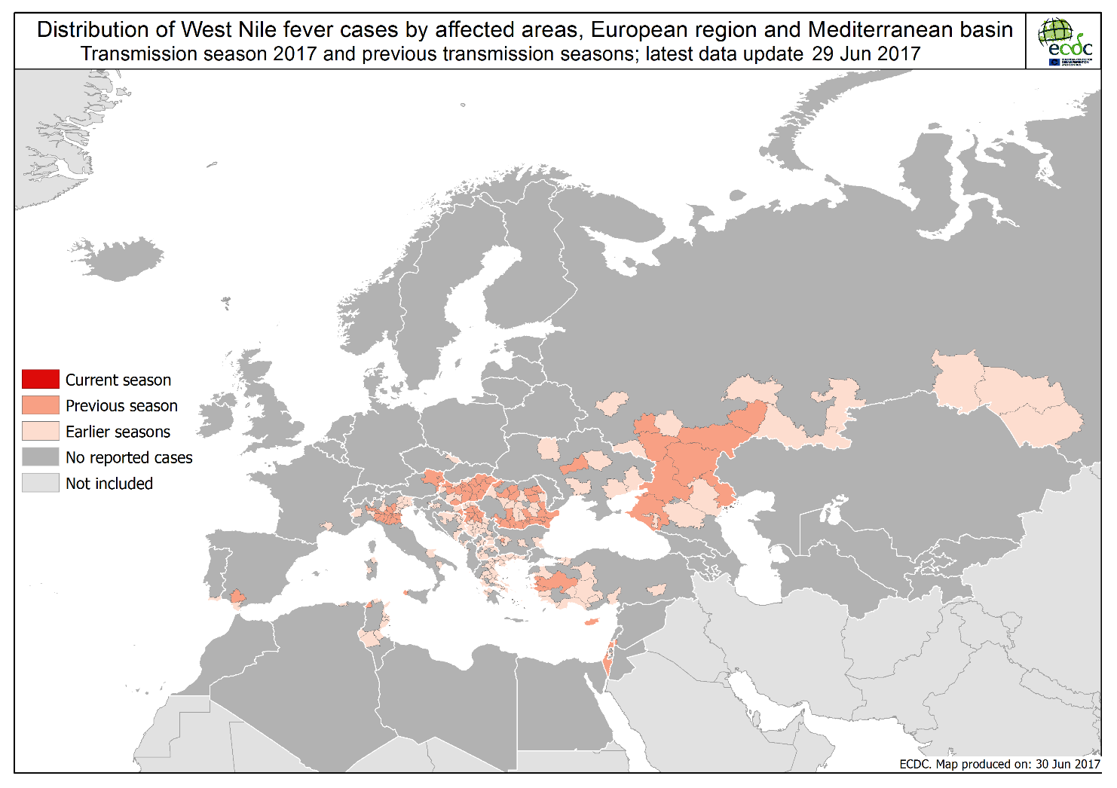

Slide 6
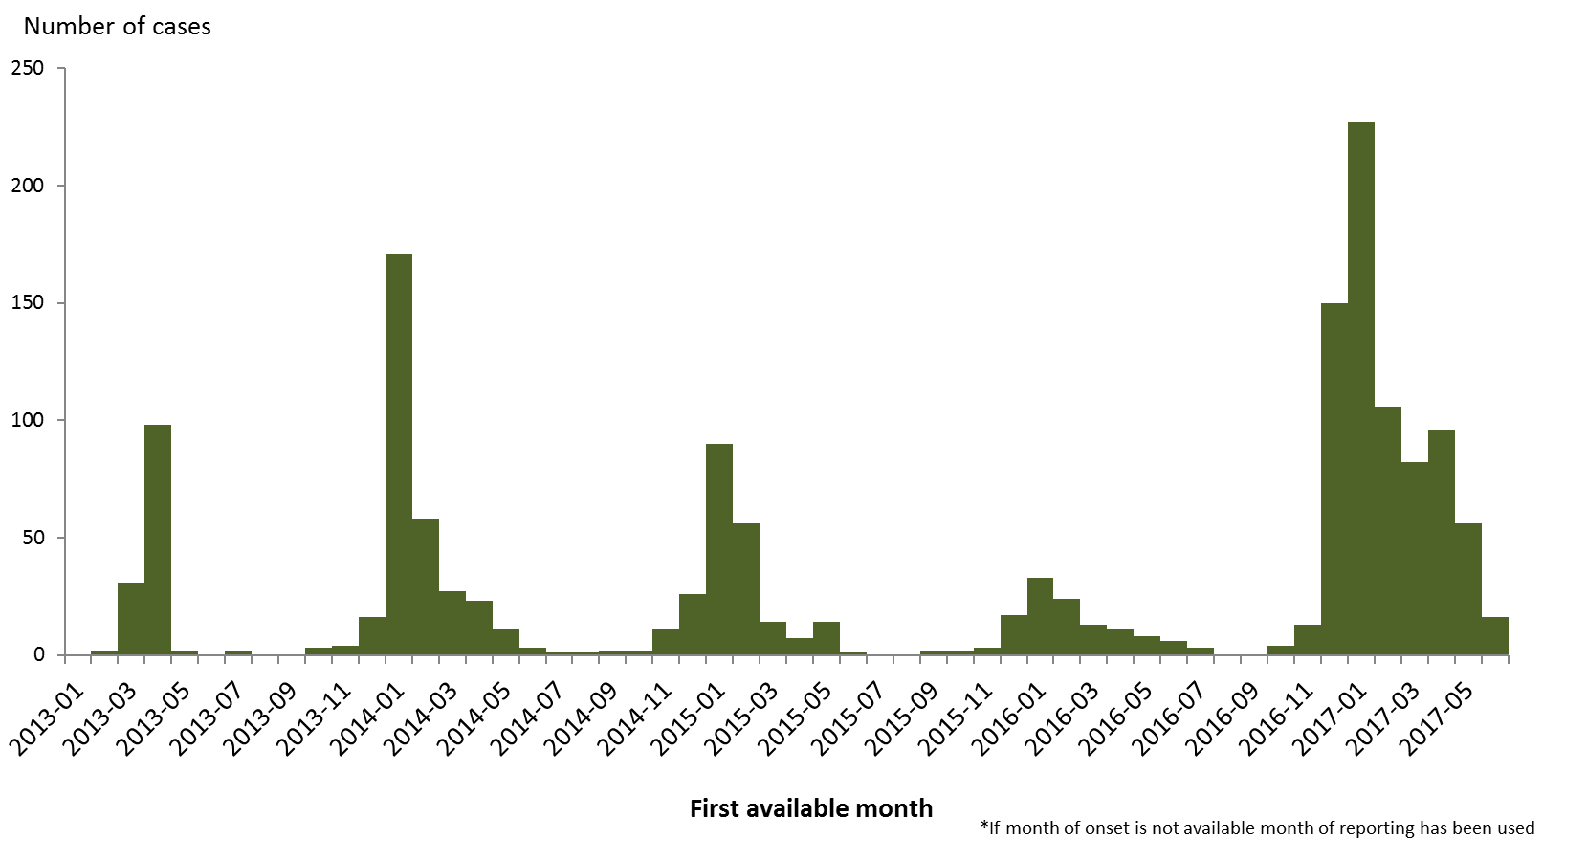
Distribution of confirmed cases of A(H7N9) by month of reporting, February 2013 to 29 June 2017**
**
** Data as of 29 June 2017

Slide 7
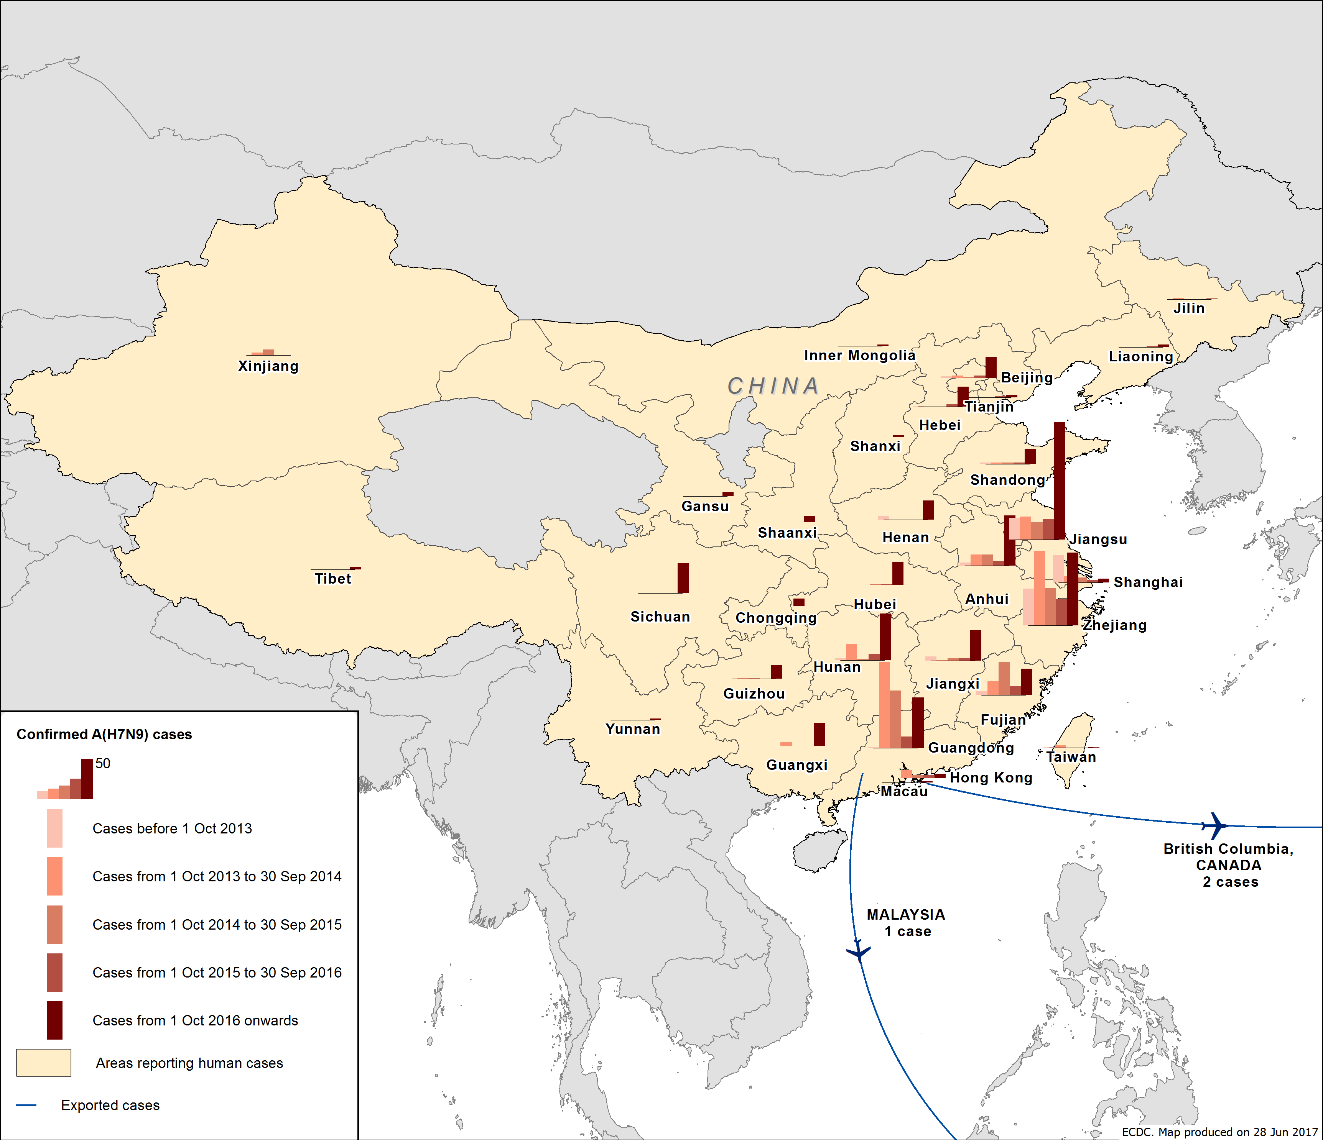
Distribution of confirmed cases of A(H7N9) by five waves, February 2013 to 29 June 2017

Slide 8
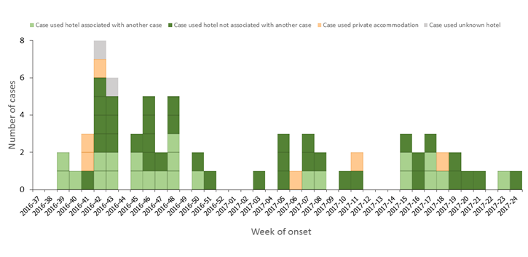
Distribution of travel-associated Legionnaires' disease cases with history of stay in Dubai, United Arab Emirates, by week of onset and accommodation site clustering, weeks 37/2016–24/2017, as reported to ELDSNet by 28 June 2017 (n=67 cases)

Slide 9
Countries and territories with reported confirmed autochthonous vector-borne transmission worldwide of Zika virus infection as of 21 June 2017

Slide 10
Countries and territories in the Caribbean with reported confirmed autochthonous vector-borne transmission worldwide of Zika virus infection as of 21 June 2017

Slide 11
Countries and territories in South East Asia with reported confirmed autochthonous vector-borne transmission worldwide of Zika virus infection as of 21 June 2017

