Slide 1
You are encouraged to reuse our maps and graphs for your own purposes and free to translate, provided the content is not altered and the source is acknowledged.
Reusable maps and graphs from ECDC Communicable Disease Threats Report
Week 38, 2018

Slide 2
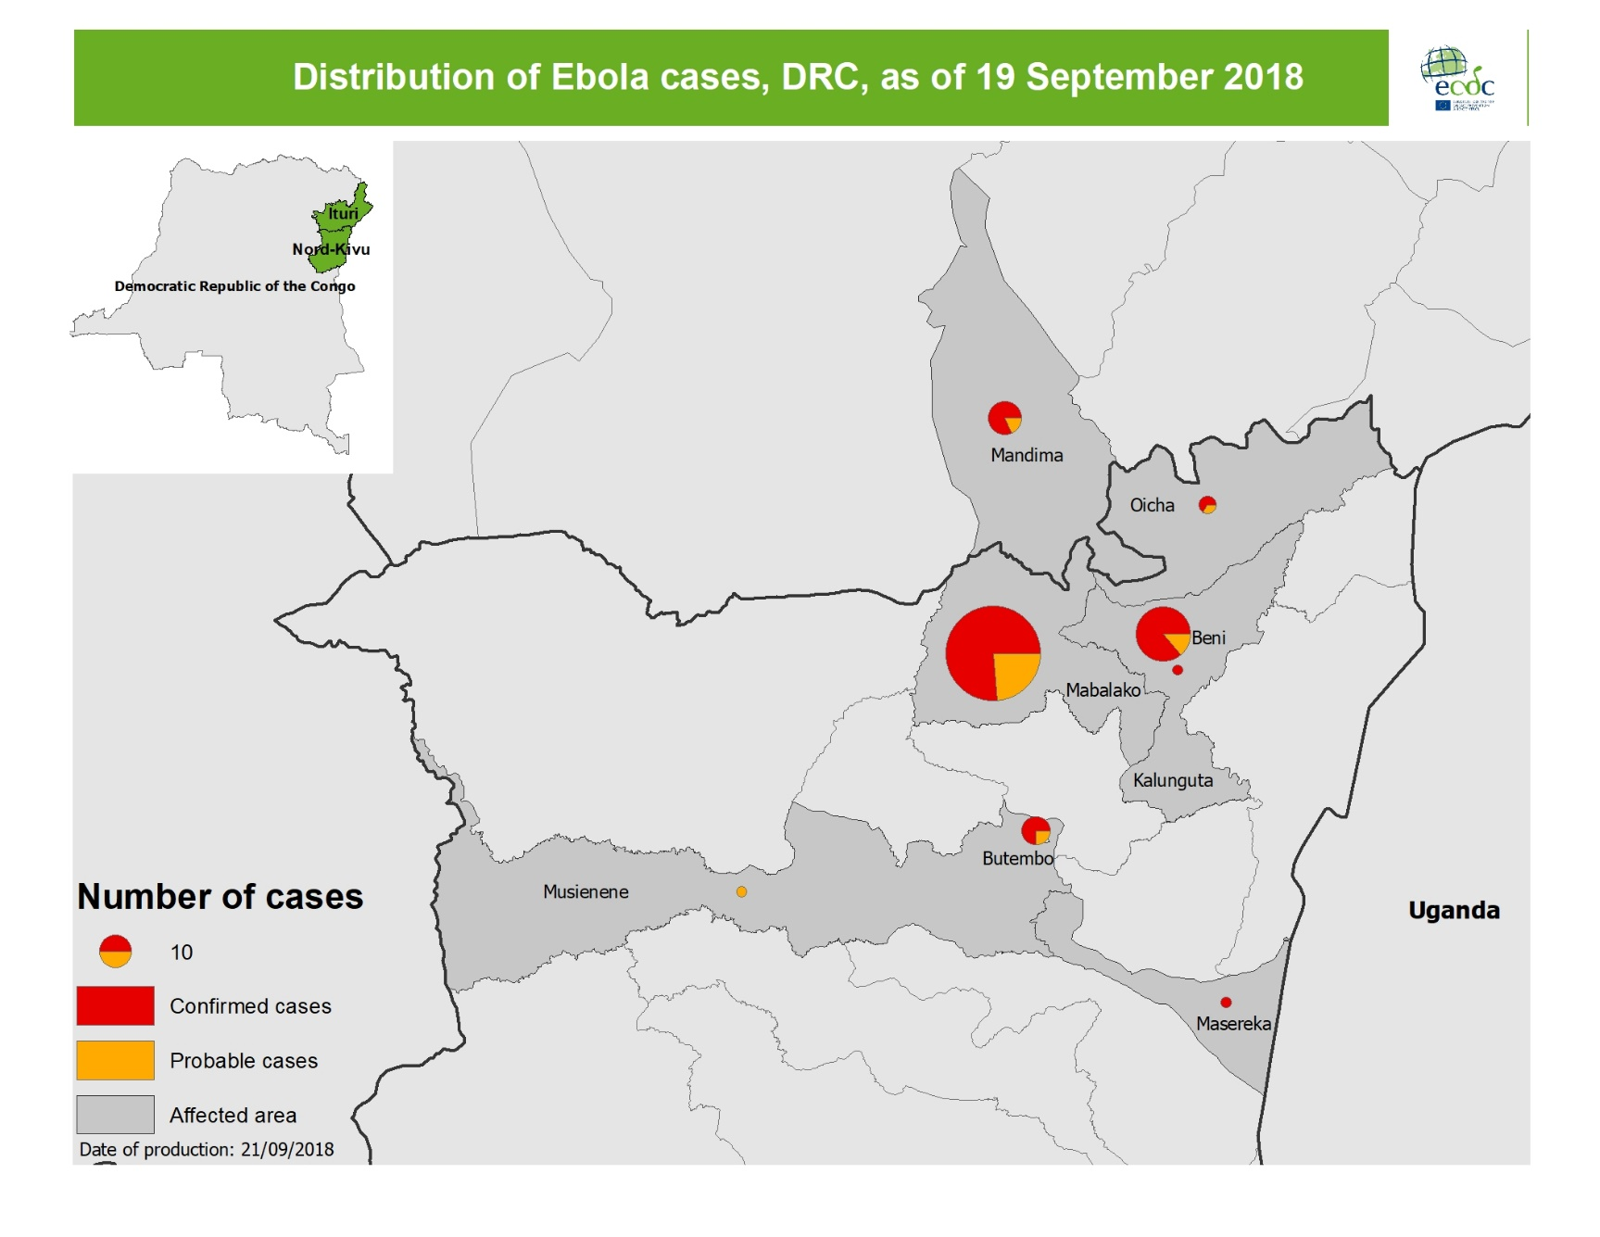
Geographical distribution of confirmed and probable cases of Ebola virus disease, North Kivu and Ituri Provinces, Democratic Republic of the Congo, as of 19 September 2018

Slide 3
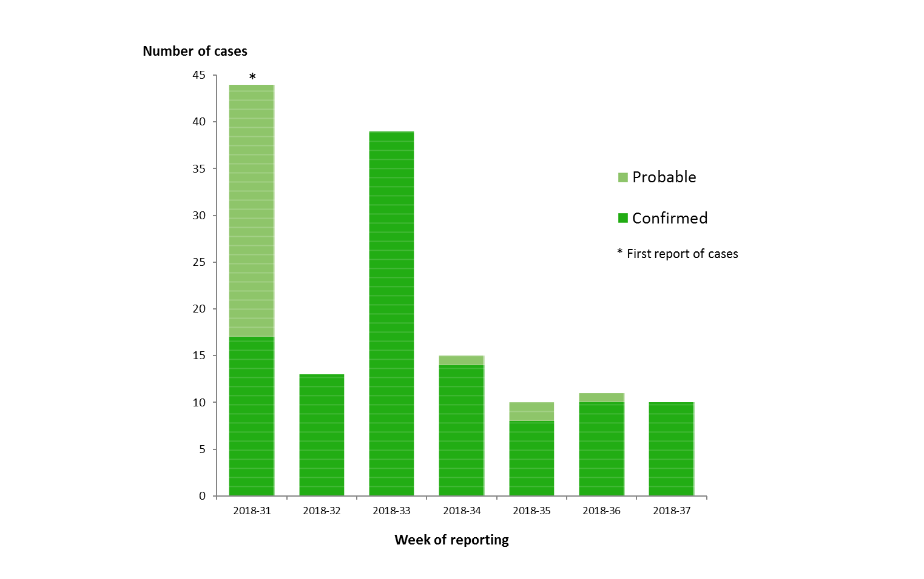
Distribution of confirmed and probable cases of Ebola virus disease, North Kivu and Ituri Provinces, Democratic Republic of the Congo, as of week 37 - 2018

Slide 4
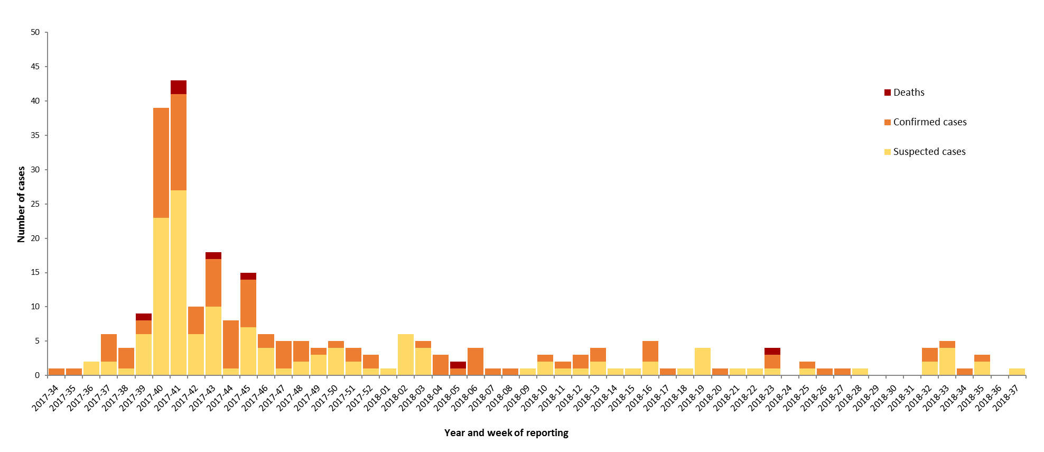
Distribution of Monkeypox cases in Nigeria by year and week of reporting, between September 2017 and 15 September 2018

Slide 9
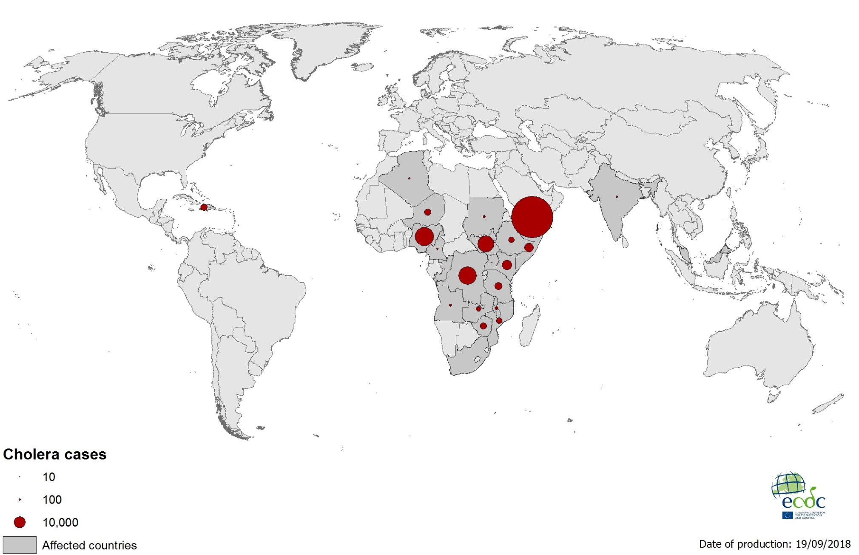
Geographical distribution of cholera cases worldwide between January and September 2018

Slide 10
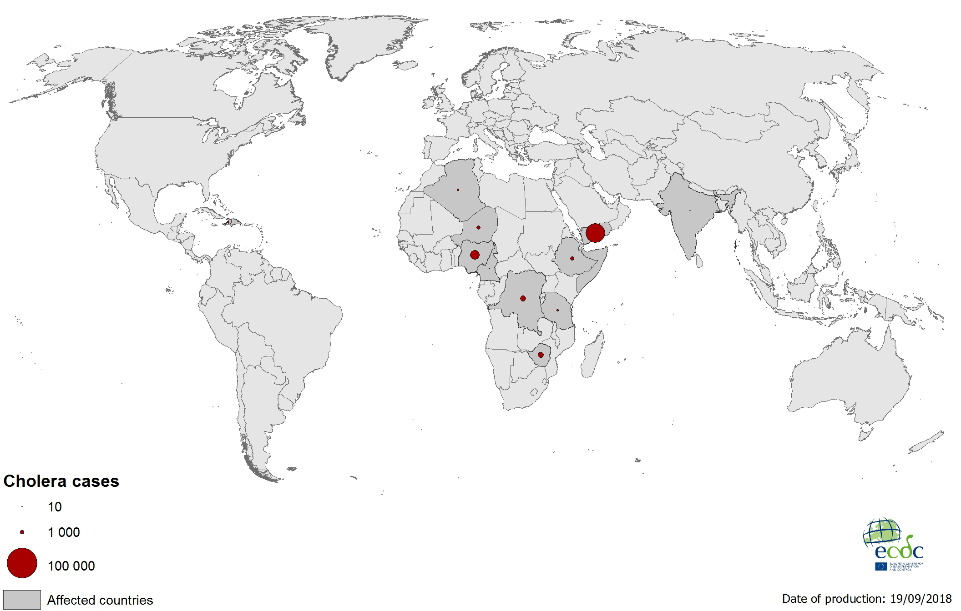
Geographical distribution of new cholera cases reported worldwide between August and September 2018

