Slide 1
Reusable maps and graphs from ECDC Communicable Disease Threats Report Week 42 2021
You are encouraged to reuse our maps and graphs for your own purposes and are free to translate them, provided the content is not altered and the source is acknowledged.

Slide 2
Distribution of COVID-19 cases worldwide, in accordance with the applied case definitions in the affected countries, as of week 41 2021

Slide 3
Distribution of COVID-19 deaths worldwide, as of week 41 2021

Slide 4
Distribution of laboratory-confirmed cases of COVID-19 in the EU/EEA, as of week 41 2021

Slide 5
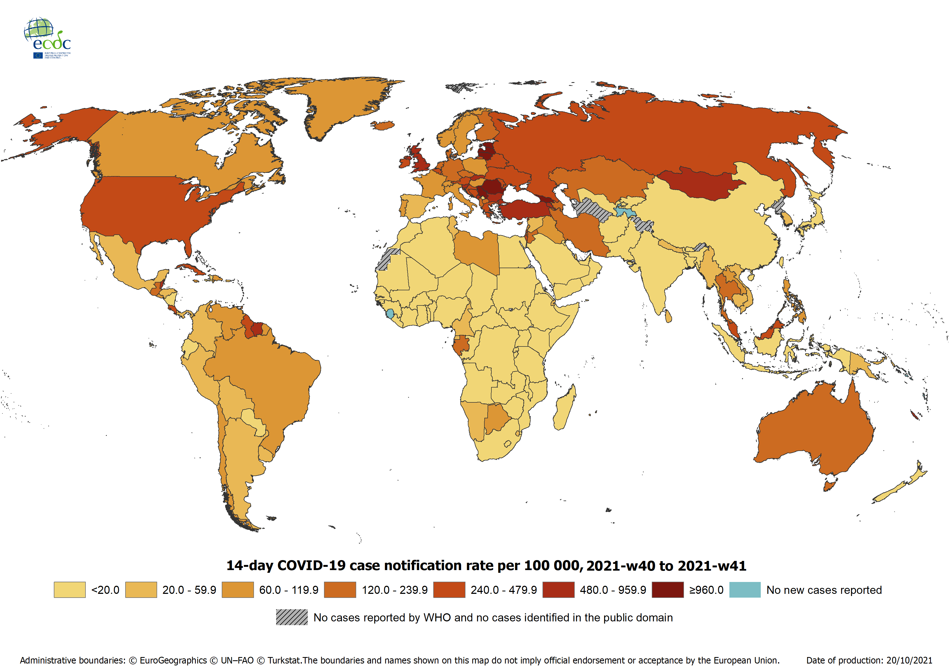
Geographical distribution of 14-day cumulative number of reported COVID-19 cases per 100 000 population, worldwide, week 40 to week 41 2021
14-day notification rates and trends are collected using epidemic intelligence from various sources and are affected by the testing strategy, laboratory capacity and effectiveness of surveillance systems. As all of these factors can differ greatly between countries, ECDC does not recommend using notification rates to directly compare countries. Particular caution is needed when interpreting reported rates from areas with small populations, where small changes in the numbers of reported cases can have a large impact on the notification rate. In addition, the retrospective adjustment of data by reporting authorities is possible. Negative counts of new cases can arise if countries or subnational areas report cumulative totals that are lower than those reported previously, which can affect the presentation of data in maps and time-series plots.

Slide 6
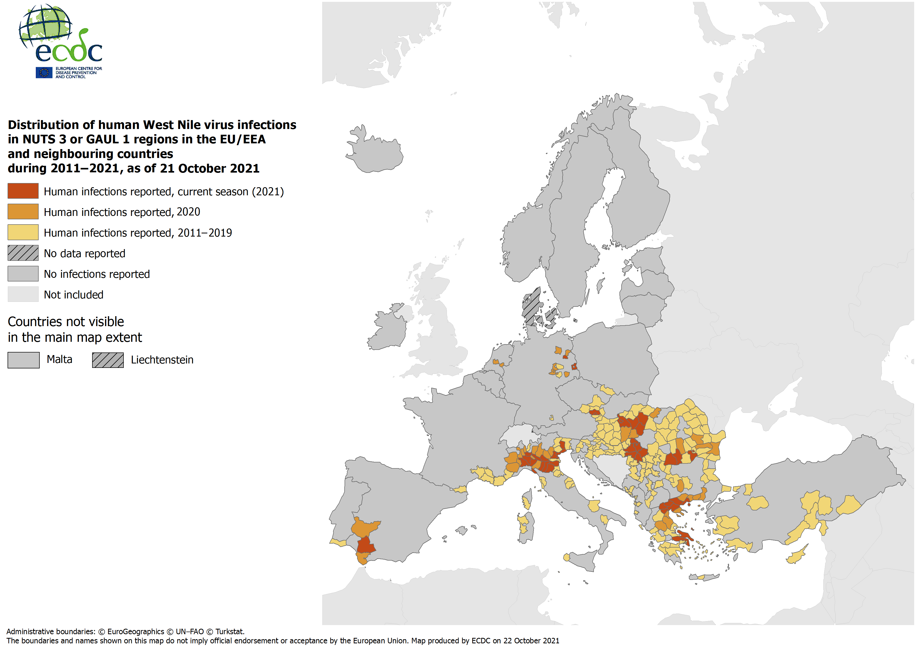
Distribution of human West Nile virus infections by affected areas as of 21 October 2021

Slide 7
Distribution of West Nile virus infections among humans and outbreaks among equids and/or birds in the EU as of 21 October 2021

Slide 8
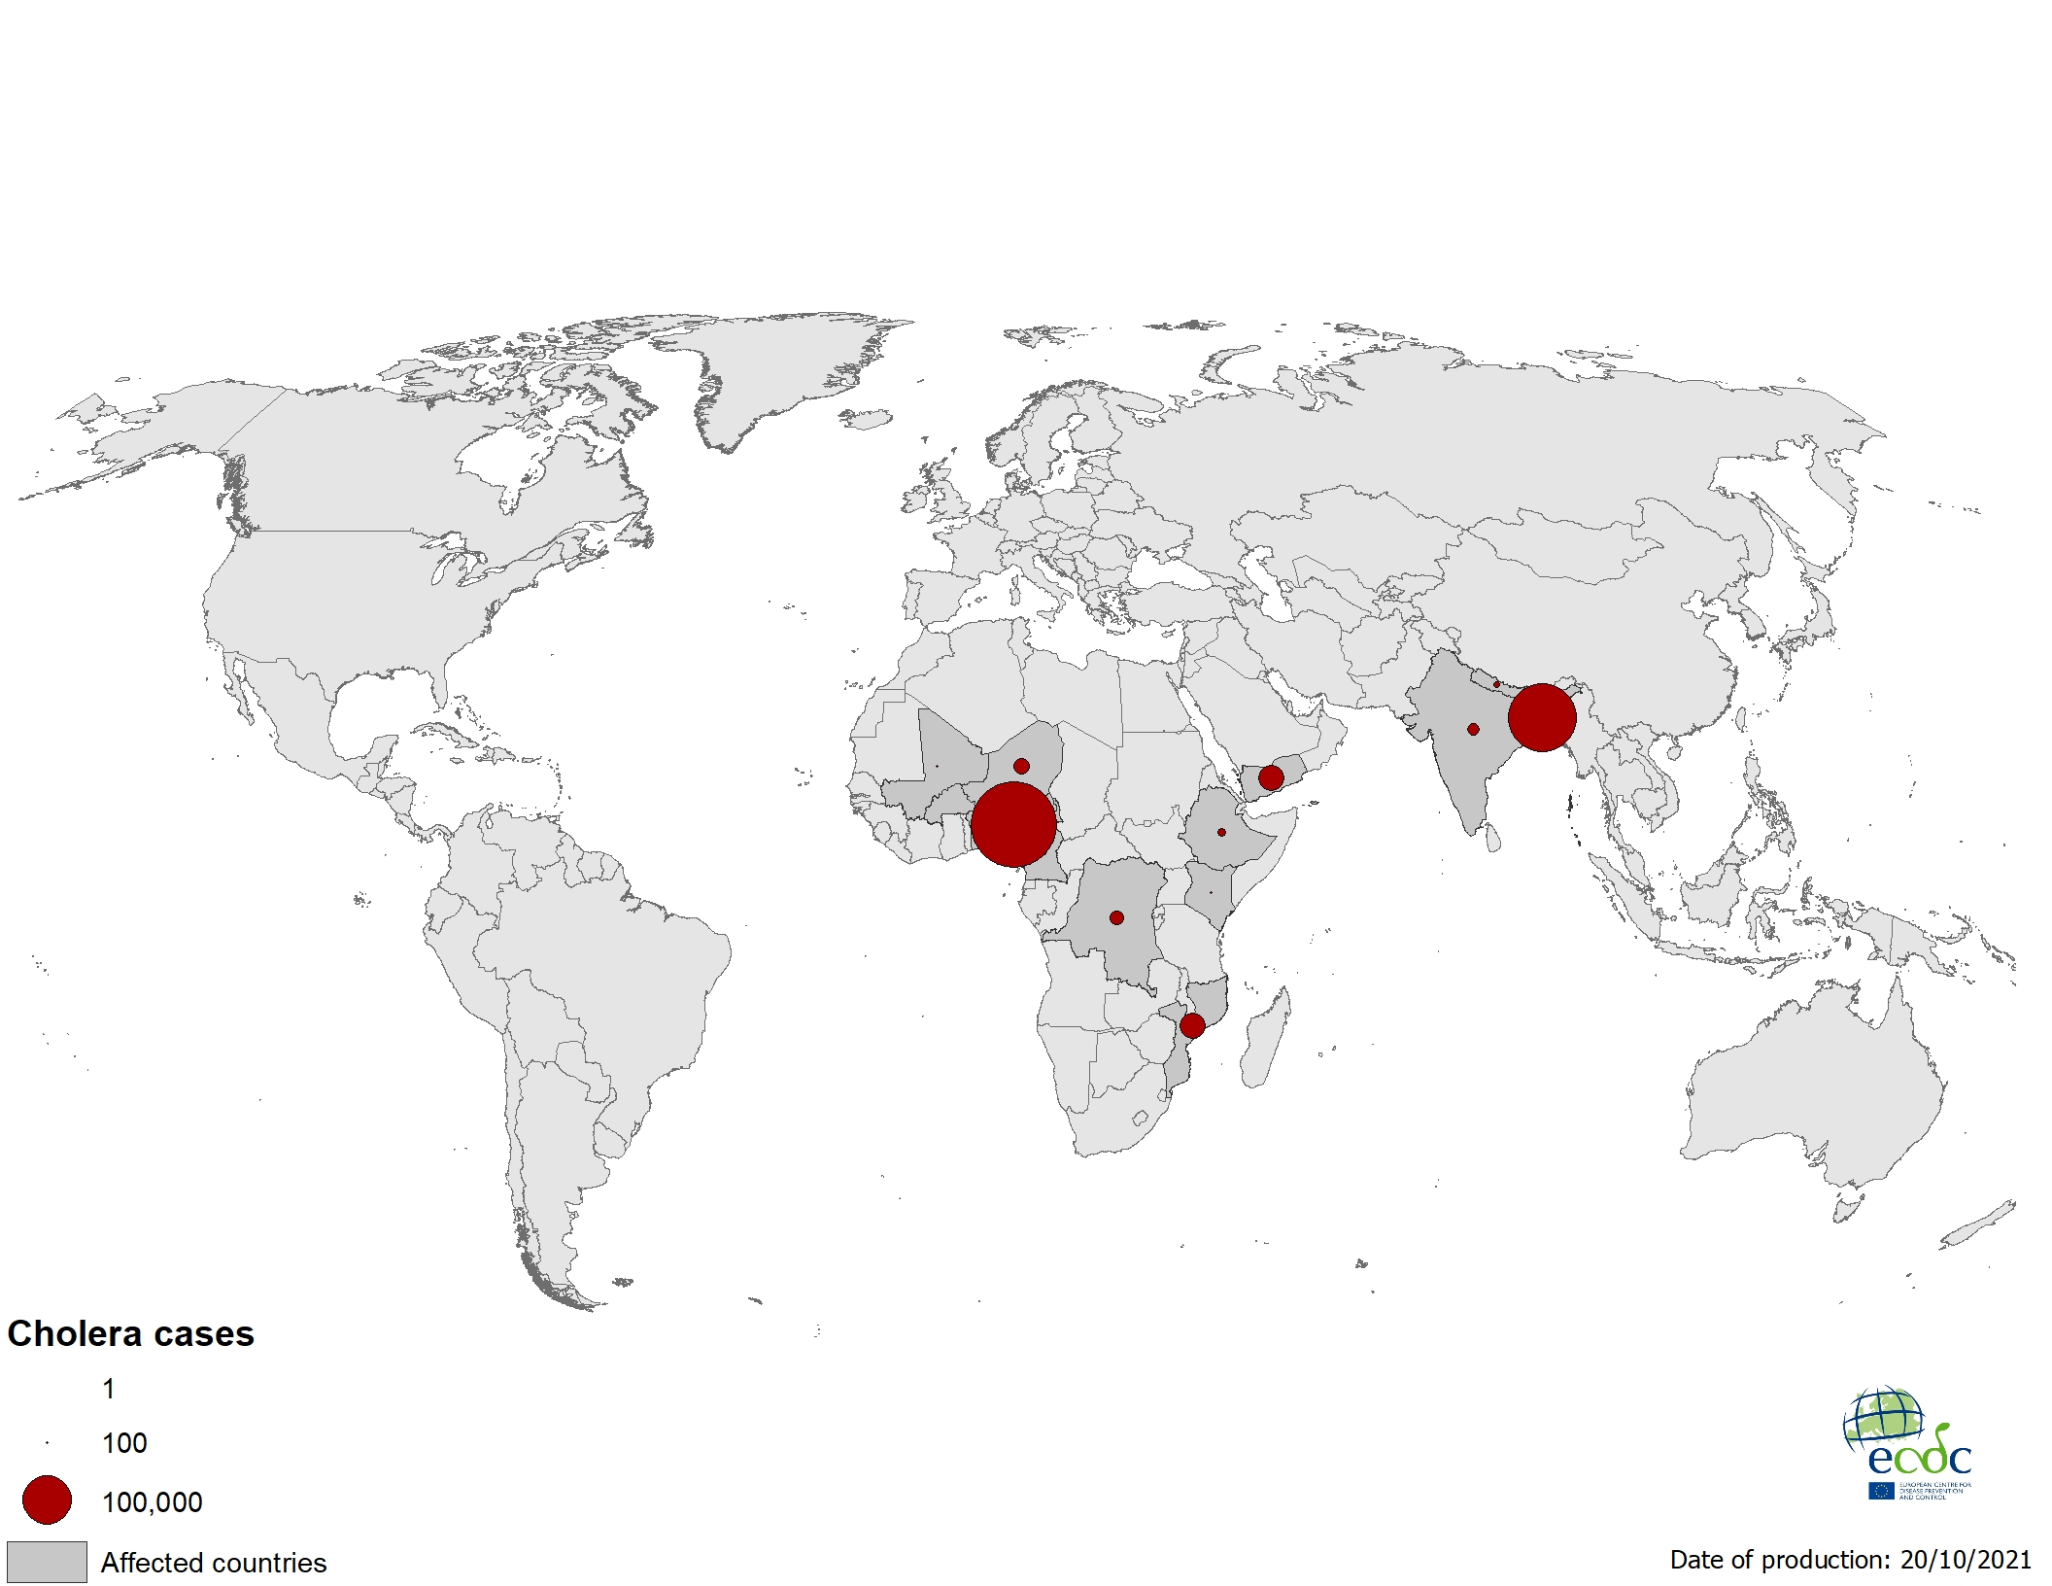
Geographical distribution of cholera cases reported worldwide from August to October 2021

Slide 9
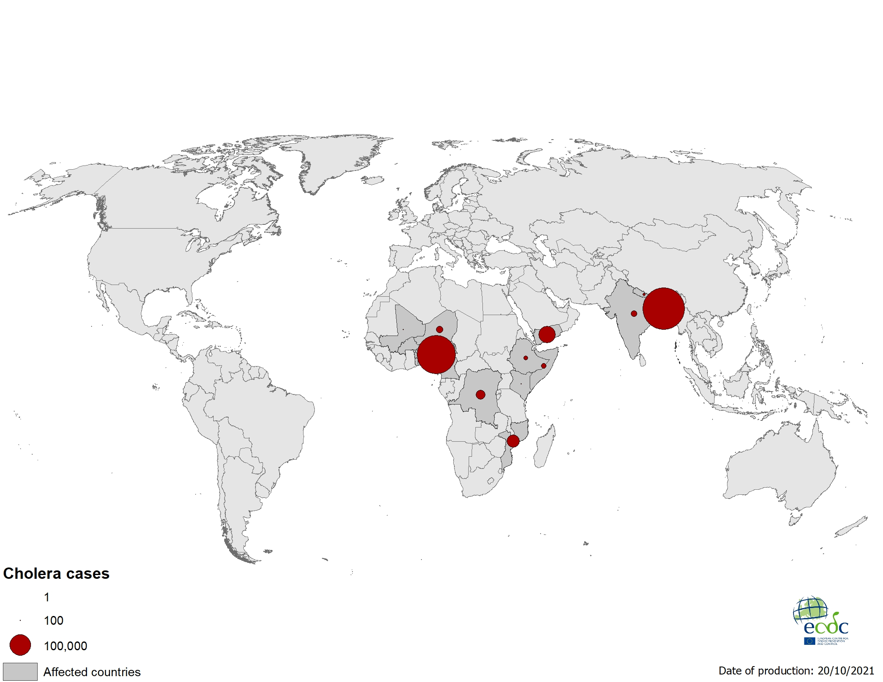
Geographical distribution of cholera cases reported worldwide as of October 2021

Slide 10
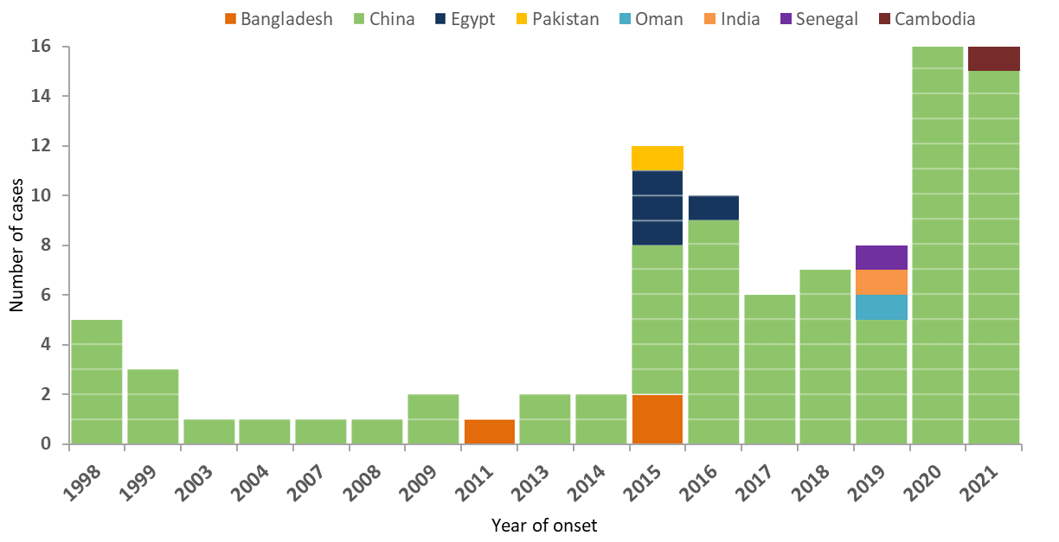
Distribution of confirmed human cases of avian influenza A(H9N2) virus infection by year of onset and country, 1998–2021 (n=94)

Slide 11
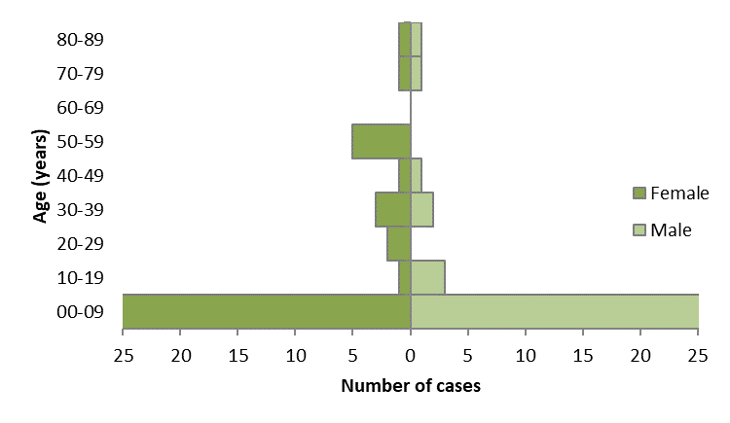
Age and sex distribution of confirmed human cases with influenza A(H9N2) virus infection, 1998–2021 (n=94)
Notes:
Median age 38.5 years, average 36

Slide 12
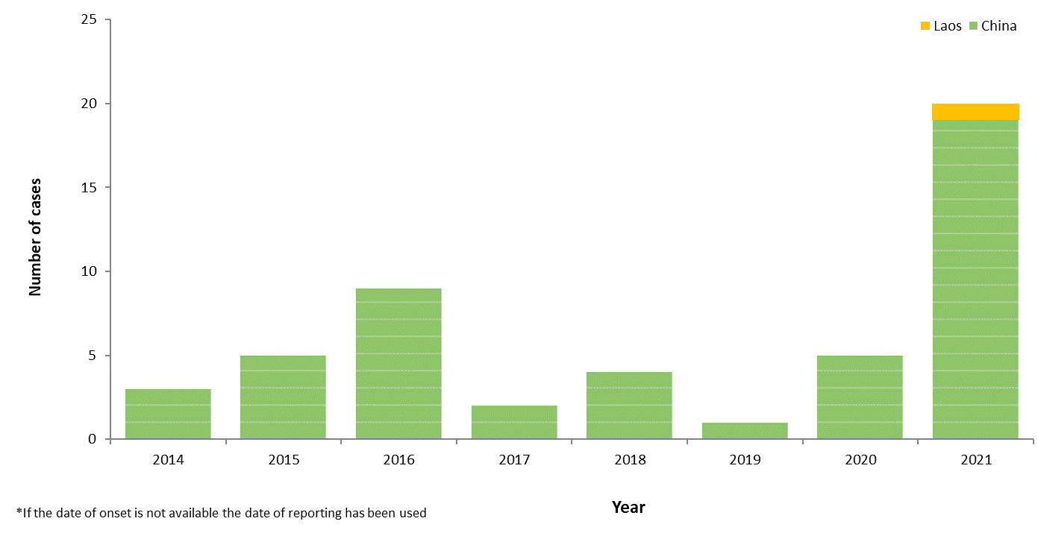
Distribution of confirmed human cases of avian influenza A(H5N6) virus infection by year of onset and country, 2014–2021 (n=49)

Slide 13
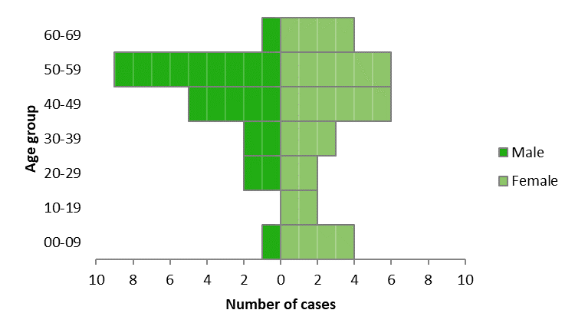
Age and sex distribution of confirmed human cases with influenza A(H5N6) virus infection, 2014–2021, China and Laos (n=49)
Notes:
Median age 38.5 years, average 36

Slide 14
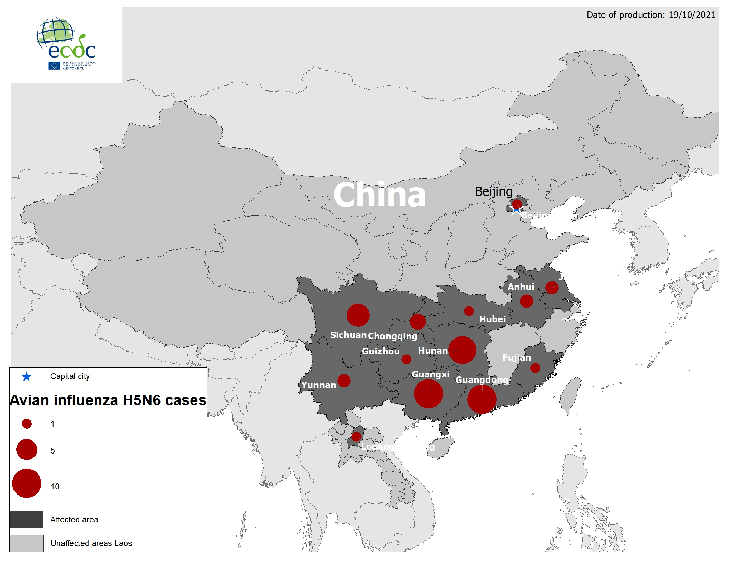
Geographical distribution of confirmed human cases with influenza A(H5N6) virus infection, 2014–2021, China and Laos (n=49)

