Slide 1
Reusable maps and graphs from ECDC Communicable Disease Threats Report Week 43, 2022
You are encouraged to reuse our maps and graphs for your own purposes and are free to translate them, provided the content is not altered and the source is acknowledged.

Slide 2
Geographic distribution of EVD cases, Uganda, 2022

Slide 3
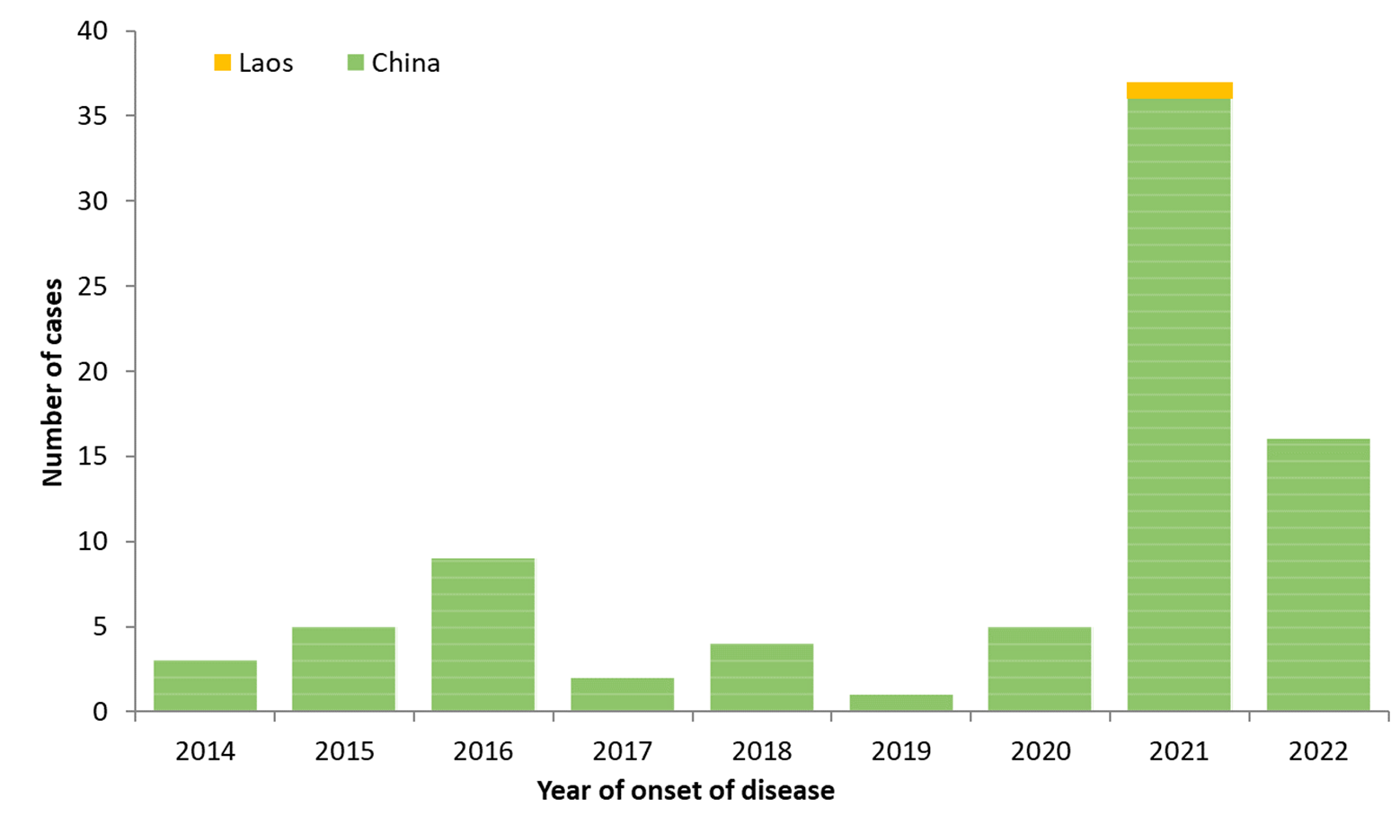
Distribution of confirmed human cases of avian influenza A(H5N6) virus infection by year of onset and country, 2014–2020 October 2022 (n=82)

Slide 4
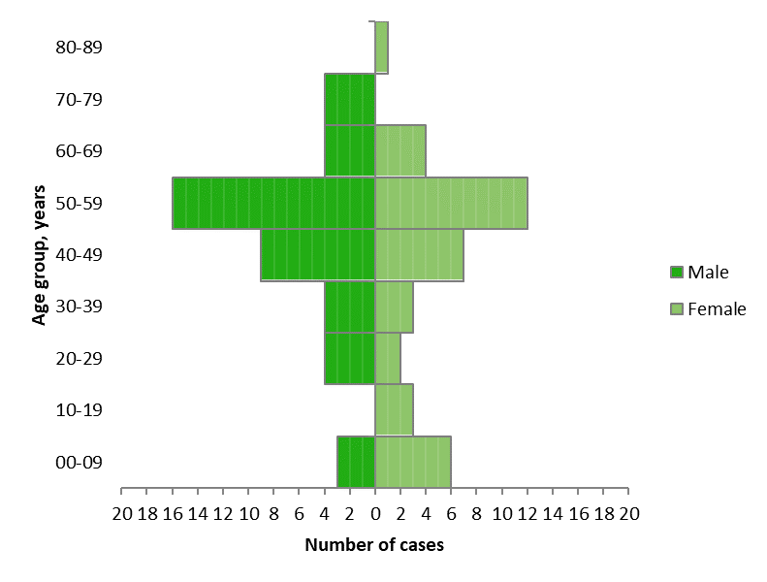
Distribution of confirmed human cases of avian influenza A(H5N6) virus infection by age and sex, 2014–2020 October 2022 (n=82)

