Slide 1
Reusable maps and graphs from ECDC Communicable Disease Threats Report
Week 45, 2019
You are encouraged to reuse our maps and graphs for your own purposes and free to translate, provided the content is not altered and the source is acknowledged.

Slide 2
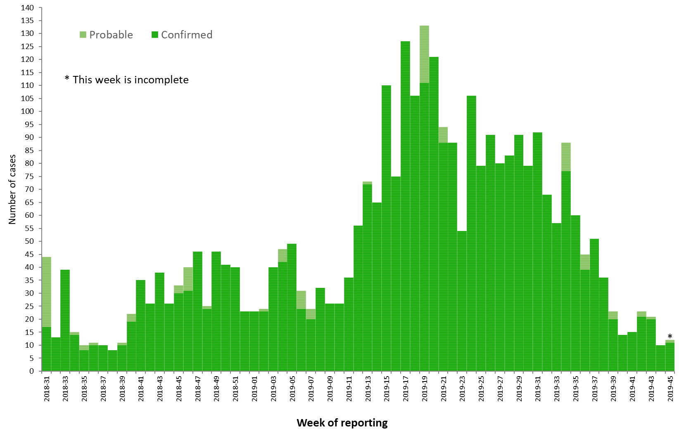
Distribution of confirmed and probable cases of Ebola virus disease by week of reporting, Democratic Republic of the Congo and Uganda, as of 6 November 2019

Slide 3
Ebola Virus Disease case distribution in DRC and Uganda as of 6 November 2019

Slide 4
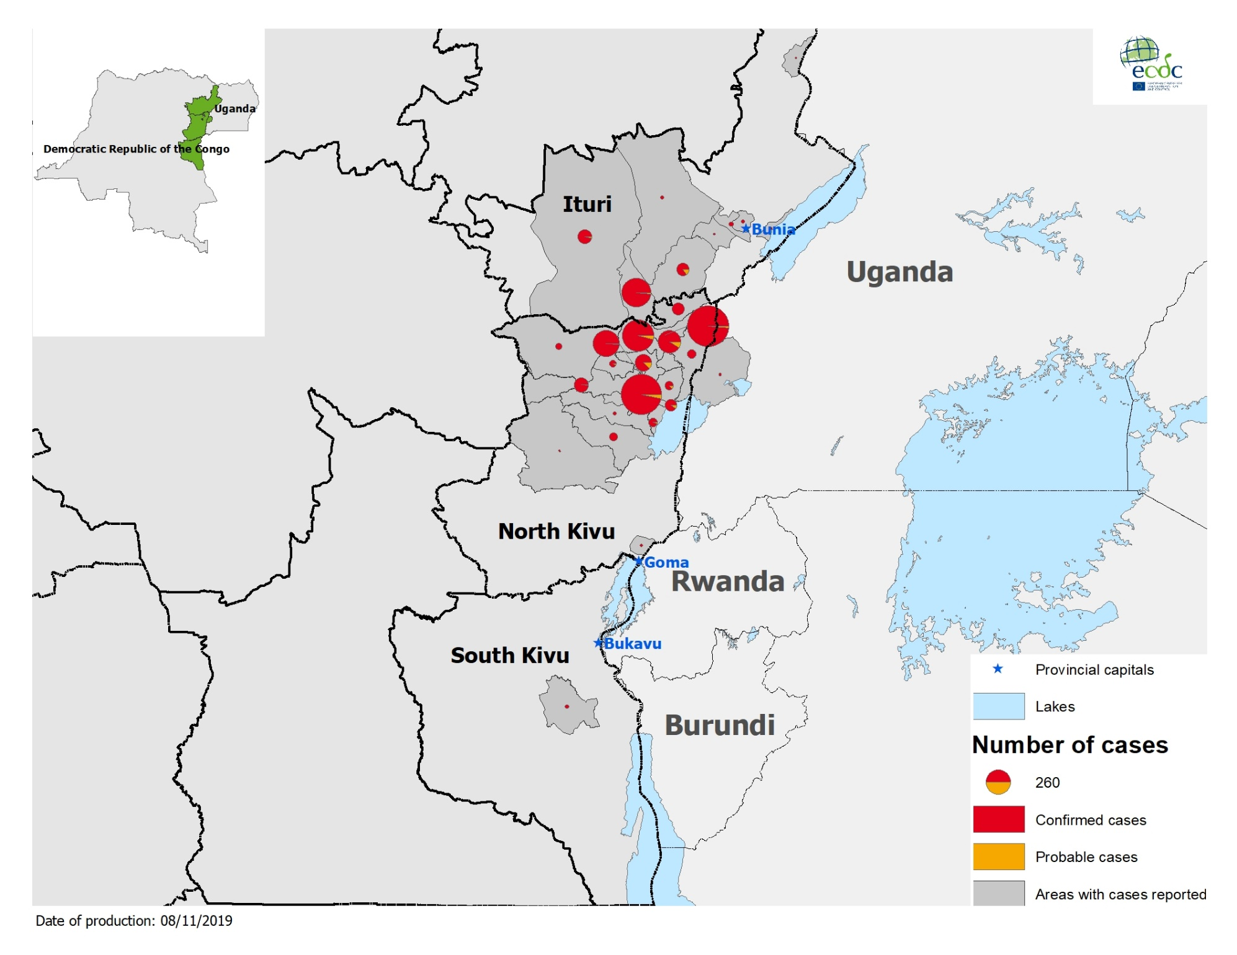
Geographical distribution of confirmed and probable cases of Ebola virus disease,
Democratic Republic of the Congo and Uganda as of 6 November 2019

Slide 5
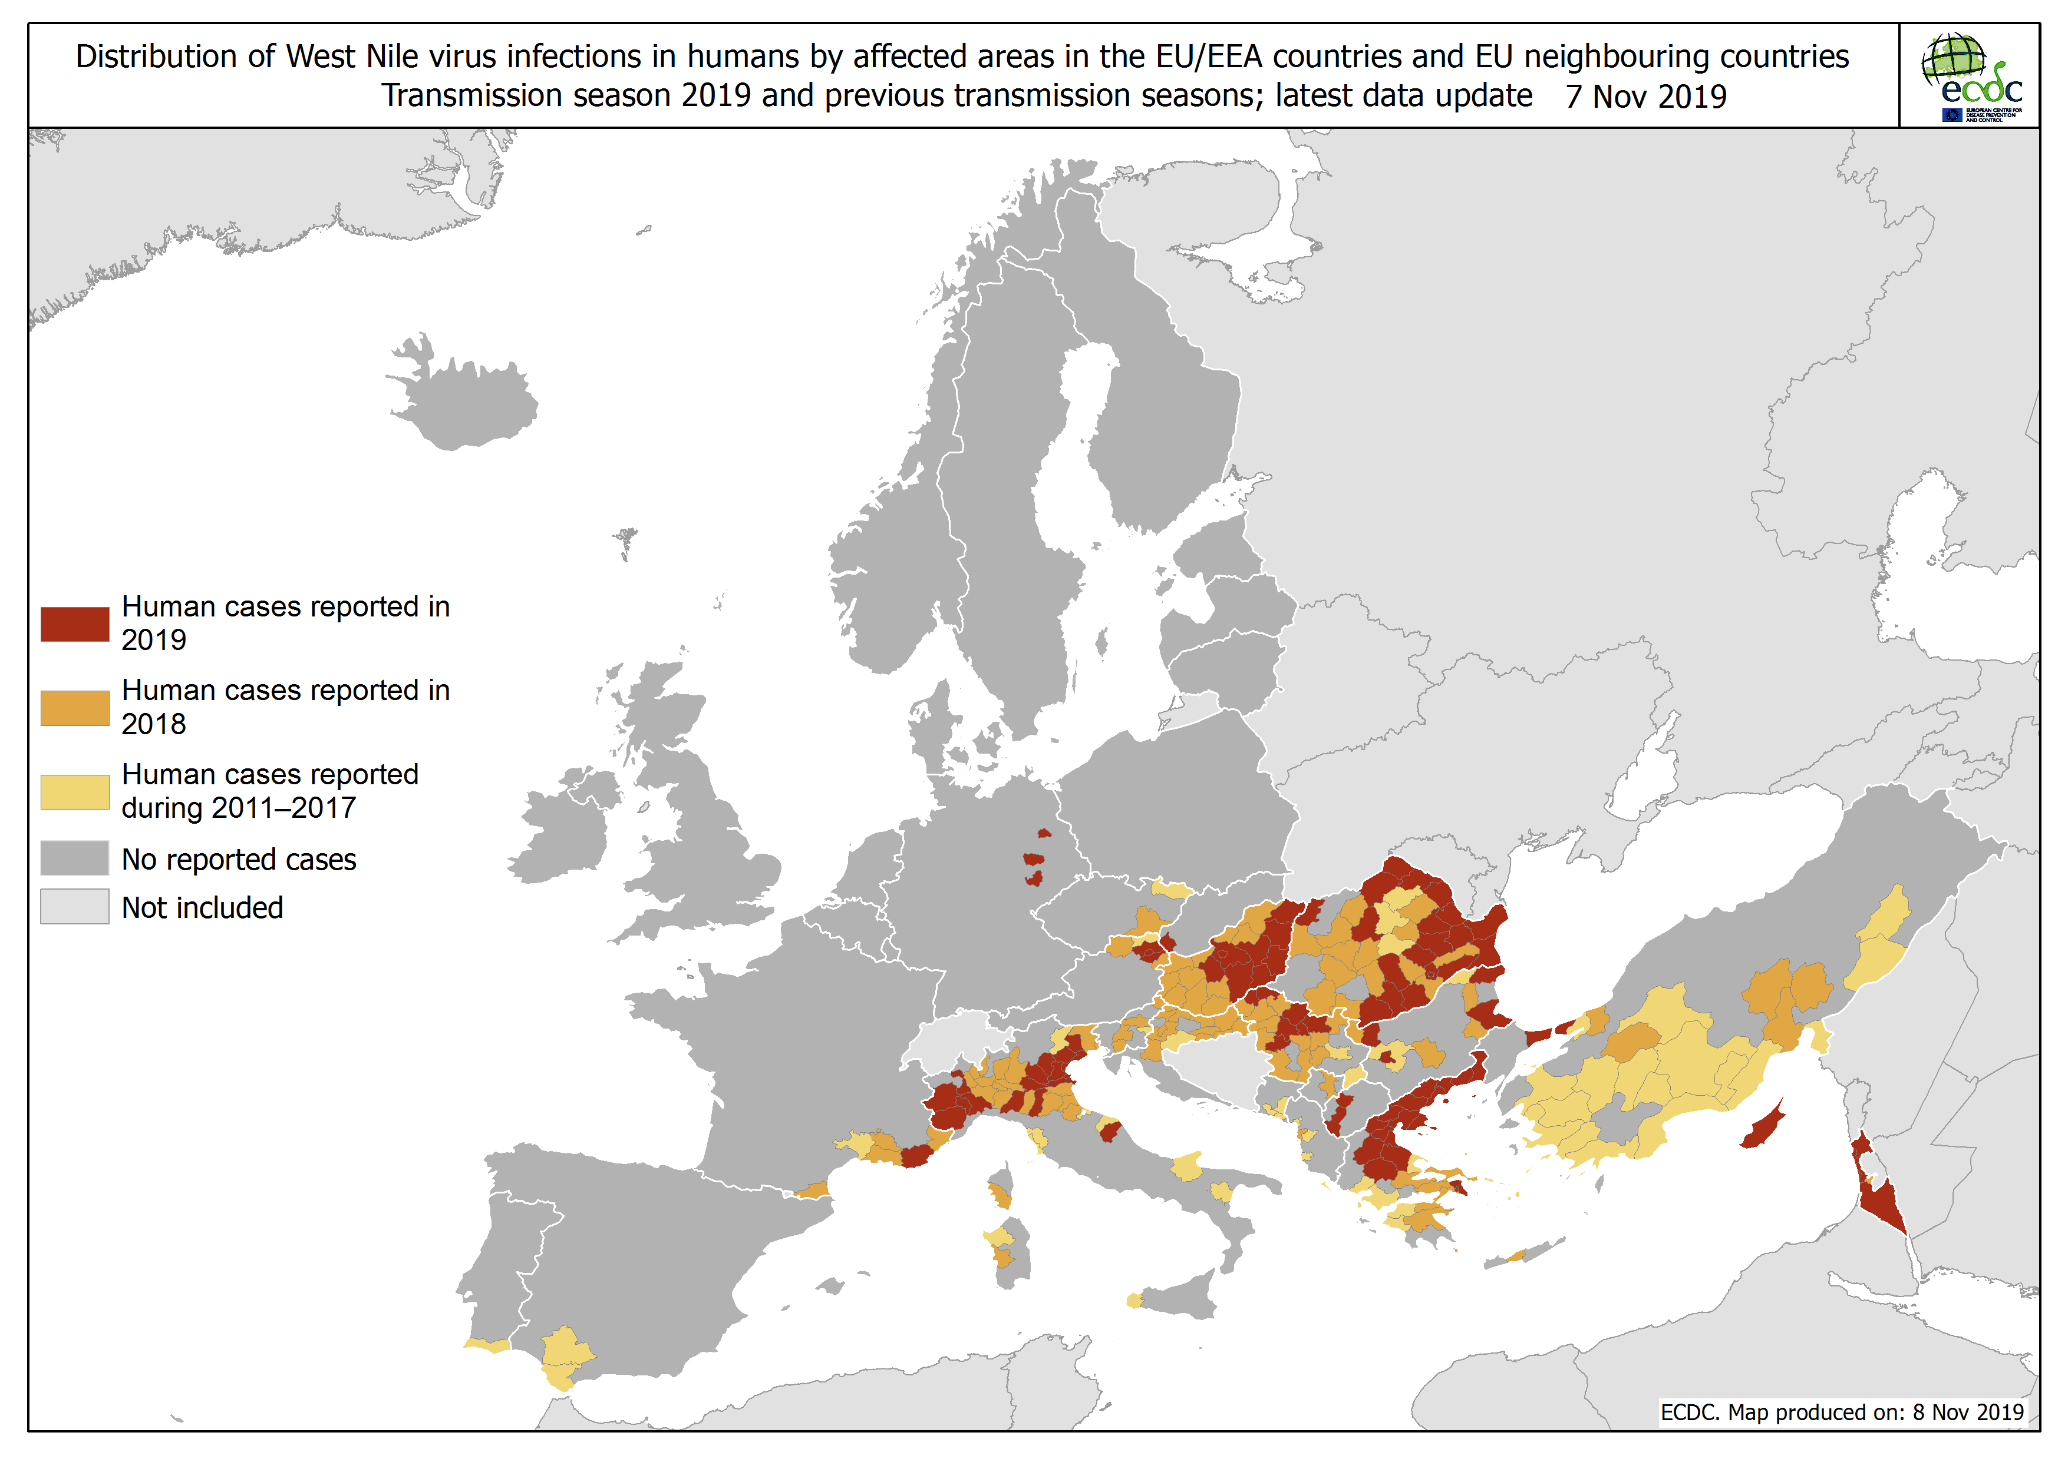

Slide 6
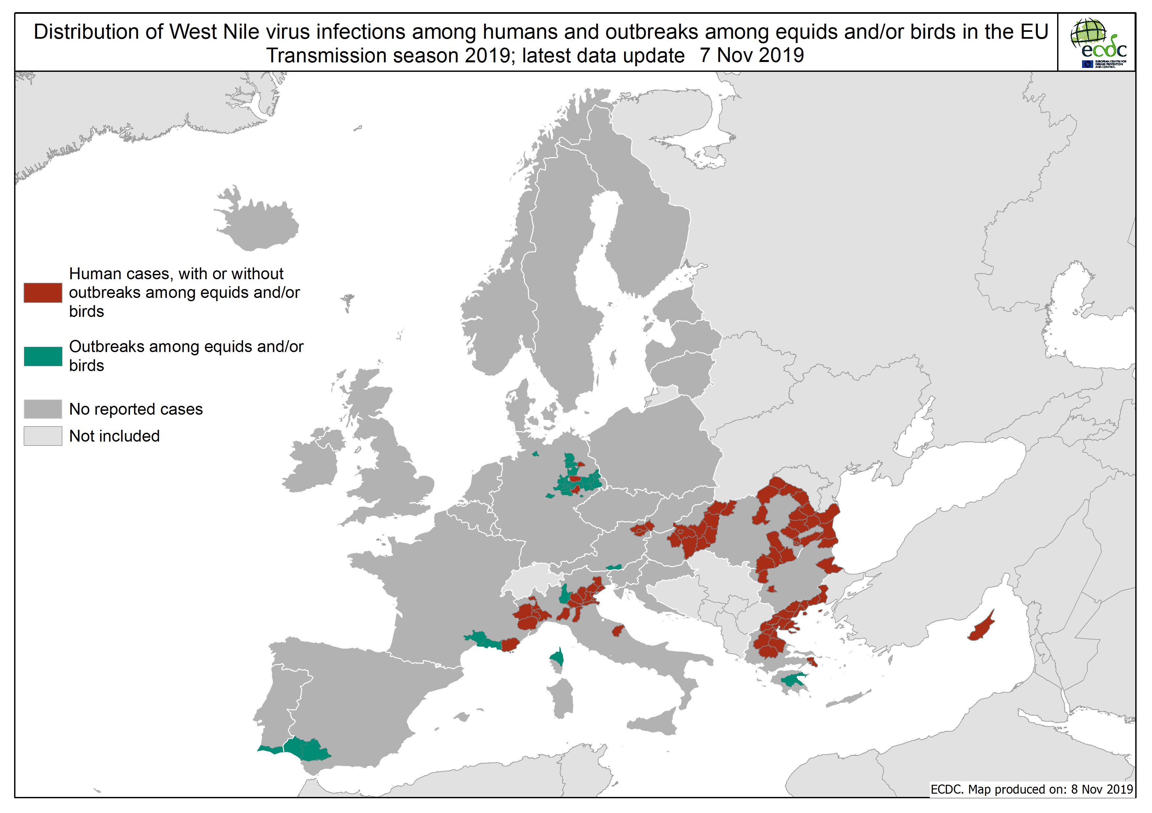

Slide 7
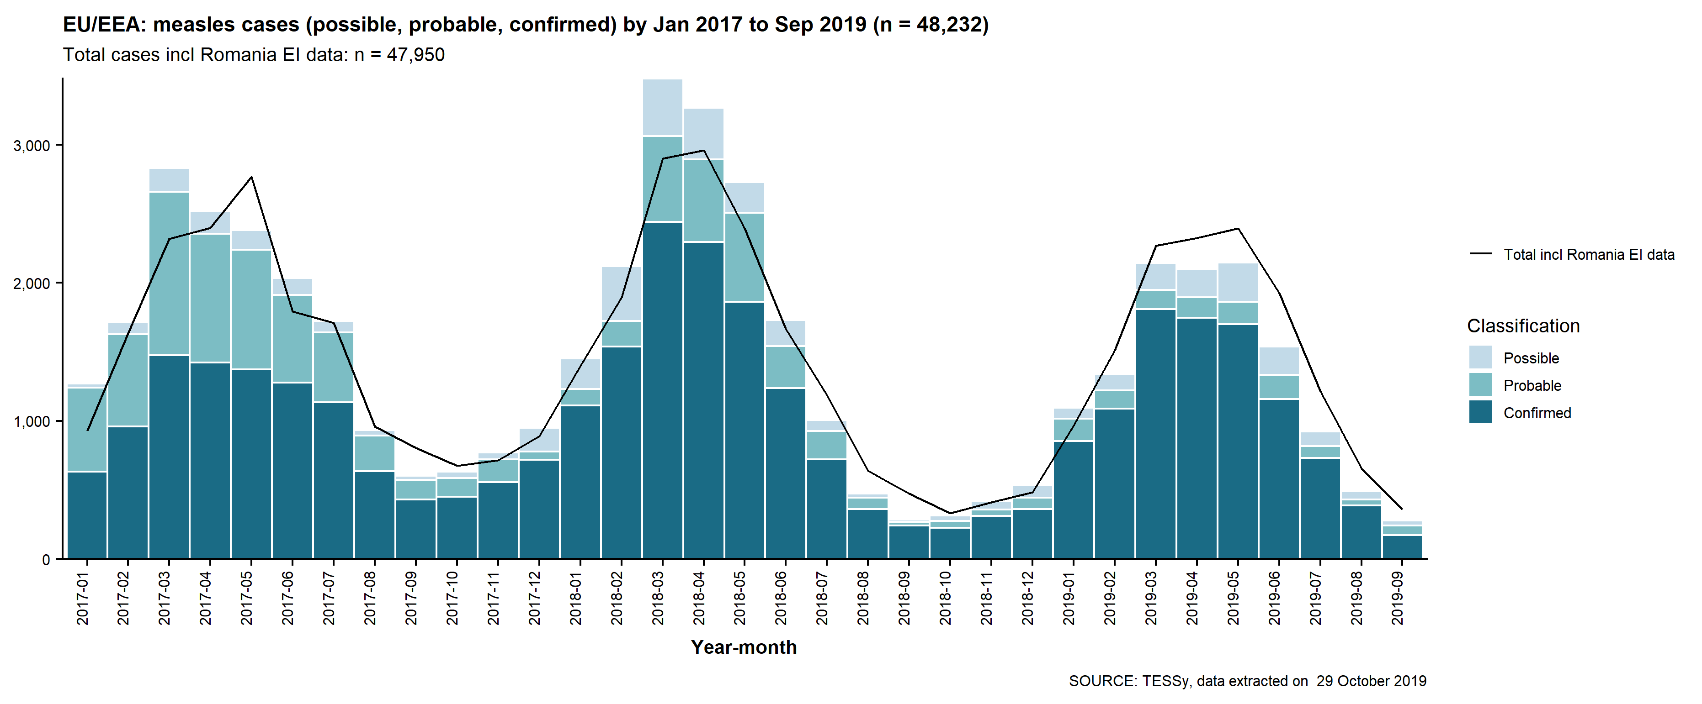
Distribution of measles cases reported by EU/EEA, January 2017-September 2019

Slide 8
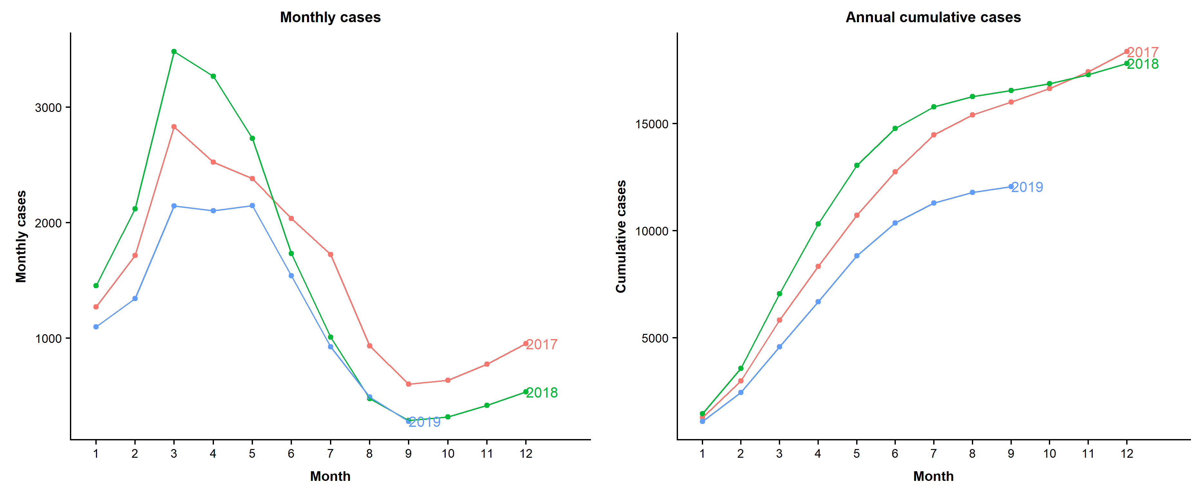
Distribution of measles cases reported by EU/EEA countries to TESSy by month and annual cumulative cases, January 2017- September 2019

Slide 9
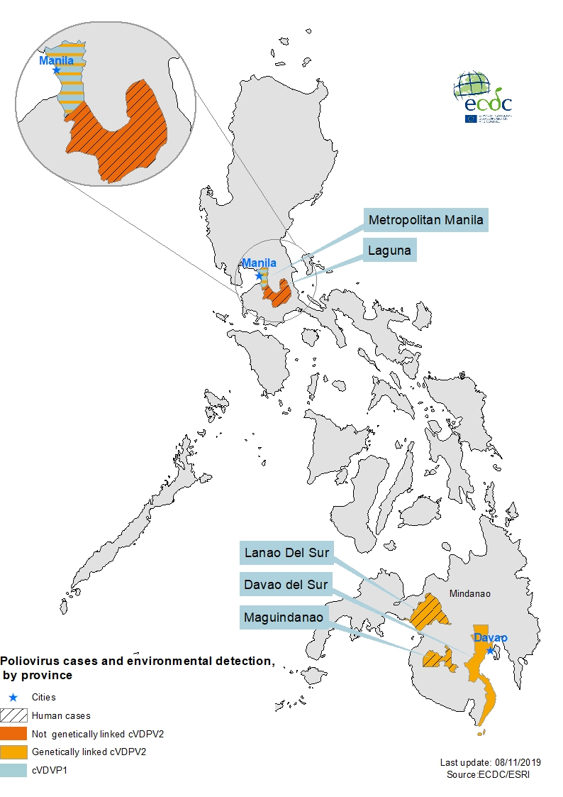
Poliovirus cases and environmental detection, by province, Philippines, July - November 2019

