Slide 1
You are encouraged to reuse our maps and graphs for your own purposes and are free to translate them, provided the content is not altered and the source is acknowledged. Either copy the images from the following slides or download directly from: ecdc.europa.eu/en/publications/surveillance_reports/Communicable-Disease-Threats-Report/Pages/cdtr.aspx
European Centre for Disease Prevention and Control
Reusable maps and graphs from ECDC Communicable Disease Threats Report - week 15, 2018

Slide 2
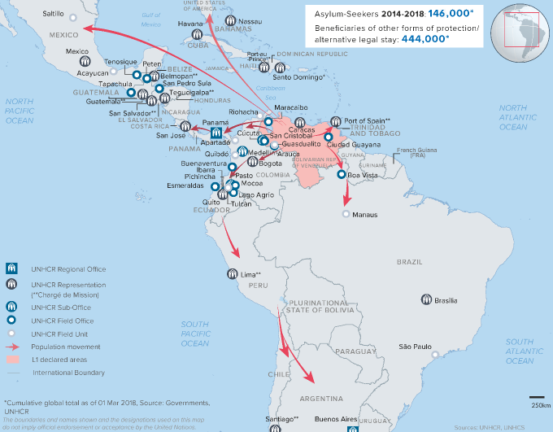
Asylum-seekers, Venezuela, 2014 -2018

Slide 3
Number of measles cases (possible, probable, confirmed) by week of onset, France, 2015-2018, according to last update in TESSy of 26 March 2018

Slide 4
Number of measles cases (possible, probable, confirmed) by week of onset, Greece, 2017-2018, as of 5 April 2018

Slide 5
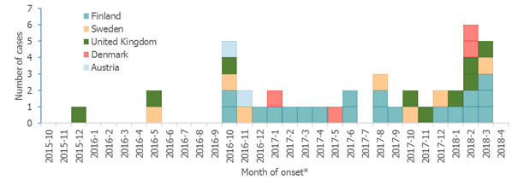
Listeria monocytogenes PCR serogroup IVb, ST 6; confirmed outbreak cases by month of symptom onset*, European Union, 2015–2018 (n=41)
* Date of sampling or date of receipt in reference laboratory was used if month of onset was missing.

Slide 6
Number of dengue autochthonous cases by week of onset between week 1-2017 and week 13-2018 in La Réunion
Source: adapted from "Surveillance de la dengue à la Réunion. Point épidémiologique au 9 avril 2018”

Slide 7
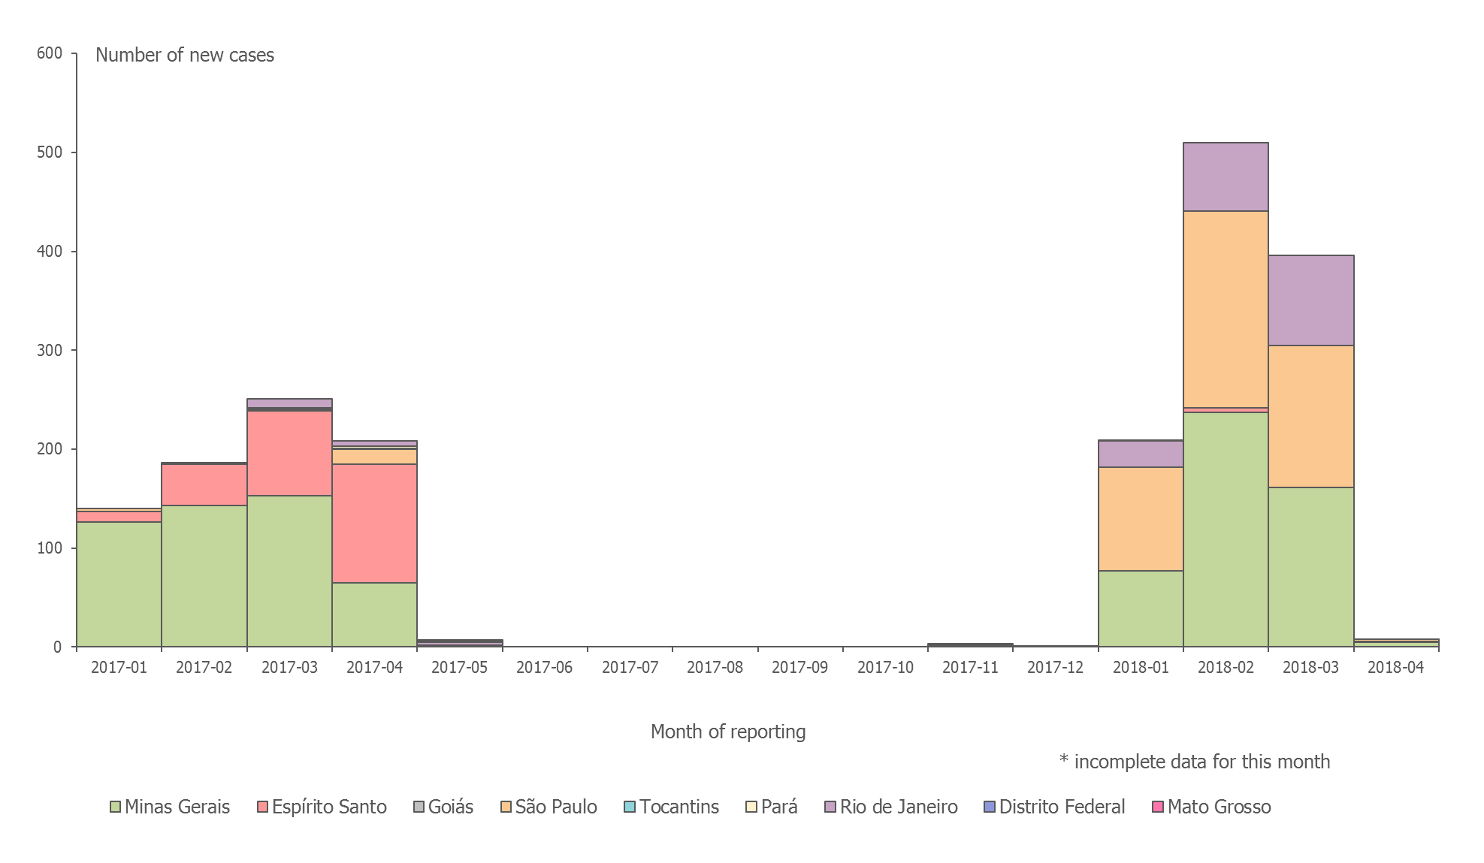
Distribution of confirmed human cases of yellow fever by month, Brazil,
January 2017–10 April 2018

Slide 8
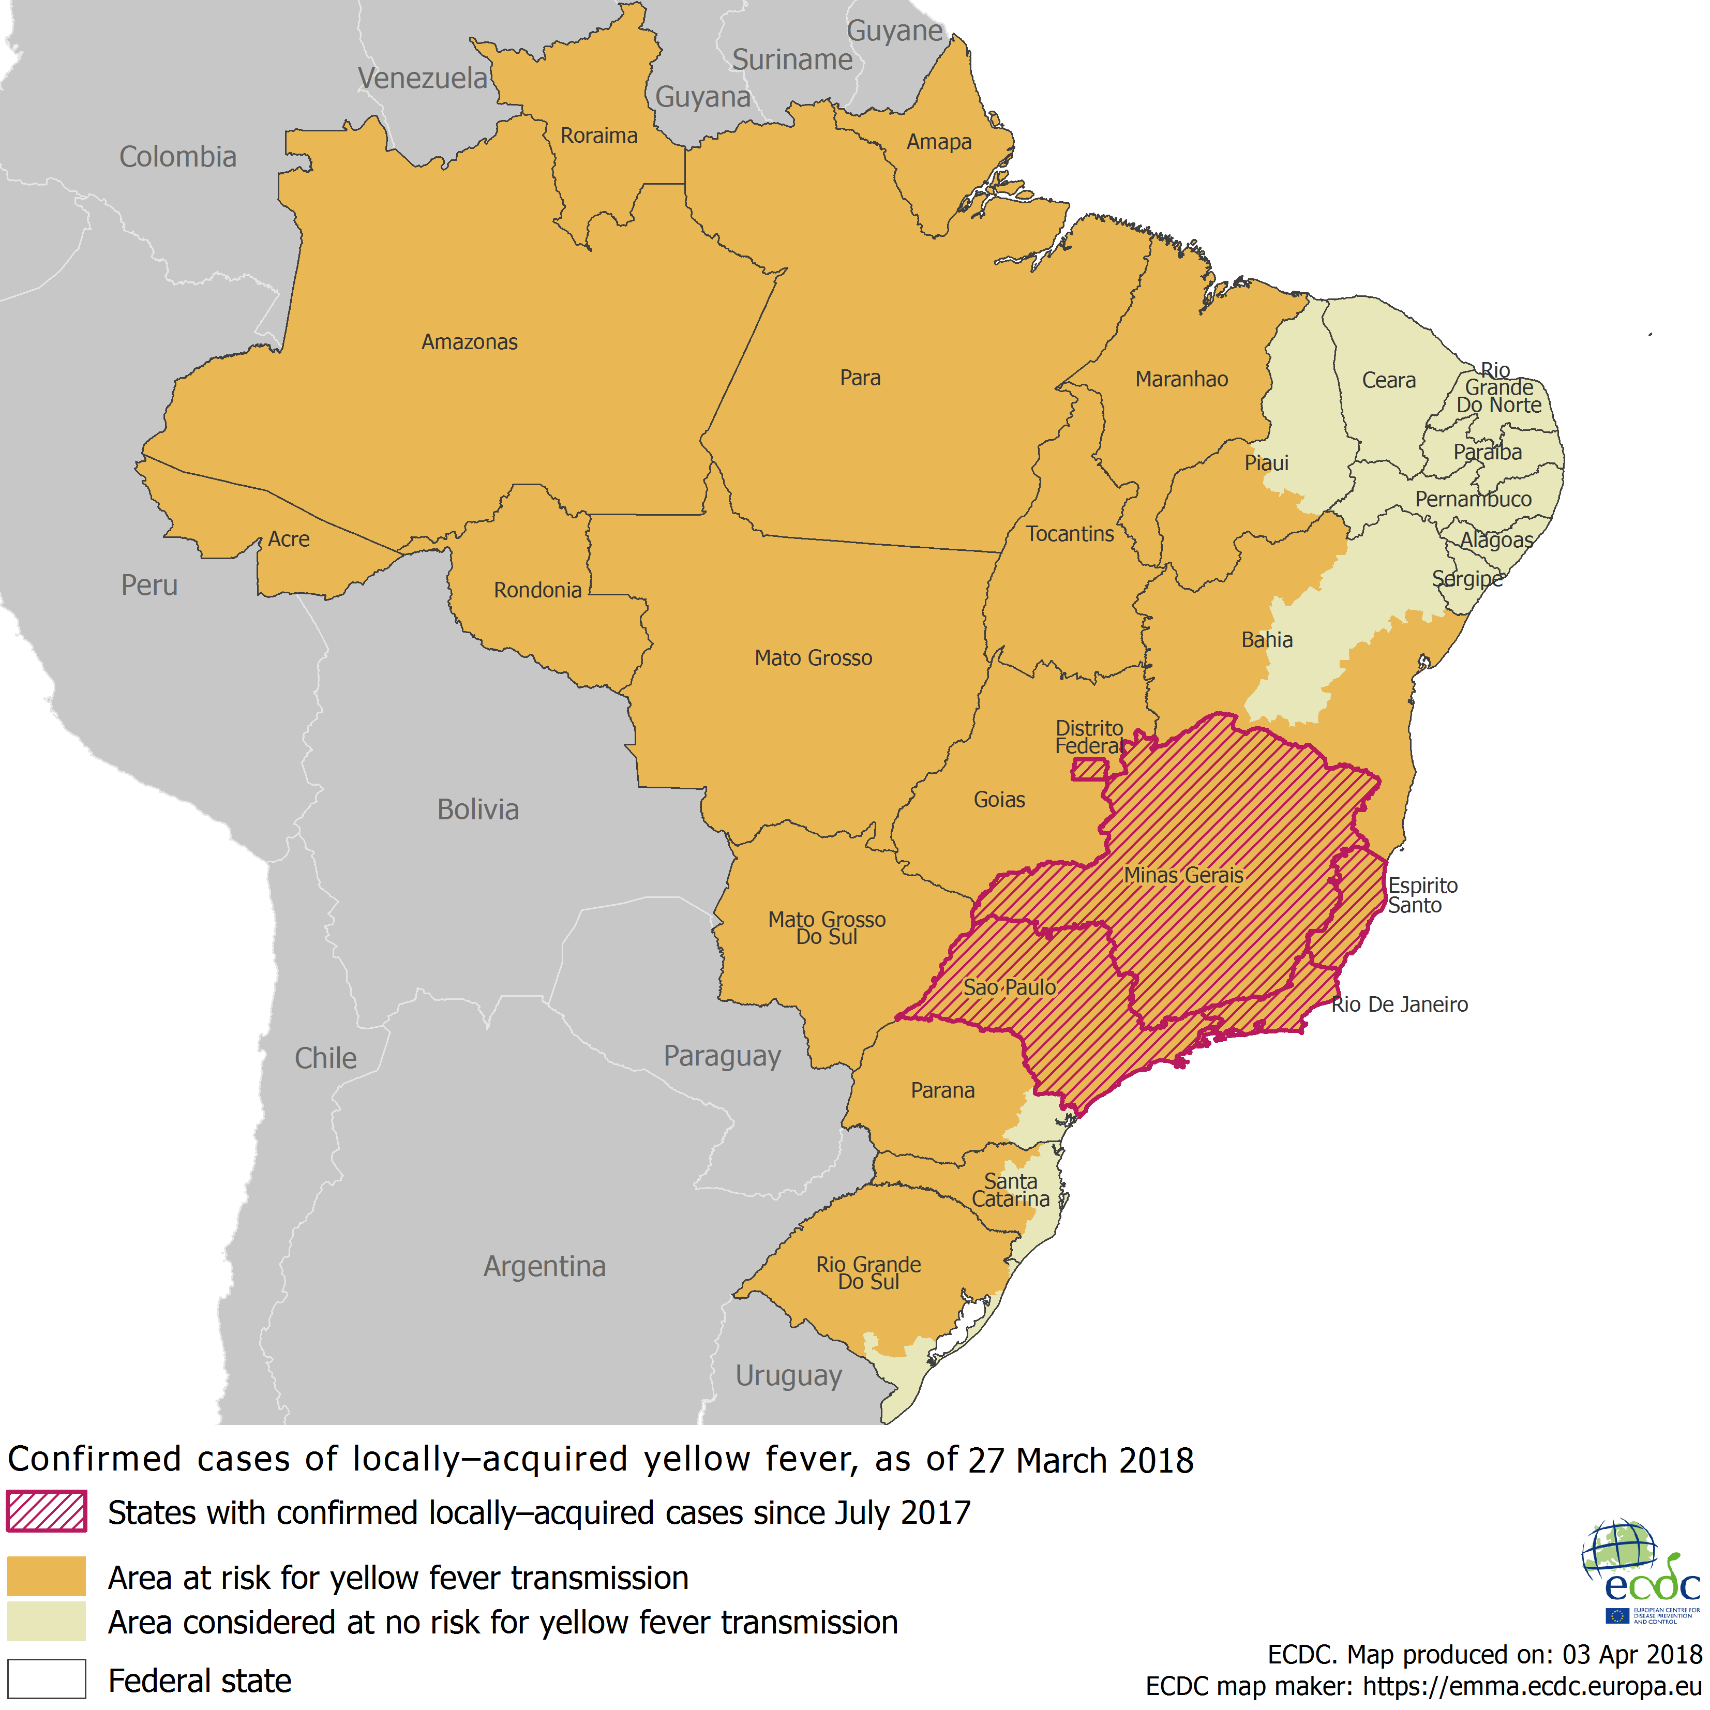
Distribution of confirmed yellow fever cases by state, Brazil, July 2017 – April 2018

