Slide 1
You are encouraged to reuse our maps and graphs for your own purposes and free to translate, provided the content is not altered and the source is acknowledged. Either copy the images from the following slides or download directly from: ecdc.europa.eu/en/publications/surveillance_reports/Communicable-Disease-Threats-Report/Pages/cdtr.aspx
European Centre for Disease Prevention and Control
Reusable maps and graphs from ECDC Communicable Disease Threats Report, week 46, 2017

Slide 2
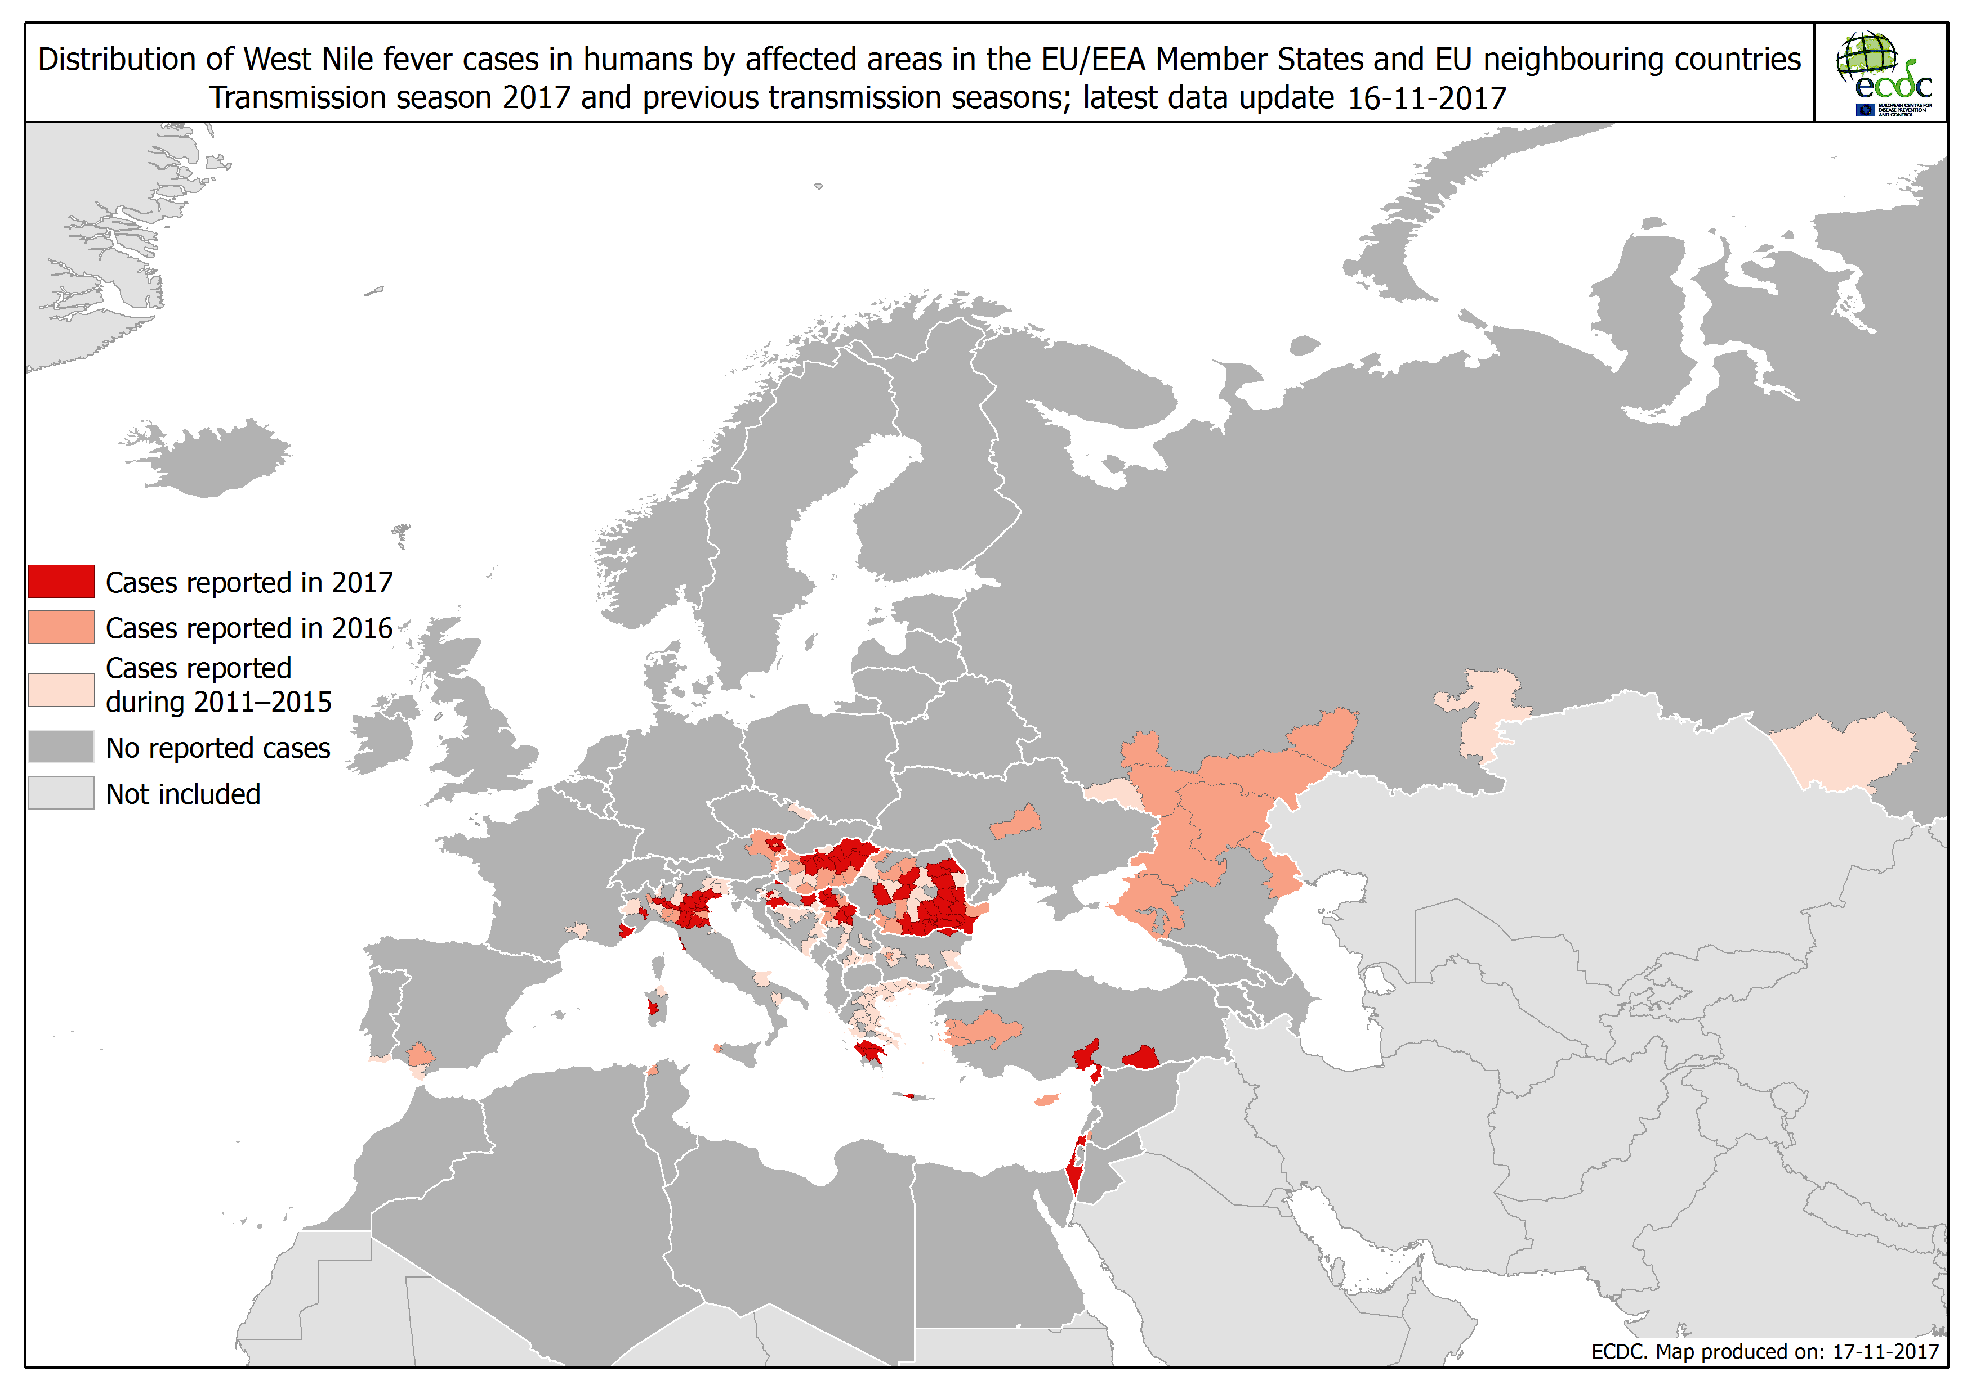

Slide 3
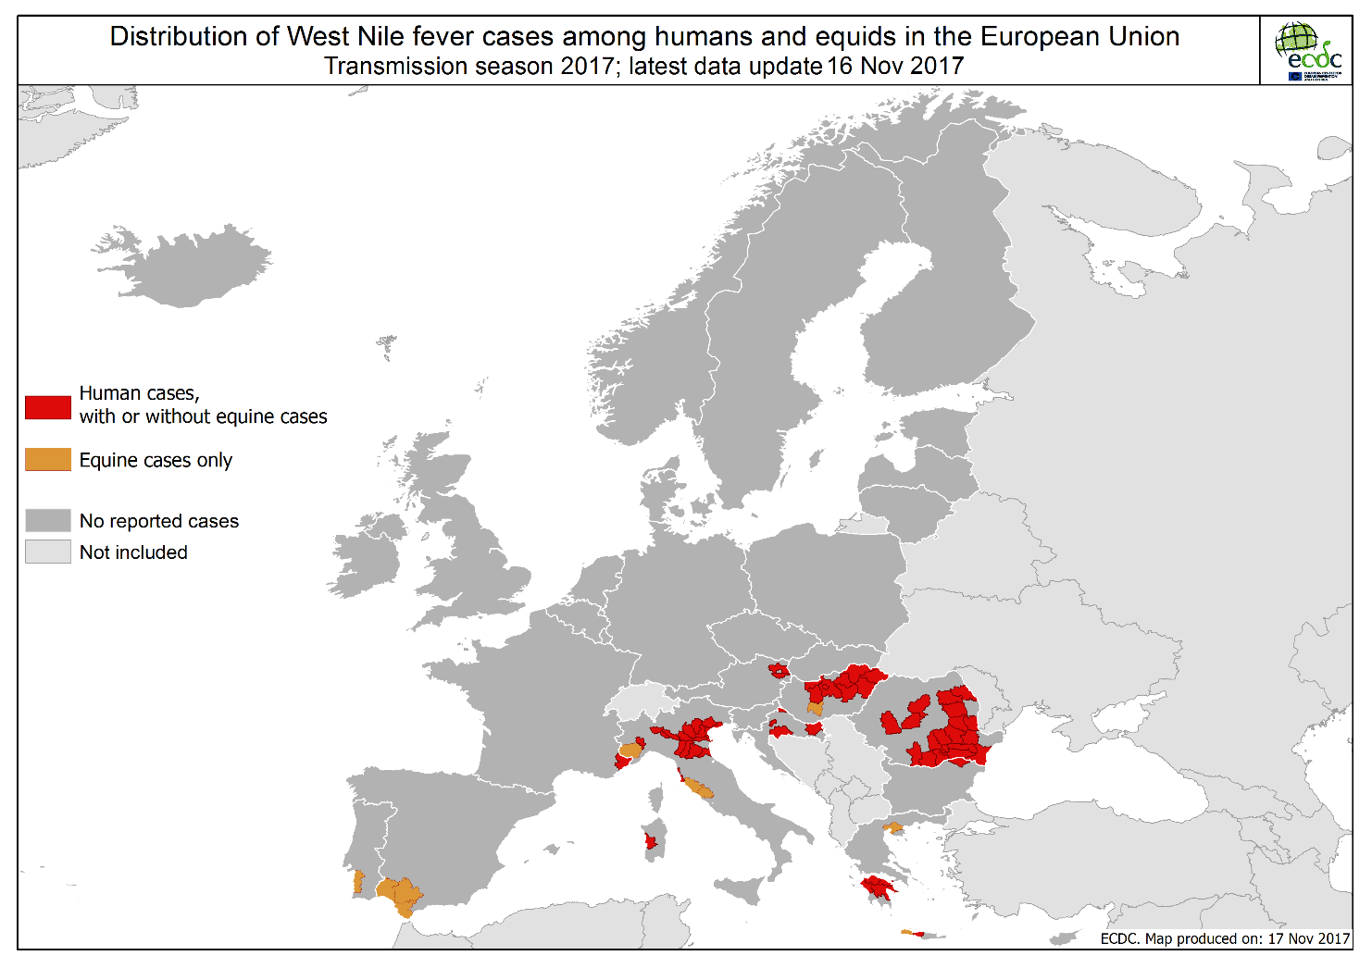

Slide 4
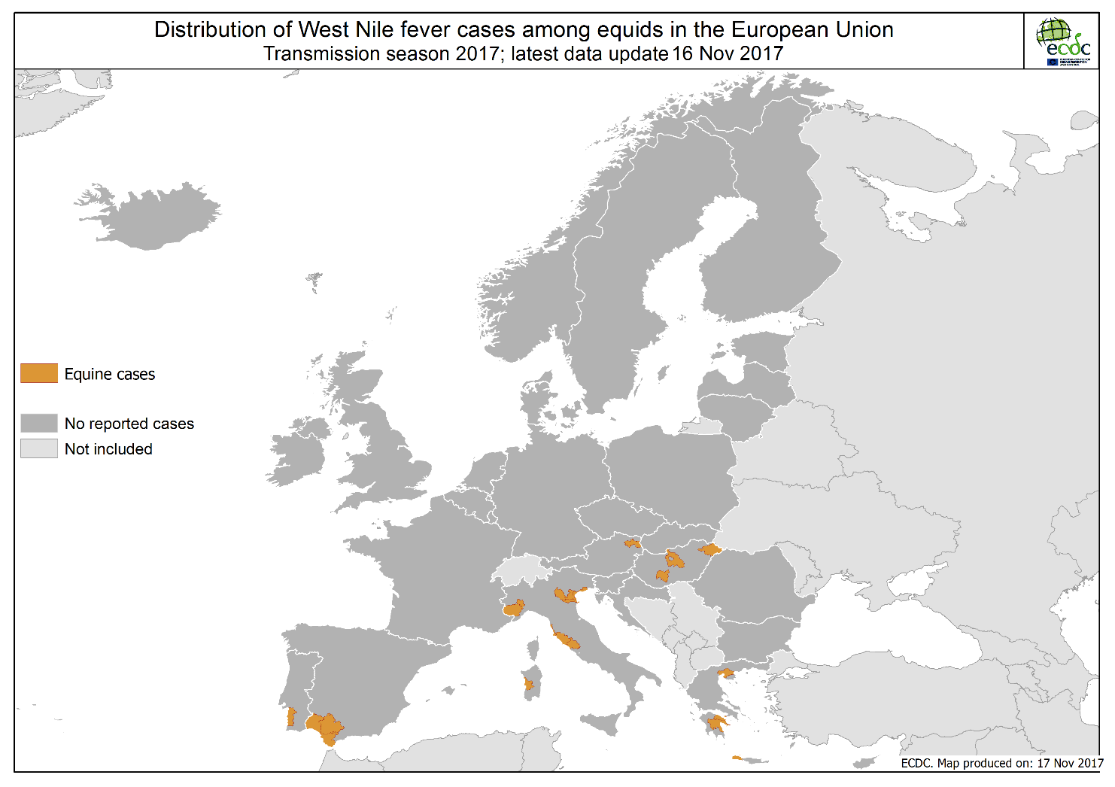

Slide 5
Number of autochthonous malaria cases by week of reporting as of week 45 - 2017, Cape Verde

Slide 6
Distribution of cumulative cholera cases, worldwide, data entered on 11 October and 15 November 2017
Continent | Country | 11 Oct 2017* |  | 15 Nov 2017* |  | Difference new cases Nov vs total cases Oct
 |  | Cases | Deaths | Cases | Deaths | Cases | Deaths | Increase of cases % | Increase of deaths %
Africa | Nigeria | 7 052 | 149 | 8 852 | 157 | + 1800 | + 8 | +26% | +5%
 | DR Congo | 31 646 | 629 | 42 334 | 838 | + 10 688 | + 209 | +34% | +33%
 | Burundi | 38 | 0 | 147 | 0 | + 109 | 0 | +287% | 0
 | Kenya | 2 996 | 55 | 3 518 | 66 | + 522 | + 11 | +17% | +20%
 | South Sudan | 20 568 | 378 | 21 097 | 418 | + 529 | + 40 | +3% | +11%
 | Ethiopia | 45 268 | 856 | 47 711 | 877 | + 2 443 | + 21 | +5% | +3%
 | Chad | 445 | 56 | 895 | 65 | + 450 | + 9 | +101% | +16%
 | Uganda | 140 | 3 | 168 | 3 | + 28 | 0 | +20% | 0
 | Malawi | 36 | 0 | 52 | 0 | + 16 | 0 | +44% | 0
 | Zambia | 11 | 0 | 135 | 3 | + 124 | + 3 | +1127% | +300%
 | Angola | Unk | Unk | 375 | 21 | - | - | - | -
 | Tanzania | Unk | Unk | 3 348 | 52 | - | - | - | -
 | Mozambique | Unk | Unk | 342 | 1 | - | - | - | -
 | Somalia | Unk | Unk | 77 783 | 1 159 | - | - | - | -
America | Haiti | 10 868 | 122 | 12 167 | 138 | + 1 299 | + 16 | +12% | +13%
Asia | Yemen | 780 886 | 2 137 | 913 741 | 2 196 | + 132 855 | + 59 | +17% | +3%
 | Philippines | Unk | Unk | 1 | 0 | - | - | - | -
* Data shown is the latest available data from official reports or media.

