Slide 1
Monitoring the implementation of the TB Action Plan for the WHO European Region, 2016–2020 EU/EEA situation in 2016
ECDC Tuberculosis Programme
European Centre for Disease Prevention and Control
Stockholm, 24 March 2018

Slide 2
Three areas of intervention with 26 indicators to assess countries’ performance in tackling TB*
Integrated patient-centred care and prevention
Bold policies and supportive system
Intensified research and innovation
* 19 indicators out of 26 are analysed for 2016

Slide 3
1. Integrated patient-centred care and prevention

Slide 4
1.A. Systematic screening of contacts and high-risk groups
Indicator 1.A.1 Percentage of coverage for population at risk with systematic screening for active TB and latent tuberculosis infection (LTBI) (only TB contacts evaluated), 2016
Target: 80%
Status 2016: Five countries reported data, four countries met the target
Source: ECDC/WHO (2018). Tuberculosis surveillance and monitoring in Europe 2018– 2016 data

Slide 5
1.B. Early diagnosis of all forms of TB and universal access to drug susceptibility testing, including the use of rapid tests
Indicator 1.B.1 Percentage of newly notified TB patients diagnosed using WHO-recommended rapid tests
Target: 40%
Status 2016: 25 countries reported data, nine met the target
Source: ECDC/WHO (2018). Tuberculosis surveillance and monitoring in Europe 2018– 2016 data

Slide 6
1.B. Early diagnosis of all forms of TB and universal access to drug susceptibility testing, including the use of rapid tests
Indicator 1.B.2 First-line drug susceptibility testing (DST) coverage (%) among all bacteriologically confirmed TB cases (G1)
Target: 100%
Status 2016: 30 countries reported data, seven met the target
Target = 100%
Source: ECDC/WHO (2018). Tuberculosis surveillance and monitoring in Europe 2018– 2016 data

Slide 7
1.B. Early diagnosis of all forms of TB and universal access to drug susceptibility testing, including the use of rapid tests
Indicator 1.B.3: Percentage of rifampicin-resistant and multidrug-resistant (RR/MDR) TB case detection rate (%)
Target: 85%
Status 2016: 24 countries reported data, nine met the target
Source: ECDC/WHO (2018). Tuberculosis surveillance and monitoring in Europe 2018– 2016 data

Slide 8
1.B. Early diagnosis of all forms of TB and universal access to drug susceptibility testing, including the use of rapid tests
Indicator 1.B.4 TB notification rate per 100 000 population (E1)
Target: below 24.6
Status 2016: 30 countries reported data, 27 met the target
Source: ECDC/WHO (2018). Tuberculosis surveillance and monitoring in Europe 2018– 2016 data

Slide 9
1.B. Early diagnosis of all forms of TB and universal access to drug susceptibility testing, including the use of rapid tests
Indicator 1.B.5: percentage of TB case detection rate (%)
Target: 84%
Status 2016: 30 countries reported data, 26 met the target
Source: ECDC/WHO (2018). Tuberculosis surveillance and monitoring in Europe 2018– 2016 data

Slide 10
1.B. Early diagnosis of all forms of TB and universal access to drug susceptibility testing, including the use of rapid tests
Indicator 1.B.6 Percentage of RR/MDR TB among new TB patients (E2)
Target: Decreasing percentage compared to baseline in 2014
Status 2016: 30 countries reported data, 14 met the target
Source: ECDC/WHO (2018). Tuberculosis surveillance and monitoring in Europe 2018– 2016 data

Slide 11
1.B. Early diagnosis of all forms of TB and universal access to drug susceptibility testing, including the use of rapid tests
Indicator 1.B.7 Percentage of RR/MDR TB among previously treated TB patients
Target: Decreasing percentage compared to baseline in 2014
Status 2016: 24 countries participated, 14 met the target
Source: ECDC/WHO (2018). Tuberculosis surveillance and monitoring in Europe 2018– 2016 data

Slide 12
1.C. Equitable access to quality treatment and continuum of care for all people with tuberculosis, including drug-resistant tuberculosis; and patient support to facilitate treatment adherence
Indicator 1.C.1 Percentage of hospitalisation among new TB patients (E3)
Target: Decreasing percentage compared to baseline in 2014 (data for 2014 not available)
Status 2016: 18 countries reported data
Source: ECDC/WHO (2018). Tuberculosis surveillance and monitoring in Europe 2018– 2016 data

Slide 13
1.C. Equitable access to quality treatment and continuum of care for all people with tuberculosis, including drug-resistant tuberculosis; and patient support to facilitate treatment adherence
Indicator 1.C.2 Percentage of detected RR/MDR TB enrolled in treatment
Target: 100%
Status 2016: 26 Member States reported data, 22 met the target
Source: ECDC/WHO (2018). Tuberculosis surveillance and monitoring in Europe 2018– 2016 data

Slide 14
1.C. Equitable access to quality treatment and continuum of care for all people with tuberculosis, including drug-resistant tuberculosis; and patient support to facilitate treatment adherence
Indicator 1.C.3 Treatment success rate (G2)
Target: 85% for new and relapse cases
Status 2016: 24 Member States reported data, six met the target
Source: ECDC/WHO (2018). Tuberculosis surveillance and monitoring in Europe 2018– 2016 data

Slide 15
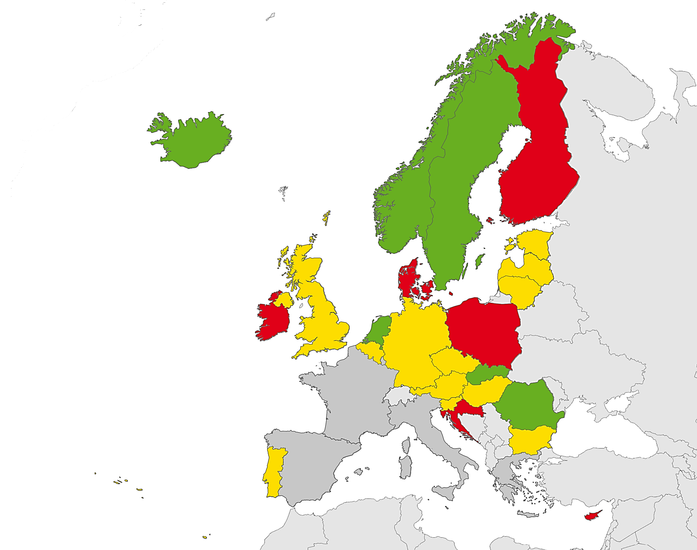
1.C. Equitable access to quality treatment and continuum of care for all people with tuberculosis, including drug-resistant tuberculosis; and patient support to facilitate treatment adherence
Indicator 1.C.3: Treatment success rate
Target: 85% for new and relapse cases
Status 2016: 24 Member States reported data, six met the target
Proportion of treatment success
< 60%
60 to 84.9%
≥ 85%
Not reporting
Source: ECDC/WHO (2018). Tuberculosis surveillance and monitoring in Europe 2018– 2016 data

Slide 16
1.C. Equitable access to quality treatment and continuum of care for all people with tuberculosis, including drug-resistant tuberculosis; and patient support to facilitate treatment adherence
Indicator 1.C.4 TB treatment success rate among the RR/MDR TB cohort, 2016
Target: 75% for new and relapse RR/MDR TB cases
Status 2016: 20 Member States reported data, four met the target
Source: ECDC/WHO (2018). Tuberculosis surveillance and monitoring in Europe 2018– 2016 data

Slide 17
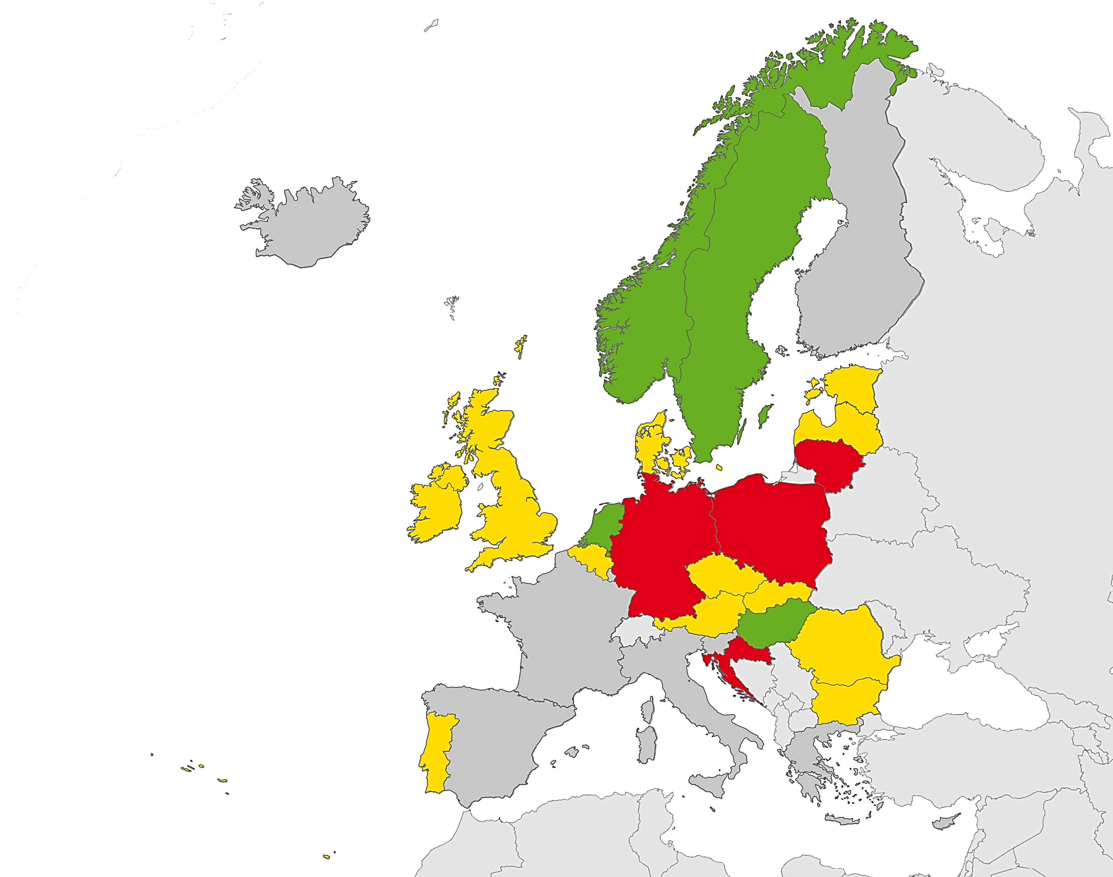
1.C. Equitable access to quality treatment and continuum of care for all people with tuberculosis, including drug-resistant tuberculosis; and patient support to facilitate treatment adherence
Indicator 1.C.4: TB treatment success rate among the RR/MDR TB cohort, 2016
Target: 75% for new and relapse RR/MDR TB cases
Status 2016: 20 Member States reported data, four met the target
Proportion of treatment success
< 40%
40 to 74.9%
≥ 75%
Not reporting
Source: ECDC/WHO (2018). Tuberculosis surveillance and monitoring in Europe 2018– 2016 data

Slide 18
1.C. Equitable access to quality treatment and continuum of care for all people with tuberculosis, including drug-resistant tuberculosis; and patient support to facilitate treatment adherence
Indicator 1.C.5 TB mortality rate (ICD A15-19)*
Target: below 2.7 deaths for WHO European Region
Status 2016: calculated for 30 EU/EEA countries, 28 met the target
*WHO estimates for 2016
Source: ECDC/WHO (2018). Tuberculosis surveillance and monitoring in Europe 2018– 2016 data

Slide 19
1.D. Collaborative TB/HIV activities, and management of relevant co-morbidities
Indicator 1.D.1 Percentage of detected cases among estimated incident TB/HIV co-infected cases
Target: 100%
Status 2016: 16 Member States reported data, one met the target
Source: ECDC/WHO (2018). Tuberculosis surveillance and monitoring in Europe 2018– 2016 data

Slide 20
1.D. Collaborative TB/HIV activities, and management of relevant co-morbidities
Indicator 1.D.2 HIV testing coverage
Target: 100%
Status 2016: 20 Member States reported data, one met the target
Target=100%
Source: ECDC/WHO (2018). Tuberculosis surveillance and monitoring in Europe 2018– 2016 data

Slide 21
1.D. Collaborative TB/HIV activities, and management of relevant co-morbidities
Indicator 1.D.3 Percentage of HIV co-infection among all TB (new and relapse TB cases)
Target: Decrease compared to baseline in 2014
Status 2016: 20 Member States reported data, 10 met the target
Source: ECDC/WHO (2018). Tuberculosis surveillance and monitoring in Europe 2018– 2016 data

Slide 22
1.D. Collaborative TB/HIV activities, and management of relevant co-morbidities
Indicator 1.D.4 Percentage of HIV/TB co-infected patients enrolled in antiretroviral therapy (ART)
Target: 100%
Status 2016: 8 Member States reported data, four met the target
Source: ECDC/WHO (2018). Tuberculosis surveillance and monitoring in Europe 2018– 2016 data

Slide 23
1.D. Collaborative TB/HIV activities, and management of relevant co-morbidities
Indicator 1.D.5 LTBI treatment enrolment rate (%) among people living with HIV/AIDS (PLHIV)
Target: 30%
Status 2016: Data were not available for 2016
Source: ECDC/WHO (2018). Tuberculosis surveillance and monitoring in Europe 2018– 2016 data

Slide 24
1.E. Management of latent tuberculosis infection and preventive treatment of persons at high risk, and vaccination against tuberculosis
Indicator 1.E.1: Percentage contact investigation coverage
Target: 90%
Status 2016: 4 Member States reported data, four met the target
Target = 90%
Source: ECDC/WHO (2018). Tuberculosis surveillance and monitoring in Europe 2018– 2016 data

Slide 25
1.E. Management of latent tuberculosis infection and preventive treatment of persons at high risk, and vaccination against tuberculosis
Indicator 1.E.2: Percentage of LTBI treatment coverage among childhood TB contacts aged under five years
Target: 90%
Status 2016: Three Member States reported data, one met the target
Target = 90%
Source: ECDC/WHO (2018). Tuberculosis surveillance and monitoring in Europe 2018– 2016 data

Slide 26
2. Bold policies and supportive systems

Slide 27
2.A. Political commitment with adequate resources, including universal health coverage policy
Indicator 2.A.1 Number of Member States that have a regular TB control/elimination performance publication every five years (E8)
Target: TB control/elimination performance publication published
Status 2016: Data were not available for 2016
2.B. Health systems strengthening in all functions, including well-aligned financing mechanisms for tuberculosis and human resources
Indicator 2.B.1 Percentage of TB patients and their households that experience catastrophic financial consequences due to TB (G8) (E9)
Target: Close to 0
Status 2016: Data were not available for 2016
Source: ECDC/WHO (2018). Tuberculosis surveillance and monitoring in Europe 2018– 2016 data

Slide 28
2.C. Regulatory frameworks for case-based surveillance, strengthening vital registration, quality and rational use of medicines, and pharmacovigilance
Indicator 2.C.1 Treatment coverage with new TB drugs (%)
Target: 20%
Status 2016: Data were not available for 2016
2.D. Community systems and civil society engagement
Indicator 2.D.1 Number of Member States with functioning multi-stakeholder coalitions advocating for TB care and resources
Target: Not defined
Status 2016: Data were not available for 2016
Source: ECDC/WHO (2018). Tuberculosis surveillance and monitoring in Europe 2018– 2016 data

Slide 29
2.E. Social protection, poverty alleviation and actions on other determinants of tuberculosis, such as migration and prisons
Indicator 2.E.1: Percentage treatment success of new and relapse TB cases among prisoners
Target: 85%
Status 2016: 13 countries reported data, four met the target
Source: ECDC/WHO (2018). Tuberculosis surveillance and monitoring in Europe 2018– 2016 data

Slide 30
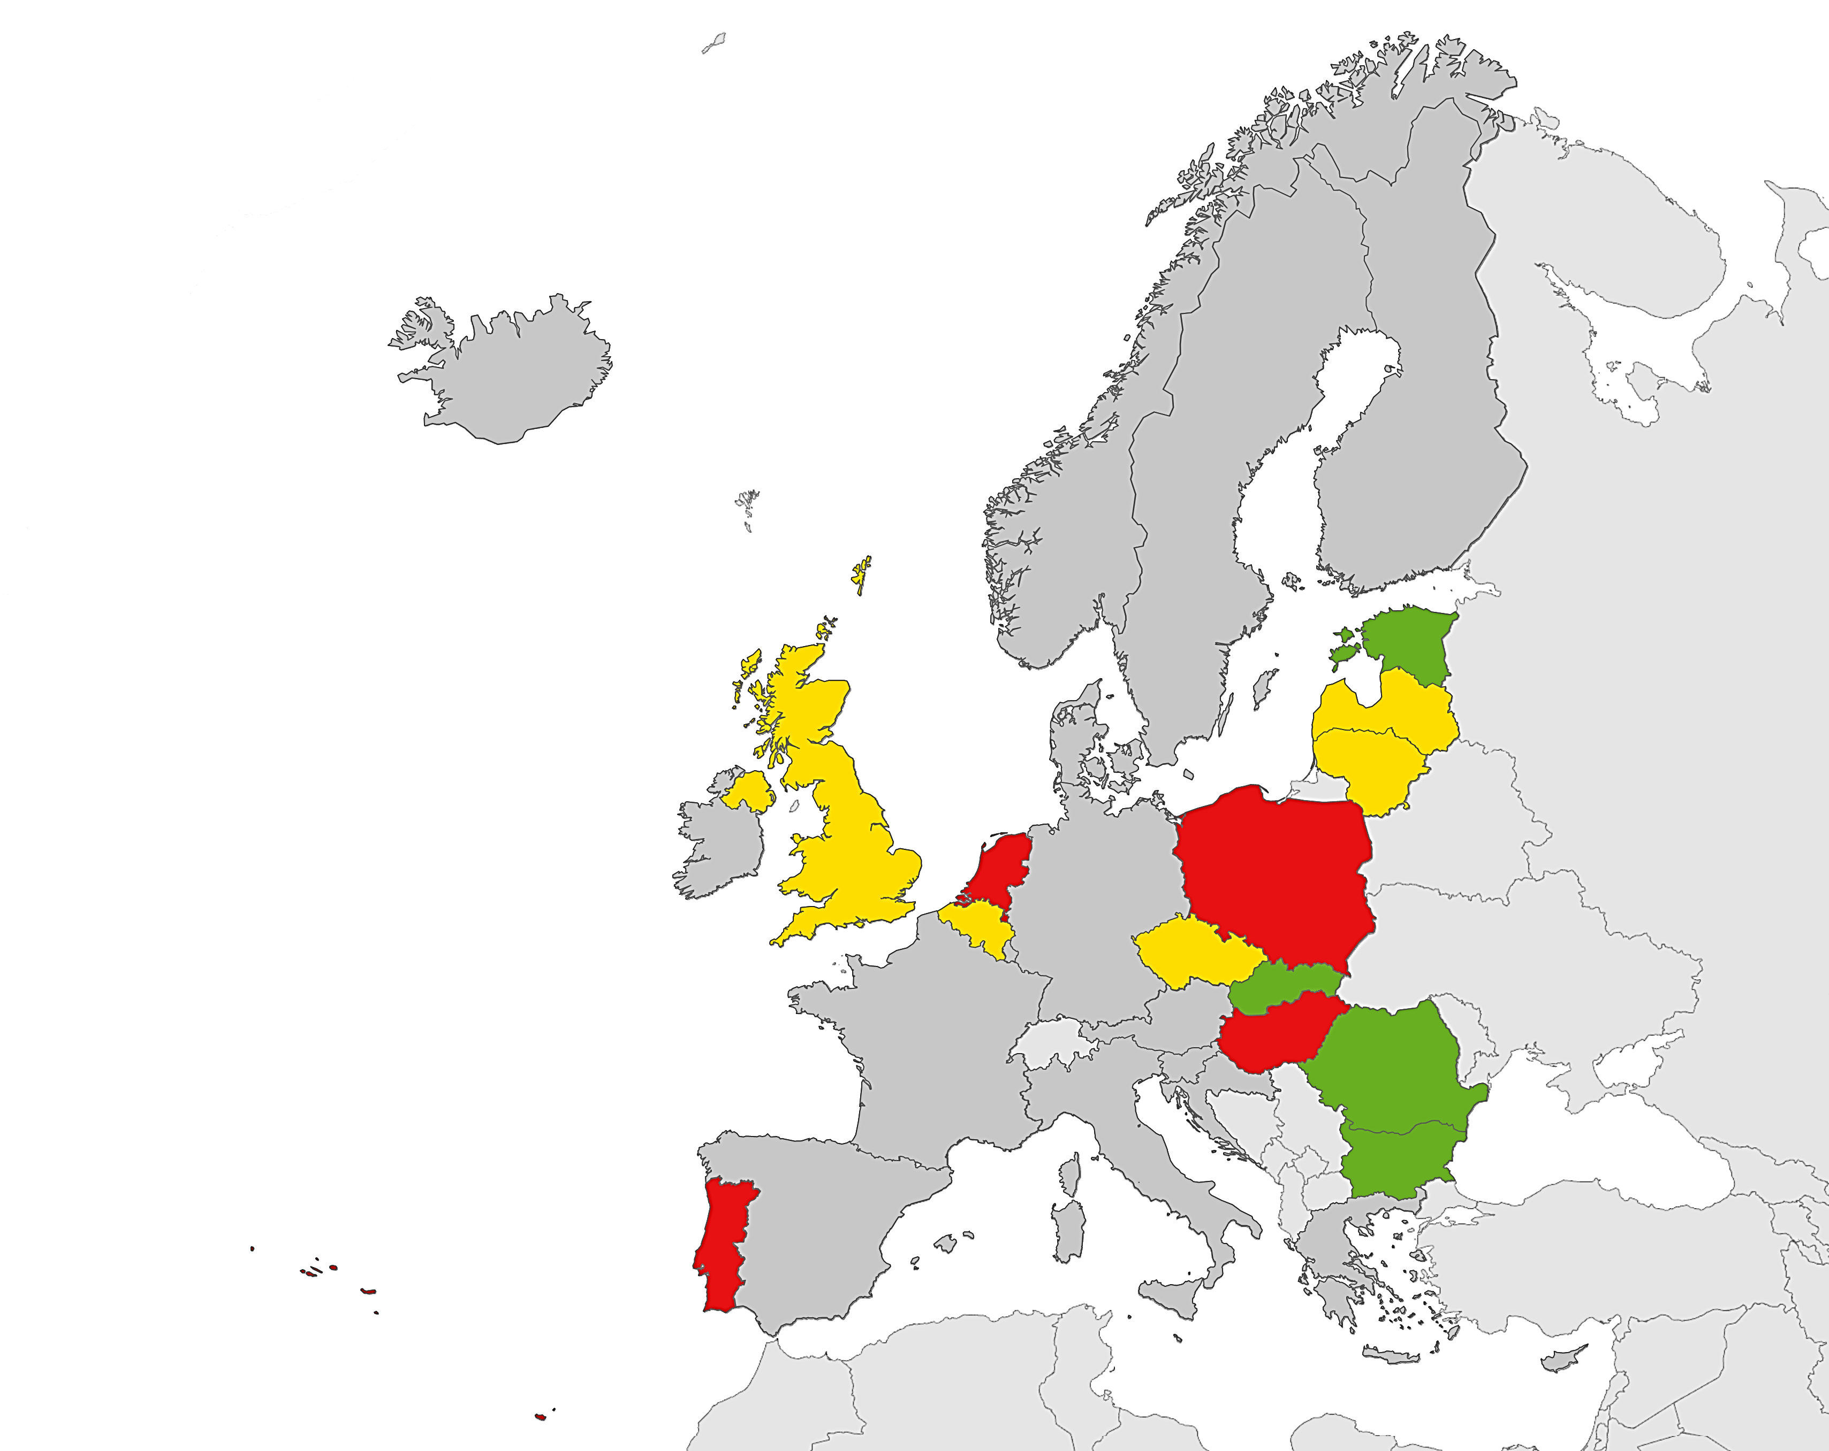
2.E. Social protection, poverty alleviation and actions on other determinants of tuberculosis, such as migration and prisons
Indicator 2.E.1 Treatment success of new and relapse TB cases among prisoners
Target: 85%
Status 2016: 13 countries reported data, four met the target
Proportion of treatment success
< 60%
60 to 84.9%
≥ 85%
Not reporting
Source: ECDC/WHO (2018). Tuberculosis surveillance and monitoring in Europe 2018– 2016 data

Slide 31
3. Intensified research and innovation

Slide 32
3.A. Discovery, development and rapid uptake of new tools, interventions and strategies
Indicator 3.A.1 European Tuberculosis Research Initiative established by mid-2016
Target: Established
Status 2016: Country-specific indicators are not defined for 2016
Source: ECDC/WHO (2018). Tuberculosis surveillance and monitoring in Europe 2018– 2016 data

Slide 33
Summary by activity related to areas of intervention, EU/EEA, 2016
Integrated, patient-centred care and prevention
Five activities with 20 indicators defined, nine targets met at EU/EEA level, seven targets not met, and one target not defined.
2. Bold policies and supportive system
Five activities with five indicators defined, for four targets data were not available for EU/EEA countries, one target not met.
3. Intensified research and innovation
One activity with one indicator defined and country level target not defined.

