Slide 1
Situation overview on hepatitis E in the EU/EEA Member States

Slide 2
Surveillance of hepatitis E in Europe
One of the most common causes of acute hepatitis in the EU/EEA
Evidence of increasing number of autochthonous cases in Europe
Hepatitis E is not notifiable at EU level
Populations under surveillance, case definitions and reporting systems, are set by Member States

Slide 3
Key objectives of current work at EU level on HEV
To describe national surveillance systems, case definitions and laboratory methods for diagnosis
To collect case numbers, where possible, to describe epidemiology, burden and severity (clinical picture) across Europe
To describe populations at risk
To explore rationale and objectives of national hepatitis E surveillance

Slide 4
ECDC activities 2015–2019
Establishment of an expert group
Members are nominated experts from the EU/EEA MS + 3 external scientific experts + EFSA + WHO
EU/EEA Member State survey
Surveillance systems, applied case definitions and laboratory methods for diagnosis, collect case numbers
Support of a voluntary centralised sequence data repository
Facilitate communication, support development and first HEVnet meeting
https://eurosurveillance.org/content/10.2807/1560-7917.ES.2019.24.10.1800407
Expert opinion on national surveillance standards

Slide 5
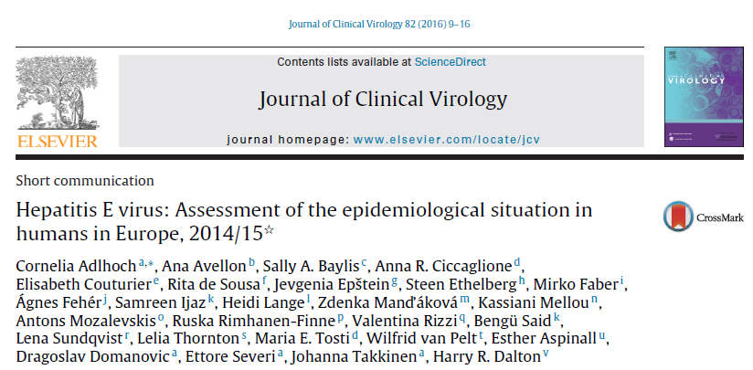
Hepatitis E virus: Assessment of the epidemiological situation in humans in Europe, 2014/15

Slide 6
Presentations from ECDC expert group meetings, 2015 and 2018
https://www.slideshare.net/tag/ecdc-hev-meeting-2018
https://www.slideshare.net/tag/ecdc-hev-meeting-2015

Slide 7
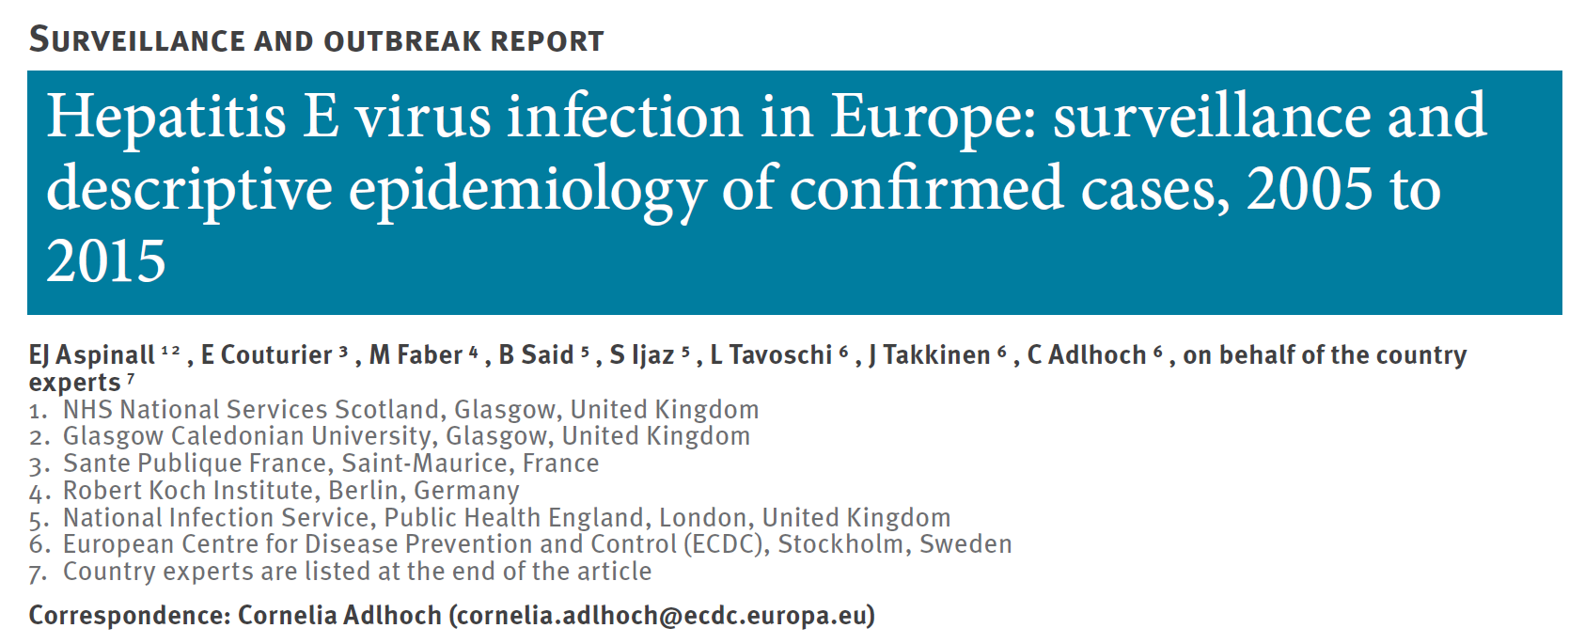
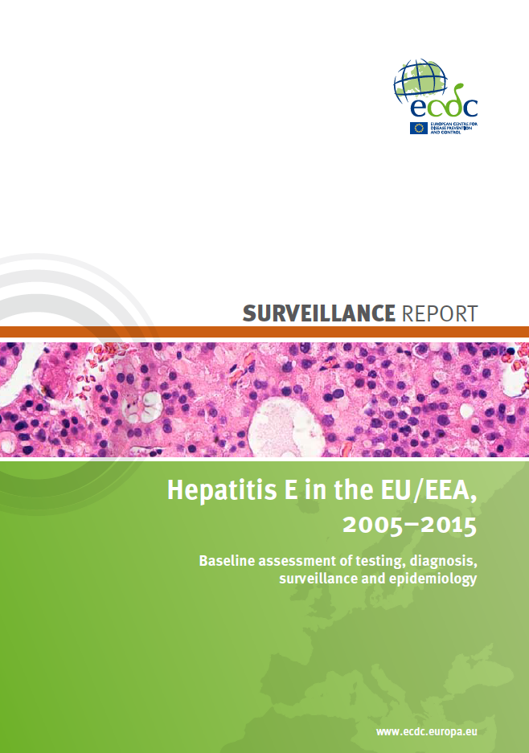
EU/EEA Member State survey
https://ecdc.europa.eu/en/publications-data/hepatitis-e-eueea-2005-2015
https://eurosurveillance.org/content/10.2807/1560-7917.ES.2017.22.26.30561

Slide 8
Emergence and surveillance of hepatitis E in humans, EU/EEA, 2005–2015
Study objective:
Provide an overview of national surveillance systems, applied case definitions, laboratory methods for diagnosis, and numbers of confirmed HEV cases across the EU/EEA
https://ecdc.europa.eu/en/publications-data/hepatitis-e-eueea-2005-2015
https://eurosurveillance.org/content/10.2807/1560-7917.ES.2017.22.26.30561

Slide 9
Methods
Questionnaire developed and piloted with participants at an ECDC HEV expert group meeting
Electronic PDF survey sent to all 31 Member States
Response from 30/31 EU/EEA countries
Descriptive analysis of surveillance systems, number of cases by age, gender, hospitalisation status, number of deaths
https://ecdc.europa.eu/en/publications-data/hepatitis-e-eueea-2005-2015
https://eurosurveillance.org/content/10.2807/1560-7917.ES.2017.22.26.30561
Notes:
National Focal Points for Food and Waterborne Diseases and Zoonosis,
National and Operational Contact Points for microbiology and surveillance

Slide 10
HEV surveillance systems in EU/EEA, 2015
20 EU/EEA countries with HEV-specific surveillance
https://ecdc.europa.eu/en/publications-data/hepatitis-e-eueea-2005-2015
https://eurosurveillance.org/content/10.2807/1560-7917.ES.2017.22.26.30561

Slide 11
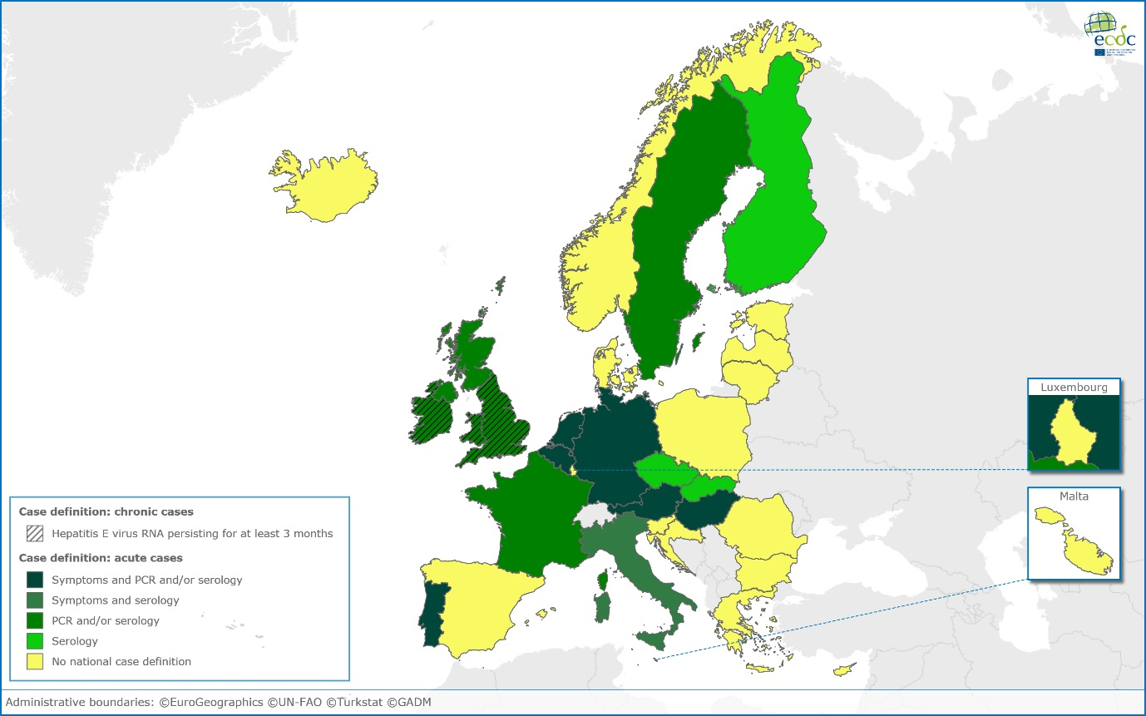
HEV case definitions in EU/EEA surveillance systems
Case definitions varied across countries, two countries with case definitions for chronic cases
https://ecdc.europa.eu/en/publications-data/hepatitis-e-eueea-2005-2015
https://eurosurveillance.org/content/10.2807/1560-7917.ES.2017.22.26.30561
Notes:
Case definitions varied across countries with three having additional case definitions for chronic cases.
PCR only: 1 (3%)
PCR and/or serology: 9 (30%)
Serology only: 2 (7%)
No case definition: 8 (27%)

Slide 12
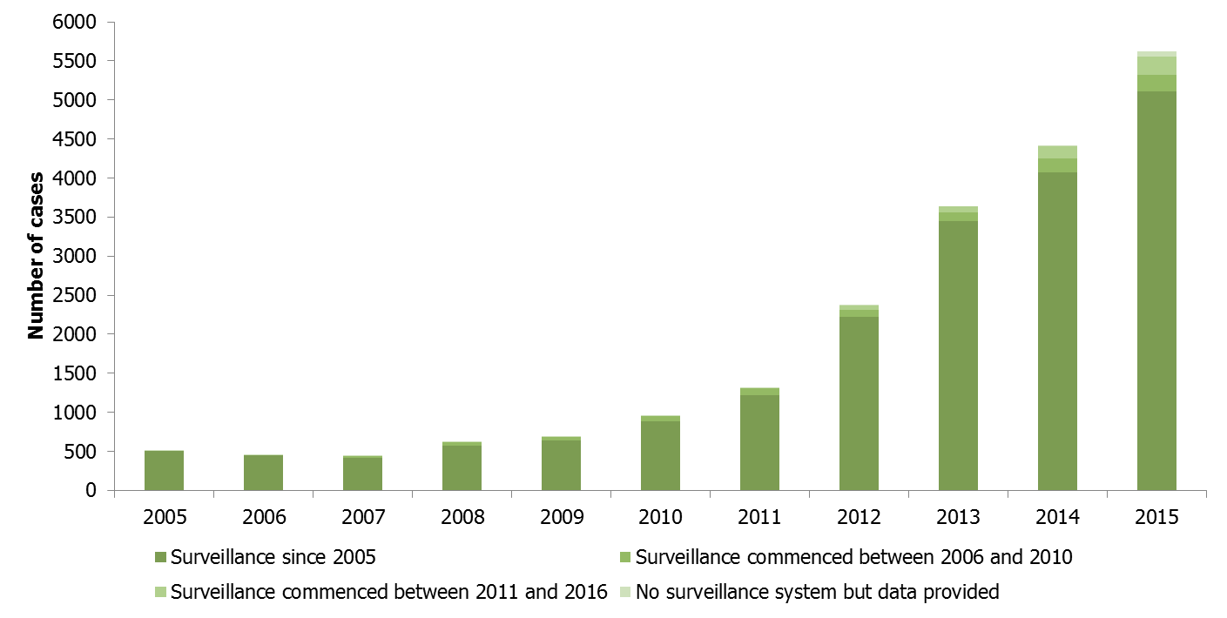
Number of laboratory-confirmed cases of HEV by year and start of surveillance, 22 EU/EEA Member States, 2005–2015*
10-fold increase 2005–2015 due locally acquired infections
78% of cases reported from France, Germany and UK
* Data available for: Austria, Belgium, Bulgaria, Croatia, Cyprus, Czech Republic, Estonia, Finland, France, Germany, Hungary, Italy, Latvia, Netherlands, Norway, Poland, Portugal, Slovakia, Slovenia, Spain, Sweden, United Kingdom
Notes:
Laboratory-confirmed cases were reported from 22 countries and showed a nearly 10-fold increase between 2005 and 2015 due to an increase of autochthonous cases. Three Western EU/EEA countries contributed to more than 75% of the cases while lower numbers were seen in Northern and Southern European countries.
Infections were predominantly caused by HEV genotype 3, the most prevalent virus type in the animal reservoirs.

Slide 13
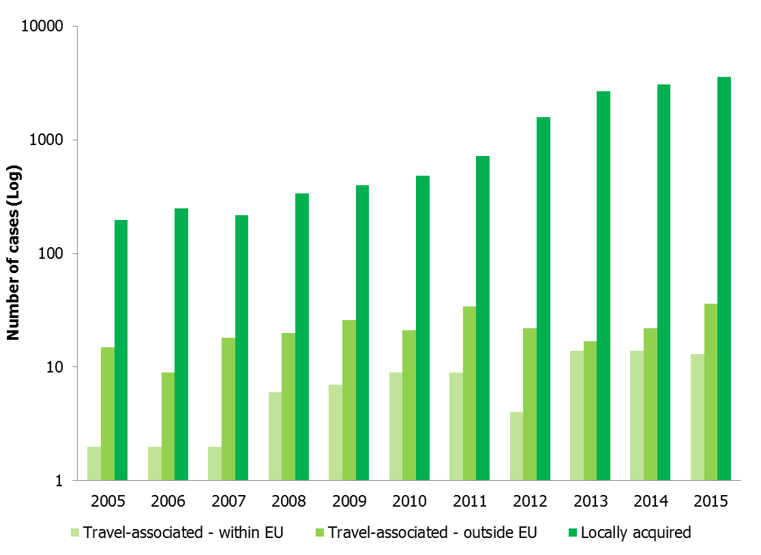
Confirmed cases of hepatitis E by travel history and year, 15 EU/EEA Member States 2005–2015*
*Data on travel history available for: Austria, Croatia, Czech Republic, Estonia, France, Hungary, Italy, Latvia, Poland, Portugal, Slovakia, Slovenia, Spain, Sweden, United Kingdom (England, Wales, Northern Ireland);

Slide 14
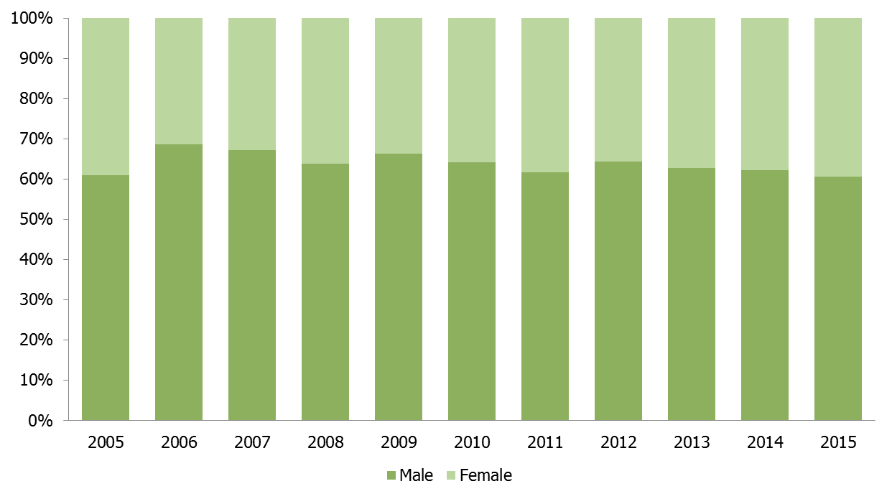
Proportion of confirmed HEV cases by sex and year in 17 EU/EEA Member States, 2005–2015*
The proportion of male cases ranged between 61% and 69% overall
* Data on cases by sex available for: Austria, Belgium, Croatia, Czech Republic, Estonia, Finland, Germany, Hungary, Italy, Latvia, Poland, Portugal, Slovakia, Slovenia, Spain, Sweden, United Kingdom (Northern Ireland, Scotland)

Slide 15
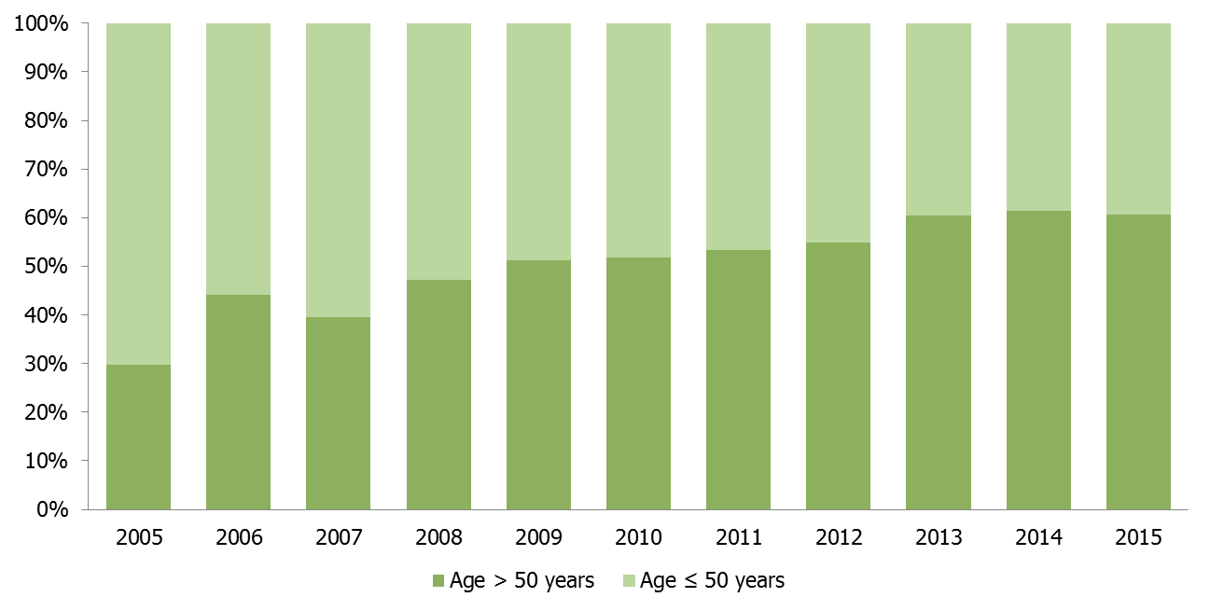
Proportion of HEV confirmed cases by age group and year in 16 EU/EEA Member States, 2005–2015*
The proportion of cases over 50 years of age increased between 2005–2015 from 30% to 61%
* Data on cases by age group available for: Austria, Belgium, Croatia, Czech Republic, Finland, Germany, Hungary, Italy, Latvia, Poland, Portugal, Slovakia, Slovenia, Spain, Sweden, United Kingdom (Northern Ireland, Scotland)

Slide 16
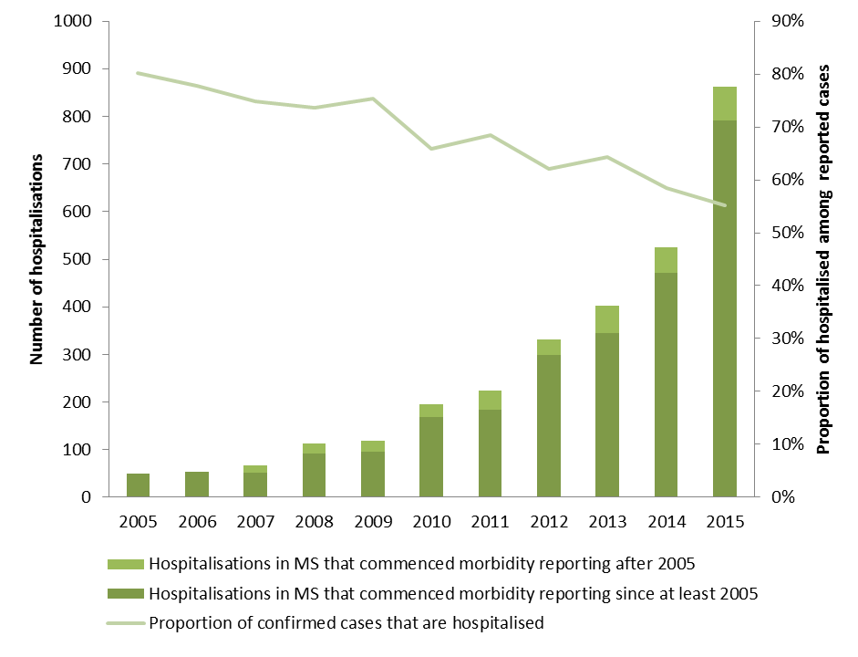
Number of hospitalisations in confirmed HEV cases in 14 EU/EEA Member States, 2005–2015*
The proportion of hospitalised cases decreased
-> higher awareness in non-hospital settings and inclusion of HEV in routine diagnosis?
* Data on hospitalisation available for: Austria, Belgium, Croatia, Czech Republic, Estonia, Germany, Hungary, Italy, Latvia, Poland, Portugal, Slovakia, Slovenia, United Kingdom (Northern Ireland)
Notes:
The pooled number of hospitalisations increased from 50 in 2005 to 861 in 2015 in 14 reporting countries representing up to 69% of the confirmed cases reported

Slide 17
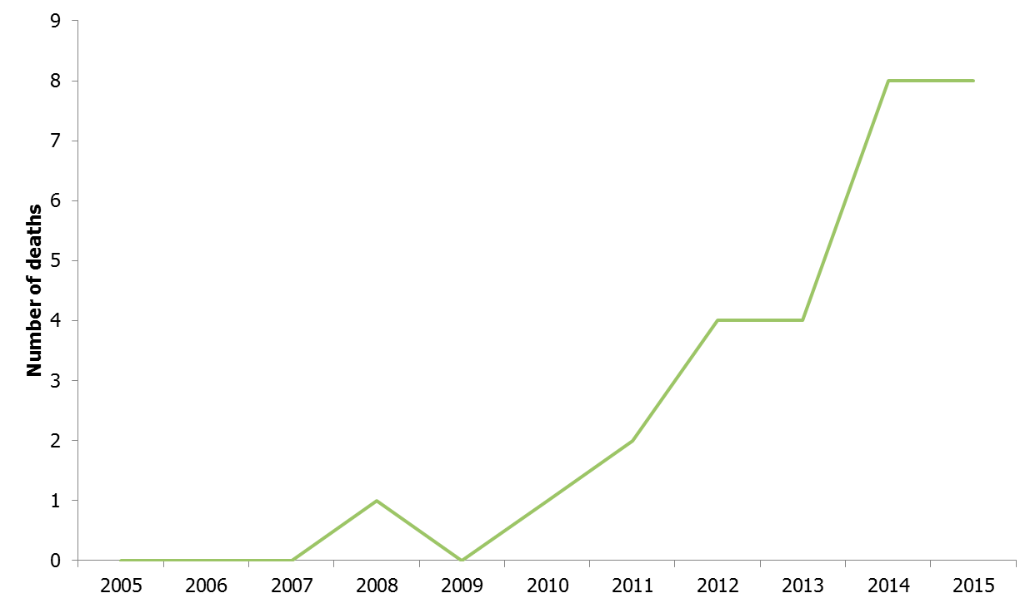
Number of deaths associated with HEV infection, 12 EU/EEA Member States, 2005–2015*
28 deaths associated with HEV infection reported from five countries
Notes:
28 deaths associated with HEV infection were reported from 12 countries during the studied period.

Slide 18
Technical guidance: suggestions for national testing and surveillance of hepatitis E

Slide 19
Technical guidance: suggestions for national testing and surveillance of hepatitis E
Objectives for national surveillance of hepatitis E infections
Suggested case definition for acute and chronic cases
Requirements for reporting hepatitis E cases and variables to be collected to achieve suggested surveillance objectives
Conclusions including expected public health impact
To be finalised and published 2019

Slide 20
Risk and prevention of HEV transmission through substances of human origin
Meeting report available on request

Slide 21
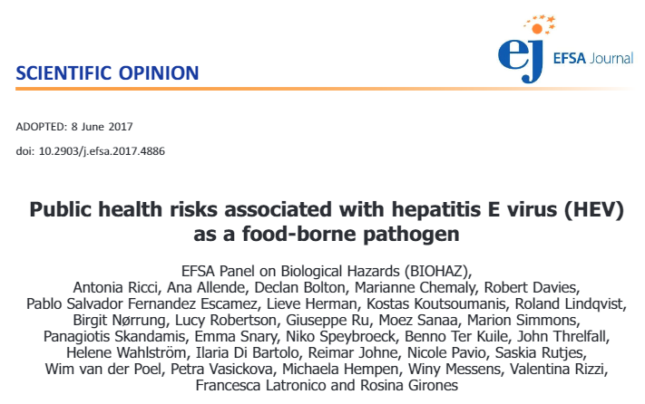
Collaboration with EFSA

Slide 22
Conclusions
20/30 countries have specific national hepatitis E surveillance system, case definitions and guidelines in place
>21,000 cases reported 2005–2015 with >5,000 in 2015
98% of the cases are locally acquired
More than 50% are diagnosed at hospitals
28 fatal cases reported from 5 countries 2005–2015
Expert opinion on national surveillance to be published in 2019

Slide 23
Acknowledgement
HEV expert group: Ana Avellon (Spain), Sally Baylis (Germany), Anna Rita Ciccaglione (Italy), Elisabeth Couturier (France, until 2017), Harry Dalton (United Kingdom), Jevgenia Epstein (Estonia), Steen Ethelberg (Denmark), Mirko Faber (Germany), Ágnes Fehér (Hungary, until 2017), Julie Figoni (France, replacement of Elisabeth Couturier from 2018), Agnetha Hofhuis (Netherlands, replacement for Wilfrid van Pelt fom 2018), Samreen Ijaz (United Kingdom), Rita Korotinska (Latvia), Heidi Lange (Norway), Zdenka Manďáková (Czech Republic), Kassiani Mellou (Greece), Niamh Murphy (Ireland, 2018 only), Joanne O’Gorman (Ireland, replacement of Lelia Thornton from 2018), Ruska Rimhanen-Finne (Finland), Bengü Said (United Kingdom), Lena Sundqvist (Sweden), Lelia Thornton (Ireland, until 2018), Maria Elena Tosti (Italy), Rita de Sousa (Portugal), Wilfrid van Pelt (Netherlands, until 2018) and Hans Zaaijer (Netherlands).
Countries providing data on HEV surveillance: Austria (Daniela Schmid, Elisabeth Kanitz), Belgium (Stéphanie Jacquinet, Steven van Gucht), Bulgaria (Kremena Parmakova), Croatia (Sanja Kurečić Filipović), Cyprus (Maria Koliou), Czech Republic (Zdenka Manďáková), Denmark (Steen Ethelberg), England&Wales (Bengü Said, Samreen Ijaz), Estonia (Jevgenia Epstein), Finland (Ruska Rimhanen-Finne), France (Henriette de Valk, Elisabeth Couturier), Germany (Mirko Faber, Sally Baylis, Jürgen Wenzel), Greece (Kassiani Mellou), Hungary (Ágnes Fehér), Iceland (Thor Gudnason), Ireland (Lelia Thornton), Italy (Maria Elena Tosti, Anna Rita Ciccaglione), Latvia (Rita Korotinska), Lithuania (Galina Zagrbneviene), Luxembourg (Patrick Hoffmann), Malta (Tanya Melillo), Netherlands, (Wilfrid van Pelt), Northern Ireland (Paul Cabrey), Norway (Line Vold, Heidi Lange), Portugal (Paula Vasconcelos, Rita de Sousa), Poland (Małgorzata Sadkowska-Todys), Romania (CNSCBT team), Scotland (Alison Smith-Palmer), Spain (Silvia Herrera León, Ana Avellon), Slovakia (Helena Hudecová, Jan Mikas), Slovenia (Eva Grilic), and Sweden (Lena Sundqvist).
ECDC: Cornelia Adlhoch, Johanna Takkinen, Ettore Severi, Dragoslav Domanovic, Lara Tavoschi, and Erika Duffell
The work was supported by two service contracts No. ECD.7600 (HEV epidemiological support - NP/2017/OCS/253) and No. ID 5132 (Hepatitis B, C, and E in the EU/EEA: monitoring and testing activities). The following staff were involved on the contractor’s side: Esther Aspinall (Glasgow Caledonian University and Health Protection Scotland), Andrew Rideout (NHS Dumfries and Galloway), Chris Biggam (Glasgow Caledonian University), Gill Hawkins (Health Protection Scotland), and Alison Smith-Palmer (Health Protection Scotland)

