Slide 1
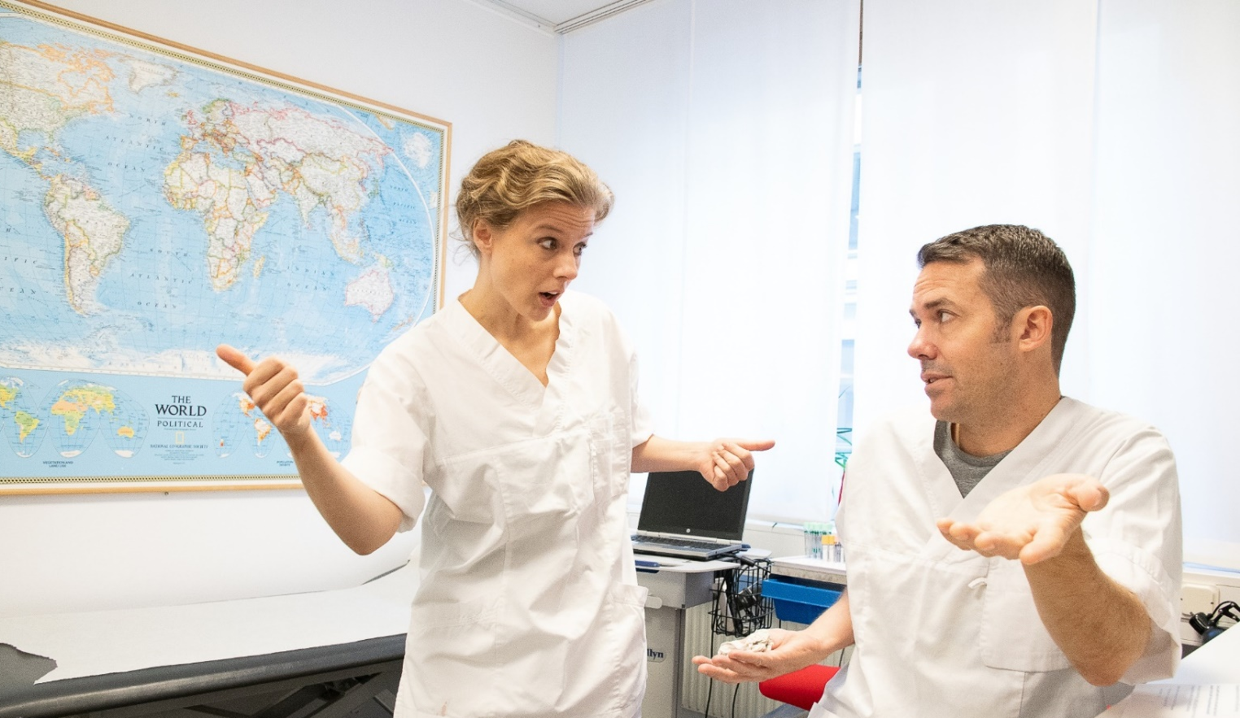
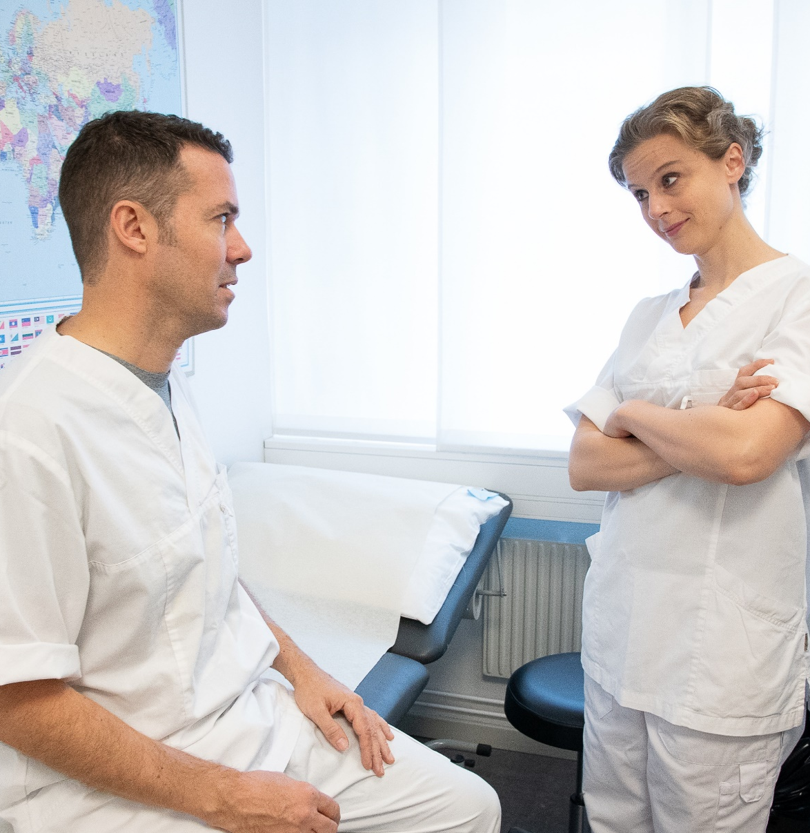
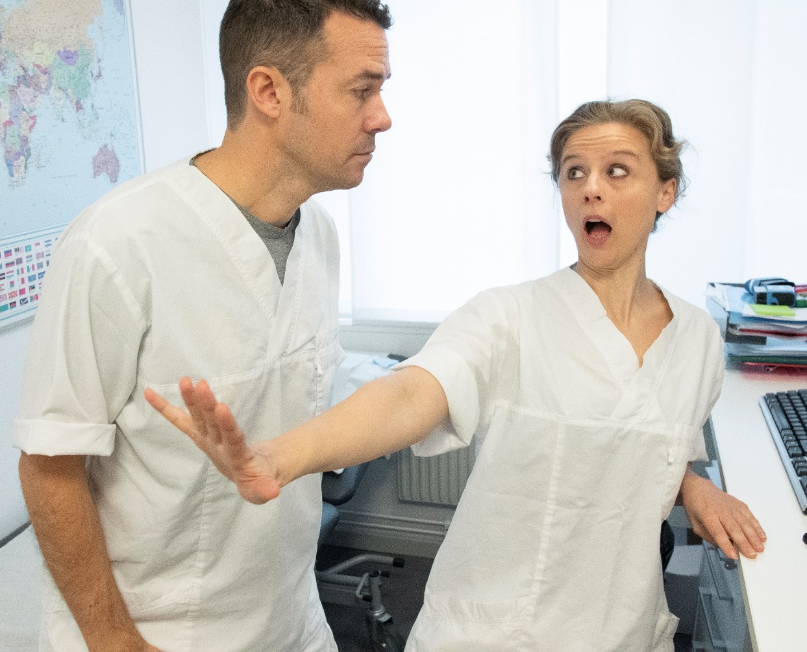
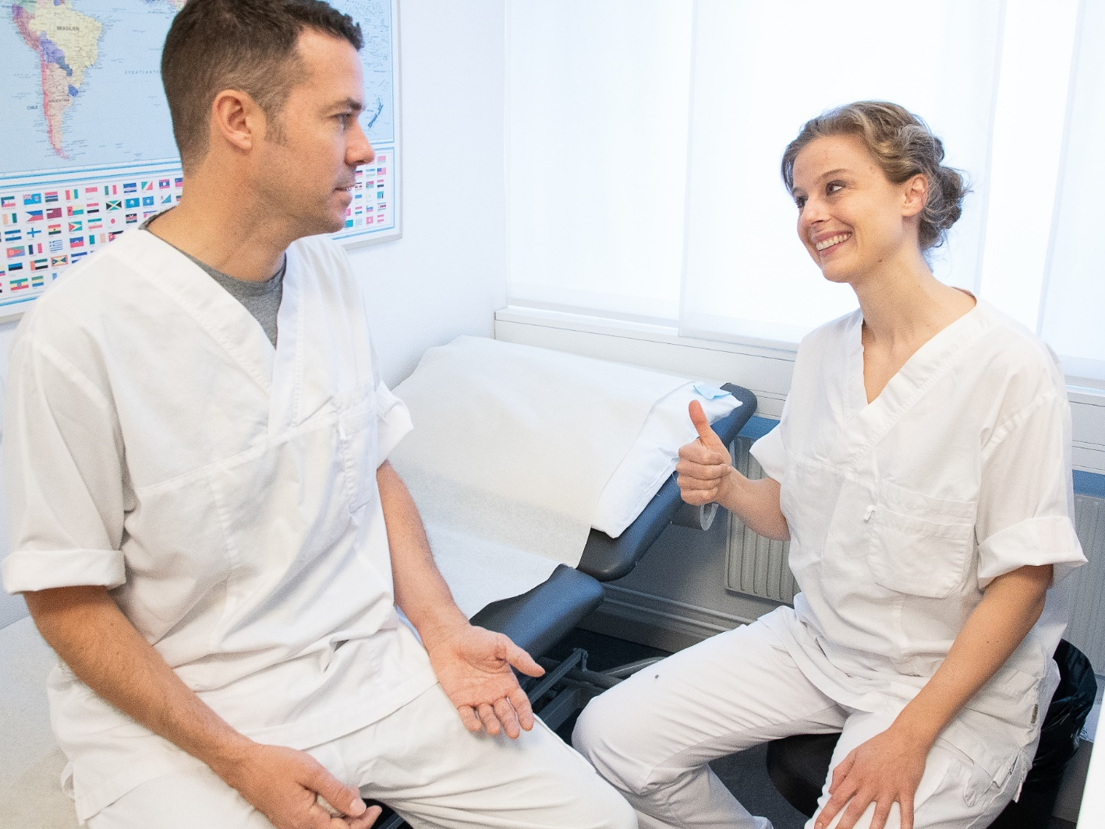
The sick doctor who didn’t want to go home
“I was contagious, but refused to go home.”
Yup. I definitely don’t feel a hundred percent today. I might have the flu.
Hey Pete, what’s the matter? You’re looking really weary.
You know what, why don’t you let me do a quick check-up?
Have you seen the waiting room? There must be 20 people out there waiting to see me.
I know, I know, but it will only take a second.
A few minutes later, both doctors are in an examination room…
Ahhhhh
Just what I thought: sore throat and a fever. It looks like you have the flu!
I really think you should go home and rest.
What are you saying?
I’ve got work to do!
Why don’t we do a rapid test to find out for sure?
Fine. That’ll take about 30 minutes, in the meantime
I’ll take care of
Mrs. Miller…
Hold it right there, my friend!
Mrs Miller?! The old lady with the bad hip? She’s in her late 70s! People 65 years or older are at increased risk for developing flu-related complications.
You sure know your public health guidelines! But I guess you are right: I should stay away from people – even if this turns out to be nothing but a cold.
I am glad you agree. The fever must’ve temporarily clouded your mind. Now go home and get some rest. I’ll take care of business.
Thanks.
And about that test… I don’t think I need it. I’ll stay home, no matter what the results.
Get well soon!
Influenza vaccination protects yourself and the people around you.
As a healthcare worker, there’s a lot you can do against the flu:
Get vaccinated each year
Wash your hands
Stay home when sick

