Slide 1
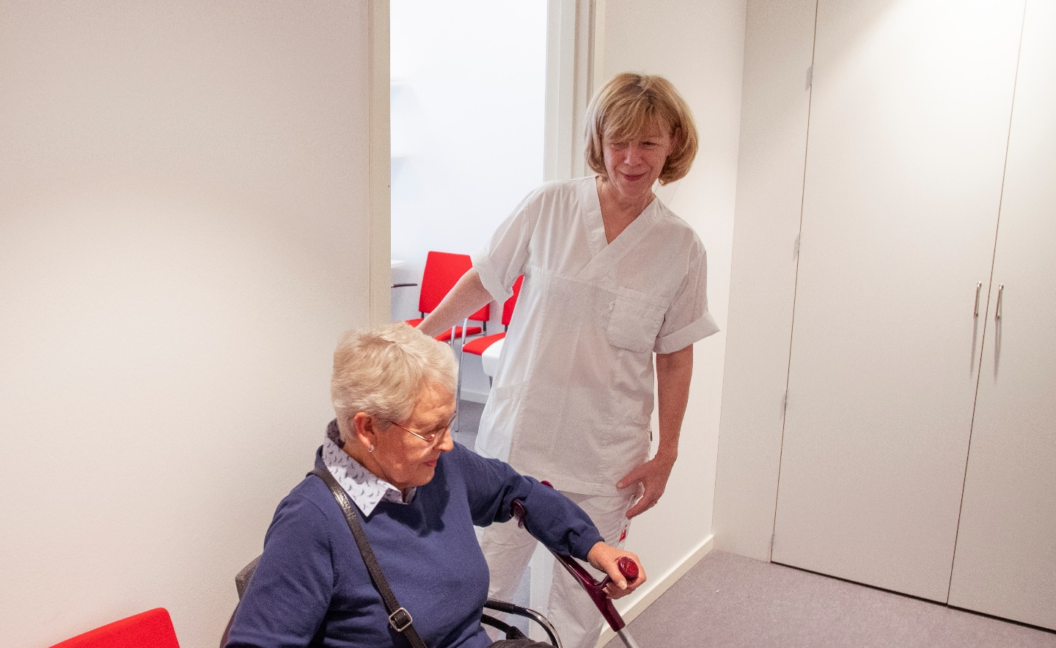
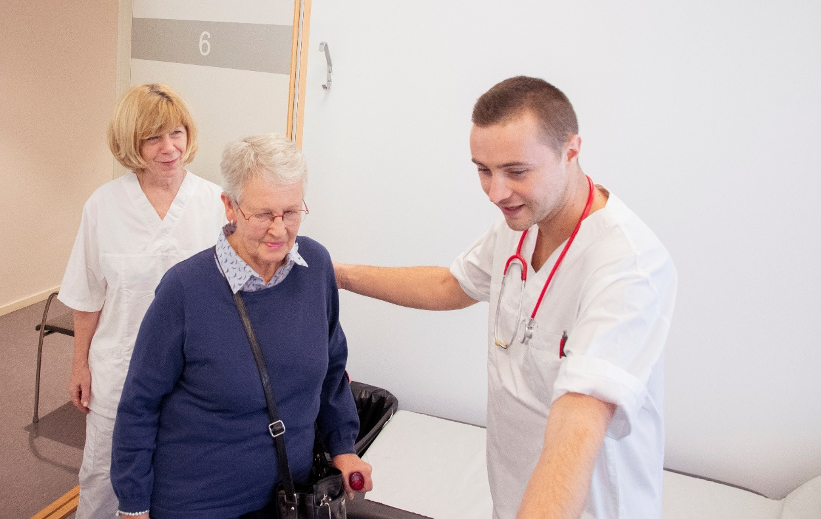
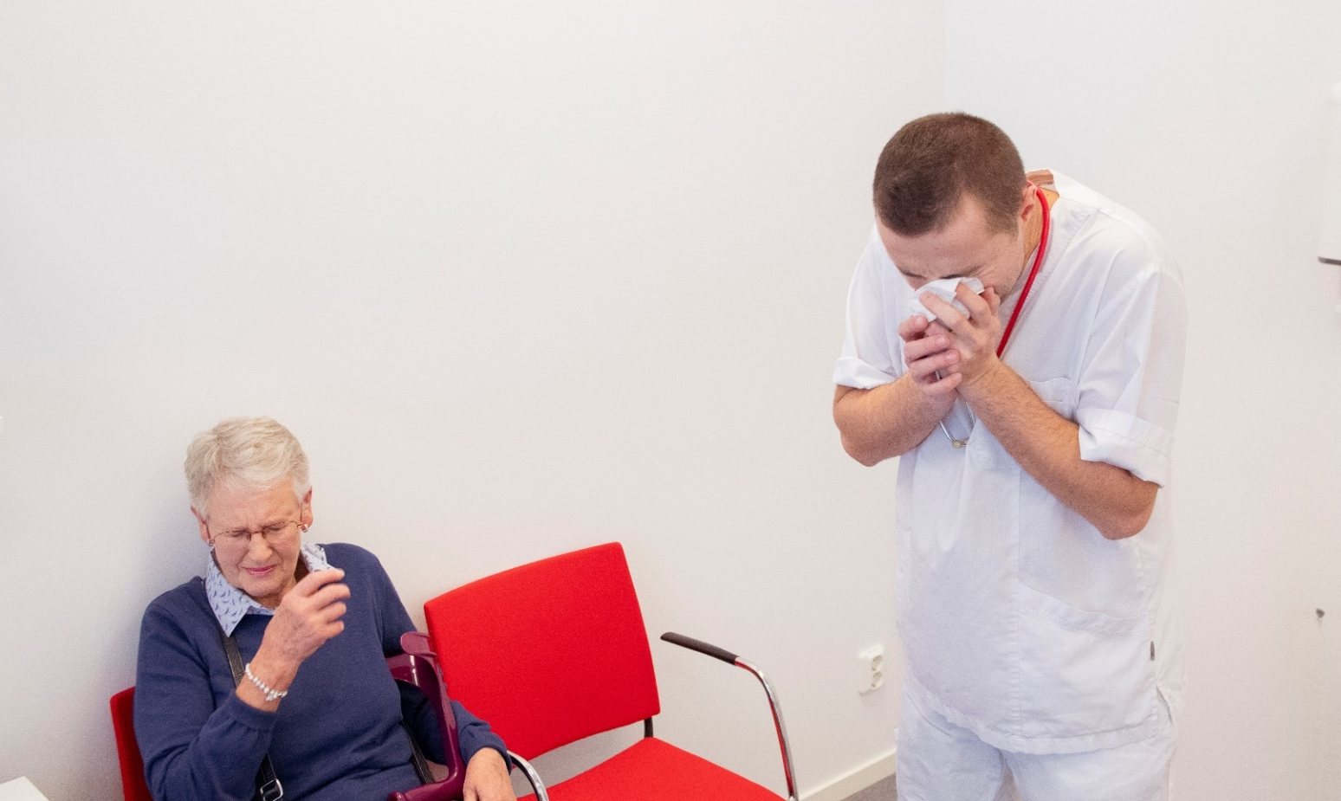
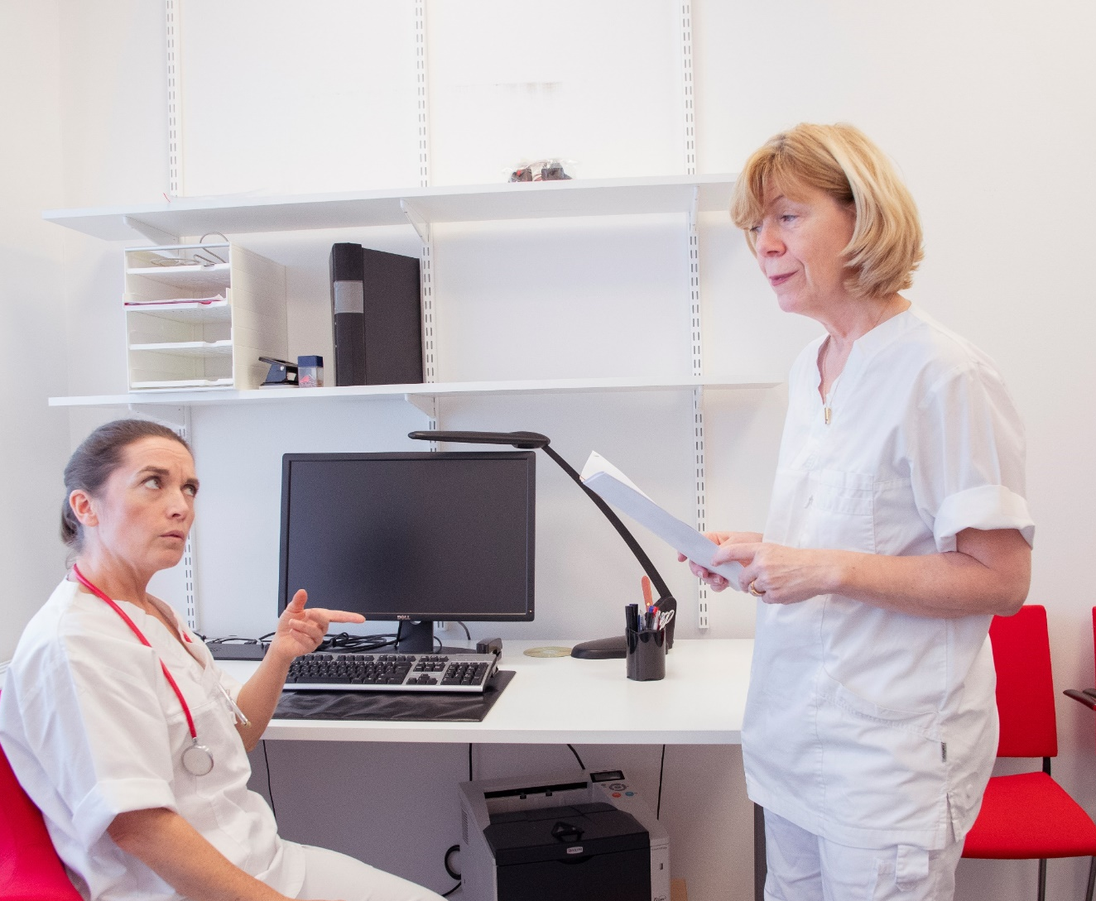
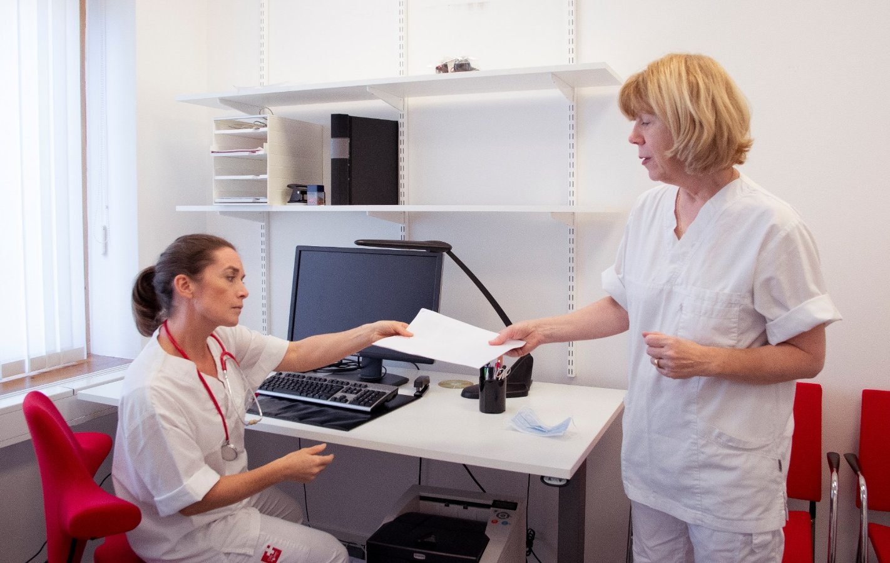
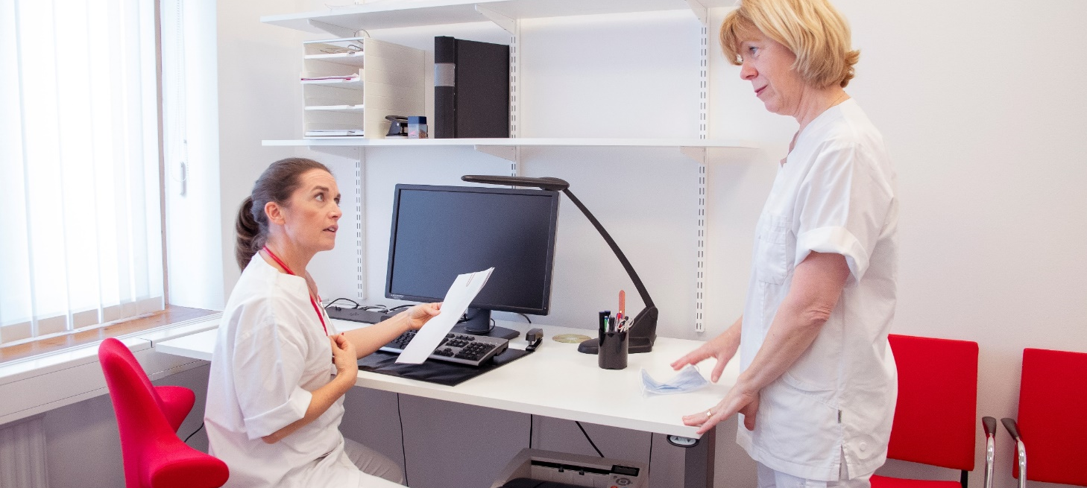
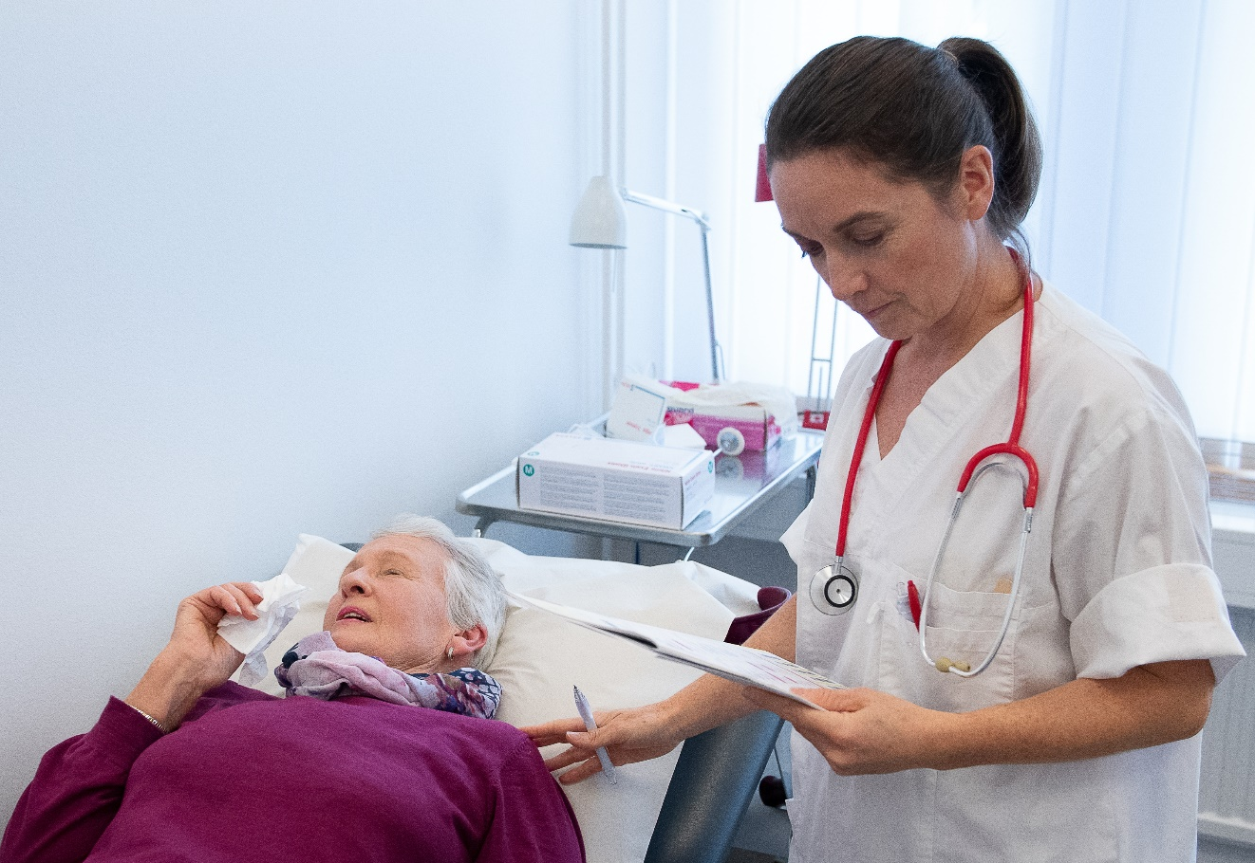
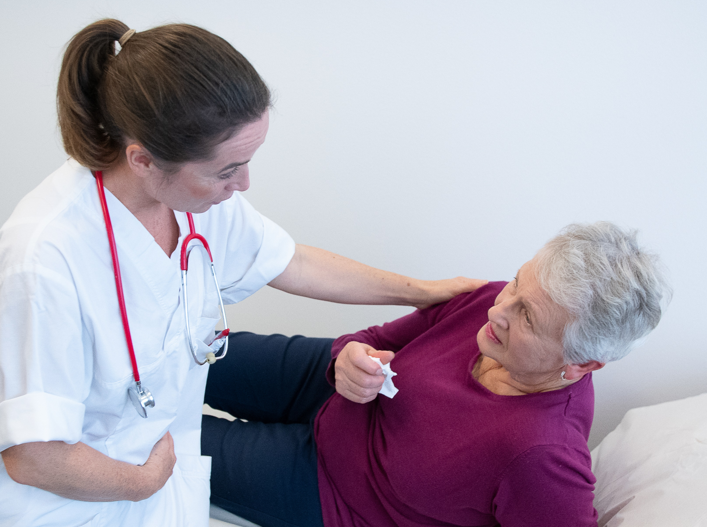
Dr. Adam’s confession:
“How I forgot my flu shot and
made my patient really sick”
You’re next,
Mrs. Johnson.
Dr. Adam is waiting for you.
Yes… just give me a second, it’s hard getting up with my old bones.
Hello, Dr. Adam!
Good to see you,
Mrs. Johnson, please have a seat.
How are you today, Mrs. John…
Aaa-...
A- choo!
Yikes.
Disgusting.
Oh my.
You poor thing. Sounds like you’re even worse off than me.
Two days later…
I wonder why Dr. Adam didn’t show up for work today.
Haven’t you heard? He called in sick this morning. He’s got a really bad case of the flu.
Could you take care of one of Dr. Adam’s patients? Mrs. Johnson is here waiting to see a doctor.
Mrs. Johnson, the lady with the bad knee? Fine, no problem.
Yes, that’s her. But I don’t think arthritis seems to be the problem today.
Minutes later, in the doctor’s office
Okay, send her in.
Well, Mrs. Johnson, you have a bad case of the flu.
I thought so myself. When I was here two days ago to see Dr. Adam, he had the flu too, I think.
Well, yes, I assume so. He called in sick this morning.
I didn’t even know that you doctors can also catch the flu. I thought you were all vaccinated!
Well, Mrs. Johnson, sometimes we doctors are so busy that we forget…
Influenza vaccination protects yourself and the people around you.
As a healthcare worker, there’s a lot you can do against the flu:
Get vaccinated each year
Wash your hands
Stay home when sick

