Slide 1
PREVENTING GASTROENTERITIS IN SCHOOLS Presentation for parents and teachers Draft for piloting
Notes:
This presentation is part of the ECDC Communication toolkit to support infection prevention in schools - Focus on gastrointestinal diseases developed by the European Centre for Disease Prevention and Control (ECDC). It can be used, for example, in meetings with parents or during information sessions with teachers, to disseminate information about gastroenteritis, or after an outbreak in schools, in order to highlight the importance of prevention.

Slide 2
Overview of this presentation
Gastroenteritis: what is it?
Causes, symptoms, complications and treatment
Gastroenteritis: why should you care?
Transmission
Facts and figures
In a nutshell
Gastroenteritis: Importance of prevention
Consequences for the children
Benefits of good hygiene for children!
Consequences for the parents
Benefits of good hygiene for parents!
Key preventive measures
Gastroenteritis: What you should do in case you get infected
About ECDC
Notes:
This presentation provides an outline of:
What is gastroenteritis.
Why it is important to put in place preventive measures, in particular good hygiene.
Some measures to take in case children or other family members get infected.

Slide 3
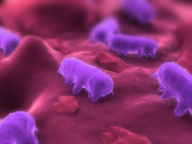
Gastroenteritis: what is it? Causes, symptoms, complications and treatment
Gastroenteritis is an inflammation in the stomach and intestines, and is often referred to as stomach flu or bug.
Causes:
Bacteria (e.g. Salmonella, E.coli)
...parasites (e.g. protozoans)...
...or viruses (e.g. Norovirus)
Most common symptoms: diarrhoea and/or vomiting...
Complications: dehydration, particularly dangerous for infants and babies. Sometimes leading to chronic conditions.
Treatment of symptoms: resting at home and preventing dehydration (i.e. intake of liquids). Medication may be required upon medical advise.
Notes:
Gastroenteritis is an inflammation in the stomach and intestines, and is often referred to as stomach flu or bug.
There are three main causing agents of gastroenteritis:
Bacteria (e.g. Salmonella, E.coli, Campylobacter), including toxins produced in food (e.g. Staphylococcus)…
Parasites (e.g. protozoans)...
Viruses (e.g. Norovirus)
The most common symptoms are diarrhoea and/or vomiting. Other symptoms may not necessarily occur but include nausea, stomach cramps, headaches, moderately high fever of 38-39º. However, there can be asymptomatic cases (infected people not showing any symptoms), and these people could be spreading the disease without knowing it!
The complications are dependant on the causative agent (bacteria, parasites or viruses) and the health condition of the affected person. For bacterial gastroenteritis, complications can include sepsis and renal failure. Other complications can include reactive arthritis, haemolytic uremic syndrome (HUC – a condition affecting the blood cells) and Guillain-Barré Syndrome (a rare disorder that causes muscle weakness and sometimes paralysis).
Gastroenteritis may be treated according to the symptoms, and it is recommended to contact a healthcare professional for advice on adequate treatment. To prevent the loss of fluids (dehydration), oral rehydration solutions may be useful. If necessary, a patient may need to take medication (following recommendations from the healthcare professional), which depending on the causative agent could include antibiotics or antihelminthics (anti-parasitic medication). However, treatment with antimicrobials may be contraindicated, for example in the case of STEC (Shiga-like toxin-producing Escherichia coli) infections, where antibiotic treatment may induce severe complications like haemolytic uremic syndrome. Some patients may even require hospitalisation.

Slide 4
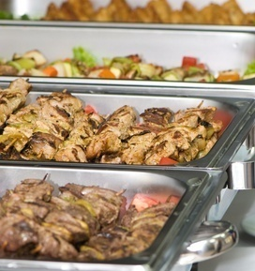
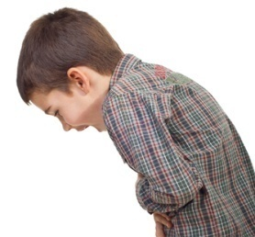
Gastroenteritis: why should you care? Transmission
You can be infected through:
NOTE
It can easily spread, especially in confined places, e.g. schools, childcare facilities, hospitals, nursing homes.
Even if a person does not show symptoms, he/she may still be carrying an infection and spread it!
Infection can happen several times and it affects individuals of all ages.
Some causing germs can survive for a long time on various surfaces, therefore adequate surface cleaning is important.
Person to person
Contaminated food or water
Contaminated surfaces
or objects
Air -droplets from vomit
Hand to mouth
Notes:
Gastroenteritis can be transmitted and spread via various ways, including:
Person to person (directly or indirectly, e.g. person – contaminated food – person)
Contaminated food or water
Contaminated surfaces or objects
Air – droptlets from vomit
Hand to mouth (faecal-oral)

Slide 5
Gastroenteritis: why should you care? Facts and figures
Gastrointestinal diseases are common, can be very contagious and can lead to chronic health conditions and sometimes fatal complications
48,964
Illnesses due to food-borne outbreaks in the area of the EU in 2009
4,356
Hospitalizations out of the 48,964 illnesses
Deaths out of the 48,964 illnesses
46
EFSA-ECDC: EU Summary Report on Trends and Sources of Zoonoses; EFSA Journal 2011; 9(3): 2090, p.4
Notes:
In this slide the seriousness of food-borne diseases is presented in numbers.
These numbers are the results of the analysis of EU data on reported food-borne disease outbreaks corresponding to 2009. This analysis has been conducted by the European Centre for Disease Prevention and Control (ECDC) and the European Food Safety Authority (EFSA).
According to these data, a total of 5,550 food-borne outbreaks were reported in 2009, causing almost 49,000 human cases. Out of this number over 4,300 people got hospitalized and 46 deaths occurred.

Slide 6
Gastroenteritis: why should you care? In a nutshell
Gastroenteritis can spread easily in schools but is largely preventable if good hygiene from the school community is assured
Hand washing is key!
When?
Before touching food or eating
After toilet use
After having been playing outside
Notes:
To prevent gastroenteritis from spreading in schools and at home, everyone needs to engage in preventive measures, of which good hygiene is fundamental.

Slide 7
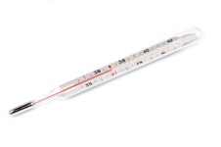
Gastroenteritis: Consequences for the children
I want to vomit… I do not feel well
I have to stay in bed
I cannot play
I cannot see my friends
I am worried. I may need to go to the hospital
I will have to catch up when I am back to school
Notes:
The following slides present the consequences of getting sick and the benefits of good hygiene.
Consequences for the children
If good hygiene practices are not in place and outbreaks of gastroenteritis occur, then the children:
get worried as they may need to go to the hospital;
will not be able to play;
must stay in bed;
feel unwell, with vomit and/or diarrhoea;
cannot see their friends, since gastroenteritis can easily spread to other children;
will have to catch up with lessons when they are back at school.

Slide 8
Gastroenteritis: importance of prevention Benefits of good hygiene
I feel strong and healthy
I am able to perform well at school
I can go out and play with my friends
I know how
to stay healthy
Notes:
Children
If good hygiene measures are applied to prevent gastroenteritis, the children:
will feel strong and healthy;
will be able to perform well at school, as they won’t miss lessons;
can go out and play with their friends;
acquire lifelong skills useful for their health and wellbeing.

Slide 9
Gastroenteritis: Consequences for the parents / teachers
It is painful and unpleasant
I feel discomfort
My family may get infected
I cannot take care of my family
I will be absent from work
It may get worse
Notes:
Consequences for the parents / teachers
If any of the family members or members of the school community catches gastroenteritis:
parents will have a hard time taking care of their family;
the affected person(s) can experience pain and discomfort, and fear that it may get worse;
an affected family member or school community member may spread the disease to others, since gastroenteritis can be highly contagious;
a parent/teacher will be absent from work.

Slide 10
Gastroenteritis: importance of prevention Benefits of good hygiene
We have skills to stay healthy
We can enjoy our time as a family together
We can avoid unexpected expenses and bothering about going to the doctor
We do not miss out on work and school
I do not have to worry about my children’s health and mine
Notes:
Parents / teachers
If parents / teachers apply and teach appropriate hygiene measures against gastroenteritis, then they:
will not have to refrain from work; children will be able to go to school;
will be able to spend enjoyable time as a family / group;
will avoid unexpected expenses and having to bother about going to the doctor;
they will not have to worry about their and the children’s health;
will help children in acquiring lifelong skills for their health and wellbeing.

Slide 11
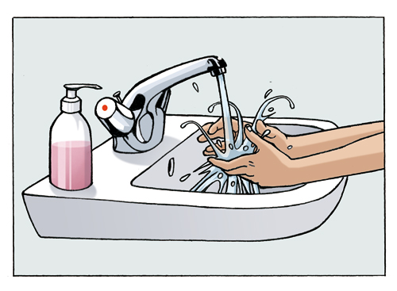
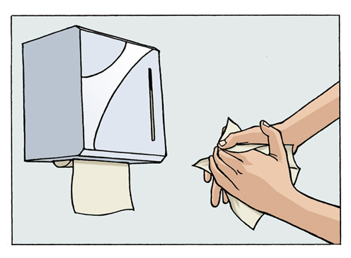
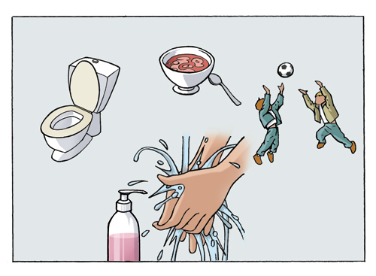
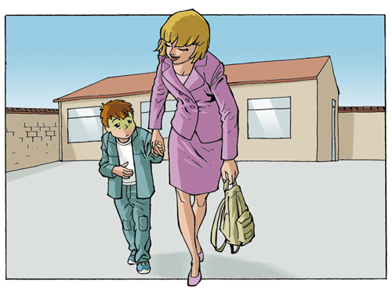
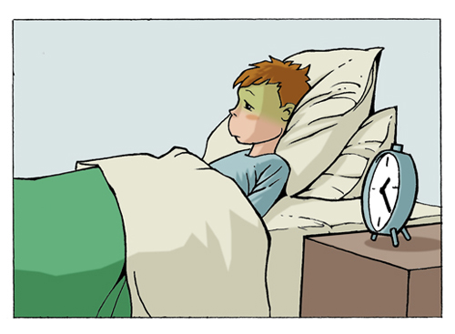
Key preventive measures
Notes:
Gastroenteritis is largely preventable if good hygiene measures are applied!
Key preventive measures include:
Wash hands with liquid soap and water and dry them well with disposable paper towels.
Wash hands after toilet use, before eating/handling food and after being outside.
Any child or staff member with diarrhoea and/or vomiting should be sent home.
Stay home until symptom free for 48 hours.

Slide 12
Gastroenteritis: what you should do in case you get infected
Avoid dehydration
Reinforce hand hygiene
Actions to take
Stay at home
Ensure proper cleaning and disinfection
Inform the school / working place
Notes:
In case of gastroenteritis, then you should:
avoid dehydration (loss of fluids), and for this oral rehydration solutions may be useful;
stay at home until symptom free for 48 hours;
inform the school/working place;
reinforce hand hygiene;
ensure adequate cleaning and disinfection of frequently touched surfaces (and take specific precautions when dealing with spillage of body fluids).

Slide 13
About ECDC
ECDC is a European Union agency working on prevention and control of infectious diseases in the EU. This includes the development of communication tools to raise awareness and promote prevention of diseases such as
GASTROENTERITIS
For more information, please visit: www.ecdc.europa.eu
Click on this link to download ECDC communication toolkit materials.
Notes:
The European Centre for Disease Prevention and Control (ECDC) works in partnership with national health authorities to strengthen the defenses against the spread of infectious diseases across the European Union (EU).
One of ECDC’s roles is to support EU Member States with communication materials in order to raise awareness and promote prevention of infectious diseases in Europe. This includes the prevention of gastrointestinal diseases.
As such, ECDC has developed this presentation as part of the Communication toolkit to support infection prevention in schools - Focus on gastrointestinal diseases. This toolkit offers countries key messages and template materials (such as posters targeted at children and to parents and teachers) that can be used and adapted according to national strategies, needs and to different audiences.

