Slide 1
PREVENTING GASTROENTERITIS
IN SCHOOLS
The role of schools
and local health authorities
Draft for piloting
Notes:
This presentation is a component of the ECDC Communication toolkit to support infection prevention in schools – Focus: gastrointestinal diseases, developed by the European Centre for Disease Prevention and Control (ECDC). ECDC works in partnership with national health authorities to strengthen the European Union’s (EU) defenses against infectious diseases.

Slide 2
Overview of this presentation
About ECDC
Gastroenteritis: what is it?
Causes, symptoms, complications and treatment
Gastroenteritis: why should you care?
Transmission
Facts and figures
In a nutshell
Gastroenteritis: what can your role be?
Where do you stand as a stakeholder?
Who communicates with whom?
Gastroenteritis: what can schools do?
Prevent – Manage: key suggestions
Gastroenteritis: what can health authorities do?
Prevent – Manage – Assess: key suggestions
Notes:
This presentation provides an outline of:
The work of ECDC
What gastroenteritis is
Why it is important to deal with gastroenteritis and to put in place preventive measures to avoid outbreaks
What your role can be and how to address an outbreak, including key actions and ideas on how to best communicate with the school community

Slide 3
About ECDC
ECDC is a European Union agency working on prevention and control of infectious diseases. It supports EU Member States in their preparedness and response capacities. This includes the development of communication tools to raise awareness and promote prevention of diseases such as
GASTROENTERITIS
Notes:
The European Centre for Disease Prevention and Control (ECDC) works in partnership with national health authorities to strengthen the European Union’s (EU) defenses against infectious diseases.
One of ECDC’s roles is to support EU Member States with communication materials in order to raise awareness and promote prevention of infectious diseases in Europe, such as gastrointestinal diseases.
ECDC has developed this presentation as part of the Communication toolkit to support infection prevention in schools – Focus: gastrointestinal diseases. This toolkit offers countries key messages and template materials (such as posters targeted at children and at parents and teachers) that can be used and adapted according to national strategies, needs and to different audiences.
This is particularly relevant for countries that may not have yet developed extensive communication materials and guidelines on gastroenteritis prevention, and can contribute to reduce costs for communication initiatives.
This presentation is aimed at outlining the role that schools and local health authorities can play in the prevention of gastroenteritis.

Slide 4
Gastroenteritis: what is it? Causes, symptoms, complications and treatment
Gastroenteritis is an inflammation in the stomach and intestines, and is often referred to as stomach flu or bug.
Causes:
Bacteria (e.g. Salmonella, E.coli)
...parasites (e.g. protozoans)...
...or viruses (e.g. Norovirus)
Most common symptoms: diarrhoea and/or vomiting...
Complications: dehydration, particularly dangerous for infants and babies. Sometimes leading to chronic conditions.
Treatment of symptoms: resting at home and preventing dehydration (i.e. intake of liquids). Medication may be required upon medical advise.
Notes:
Gastroenteritis is an inflammation in the stomach and intestines, and is often referred to as stomach flu or bug.
There are three main causing agents of gastroenteritis:
Bacteria (e.g. Salmonella, E.coli, Campylobacter), including toxins produced in food (e.g. Staphylococcus)…
Parasites (e.g. protozoans)...
Viruses (e.g. Norovirus)
The most common symptoms are diarrhoea and/or vomiting. Other symptoms may not necessarily occur but include nausea, stomach cramps, headaches, moderately high fever of 38-39º. However, there can be asymptomatic cases (infected people not showing any symptoms), and these people could be spreading the disease without knowing it!
The complications are dependant on the causative agent (bacteria, parasites or viruses) and the health condition of the affected person. For bacterial gastroenteritis, complications can include sepsis and renal failure. Other complications can include reactive arthritis, haemolytic uremic syndrome (HUC – a condition affecting the blood cells) and Guillain-Barré Syndrome (a rare disorder that causes muscle weakness and sometimes paralysis).
Gastroenteritis may be treated according to the symptoms, and it is recommended to contact a healthcare professional for advice on adequate treatment. To prevent the loss of fluids (dehydration), oral rehydration solutions may be useful. If necessary, a patient may need to take medication (following recommendations from the healthcare professional), which depending on the causative agent could include antibiotics or antihelminthics (anti-parasitic medication). However, treatment with antimicrobials may be contraindicated, for example in the case of STEC (Shiga-like toxin-producing Escherichia coli) infections, where antibiotic treatment may induce severe complications like haemolytic uremic syndrome. Some patients may even require hospitalisation.

Slide 5
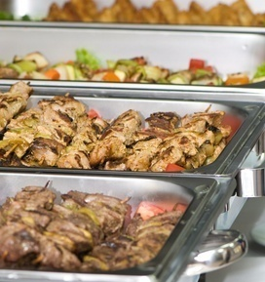
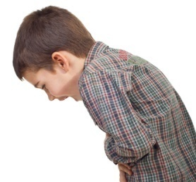
Gastroenteritis: why should you care? Transmission
You can be infected through:
NOTE
It can easily spread, especially in confined places, e.g. schools, childcare facilities, hospitals, nursing homes.
Even if a person does not show symptoms, he/she may still be carrying an infection and spread it!
Infection can happen several times and it affects individuals of all ages.
Some causing germs can survive for a long time on various surfaces, therefore adequate surface cleaning is important.
Person to person
Contaminated food or water
Contaminated surfaces
or objects
Air -droplets from vomit
Hand to mouth
Notes:
Gastroenteritis can be transmitted and spread via various ways, including:
Person to person (directly or indirectly, e.g. person – contaminated food – person)
Contaminated food or water
Contaminated surfaces or objects
Air – droptlets from vomit
Hand to mouth (faecal-oral)

Slide 6
Gastroenteritis: why should you care? Facts and figures
Gastrointestinal diseases are common, can be very contagious and can lead to chronic health conditions and sometimes fatal complications
48,964
Illnesses due to food-borne outbreaks in the area of the EU in 2009
4,356
Hospitalizations out of the 48,964 illnesses
Deaths out of the 48,964 illnesses
46
EFSA-ECDC: EU Summary Report on Trends and Sources of Zoonoses; EFSA Journal 2011; 9(3): 2090, p.4
Notes:
In this slide the seriousness of food-borne diseases is presented in numbers.
These numbers are the results of the analysis of EU data on reported food-borne disease outbreaks corresponding to 2009. This analysis has been conducted by the European Centre for Disease Prevention and Control (ECDC) and the European Food Safety Authority (EFSA).
According to these data, a total of 5,550 food-borne outbreaks were reported in 2009, causing almost 49,000 human cases. Out of this number over 4,300 people got hospitalized and 46 deaths occurred.

Slide 7
Gastroenteritis: why should you care? In a nutshell
Gastroenteritis can spread easily in schools but is largely preventable if good hygiene in the school community is assured
Notes:
To prevent gastroenteritis from spreading in schools, all stakeholders need to engage in preventive measures, of which good hygiene is fundamental.

Slide 8
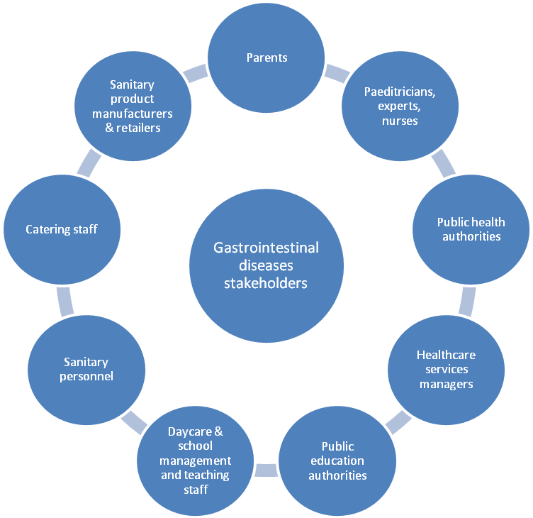
Gastroenteritis: what can your role be? Where do you stand as a stakeholder?
Notes:
Within your school community, there are many players to take into account for the promotion of hygiene measures for the prevention of gastrointestinal diseases and potential outbreaks. Many of these stakeholders are interlinked and close collaboration is needed. Some are more directly involved in taking preventive measures (such as school staff, parents, the pupils themselves), while others may play a role indirectly. Also, some stakeholders may have developed strategies and guidelines to address prevention and management of gastrointestinal disease outbreaks (e.g. health authorities).
While liaising and coordinating within the variety of stakeholders, the school and health authorities are likely to be at the centre of all communications and activities, be it to promote hygiene measures to prevent the spread of gastrointestinal disease and potential outbreaks, or to manage an outbreak.
The next slides provide an overview of some key steps to consider in order to address prevention, communication to raise awareness and encourage preventive measures, as well as actions for managing an outbreak, depending on whether you are a representative from a school or from the health authorities.

Slide 9
Gastroenteritis: what can your role be? Who communicates with whom?
Health authorities
Schools
DIALOGUE
DIALOGUE
DIALOGUE
Notes:
As mentioned before, depending on where you stand in the wheel of stakeholders, you should be coordinating your communications and taking the lead in the communication with other stakeholders.
If you are a health authority you may take the lead on the communications with health care professionals and the media.
As a school representative, your may be taking the lead in the communications with your staff, including teachers, canteen and cleaning personnel, as well as with parents and children.
Parents should always report to the school if they find their child is showing symptoms of gastroenteritis or feeling sick.
Both health authorities and schools should engage in a dialogue to ensure coordinated and consistent messages are disseminated and avoid a situation of cacophony and possibly panic during an outbreak situation.
But let’s look into the specifics of what role the schools and the health authorities should play to prevent and to control outbreaks of gastrointestinal disease.

Slide 10
Gastroenteritis: what can your role be? Who communicates with whom?
Health authorities
Schools
DIALOGUE
Notes:
First of all: let’s look at the schools.

Slide 11
Gastroenteritis: what can schools do? Prevent – Manage: key suggestions
Before an outbreak occurs
*** Depending on available resources and in collaboration with the relevant authorities as appropriate***
Advise everyone to wash hands with liquid soap and water and to dry hands thoroughly with disposable paper towels before touching food, after toilet use and after having been outside.
Develop tools (checklists, calling tree, contact lists, etc) and a written school policy regarding exclusion.
Implement awareness raising campaigns about gastroenteritis and provide instructions and training on hygiene measures.
Ensure that the school has appropriate supplies of materials to secure hygienic environments.
Ensure canteen staff follows appropriate food handling procedures and cleaning staff appropriate disinfection and waste disposal measures.
Notes:
First of all let’s focus on the role of the schools.
It is important to have clear written policies and routines, as well as tools on how to proceed in case of outbreaks.
A school exclusion policy should state how long those affected should stay at home after the end of symptoms; it may also include advise on how to prevent transmission. Schools should also have staff sick policies that do not compel staff to return to work too early. The exclusion policy should be communicated effectively to parents and others involved, e.g. staff. Communicating it before will likely ensure compliance, e.g. the policy could be given to parents when the child joins the school/childcare facility.
For securing hygienic environments, supplies include e.g. sinks with running water, liquid soap, disposable paper towels, detergents, appropriate disinfectants, gloves, light masks, etc.

Slide 12
Gastroenteritis: what can schools do? Prevent – Manage: key suggestions
During an outbreak
*** Depending on available resources and in collaboration with the relevant authorities as appropriate***
Gather information that will aid in recognising, confirming and characterising the outbreak (e.g. about the staff or students who are ill, etc).
Contact your public health authority (local, regional, national).
In collaboration with your health authority, implement the outbreak plan.
Communicate key messages to staff and parents and discuss measures to stop the spread of disease.
Instruct everyone to stay home if they show symptoms as per school exclusion policy and inform the school nurse and/or teachers.
Notes:
The school needs to have parameters to be able to recognise early if it has an outbreak and notify promptly the relevant authorities any pattern of cases or unusual increase in cases of illness (i.e. vomiting , diarrhoea).

Slide 13
Gastroenteritis: what can schools do? Prevent – Manage: key communication suggestions
To parents
Inform them about the outbreak: what it is, the school's exclusion policy, what is being done and preventive measures.
Inform about actions to take as a parent (if sick child): report to the teacher/school and keep child at home.
Put a call number/information service at the parents’ disposal.
To students/staff
Instruct that those infected need to report to the school and stay home.
Restrict access to food handling and storage.
Redouble efforts to ensure hand washing and other hygiene measures (e.g. appropriate surface cleaning).

Slide 14
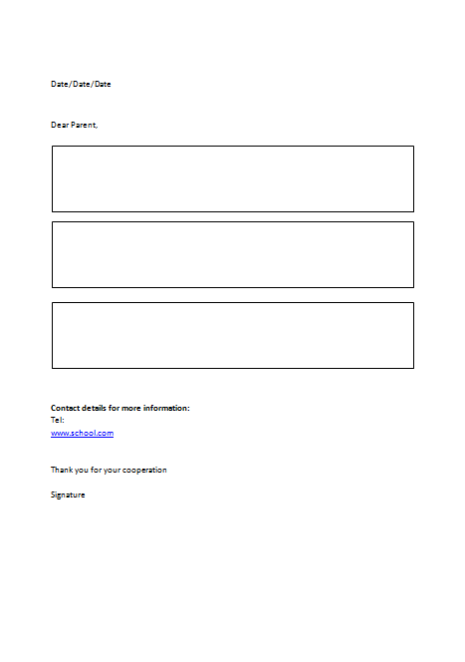
Gastroenteritis: what can schools do? Prevent – Manage: letter to inform parents about an outbreak
Acknowledge issue and explains it
Allocate “roles and responsibilities” in an action orientated manner
Provide a contact point and a reference for additional information
Notes:
A simple letter to the parents can be a great tool to communicate clearly on:
what the situation is, acknowledging the school is facing a problem without being alarmist and explaining what gastroenteritis and the specific infection are, including symptoms
explain what concrete measures the school will be taking to contain the outbreak
what is expected from the parents in terms of preventive measures
It also
provides a good reference for parents who wish to know more
provides contact details for more information

Slide 15
Gastroenteritis: what can your role be? Who communicates with whom?
Health authorities
Schools
DIALOGUE
Notes:
Now, let’s look at the role of health authorities

Slide 16
Gastroenteritis: what can health authorities do? Prevent – Manage – Assess: key suggestions
Before an outbreak occurs
*** Depending on available resources and in collaboration with the relevant authorities as appropriate***
Ensure schools are equipped with necessary resources and information to prevent and manage an outbreak.
Develop an outbreak response plan that takes into account existing guidelines.
Establish in advance a core team and allocate roles and responsibilities (including who would speak to media if needed).
Prepare communication tools (e.g. contact lists, emergency calling tree, Q&A, standard press release scripts - e.g. for addressing media questions, etc.).
Rehearse an outbreak scenario.
Notes:
There are three phases to prevention, management and control of an outbreak:
the preparatory phase
the crisis itself
the post-management phase
Because during a crisis time “shrinks” and you will be expected to react instantly, it is important to devote a lot of time in the preparatory phase (i.e. before a crisis), to develop a crisis plan and organize all the logistics required. This will help you maximize your outbreak response capacity.
For a successful planning it is essential to ensure that all actors are aware of which role they should play in the event of an outbreak and where information is (will be) available when an outbreak occurs.
Once you have established your plan, objectives and divided the roles, it is essential to develop some key communications tools that will help you in communicating and responding faster to questions stakeholders may have and expect you to answer quasi instantly.
Finally, training and rehearsing on a regular basis is essential to make sure everyone is familiar with their role and the key messages. It is also a great opportunity to identify possible loopholes in your plan and adapt it accordingly.

Slide 17
Gastroenteritis: what can health authorities do? Prevent – Manage – Assess: key suggestions in developing a communications plan
Identify potential challenges and set clear
objectives
2. Identify priority audiences
3. Develop key messages and use appropriate
channels
4. Evaluate your initiatives – learn and adjust
Notes:
Set clear objectives: define what you want to achieve with your communications
Identify the health problem that needs to be addressed, identify potential challenges related to it, and define what you want to achieve, e.g. prevent and control outbreaks, by means of building knowledge about the disease and preventive measures in order to reduce the risk of infection
Check, comply and complement existing national/regional programmes
Ensure the objectives set are S.M.A.R.T.:
Specific (straightforward: why, what, and how the communications campaign will take place)
Measurable
Attainable (possible to be achieved in a specific environment, context and with available resources)
Realistic
Timely (set a timeframe for the campaign and for measuring its results afterwards)
2. Priority audiences: who do you want to reach?
The key to identifying your priority target audience is to understand who is affected by the issue in question, who makes the relevant decisions and whose perceptions, attitudes and related behaviour need to be changed to achieve your goal.
In the case of gastrointestinal diseases in school settings, the communication activities should ideally target: (1) children, (2) parents, (3) teachers and childcare staff, and other school staff (e.g. nurses, kitchen staff and cleaning personnel). Consideration can also be given to other groups (e.g. settings that offer after-school activities, the media, etc) and other services relevant for the prevention of food-borne illnesses (e.g. catering services, food handlers). Further segmenting the priority audiences can help to pin down the right messaging (e.g. segmenting by school grade levels).
3.1 Key messages
Some tips on key messages
Language: keep it clear, simple, informal (avoid official, jargon or technical terms).
Adapt them to your different target audiences (e.g. different age groups in children, different cultural settings)
Address behavioural change to trigger it
3.2. Channels: define the media you will be using to reach efficiently and in cost-effective manner your target audiences
To reduce costs, think long term, i.e. produce template materials which can be readapted and reproduced at a lower cost in the future.
Other organisations can also be of support for effective communication, so you could engage with influential community members and organisations to rally for your communication efforts and have them disseminate your key messages too.
4. Evaluate
Depending on the objectives and deliverables set out in your initiatives, you should be able to determine performance indicators, e.g. if you decide to organise an event, performance indicators could be the number of participants, commitments put through, feedback collected in an evaluation form, etc; and indicators of a prevention campaign could be the decrease of gastroenteritis outbreaks.

Slide 18
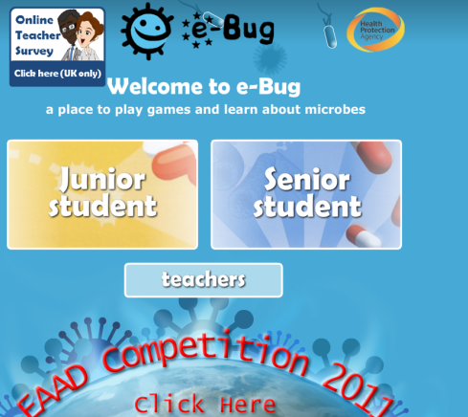
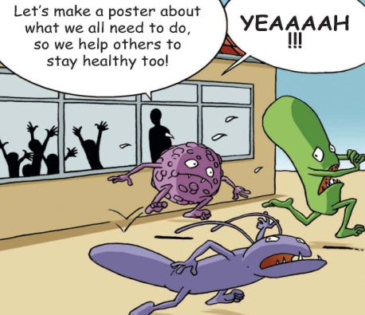
Gastroenteritis: what can health authorities do? Prevent – Manage – Assess: examples of communication materials
Online videos and computer games
Magnet memo board
Songs
Posters
Events
Leaflets
Newsletters
Check the ECDC website for ready to use communication materials
Notes:
A variety of tools can be developed for an effective communication initiative addressing schools. Ideally the initiatives are developed in close collaboration with schools and also using some already existing channels of communication developed by the school community.
For children: the tools should merge educational and recreational objectives.
Songs, e.g. create a song for children to sing before meals while washing their hands
Colouring books
Posters and leaflets
Online educational videos and video games
News edition meant especially for children and adverts
Magnet memo boards with checklists of preventive measures
Events: theme days/weeks, organise a competition where children have to develop campaign materials on prevention of gastroenteritis, organise role-play/theatre on prevention, puppet shows by health care professionals, external presentation, briefings.
Routines in the day-to-day school activities
School's communication tools, e.g. boards and/or screens
2. For parents
Posters, leaflets and newsletters
Magnet memo boards with checklists of preventive measures
Online educational videos and adverts
Events: educational seminar on prevention and on actions to take in the event of an outbreak, briefings
School's communication tools, e.g. boards and/or screens, newsletters
Note:
Make sure that all your communication materials state clearly who endorsed them and reference a contact point (e.g. a website reference for more information)
- Check the ECDC website for ready to use communication materials (e.g. the communication toolkit on prevention of gastrointestinal diseases in schools)

Slide 19
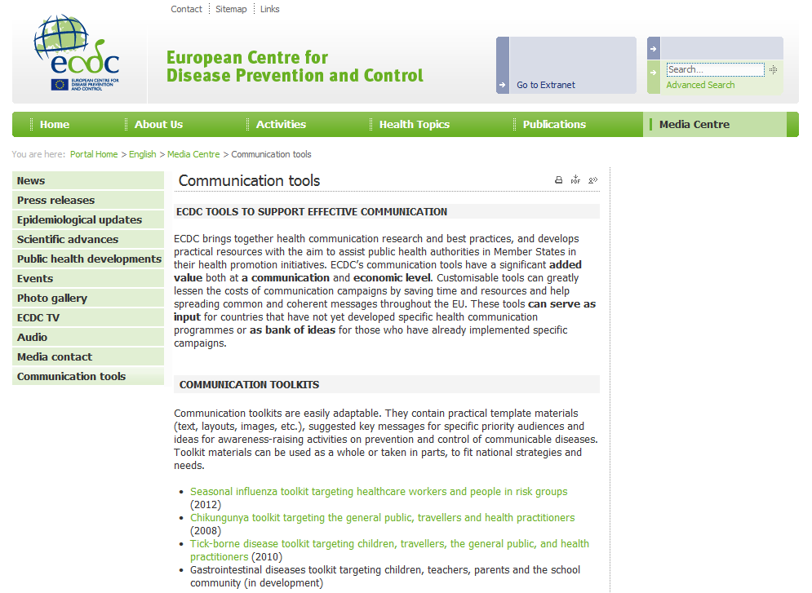
Gastroenteritis: what can health
authorities do? Prevent – Manage – Assess: helpful communication resources by ECDC
Plenty of ready-to-use Gastroenteritis communication materials for you to download and adapt on ECDC’s website: www.ecdc.europa.eu
Notes:
As ECDC is supporting EU Member States with communication materials for the prevention of infectious diseases in Europe, ECDC has developed a series of materials in relation to gastroenteritis. The communication toolkit includes:
Prototype posters targeted at children and at teachers and parents
Power Point presentations
Key messages
A checklist of key preventive measures
Pictograms in order to showcase the hygiene measures to undertake to prevent gastroenteritis
A toolkit overview guide
- A toolkit implementation handbook
All the toolkit materials are ready to use and can be adapted by Member States according to their strategies and needs.

Slide 20
Gastroenteritis: what can health authorities do? Prevent – Manage – Assess: key suggestions
During an outbreak
*** Depending on available resources and in collaboration with the relevant authorities as appropriate***
Follow your outbreak response plan to ensure rapid response.
Communicate to staff, students, parents and if appropriate the media and announce when you will be communicating next (i.e. set the pace).
When communicating: recognise you have a crisis and commit to finding the cause quickly.
In close collaboration between public health and school authorities, consider scope of actions to manage the outbreak.
Reinforce communication of preventive measures and discuss routine infection control measures with everyone.
Notes:
When a crisis occurs, it is important that you recognise the crisis, acknowledge ‘unknowns’ but commit to finding out an answer to the cause promptly, and empathise with those affected. This is particularly important if the media are interested in the outbreak and your management capacity. If this is the case, ensure you coordinate your messages with all the relevant stakeholders.
Also, when facing a crisis, some sectors (e.g. the media) may try to rush you in providing responses, which if not thought through, may lead to panic and to a communication cacophony. To avoid this situation, it is important that you set the pace of communication to the media and other stakeholders, by informing when you will be communicating next.
When assessing what to do in the event of an outbreak, the coordination with schools is very important (e.g. considerations on closing the schools if necessary, closing the canteen services, etc.)
Throughout the management of an outbreak, it is important that you reiterate the key public health messages for preventing gastroenteritis and that you provide clear guidance to those who are affected.

Slide 21
Gastroenteritis: what can health authorities do? Prevent – Manage – Assess: key suggestions
After an outbreak
*** Depending on available resources and in collaboration with the relevant authorities as appropriate***
Communicate about the successful management of the crisis.
Evaluate the management of the outbreak.
Make the necessary readjustments to your outbreak plan.
Notes:
It is often thought that a crisis is over once it is under control. However, assessing the outbreak (e.g. why it happened, what worked well, areas where improvement is needed) can help you to improve prevention in the future. In addition, it is inevitable that during a crisis you will come across some challenges you did not foresee - it is important to learn from the ‘real-life’ experience and readapt your plan accordingly.

Slide 22
Thank you!
For more information, please visit: www.ecdc.europa.eu
Click on this link to download ECDC communication toolkit materials.

